Slide 1




i-Learn

Slide 2


Learning
Intelligent
Interactive
Inquisitive
i-Learn

Slide 3




Learn
i-Learn
i
Learn

Slide 4
Learn
i
Learn
i-Learn

Slide 5


Slide 8
iLearn
__________________________________________________________________________________
Interactive, Intelligent, & Inquisitive Learning

Slide 9
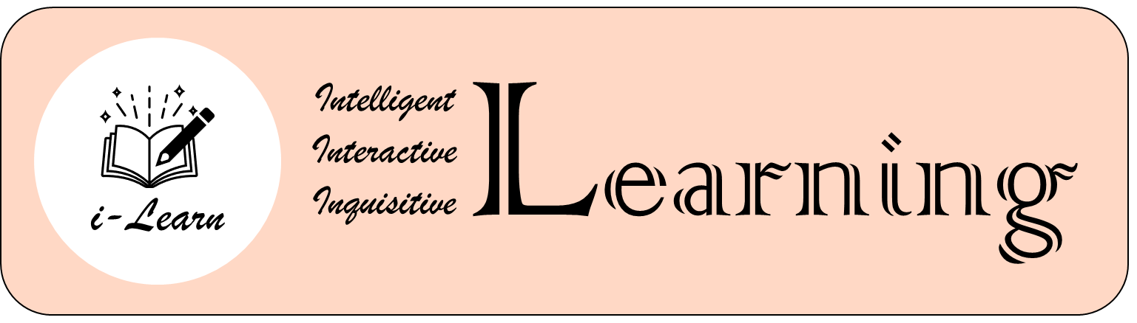

Slide 10




Slide 11
