Slide 1
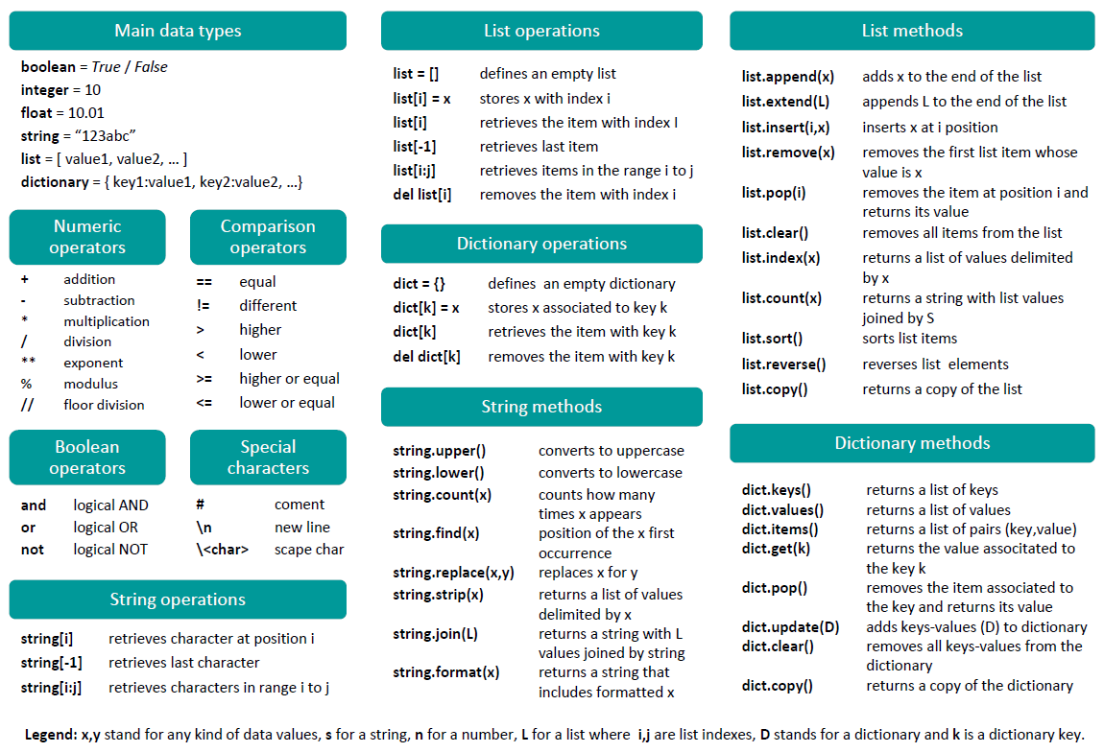
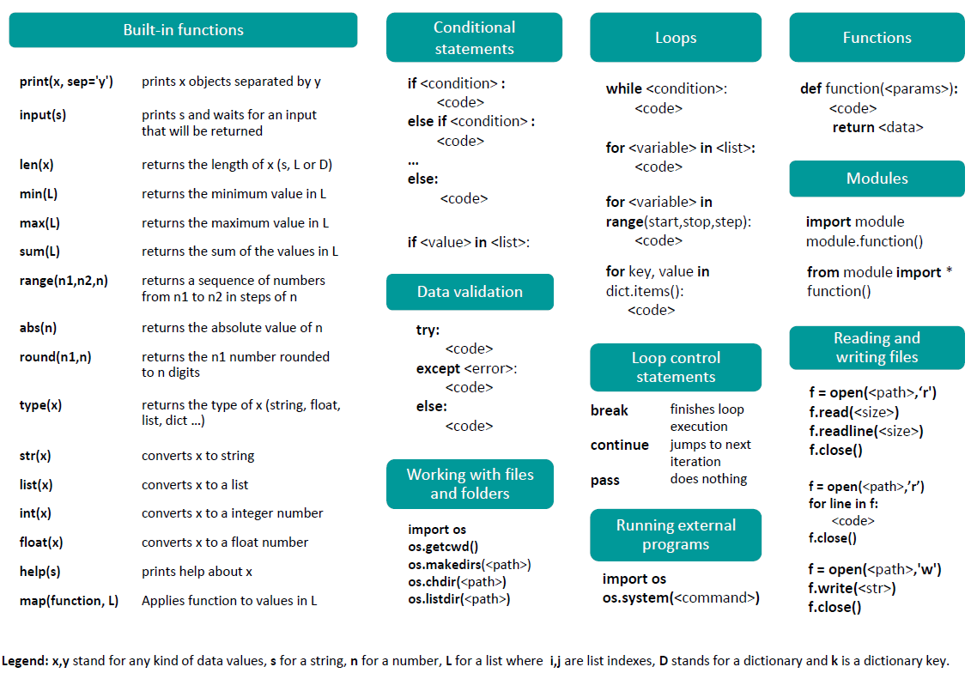
Python cheatsheet
Alvaro Sebastian
http://www.sixthresearcher.com

