Slide 1
Food Recognition For Blind People And Foreigner
Final Presentation
Kiet Nguyen Tuan
Mentor Dr. Lap Nguyen Trung

Slide 2
About me
Kiet Nguyen Tuan
Sophomore of Hoasen University, Vietnam
Major Software Engineering
Interested in Machine Learning
Mentor Dr. Lap Nguyen Trung
Introduction

Slide 3
Project
Develop a collection of model that can use to recognize food and its ingredients in photos.
Apply these models to mobile app for example.
Publish project so that every people can contribute and use it for their cases free.
Project available on GitHub: https://github.com/AmbroseNTK/Food-Recognition-For-Blind-People-And-Foreigner
Introduction

Slide 4
Overview
Project is splitted into three parts. Each part connected to others so that reach the target.
Food Recognition
Recognize food in a photo
Return food’s information in summary
Ingredient Detection
Detect food’s ingredients in a photo one by one.
Return exactly nutrition value and predict its taste.
Mobile app
Take a photo
Put it into models and get return results.
Show result to user.
Introduction
Overview

Slide 5
Overview
Mobile App
Take a photo
Food Recognition
Ingredient Detection
Calculate and show information
Introduction
Overview

Slide 6
Development Environment
TensorFlow: ML/DL Framework developed by Google
Python Programming Language
Anaconda
Introduction
Overview
Methodology

Slide 7
Prepare dataset
Food Recognition:
10 categories, about 600 photo per category.
Using GoogleImagesDownload to download photos from Google Images.
Remove incorrect photos
Ingredient Detection:
Split food categories into sub-categories based on its ingredients.
Use LabelImg tool to labeling ingredients in each sub-categories.
Introduction
Overview
Methodology

Slide 8
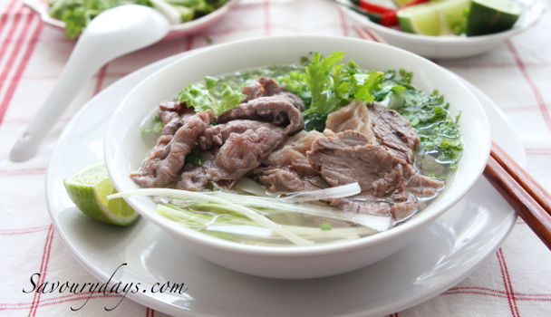
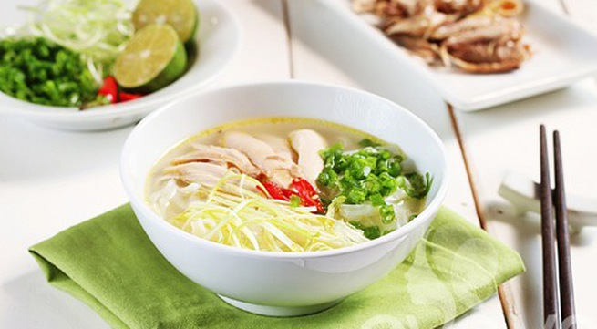
Prepare dataset
dataset
Beef Rice Noodle
Chicken Rice Noodle
Pork Rice Noodle
Pho-bo
Pho-ga
Pho-heo
…
Beef
Chicken
Onion
Pho Sub-category
Ingredients
Introduction
Overview
Methodology

Slide 9
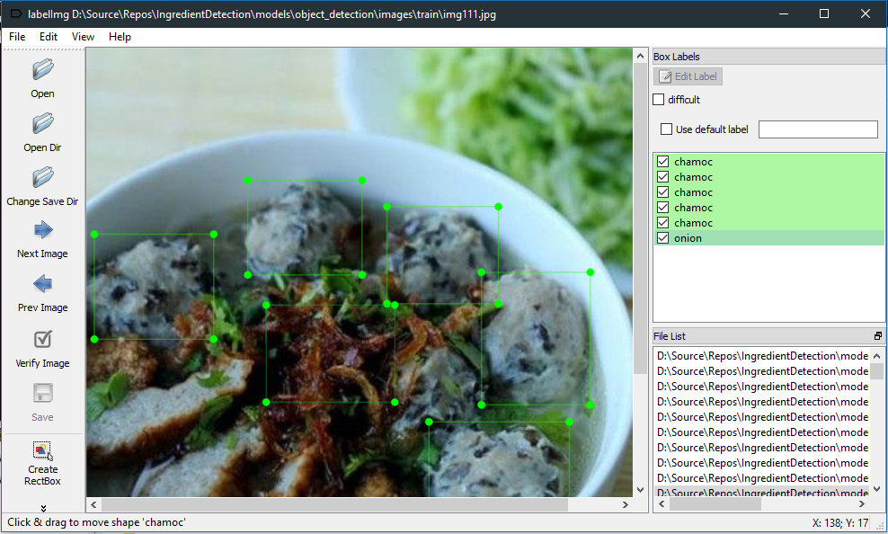
Prepare dataset
Use LabelImg tool
Introduction
Overview
Methodology

Slide 10
Retrain models
To recognize food and detect ingredient. Use model Faster RCNN Inception V2 and MobileNet V2 designed by Google.
These models are suitable for Image Recognition and Object Detection tasks.
Retrain these model with my custom dataset and configuration.
Introduction
Overview
Methodology

Slide 11
Apply these models
After training process complete. Export TF models.
Integrated into Mobile App (Android App).
Install TensorFlowLite Library to Mobile Project.
Mobile device can use model I have trained via TFLite.
Introduction
Overview
Methodology

Slide 12
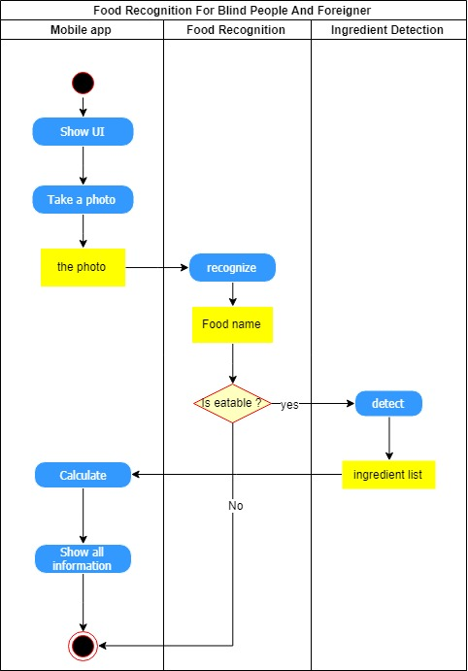
Activity Diagram
Introduction
Overview
Methodology

Slide 13
Food Recognition Result
Run train script. After 4 millions training steps. The accuracy is 78.8%
To improve accuracy, collect more photos, about 1000 photos per food.
Run this command to evaluate model
python label_image.py --graph=<DIRECTORY_TO_GRAPH_FILE> --labels=<DIRECTORY_TO_LABELS_FILE> --input_layer=Placeholder --output_layer=final_result --input_height=224 --input_width=224 --image=<YOUR_IMAGE_FILE>
Introduction
Overview
Methodology
Result

Slide 14
Ingredient Detection Result
With GPU Nvidia GT 740M and TensorFlow-GPU. I have ran above 3000 steps but accuracy is still low because I do not have enough data (photos). In some case, it returns incorrect result.
Run command below to evaluate model
python Object_detection_image.py
Introduction
Overview
Methodology
Result

Slide 15
Mobile app (Android)
It has some basic function
Take a photo
Recognize food in the photo
Show all relevant information.
It still cannot detect food’s ingredients because I have not integrated Ingredient Detection into app.
Introduction
Overview
Methodology
Result

Slide 16
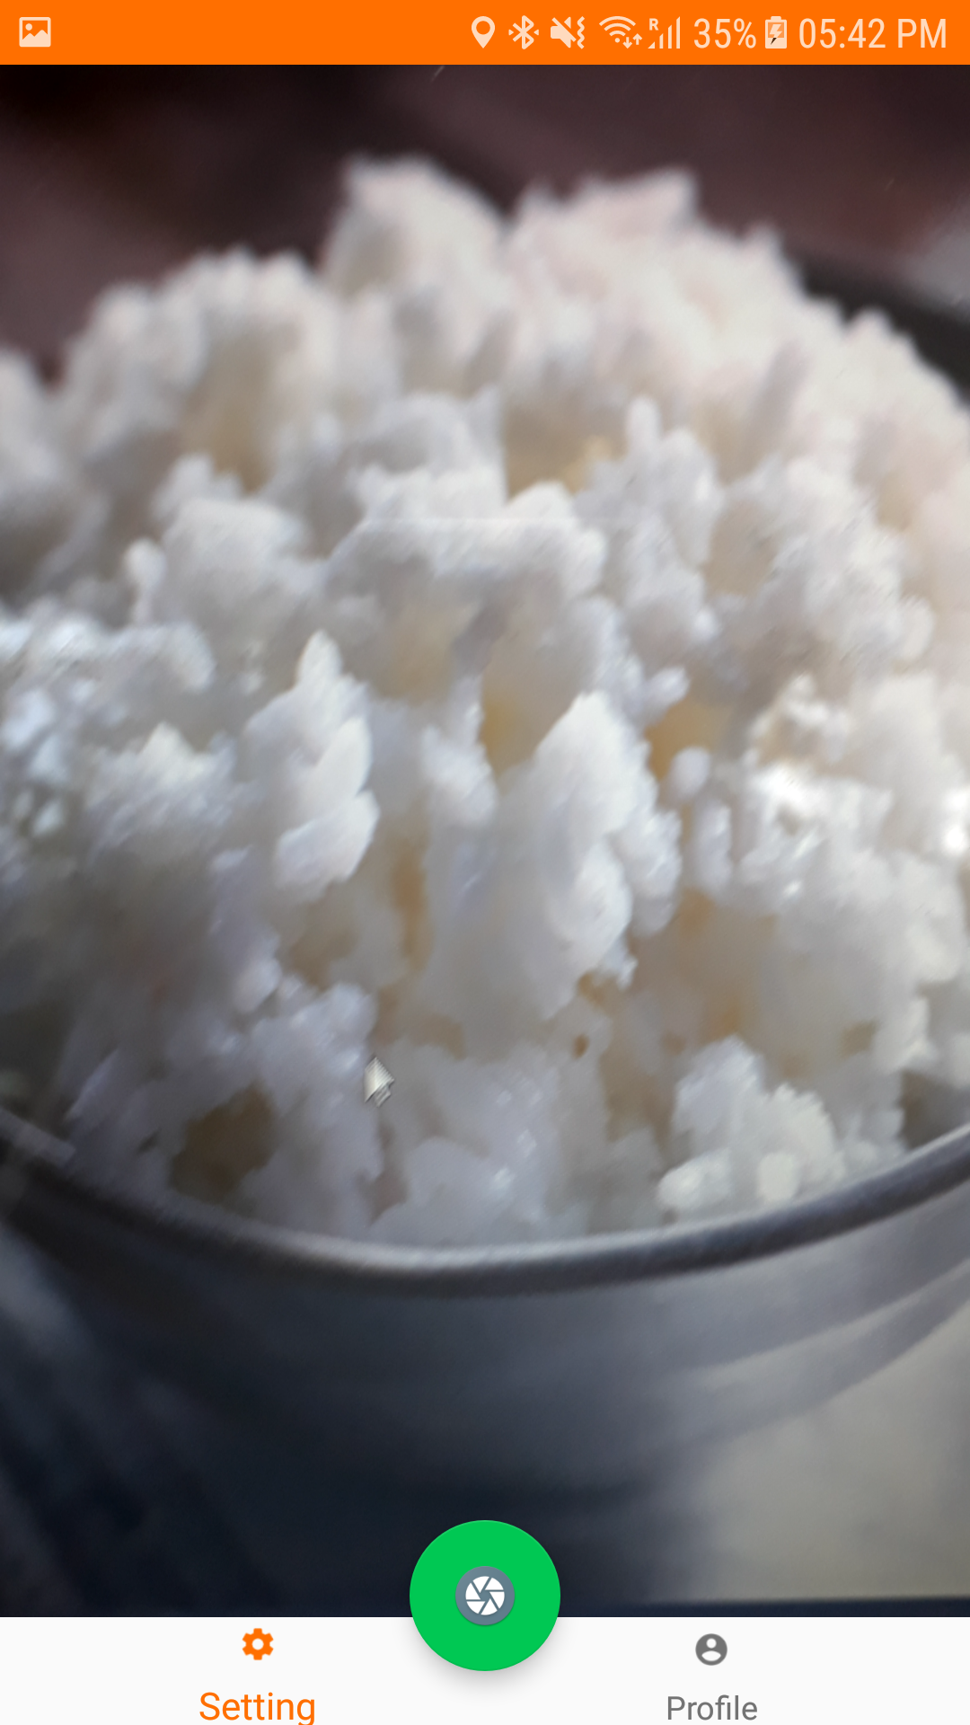
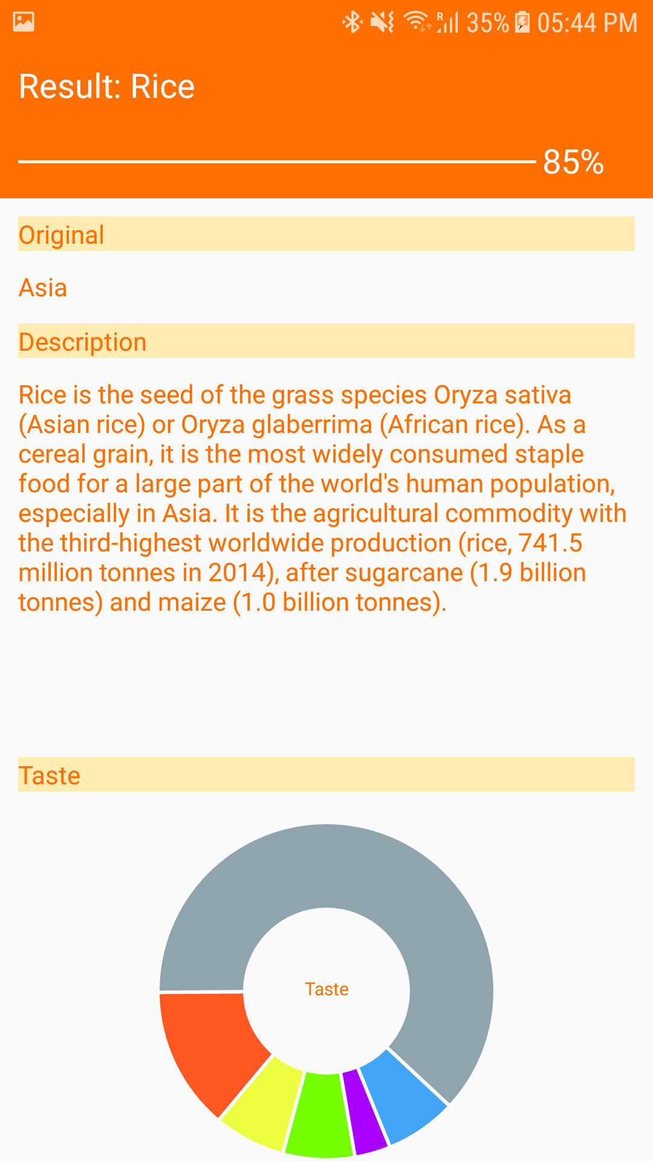
Mobile app (Android)
Introduction
Overview
Methodology
Result

Slide 17
After this camp
Prepare more data for Food Recognition. Not only 10 Vietnamese food, but also more food.
Prepare more data for Ingredient Detection. I will classify these food into a lot of subclass. I will collect 1000 photos per subclass.
Try anothor models such as mobilenet v2,...
Finish food tracking function in Android app.
Create app for iOS platform.
Improve accuracy and performance. I would like to serve as a service via Web API, so these model will be stored and ran on server.
Introduction
Overview
Methodology
Result
Future

Slide 18
Acknowledgement
This project is not possible without the overwhelming suppport from Jeju National University, Jeju Developement Center and other selfless sponsors. I would like to specifically give a big thanks to Prof. Yungcheol Byun for being the best host ever and my mentor Dr. Lap Nguyen Trung for the help and guidance.
Introduction
Overview
Methodology
Result
Future
Acknowledgement

Slide 19
References
Image recogntion: https://www.tensorflow.org/hub/tutorials/image_retraining
Object detection: https://github.com/EdjeElectronics/TensorFlow-Object-Detection-API-Tutorial-Train-Multiple-Objects-Windows-10
NutriNet: A Deep Learning Food and Drink Image Recognition System for Dietary Assessment (Simon Mezgec 1,* and Barbara Koroušic´ Seljak 2)
Deep Learning Based Food Recognition (Qian Yu Stanford University qiany@stanford.edu, Dongyuan Mao, Stanford University dmao@stanford.edu, Jingfan Wang Stanford University jingfan@stanford.edu)
FOODIMAGERECOGNITIONUSINGDEEPCONVOLUTIONALNETWORK WITHPRE-TRAININGANDFINE-TUNING (Keiji Yanai, Yoshiyuki Kawano)
Introduction
Overview
Methodology
Result
Future
Acknowledgement

Slide 20
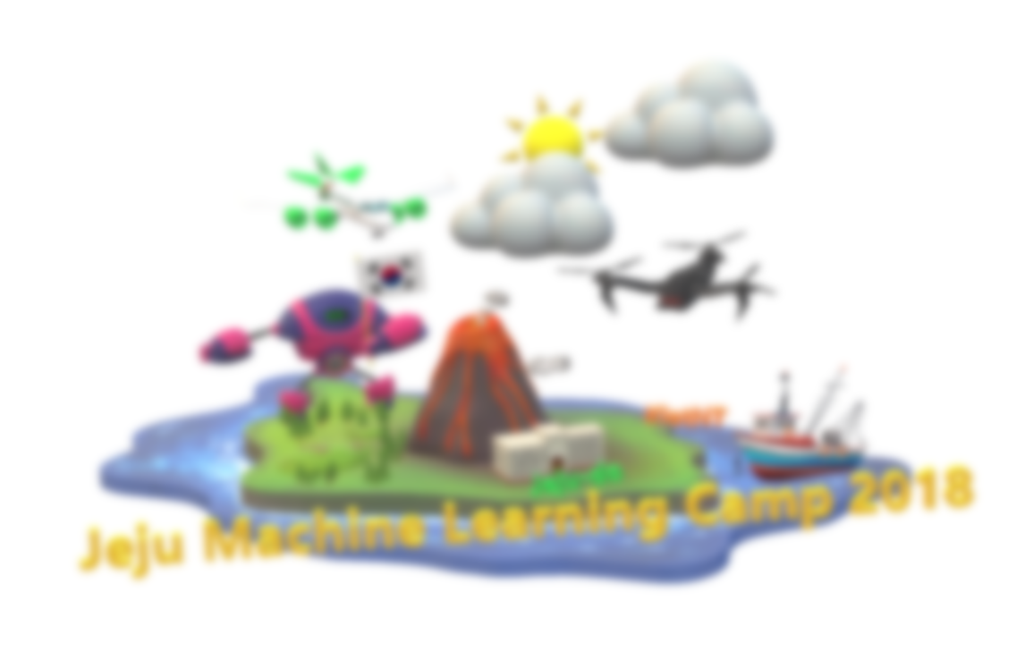

THANK YOU

