Slide 1
Computer Network Lab2 TCP receiver

Slide 2
Please pay attention to the submission date of the lab.
Lab0 and Lab1 are due tonight
The deadline for Lab 2 is October 24, 23:59
If you do not submit your assignment by the deadline, you will have a two-week grace period for late submission, but the score will be multiplied by 0.9.
Plagiarism is strictly prohibited! If you referenced someone else's ideas or code in your lab, please acknowledge it in your report.

Slide 3
What should we do in lab2？
Realize TCP Receiver

Slide 4
Wrap/Unwrap
In Lab 1, we know that substrings may arrive out of order.
We solve this questions by Reassembler.
The problem seems simple; we just need to push all the received substrings into the Reassembler.
But in Reassembler, We use a 64-bit unsigned number as an index to indicate the position of the substring.

Slide 5
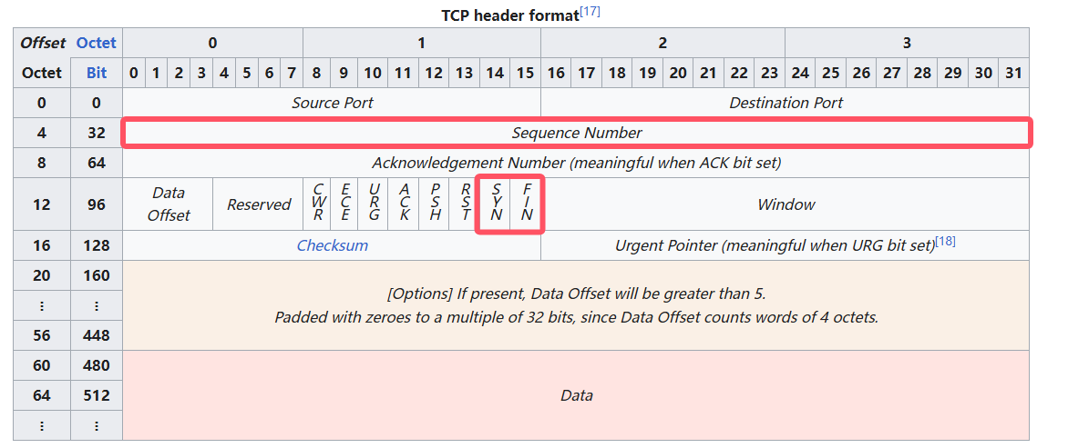
Wrap/Unwrap
A 64-bit index is big enough that we can treat it as never overflowing¹.
In the TCP headers, however, space is precious, and each byte’s index in the stream is represented not with a 64-bit index but with a 32-bit “sequence number,” or “seqno.”
¹Transmitting at 100 gigabits/sec, it would take almost 50 years to reach 2⁶⁴ bytes. By contrast, it takes only a third of a second to reach 2³² bytes.

Slide 6
Wrap/Unwrap
TCP sequence numbers start at a random value
The first sequence number in the stream is a random 32-bit number called the Initial Sequence Number (ISN).
This is the sequence number that represents the “zero point” or the SYN (beginning of stream), occupied sequence number.
Send TCP segments.
Send a segments with FIN = 1(may contain data)

Slide 7
TCP Receiver
Three different types of indexing involved in TCP
Seqno
Start at the ISN
Include SYN/FIN
32 bits, wrapping
Absolute seqno
Start at 0
Include SYN/FIN
64 bits, non-wrapping
Stream index
Start at 0
Omit SYN/FIN
64 bits, non-wrapping
element | SYN | H | E | L | L | O | C | N | FIN
Seqno | ISN | ISN+1 | ISN+2 | ISN+3 | ISN+4 | ISN+5 | ISN+6 | ISN+7 | ISN+8
Absolute seqno | 0 | 1 | 2 | 3 | 4 | 5 | 6 | 7 | 8
Stream index |  | 0 | 1 | 2 | 3 | 4 | 5 | 6
It easy to see “Absolute seqno” = “stream index” + 1
⚠ 32 bits Seqno may wrap around！

Slide 8
Seqno
unwrap
Absolute Seqno
wrap
+1
-1
Stream Index
✔ It is easy to realize wrap
Just truncate it
But how to realize unwrap?

Slide 9
Unwrap
We only have 32bits; how can we unwrap it into 64 bits?
From example, with an ISN of zero, the seqno “17” corresponds to the absolute seqno of 17, but also 2³²+17, or 2³³+17, or 2³⁴+17, or 2³³+2³⁴+17, etc.
The checkpoint helps resolve the ambiguity
It’s an absolute seqno
You should find the corresponding absolute sequence number that is closest to the checkpoint.

Slide 10
TCP Receiver
At this point, there is only a little work left for this lab.
Only two member functions.
Receive a message，and push it into the reassemble
Hint: All messages should be ignored before receiving SYN
Send a message back to the peer’s TCP sender，including ackno(32bits) and window size.

Slide 11


Let’s go！
Merge the branch to obtain initial code.
After completing the experiment, write a 2-5 page report, including some necessary screenshots
Zip your entire project and report, and submit them via the link in the QQ/WeChat group

