Slide 1
Lab3: The TCP sender

Slide 2
Lab3 DDL: 2024.11.7
Problems found in your lab0 and lab1 reports:
Screenshots of test results are not included in your report.
Some reports only include test result screenshots without providing even a brief explanation of how the implementation works.
Test result screenshots were incomplete, for example, only showing one line like “100% tests passed, …”
Some reports only contain text, while the images are in another folder. Screenshots should be directly embedded into the PDF.
Some students only submitted the report without the zipped code.

Slide 3
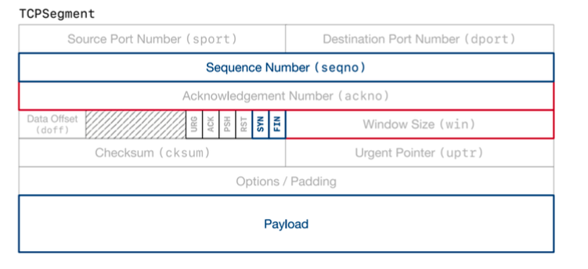
TCP Sender
TCP Sender :
Write:
The sequence number, The SYN flag, The payload, The FIN flag.
Read:
The ackno, The window size.
The highlighting fields that will be read by the sender

Slide 4
TCP Sender’s Responsibility
TCPSender’s Responsibility :
Keep track of the receiver’s window
acknos and window sizes
Fill the window when possible, by reading from the ByteStream, creating new TCP segments and sending them. The sender should keep sending segments until either the window is full or the outbound ByteStream is has nothing more to send.
Including SYN and FIN flags if needed
Keep track of which segments have been sent but not yet acknowledged by the receiver— we call these “outstanding” segments
Re-send outstanding segments if enough time passes since they were sent, and they haven’t been acknowledged yet

Slide 5
How does the TCPSender know if a segment was lost?
Every few milliseconds, your TCPSender’s tick method will be called with an argument that tells it how many milliseconds have elapsed since the last time the method was called.
RTO（ retransmission timeout）： the number of milliseconds to wait before resending an outstanding TCP segment.（change over the time)
The “initial value” of the RTO ： _initial_retransmission_timeout.（stays the same）
To implement the retransmission timer to be a an alarm to show whether RTO has elapsed.
To start the timer running to make it will expire after RTO millisecond when send a segment containing data.
When all outstanding data has been acknowledged, stop the retransmission timer.

Slide 6
When tick is called and the retransmission timer has expired
Retransmit the earliest (lowest sequence number) segment that hasn’t been fully acknowledged by the TCP receiver. You’ll need to be storing the outstanding segments in some internal data structure that makes it possible to do this.
If the window size is nonzero:
Keep track of the number of consecutive retransmissions, and increment it because you just retransmitted something. Your TCPConnection will use this information to decide if the connection is hopeless (too many consecutive retransmissions in a row) and needs to be aborted.
Double the value of RTO. This is called “exponential backoff”—it slows down retransmissions on lousy networks to avoid further gumming up the works.
Reset the retransmission timer and start it such that it expires after RTO milliseconds (taking into account that you may have just doubled the value of RTO!)

Slide 7
Cumulative Acknowledgment
When the receiver gives the sender an ackno that acknowledges the successful receipt of new data (the ackno reflects an absolute sequence number bigger than any previous ackno):
Set the RTO back to its “initial value.”
If the sender has any outstanding data, restart the retransmission timer so that it will expire after RTO milliseconds (for the current value of RTO).
Reset the count of “consecutive retransmissions” back to zero.
We would suggest implementing the functionality of the retransmission timer in a separate class, but it’s up to you. If you do, please add it to the existing files (tcp_sender.hh and tcp_sender.cc).

Slide 8
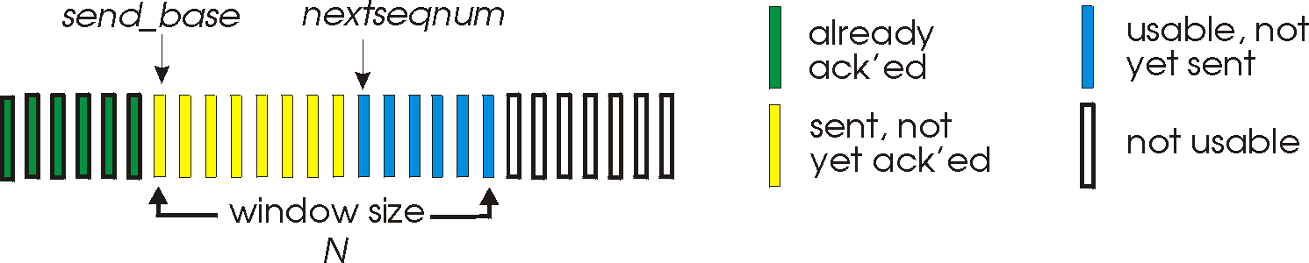
Implementing the TCP sender
void push(const TransmitFunction& transmit)
TCPSenderMessage <=TCPConfig::MAX_PAYLOAD_SIZE (1452bytes).
TCPSenderMessage::sequence_length() method to count the total number of sequence numbers occupied by a segment(SYN and FIN flags occupy a sequence number )
void receive(const TCPReceiverMessage& msg)
msg.ackno
next_ack_no

Slide 9
Implementing the TCP sender
void tick(uint64_t ms_since_last_tick, const TransmitFunction& transmit):
To handle the timed retransmission of segments to ensure that they reach the receiver without being lost.
To attempt to retransmit the packet when the sender doesn't receive an acknowledgment within the specified timeout period.
void make_empty_message():
Generate an empty TCPSenderMessage, this is useful.

