Slide 1
Docker hands on & K8S Fundamentals
Kubernetes Workshop – Session 2

Slide 2
Agenda
Docker hands on – Contd
Kubernetes
Why we need container orchestration?
K8S Architecture
Hands-on
Setup lab, Bootstrap a cluster, add nodes to the cluster
Kubectl command line basics
Deploy a container

Slide 3
Docker hands-on: Continued
- Docker volumes
- Build and push image to Dockerhub registry.
- Pull the image
docker volume create my-volume docker volume inspect my-volume docker run -d -v my-volume:/data nginx:latest

Slide 4
Need for container orchestration
- To keep up with the trend of converting Monolith to microservices based architecture.
- Increased usage of containers.
- Demand for a fail-proof way to manage numerous running containers.

Slide 5
Kubernetes

Slide 6
Kubernetes
- Kubenetes (K8S in short) is an open-source container orchestration tool built by Google.
- Helps us manage containerized applications running in hundreds and thousands of containers, across different deployment environments.
- Assures high availability with zero downtime
- Highly performant and scalable
- Reliable infrastructure to support data recovery with ease

Slide 7
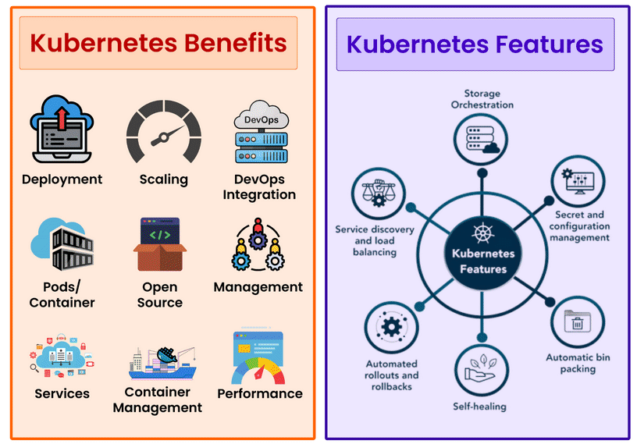

Slide 9
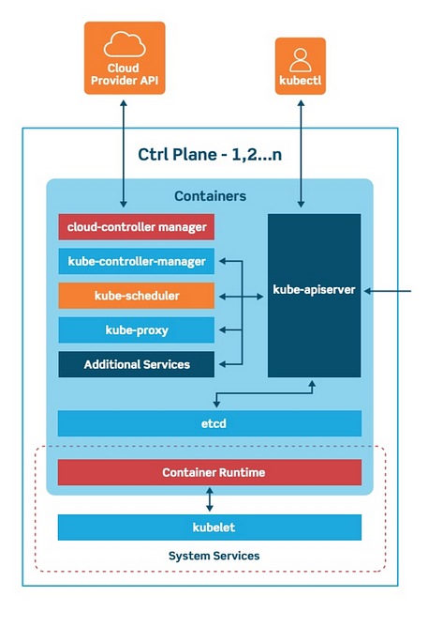
Master node key components
- Responsible for manage slave/worker nodes efficiently.
kube-apiserver: It is the main gateway to access the k8s cluster and act as the main gatekeeper for client level authentication.
kube-scheduler: Keeps a watch for newly created Pods with no assigned worker node, and selects a worker node for them to be scheduled and run on.
kube-controller-manager: Monitors the status of any worker node level failures, request scheduler to take actions.
etcd: Brain of the k8s cluster which keeps the log of every minute details of changes occurring in the cluster.

Slide 10
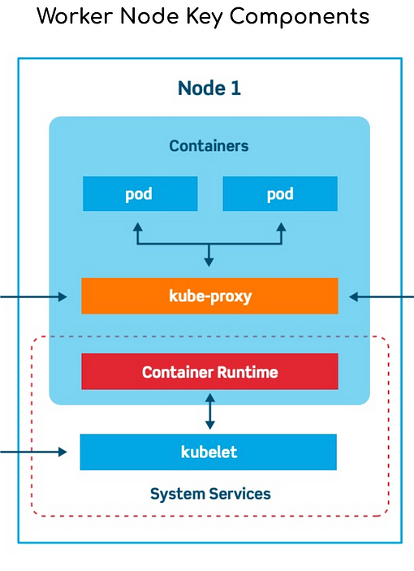
-
Kubelet: An agent that runs on each node in the cluster. It makes sure that containers are running in a Pod.
kube-proxy: A network proxy that runs on each node in your cluster, implementing part of the Kubernetes Service concept.
Pod: A group of one or more containers, with shared storage and network resources, and a specification for how to run the containers.

Slide 11
Key K8s Concepts
Pods: Smallest unit of k8s, which is an abstraction of the container application
Services & Ingress: To manage external communication between nodes and internal pod level communication
ConfigMaps: To manage the end-point URLs, environment properties, etc., required by the pods
Secrets: To keep app-level passwords and secret keys securely using based64 encoding
Volume: For Persistent data storage
Deployments: To deploy create replicas & manage stateless apps
Statefulsets: For stateful apps and databases

Slide 12
Hands on – K8s Fundamentals
- Understand the deployment yaml file of nginx deployment.
- Explore Kubectl commands
- Deploy the sample nginx.
- Experiment with scaling, exposing service, etc.,
- Kubernetes dashboard demo from one of the Fusion Stooges.

