Slide 1
Multi-Container Deployments
Kubernetes Workshop – Session 3

Slide 2

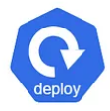

Kubernetes Objects
Pods
Deployment
Service
Pod is the smallest unit.
Runs the docker container.
Higher level controller.
Use Cases:
- Ensuring right number of pods are running.
- Scale up or down
- Roll out upgrades.
- Roll back or pause deployment
Exposes application to other pods and external users.
Pod specification
- CPU limit
- Memory limit
- Readiness Probe
- Liveness probe
- Volume

Slide 3
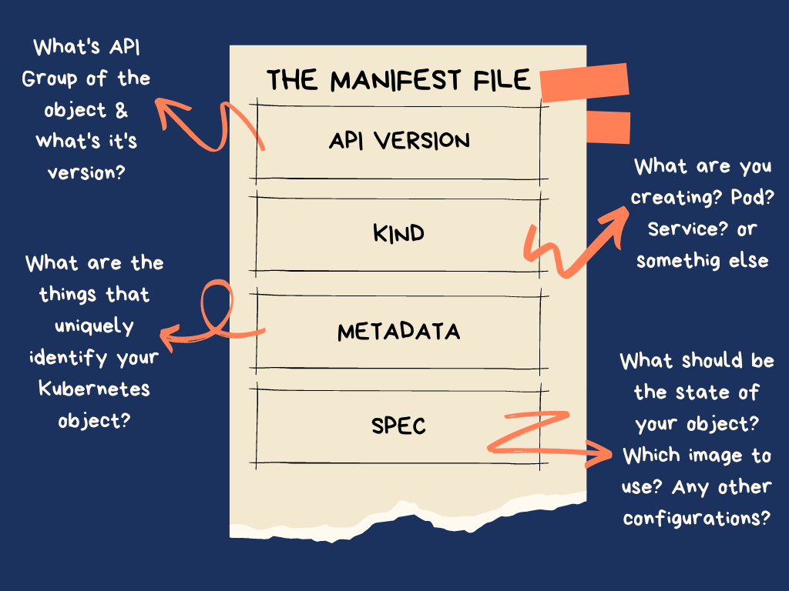
Infrastructure As Code

Slide 4
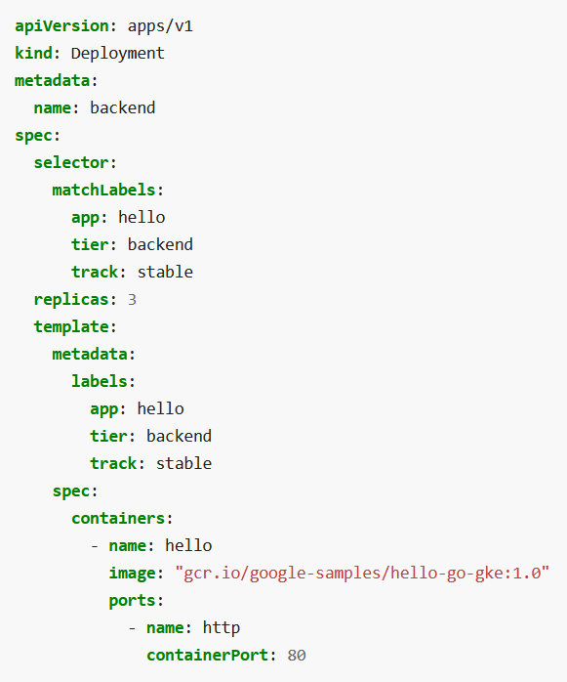


Deployment Spec
Deployment
Replica Set
tier=frontend
tier=backend
10.1.1.1
Number of pods
tier=backend
Labels to apply on the pods created
10.1.1.2
tier=backend
Pod specification
10.1.1.3

Slide 5
Deployment Hands On
Instructions @ https://kubernetes.io/docs/tasks/access-application-cluster/connecting-frontend-backend/
kubectl apply -f https://k8s.io/examples/service/access/backend-deployment.yaml
kubectl describe deployment backend

Slide 6
Services Overview
What are services?
Services provide a stable name for accessing pods.
It helps pods to be accessed from other pods in the cluster and from external world.
Why are they needed?
- IP based communication is possible but wont work as pods are ephemeral.
- Number of pods changes during the life of deployment.
How do they work?
Four techniques – ClusterIP, NodePort, LoadBalancer, ExternalName

Slide 7
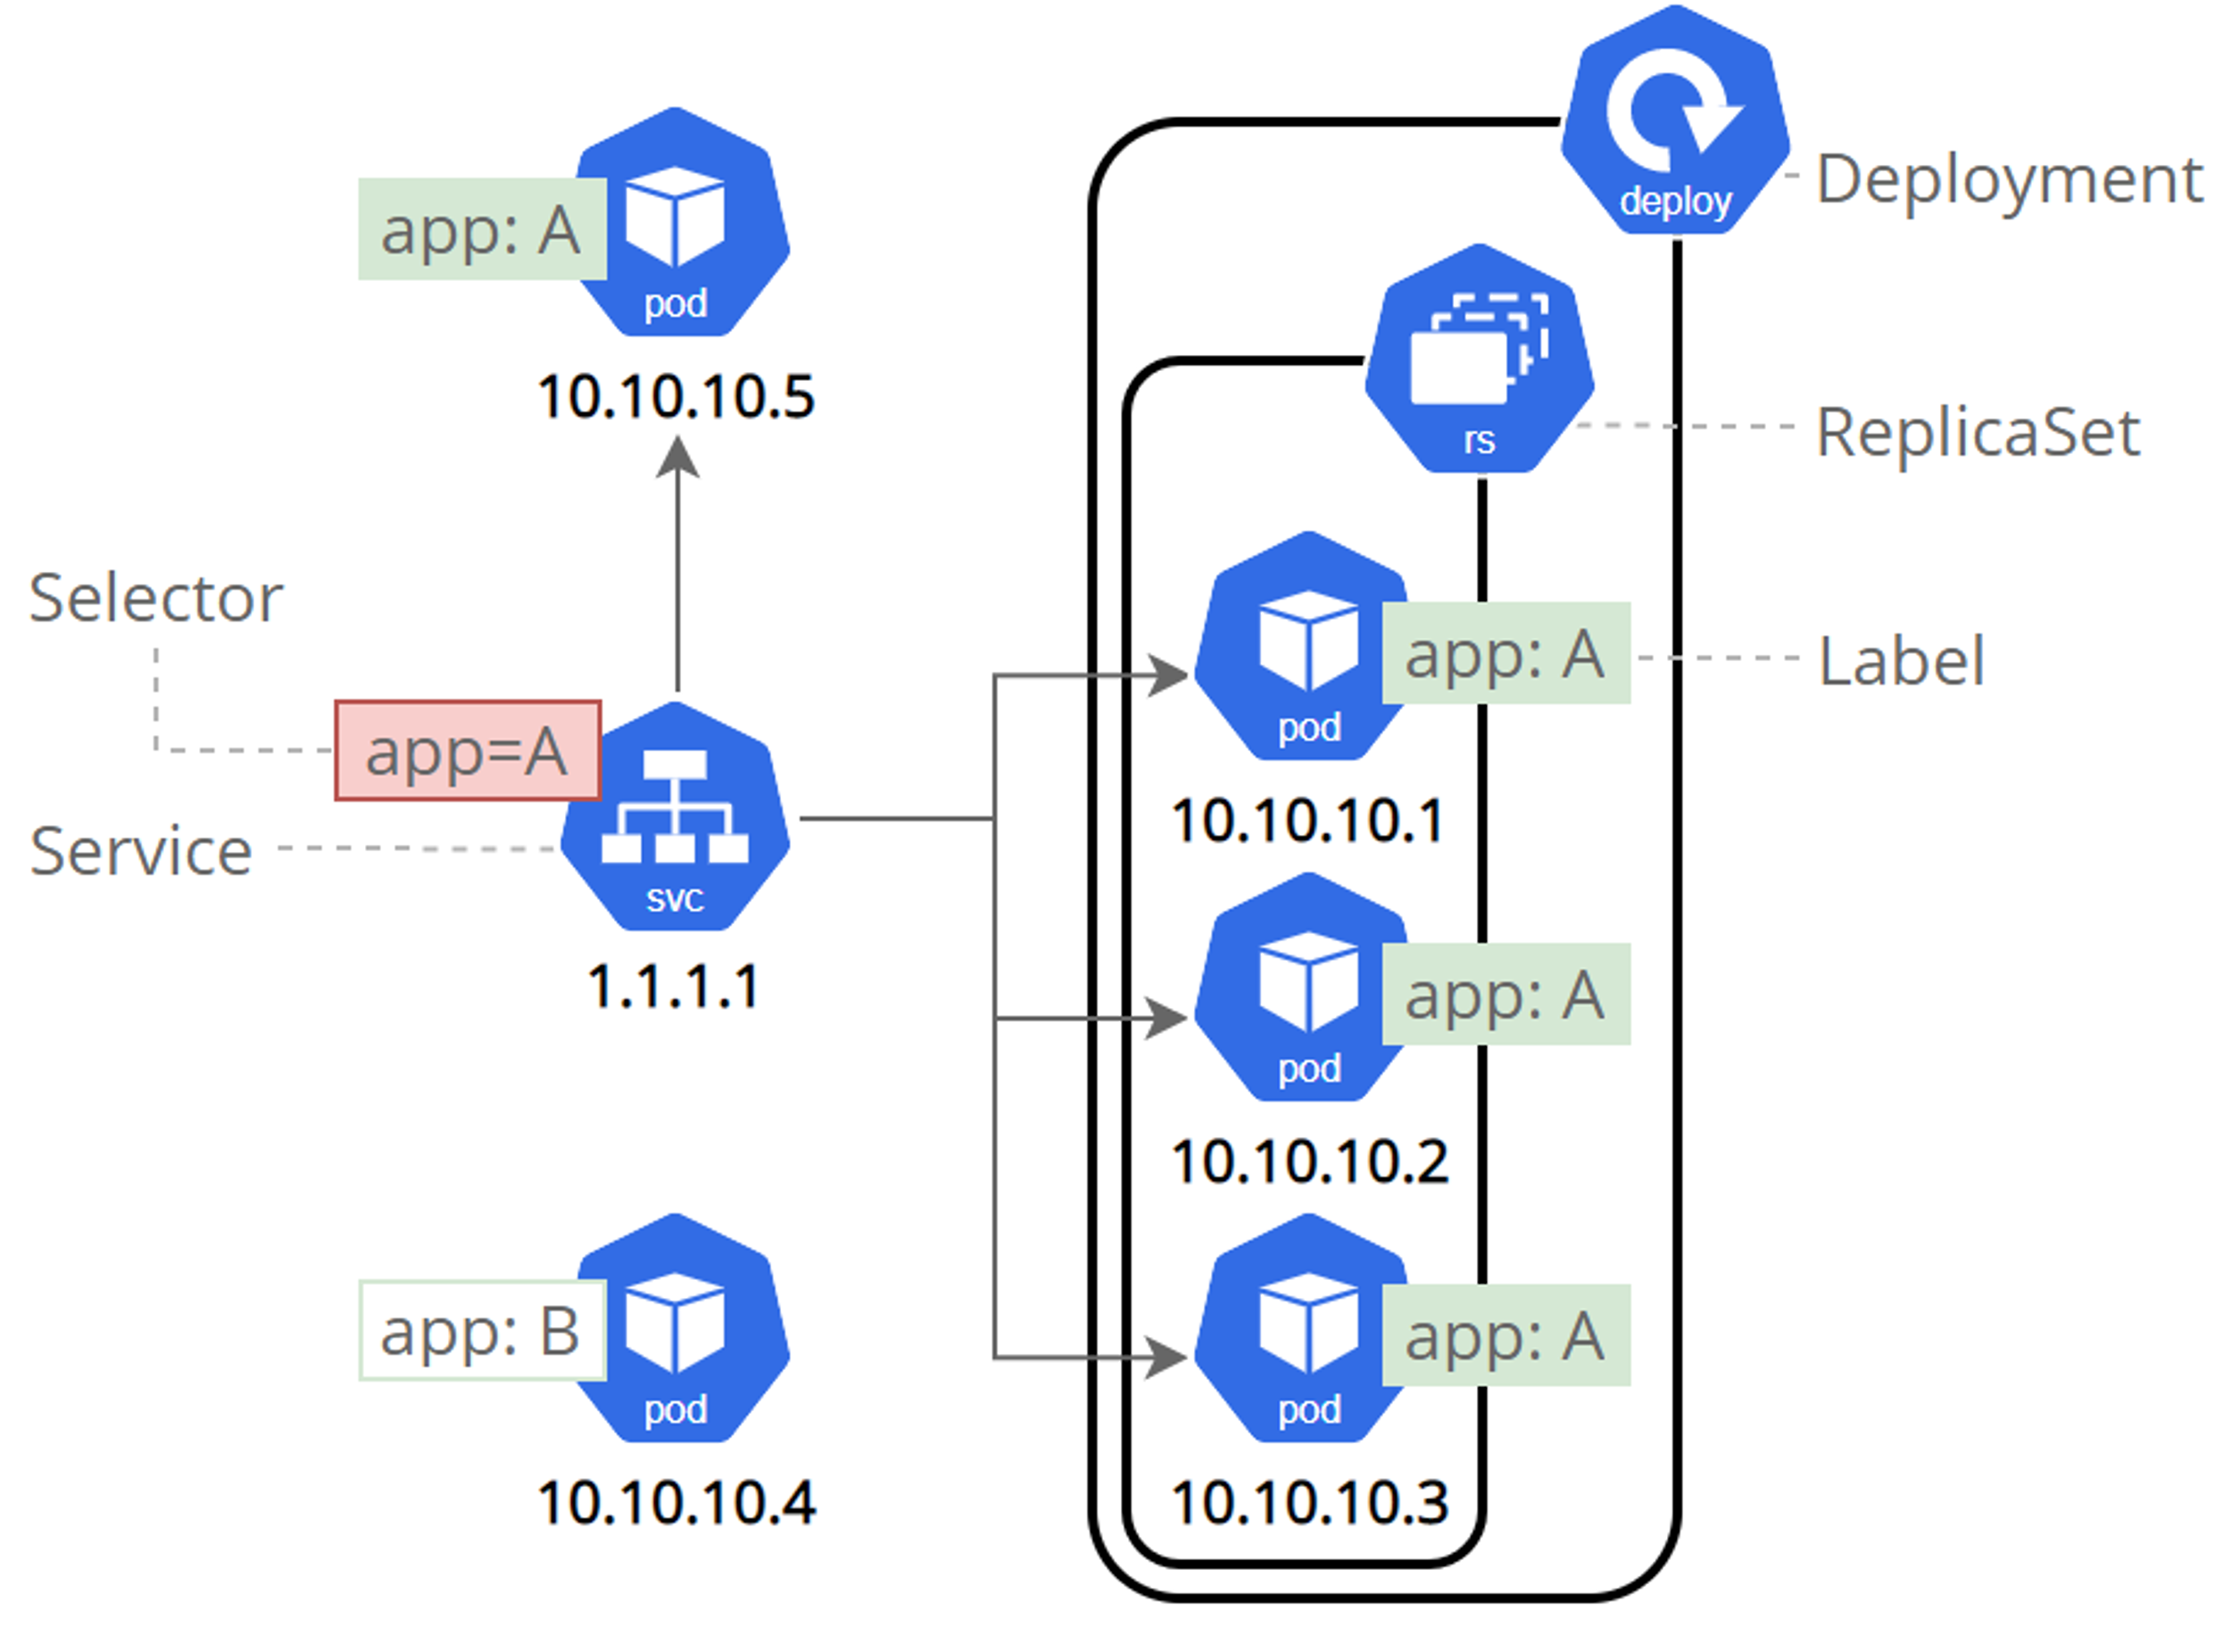
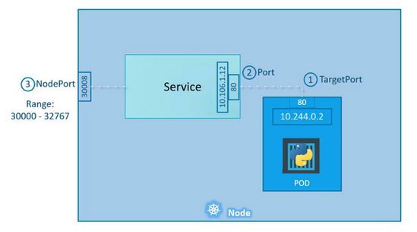
NodePort Service
Exposes application to external clients outside of the cluster.
How it works:
Kubernetes opens a port on all of its worker nodes.
All traffic incoming to the worker node's IP address, and that specific port, are sent to the service.
Service then forwards the request to one of its associated pods.

Slide 8
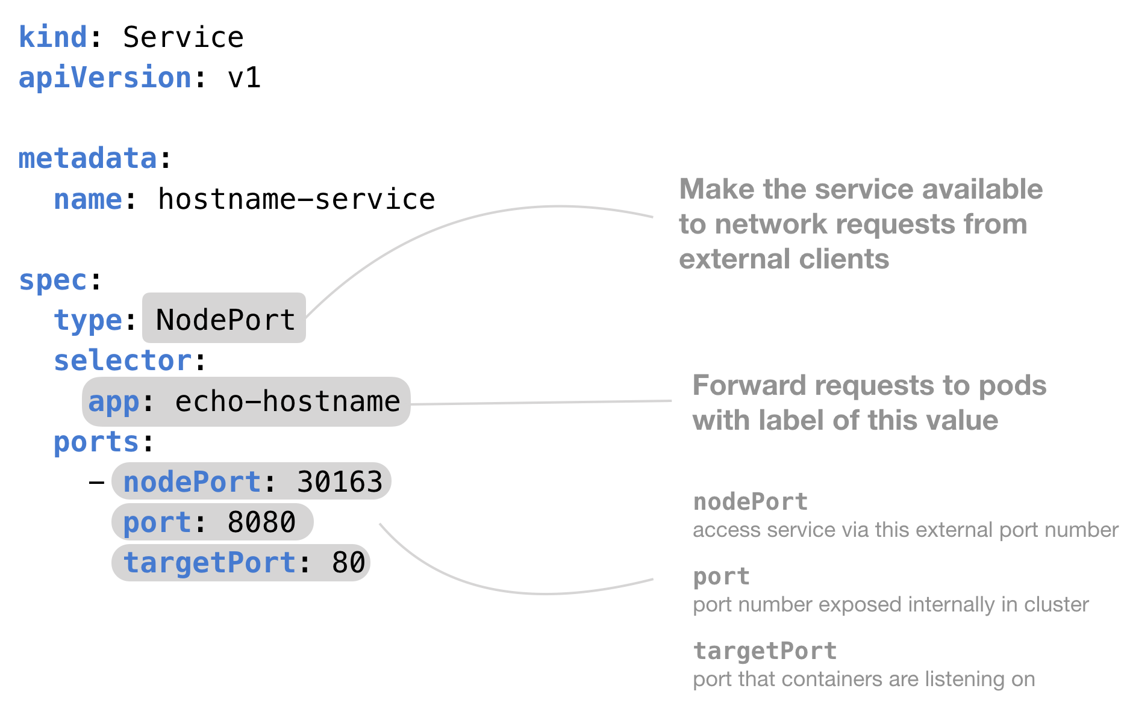
Service Manifest

Slide 9
Services Hands On
Instructions @ https://kubernetes.io/docs/tasks/access-application-cluster/connecting-frontend-backend/

Slide 10
Service Types
NodePort
LoadBalancer
Ingress Controller
Access service on specific <nodeIP>:<nodePort>
Backend @ 10.1.1.1:30200
Frontend @ 10.2.2.2:30300
Access service using Cloud loadbalancer.
<LoadBalancerIP>/path
Access service using an Ingress controller. Not a service type. Provides load balancing, SSL termination, and routing based on your defined rules, access control
ClusterIP
Headless
ExternalName
Pod to pod communication within cluster. Service is assigned a static IP, that other pods connect to.
Service returns the list of pods it has and the client uses the pod IP to connect directly to a specific pod. Created with ClusterIP: None
Access services outside of Kubernetes cluster like a database.

Slide 11
kubectl Hands On
How to manage various objects of an application?
kubectl create namespace workshop
kubectl apply -f https://k8s.io/examples/service/access/backend-deployment.yaml -n workshop
kubectl get all –A
kubectl delete deployment backend –n workshop
How to debug in Kubernetes?
kubectl logs <pod name>
kubectl describe <pod name>

Slide 12
References
Deployment Upgrade strategies - https://auth0.com/blog/deployment-strategies-in-kubernetes/
Services - https://kodekloud.com/blog/kubernetes-services/

