Slide 1
External Configurations
Kubernetes Workshop – Session 5

Slide 2



Kubernetes Objects
Secrets
Config Map
Persistent Volume
Higher level controller.
Use Cases:
- Ensuring right number of pods are running.
- Scale up or down
- Roll out upgrades.
- Roll back or pause deployment
Pod specification
- CPU limit
- Memory limit
- Readiness Probe
- Liveness probe
- Volume
Exposes application to other pods and external users.

Slide 3
Deployment Hands On
Instructions @ https://kubernetes.io/docs/tasks/access-application-cluster/connecting-frontend-backend/#creating-the-backend-using-a-deployment
https://kubernetes.io/docs/tasks/configure-pod-container/configure-pod-configmap/
- create config map
- ssh into pod to see the env variables
- load as volume
https://kubernetes.io/docs/tasks/configure-pod-container/configure-pod-configmap/#define-container-environment-variables-using-configmap-data
kubectl apply -f https://k8s.io/examples/service/access/backend-deployment.yaml
kubectl describe deployment backend

Slide 4
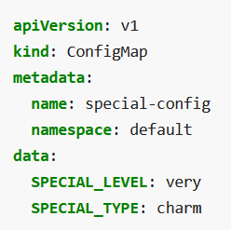
Config Map
How to manage configurations?
Backend Application
DB
- Configurations are also objects like pod, service.
- Created and managed by cluster administrator
- Shared with all pods that need that config
- Config changes are automatically updated in pods
DB_Host=
DB_Name=
…
app-config
https://killercoda.com/killer-shell-ckad/scenario/playground

Slide 5
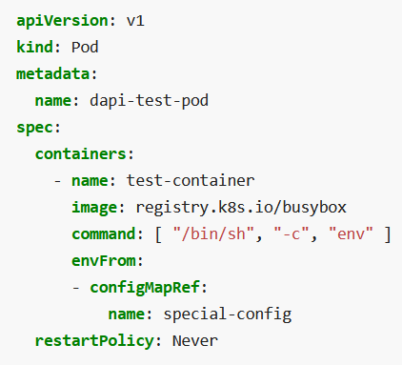
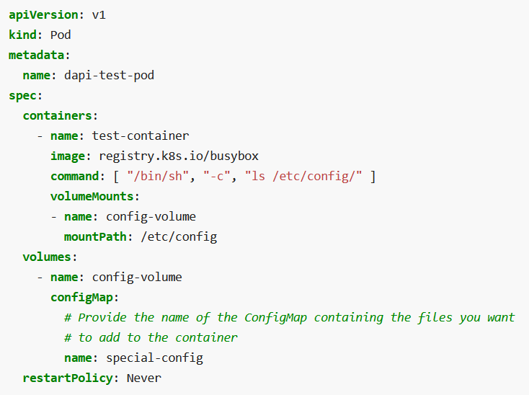
Using ConfigMap in Pod
Inject as environment variables
Inject as file on disk

Slide 6
wget https://kubernetes.io/examples/configmap/game.properties
kubectl create configmap game-config --from-env-file=game.properties
kubectl get configmaps game-config -o yaml
https://kubernetes.io/docs/tasks/configure-pod-container/configure-pod-configmap/#configure-all-key-value-pairs-in-a-configmap-as-container-environment-variables
kubectl create -f https://kubernetes.io/examples/configmap/configmap-multikeys.yaml
kubectl create -f https://kubernetes.io/examples/pods/pod-configmap-envFrom.yaml
kubectl get pods
kubectl logs dapi-test-pod
kubectl delete pod dapi-test-pod –now
kubectl create -f https://kubernetes.io/examples/pods/pod-configmap-volume.yaml
kubectl logs dapi-test-pod
kubectl delete pod dapi-test-pod –now

Slide 7
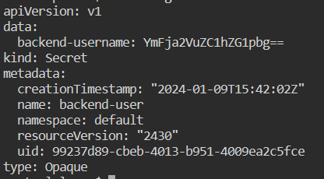
Secrets
Another Kubernetes object like ConfigMap
Secret can be created from config yaml or directly from a file.
Secrets are accessible in the pod as environment variable or a file on disk.
kubectl create secret generic backend-user --from-literal=backend-username='backend-admin'

Slide 8
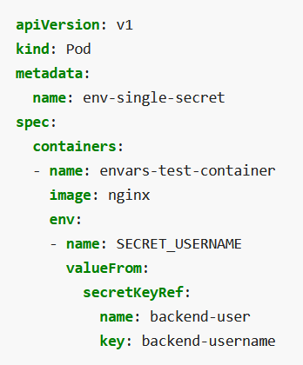
Using Secrets in Pod
Secrets vs Config Maps
- ConfigMaps are stored and viewable in plain text
- Secrets are encrypted at rest
- Can apply access controls on secrets
- Can use an external secret store

Slide 9
Secrets: Commands
kubectl create secret generic backend-user --from-literal=backend-username='backend-admin'
kubectl get secret/backend-user
kubectl describe secret/backend-user
kubectl create -f https://k8s.io/examples/pods/inject/pod-single-secret-env-variable.yaml
kubectl exec -it env-single-secret /bin/bash
env

Slide 10
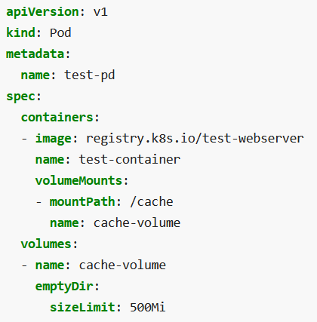
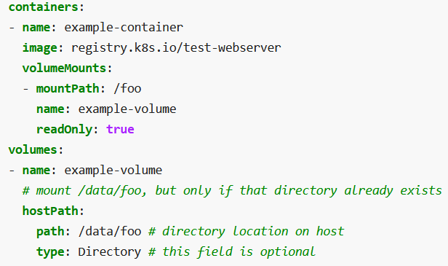
Volumes
Volumes help save state for the lifetime of the pod or permantely.
Different volumes are supported
Emptydir – location on the node allocated to a pod. Data is deleted when pod dies.
Hostpath – mounts a directory from host node into the pod.
PersistentVolumeClaim
Nfs

Slide 11
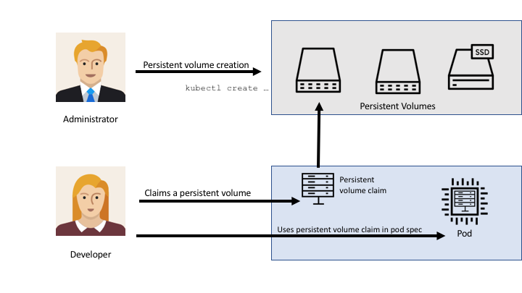
PersistentVolume
A PersistentVolume (PV) is a piece of storage in the cluster that has been provisioned by an administrator or dynamically provisioned.
A PersistentVolumeClaim (PVC) is a request for storage by a user.
Claims can request specific size and access modes

