Slide 1

isitlegalto.co
Legal Insight, Simplified.
Dhruv Jha
Avinash Kumar
Kriti Chinta
Sagnik Sarkar

Slide 2
isitlegalto.co
Legal Insight, Simplified.
Problem Statement
Introducing isitlegalto: Your One-Stop Solution for Legal Clarity
isitlegalto is a single-stop search engine designed to help users determine the legality of various activities. Whether you're curious about a specific action, seeking clarification on a legal matter, or looking to connect with legal professionals, isitlegalto provides a straightforward solution.
Expected Outcome
Legal Clarity: Instantly ascertain whether a particular activity is legal or not.
Comprehensive Search: Search through a wide range of activities and scenarios.
Connect with Lawyers: Seamlessly connect with legal professionals for further guidance.
User-Friendly Interface: Intuitive design for easy navigation and quick results.

Slide 3
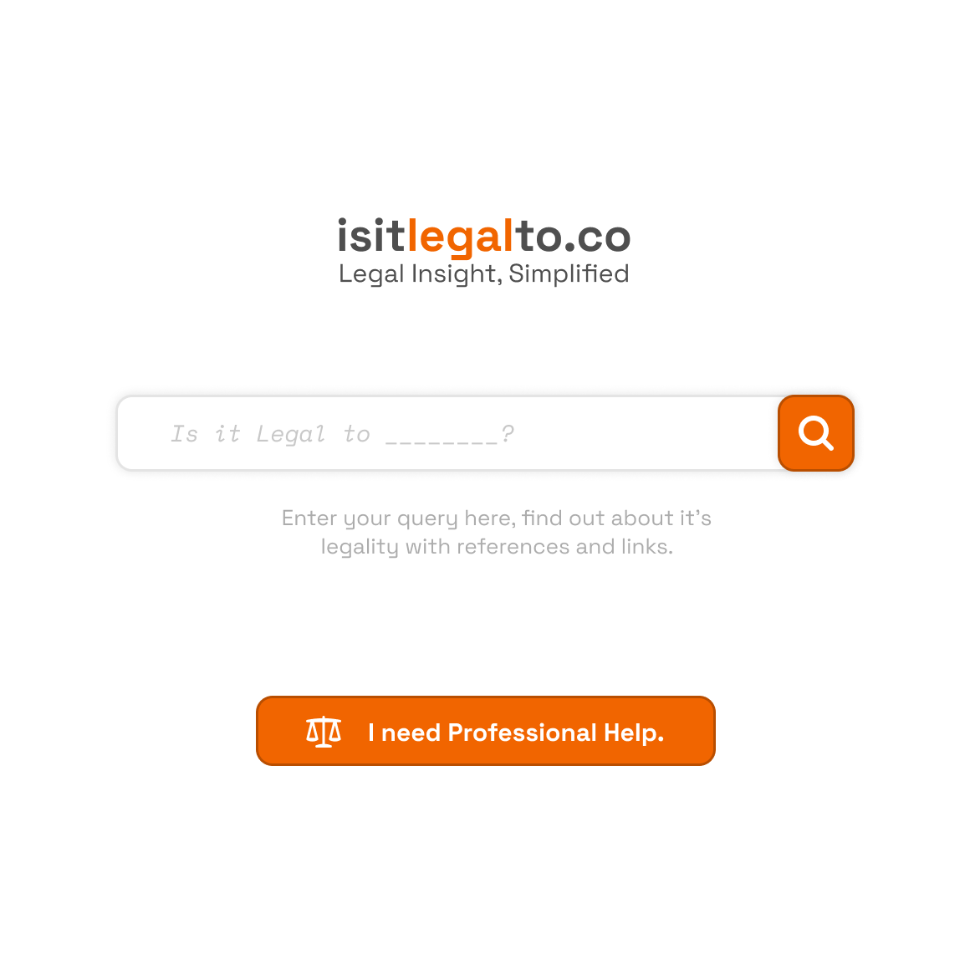

Slide 4
Accessible Legal Help for Everyone.
Our bleeding-edge solution allows everyone to get legal aid with proper references in a few seconds.
Connect to professional practitioners with ease.
isitlegalto.co

Slide 5


Be Completely Anonymous
We will not store any chat data.
Keep your chat history.
Everything stays encrypted.

Slide 6
What we do
Access swift legal counsel aided with precise references.
Streamline your legal documents for enhanced clarity and situational comprehension.
Discover legal practitioners tailored to your specific needs; allow our platform to engage them seamlessly, eliminating paperwork hassles.
Maintain absolute control over privacy settings for utmost confidentiality.

Slide 7
The Problems with current solutions.
Accessibility and Affordability: Access to legal advice or guidance through these platforms may still be limited by factors such as cost or availability, particularly for users with lower incomes or in remote areas.
Limited Scope of Search: While some platforms offer comprehensive search capabilities, others may have limitations in the range of activities or scenarios covered, leaving users with unanswered queries.
Privacy Concerns: Users may be hesitant to input sensitive or personal information into online platforms.
Language and Cultural Barriers: Users who speak languages other than those supported by the platform, or who come from different cultural backgrounds, may face challenges in understanding or accessing the information provided

Slide 8
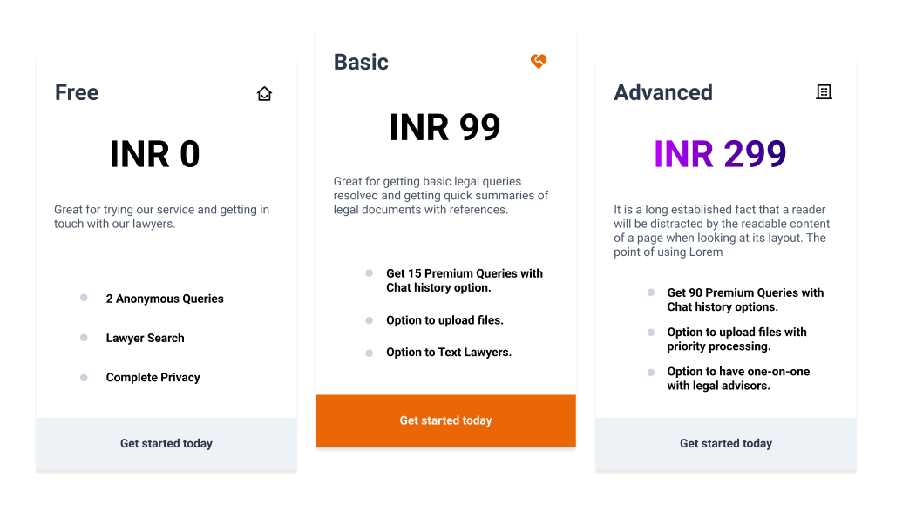
Pricing.

Slide 9
Our Approach.
How to do we aim to solve the drawback of the pre existing solutions?

Slide 10
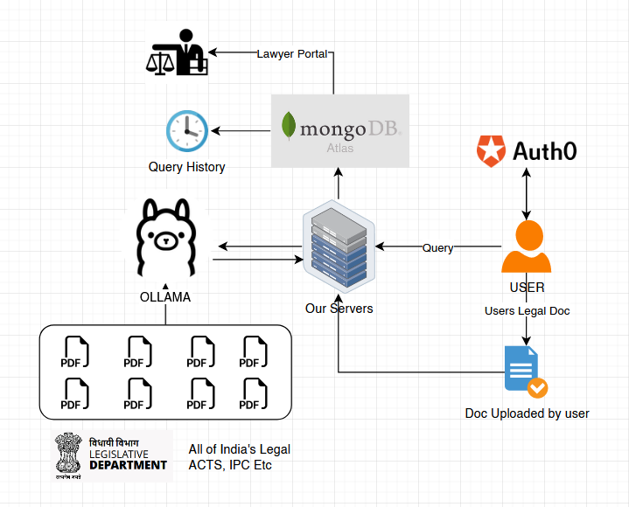
isitlegalto.co
Legal Insight, Simplified.

Slide 11
Our Approach
Custom trained LLM model
Our LLM model has been trained on a vast dataset comprising Indian laws, acts, and legal precedents, allowing it to understand and interpret complex legal language with precision.
Our LLM model doesn't just provide yes/no answers; it offers detailed explanations and context for its responses, helping users understand the legal reasoning behind its conclusions.
In addition to answering whether an activity is legal, Our LLM model also identifies the specific sections or acts of law relevant to the query, providing users with clear references for further research or verification.
Encryption and Secure Transmission:
We prioritize the privacy and security of our users' data, implementing stringent measures to safeguard sensitive information and ensure confidentiality in all interactions with our LLM Model.

Slide 12
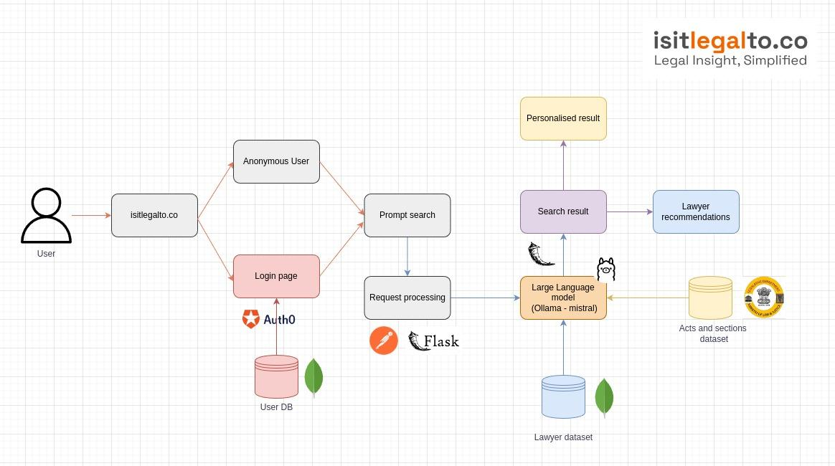

Slide 13
Benefits of Our Approach.
Accuracy: By fine-tuning Llama with a comprehensive database of Indian laws and acts, we ensure that users receive highly accurate and reliable information regarding the legality of activities.
Efficiency: Users can quickly obtain answers to their legal queries without the need for extensive research or consultation with legal professionals, saving time and effort.
Transparency: Our LLM model not only provides answers but also references specific sections or acts of law relevant to the query, enabling users to verify the information and gain a deeper understanding of the legal context.
Empowerment: By empowering users with accurate legal knowledge, our approach enables individuals to make informed decisions and navigate legal issues with confidence.

Slide 14
Thank you.
We hope to hear from you soon.
A presentation by Sagnik, Kriti, Dhruv, Avinash

