Slide 1
Sorting
Dr. B C Dhara
Department of Information Technology
Jadavpur University

Slide 2
Sorting problem
Sorting is, without doubt, the most fundamental algorithmic problem
Supposedly, 25% of all CPU cycles are spent sorting
Sorting is fundamental to most other algorithmic problems, for example binary search.
Many different approaches lead to useful sorting algorithms, and these ideas can be used to solve many other problems.
What is sorting? It is the problem of taking an arbitrary permutation of n items and rearranging them into the total order, a_{i} ≤ a_{j} for all i ≤ j (or a_{i} ≥ a_{j} for all i ≤ j)

Slide 3
Sorting problem
Input: a sequence of n numbers {a₁, a₂, a₃,…, a_{n}}.
Output: a permutation (or reordering) {a₁’, a₂’, a₃’,…, a_{n}’} such that a₁’≤ a₂’≤ a₃’≤ …≤ a_{n}’ (or a₁’≥ a₂’≥ a₃’≥ …≥ a_{n}’).
For example, n=5 and {40, 30, 10, 20, 60} i.e., a₁=40, a₂=30, a₃=10, a₄=20, and a₅=60.
  Sorted output is {10, 20, 30, 40, 60} i.e., a₁’=10, a₂’=20, a₃’=30, a₄’=40, a₅’=60.
  Or
  Sorted output is {60, 40, 30,20,10} a₁’=60, a₂’=40, a₃’=30, a₄’=20, a₅’=10.

Slide 4
Issues in Sorting
The field(s) that are used to sort, are also known as the keys.
For example, consider student records with name, roll no, score_sub1, score_sub2, …, score_sub5, total.
  Say, we ordered the students according to their total marks, so here key field is ‘total’.
  There may be the situation, total of two students is same and then, say, to order them we use ‘score of sub1’

Slide 5
Issues in Sorting
First we sort respect to ‘total’ and if equality occurs then we apply comparison on ‘score_sub1’ filed.
  We call, ‘total’ as the primary key and ‘score_sub1’ as the secondary key.

Slide 6
Issues in Sorting
Increasing or Decreasing Order? –
  If the relationship is ‘≤’, then it is ascending order.
  If the relationship is ‘≥’, then it is descending order.
The same algorithm can be used by both all we need do is change ≤ to ≥ in the comparison function as we desire.

Slide 7
Issues in Sorting
What about equal keys? - Does the order matter or not?
  Maybe we need to sort on secondary keys, or leave in the same order as the original permutations.
What about non-numerical data? –
  sorting text strings
We can ignore all three of these issues by assuming a comparison function which depends on the application. Compare (a,b) should return ``<'', ``>'', or ''=''.

Slide 8
Order Statistics
The ith order statistics of a set of n elements is the ith smallest element.
  Minimum is the first order statistic
  Maximum is the nth order statistic
  A median is the halfway point , if n is odd it is unique; else two medians.

Slide 9
Applications of Sorting
One reason why sorting is so important is that once a set of items is sorted, many other problems become easy.
Searching: Binary search lets you test whether an item is in a dictionary in time.
  Speeding up searching is perhaps the most important application of sorting.
Closest pairGiven n numbers, find the pair which are closest to each other.
  Once the numbers are sorted, the closest pair will be next to each other in sorted order, so an O(n) linear scan completes the job.

Slide 10
Applications of Sorting
Element uniquenessGiven a set of n items, are they all unique or are there any duplicates?
  Sort them and do a linear scan to check all adjacent pairs.
  This is a special case of closest pair above.
Frequency distribution – Mode
  Given a set of n items, which element occurs the largest number of times?
  Sort them and do a linear scan to measure the length of all adjacent runs.
Median and Selection: What is the kth largest item in the set?
  Once the keys are placed in sorted order in an array, the kth largest can be found in constant time by simply looking in the kth position of the array.

Slide 11
How do you sort?
There are several different ideas which lead to sorting algorithms:
Insertion - putting an element in the appropriate place in a sorted list yields a larger sorted list.
Exchange - rearrange pairs of elements which are out of order, until no such pairs remain.
Selection - extract the largest element form the list, remove it, and repeat.
Distribution - separate into piles based on the first letter, then sort each pile.
Merging - Two sorted lists can be easily combined to form a sorted list.

Slide 12
Sorting
Sorting processes are classified into two categories:
  Sorting of arrays
    arrays are stored in the fast, high-speed, random-access "internal" store of computers.
  Sorting of (sequential) files
    files are appropriate on the slower, but more spacious "external" stores based on mechanically moving devices (disks and tapes).
A sorting method is called stable if the relative order of the items with equal keys remains unchanged by the sorting process.
  Stability of sorting is often desirable, if items are already ordered (sorted) according to some secondary keys, i.e., properties not reflected by the (primary) key itself.

Slide 13
Notes
Here, we consider array as the storage structure to store the elements.
  We consider only the internal sorting.

Slide 14
Bubble sort
For increasing order.
  We compare two adjacent elements and if first one is greater then we interchange the position of these elements.
    Do this form first pair to last pair.
    So, largest will element will be in the last position.
  Repeat the process with considering first n-1 elements (i.e., maximum element is in the last position, then ignore that element).
  Stop the above process when we have only one element.

Slide 15
Bubble Sort Example
9, 6, 2, 12, 11, 9, 3, 7
6, 9, 2, 12, 11, 9, 3, 7
Bubblesort compares the numbers in pairs from left to right exchanging when necessary. Here the first number is compared to the second and as it is larger they are exchanged.
6, 2, 9, 12, 11, 9, 3, 7
Now the next pair of numbers are compared. Again the 9 is the larger and so this pair is also exchanged.
6, 2, 9, 12, 11, 9, 3, 7
In the third comparison, the 9 is not larger than the 12 so no exchange is made. We move on to compare the next pair without any change to the list.
6, 2, 9, 11, 12, 9, 3, 7
The 12 is larger than the 11 so they are exchanged.
6, 2, 9, 11, 9, 12, 3, 7
The twelve is greater than the 9 so they are exchanged
The end of the list has been reached so this is the end of the first pass. The twelve at the end of the list must be largest number in the list and so is now in the correct position. We now start a new pass from left to right.
6, 2, 9, 11, 9, 3, 12, 7
The 12 is greater than the 3 so they are exchanged.
6, 2, 9, 11, 9, 3, 7, 12
The 12 is greater than the 7 so they are exchanged.

Slide 16
Bubble Sort Example
First Pass
6, 2, 9, 11, 9, 3, 7, 12
Second Pass
6, 2, 9, 11, 9, 3, 7, 12
2, 6, 9, 11, 9, 3, 7, 12
2, 6, 9, 9, 11, 3, 7, 12
2, 6, 9, 9, 3, 11, 7, 12
2, 6, 9, 9, 3, 7, 11, 12
Notice that this time we do not have to compare the last two numbers as we know the 12 is in position. This pass therefore only requires 6 comparisons.

Slide 17
Bubble Sort Example
First Pass
6, 2, 9, 11, 9, 3, 7, 12
Second Pass
2, 6, 9, 9, 3, 7, 11, 12
Third Pass
2, 6, 9, 9, 3, 7, 11, 12
2, 6, 9, 3, 9, 7, 11, 12
2, 6, 9, 3, 7, 9, 11, 12
This time the 11 and 12 are in position. This pass therefore only requires 5 comparisons.

Slide 18
Bubble Sort Example
First Pass
6, 2, 9, 11, 9, 3, 7, 12
Second Pass
2, 6, 9, 9, 3, 7, 11, 12
Third Pass
2, 6, 9, 3, 7, 9, 11, 12
Fourth Pass
2, 6, 9, 3, 7, 9, 11, 12
2, 6, 3, 9, 7, 9, 11, 12
2, 6, 3, 7, 9, 9, 11, 12
Each pass requires fewer comparisons. This time only 4 are needed.

Slide 19
Bubble Sort Example
First Pass
6, 2, 9, 11, 9, 3, 7, 12
Second Pass
2, 6, 9, 9, 3, 7, 11, 12
Third Pass
2, 6, 9, 3, 7, 9, 11, 12
Fourth Pass
2, 6, 3, 7, 9, 9, 11, 12
Fifth Pass
2, 6, 3, 7, 9, 9, 11, 12
2, 3, 6, 7, 9, 9, 11, 12
The list is now sorted but the algorithm does not know this until it completes a pass with no exchanges.

Slide 20
Bubble Sort Example
First Pass
6, 2, 9, 11, 9, 3, 7, 12
Second Pass
2, 6, 9, 9, 3, 7, 11, 12
Third Pass
2, 6, 9, 3, 7, 9, 11, 12
Fourth Pass
2, 6, 3, 7, 9, 9, 11, 12
Fifth Pass
This pass no exchanges are made so the algorithm knows the list is sorted. It can therefore save time by not doing the final pass. With other lists this check could save much more work.
2, 3, 6, 7, 9, 9, 11, 12
Sixth Pass
2, 3, 6, 7, 9, 9, 11, 12

Slide 21
Bubble Sort Example
Quiz Time
Which number is definitely in its correct position at the end of the first pass?
Answer: The last number must be the largest.
How does the number of comparisons required change as the pass number increases?
Answer: Each pass requires one fewer comparison than the last.
How does the algorithm know when the list is sorted?
Answer: When a pass with no exchange.
What is the maximum number of comparisons required for a list of 10 numbers?
Answer: 9 comparisons, then 8, 7, 6, 5, 4, 3, 2, 1 so total 45
For n elements total number of comparisons is: (n-1)+(n-2)+…+3+2+1 = (n-1)(n-1+1)/2 = n(n-1)/2.

Slide 22
Bubble sort: example
Bubblesort(int *a, int n)
{
For(i=0;i<n-1;i++)
for(j=0;j<n-1-i;j++)
{
if(a[j]>a[j+1]
swap(a,j,j+1);
}
}
void swap(int *a, int i, int j)
{
int temp;
temp=a[i];
a[i]=a[j];
a[j]=temp;
}
Number of movements of the elements:
Minimum: 0
Maximum: 3*(n(n-1))/2 // for each 3 assignments in swap function
Average: (min+max)/2 = 3(n(n-1))/4

Slide 23
Selection sort
We have elements {a₀, a₁, a₂,…, a_{n-1}}
Findmax(a,0,k) is a function which consider elements {a₀, a₂, a₃,…, a_{k}} and return the position, p, of the largest element.
then swap(p,k);
Repeat this process for k= n-1, n-2,…,3,2,1.

Slide 24
Selection sort
Original data set
3
1
2
6
4
5
1
2
3
4
5
6
3
3
3
2
1
1
1
1
2
2
2
3
6
5
4
4
4
4
5
5
5
6
6
6
0
1
2
3
4
5
Sorted output
1
2
3
4
5
6
K=5
K=4
K=3
K=2
K=1
Findmax returns 3
Findmax returns 3
Findmax returns 3
Findmax returns 0
Findmax returns 0

Slide 25
Selection sort
selectionSort(int *a, int n)
{
for(i=n-1;i>=1;i--)
{
k=findmax(a,0,i);
swap(a,k,i);
}
}
findmax(int *a, int L, int H)
{
max=a[L];
ptr=L;
for(i=L+1;i<=H;i++)
if(max<a[i])
{max=a[i]; ptr=i;}
retrun ptr;
}

Slide 26
Analysis of the selection sort
Say, we have n elements.
Total number of comparisons is:
  To find the largest from n elements it is (n-1)
  To find the largest from n-1 elements it is (n-2)
  Total comparisons is n(n-1)/2.
Number of swapping:
  Minimum: 0, if the data set is in desired order.
  Maximum: n-1, in each pass we need the swap. E.g., data is in reverse order.

Slide 27
Insertion Sort
The basic concept is we have some elements {a₀, a₁, a₂,…, a_{i-1}} in sorted order (increasing, say) and consider a new element ‘b’ and placed this number in the sequence so that we will have a sorted list of i+1 elements.
1
1
1
1
2
2
2
2
4
4
4
4
8
7
8
8
9
8
9
8
15
9
15
9
15
15
1
2
4
8
9
9
15
15
0
1
2
3
4
5
6
7
7
b

Slide 28
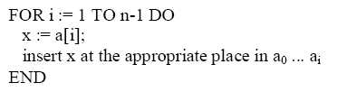
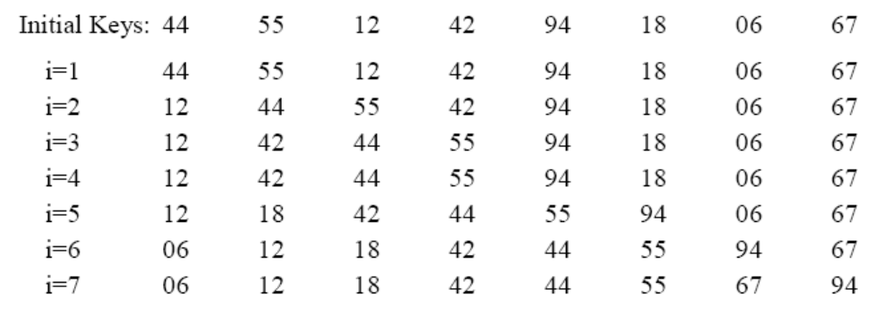
Insertion sort
A set with single element is always sorted.
So, consider second, third, fourth elements and place there into proper position.

Slide 29
Insertion sort
insertionSort(int *a, int n)
{
for(i=1;i<n;i++)
{
k=findposition(a,i);
shift(a,k,i);
a[k]=a[i];
}
}
findposition(int *a, int j)
{
/* k is the position of a[j] if a[k-1]<a[j] && a[k]>=a[j].
i.e., from a[0] to a[k-1] are less than a[j] but a[k] >=a[j]*/
p=0;
while(a[p]<a[j]) p++;
return p;
}

Slide 30
Insertion sort
shift(int *a, int k, int i)
{
/* we have to shift a[k] to a[i-1] one position right */
for(q=i-1;q>=k;q--)
a[q+1]=a[q];
}
To insert a number into proper position, we need at least one comparisons.
  At the very beginning if while loop fails (i.e., first element is larger or equal).
We need at most i comparisons, when we have total i+1 elements including the current element itself.

Slide 31
Insertion sort
Minimum number of comparisons is n-1
Maximum number of comparisons is; 1+2+3+…+(n-1)=n(n-1)/2.
When comparisons is maximum, then no shifting
When minimum comparison, then maximum number of shifting.
Minimum shifting is 0. (data in sorted order)
Maximum number of shifting is 1+2+3+…+(n-1) = n(n-1)/2.
We can reduce number of comparisons by applying binary search technique on the sorted sub-array [0…i] for (i+1)th element.

Slide 32
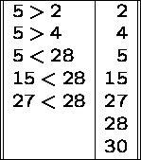
Merge sort
Given two sorted lists and merge them to form a third list, which also be in sorted order.
If total n elements are there in two lists, then at most n-1 comparisons are required.
No comparison ie needed one list is empty.

Slide 33
Merging
Say, we have two sorted (increasing) array A[0…n] and B[0…m]. We have to merge these into one array C, say, which also be in increasing order.
p=0; q=0; r=0;
while(p<n && q<m)
{
if(A[p]<B[q])
{
C[r]=A[p]; r++;p++;
}
else
{
C[r]=B[q]; r++;q++;
}
}
//Cont to next box
// end of while of the previous box indicates that one array is now empty
if(p==n)
while(q<m)
{
C[r]=B[q]; r++; q++;
}
if(q==m)
while(p<n)
{
C[r]=A[p]; r++; p++;
}

Slide 34
Sorting using merging
Number of elements is 8 = 2³

Slide 35
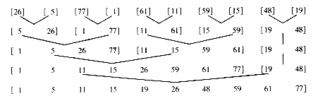
Another example
Number of elements is 10 ≠ 2^{k}

Slide 36
Quick sort
Let elements are available in an array A with indices from first to last (like 0 to n-1).
Consider any element and placed it in its (expected) position in the sorted output such that all the left side values are less (or equal) and right side values are greater.
  The positioning of the arbitrary element is known as the partition of the array.
  Without any loss we use first element of the list to partition the array.
  The element respect to which we partition the array is called as ‘pivot’ element.
Now sort the left sub-array and right-sub array recursively.

Slide 37
Quick sort
quickSort(int *a, int first, int last)
{
if(first<last)
{index=partition(a,first,last);
quickSort(a,first,index-1);
quicksort(a, index+1,last);
}
else return;
}
We call function ‘quickSort(a,0,n-1)’
There are two stopping condition:
  If first = last, i.e., only one value in sub-array→ sorted.
  If first > last, no element in the sub-array → sorted.

Slide 38
Partition of the array
pivot =a[first]
up=first; down=last;
while (up <down)
{
while(pivot >=a[up] && up <=last) up++;
while( pivot < a[down]) down--;
if(up<down) swap(a, up, down);
}
swap(a, first, down);
return down;
Define the pivot value as the contents of a[first];
Initialize up to first and down to last.
Repeat
  Increments up until up selects an element greater than pivot.
  Decrements down until it selects an element less or equal to pivot.
  If up < down swap their values
Until up >= down
Swap a[first] and a[down]
Return down as the partition index.

Slide 39
Example of partition
first
last
Pivot=3
a[up]> pivot stop
a[down]<= pivot stop
up
up
up
down
down
down
first
Swap: a[up] and a[down] as up < down
last
up
down

Slide 40
Example of partition
first
Pivot=3
last
a[up]> pivot stop
up
up
up
down
down
down
down
a[down]<= pivot stop
Swap: a[up] and a[down] as up < down
up
down

Slide 41
Example of partition
first
a[up]> pivot stop
down
down
up
up
down
a[down]<= pivot stop
No Swap: as up > down
All the elements at the left side of down is less or equal and at right side greater
End on outer while loop
Swap: between a[first] and a[down]
down

Slide 42
Example of quick sort
Partition index
first1
last1
first2
last2
quickSort(a, first, down-1)
quickSort(a, down+1,last)

Slide 43
Random quick sort
Average case analysis of quick sort, input can be any permutation of {1,2,…,n}.
Any element can be consider as the pivot element.
  Randomly select any position, p, then swap the first element and pth element and then apply the quicksort method. Do this recursively.

Slide 44
External Sort
Sort large files
  File cannot be contained in internal memory
  External storage device (like disk, tape) has to be used
  Tape: sequential access
  Disk: direct access

Slide 45
External Sort
Merge sort (general)
  Partition the large file into subfiles such that they can be stored in main memory
  Sort these subfiles by an internal sorting method.
    Sorted subfile is known as run
  Write the partial sorted file into the secondary storage
  Apply merging technique
  There are different techniques for merging

Slide 46
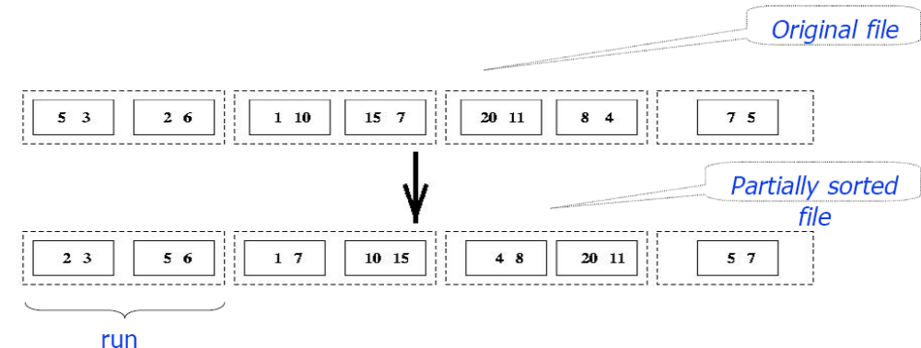
External Sort
M= number of main memory pages
N= number of pages in file to be sorted
  Sort M pages at a time; create N/M sorted runs on mass store; cost =2N
M=2; N=7

Slide 47
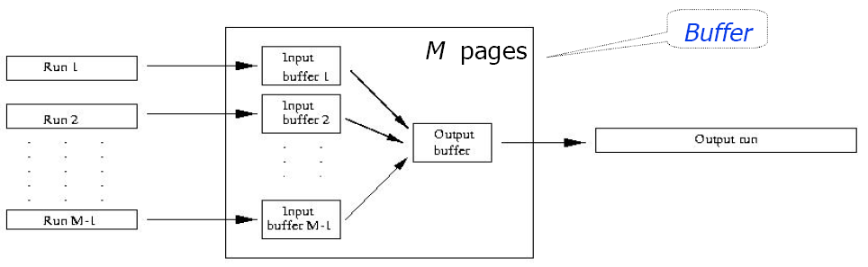
External Sort
Merge all runs into a single run using M -1 buffers for input and 1 output buffer
  Divide runs into groups of size M-1 and merge each group into a run
  Cost = 2N
  Each step reduces number of runs by factor of M-1

Slide 48
External Sort
(N/M)/(M-1)^{k} runs after k merge steps
⎡log_{M-1}(N/M)⎤, merge steps
Cost = ⎡2N log_{M-1}(N/M)⎤ ≈ 2N (log_{M-1}N – 1)
Total cost = 2N(log_{M-1}N -1) +2N = 2N log_{M-1}N

Slide 49
DAA
Design and analysis of computer algorithm for solving computational problems.
Computational problems:
  Sorting
  Order statistics
  Matrix multiplication
  Primality testing
  Hamiltonian cycle
  Traveling salesman problem

Slide 50
Computational problem
Any problem P can be specify by a relation R_{P} ⊂ I_{P} × S_{P} , I_{P} is a set of possible instances and S_{P} is a set of possible solutions.
Primality testing
  I_{P} = N, set of natural numbers
  S_{P} ={0,1}
  R_{P} (n) = 1 if prime
  = 0 otherwise

Slide 52
Tournament sort (Tree selection sort)
Consider a (left) complete binary tree with height k
  Nodes upto level (k-1) forms a full binary tree
  All leaf nodes, if any, at level k-1 are to the right of all internal nodes
  All internal nodes at level k-1 have 2 children, except possible the rightmost one may have one child and then it is left child.

Slide 53
Tournament sort
The parent child relationship i ←→2i,… holds.
A tree-tournament T on n elements from a linearly order set, simple called an n-tournament with n leaves such that
  To each leaf node an element is associated, two different leaves get two different element
  To each internal node an element is associated which is the larger of the two children

Slide 54
Tournament sort
Trunk of a tournament
  The path from root the leaf node which is associated with the same value.
8
8
8
5
8
5
4
8
2
4
8
2
5
5
Tournament
Trunk of the Tournament

Slide 55
Tournament sort
Height of the n-tournament ≥ ⎡log n⎤
k-th ordering based on tree selection (or tournament tree)
  Set up T: Set up a (left) complete tournament T on X=(x₁, x₂, x₃,…, x_{n})
  Adjust T: Successively remove the element at root of T followed by adjustment of T by recomputing element along the trunk of T (i.e., bring the next larger element at the root)

Slide 56
(left) complete binary tree
An array T[1,…,2n-1]
Assign x₁, x₂, x₃,…, x_{n} to T[n], …, T[2n-1]
Complete the tree
  For i = n-1 to 1 by -1
  T[i] = max{T[2i],T[2i+1]}
Complexity is n

Slide 57
Adjust T
α =FindTrunk(T) // α is the leaf node on the
// the trunk of the tree
if root is the only node T ← empty
else β is the brother of α
β =merge (β, parent of α) into a single node
remove α
α = β
repeat the else step until root value is updated

Slide 58
Adjust T
At the first step β is merged with parent
In other steps value of α and β are compared and updated accordingly.
Number of comparisons
  = length of trunk -1
  = 0, if length is 0.
8
5
β
8
α
β
4
5
β
4
α
4
8
8
2
5

Slide 59
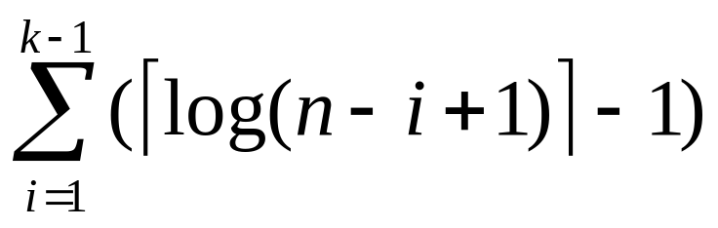
Kth ordering
Tree-select(T,k)
{
Setup the n-tournament tree
For m ← 1 to k-1 do
  Adjust T
Select the root element
}
Number of comparisons done in the loop is
≤
We consider worst case, maximum possible length for k-1 times

Slide 60
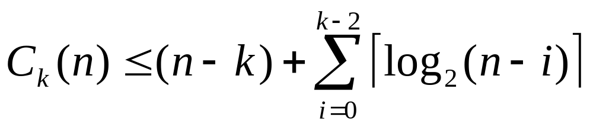
Analysis of tournament sort
C_{k}(n), number of comparison of elements done by tree selection method for kth ordering of n elements. Then
For sorting,
Detail

Slide 61
Notes
Tournament sort is not an inplace sorting method
  The space requirement 2n-1 for n data
The inplace version of this sorting method is the heap sort.
In heap sort, we have a (left) complete tree with nodes n
  Each node with a given data.

Slide 62
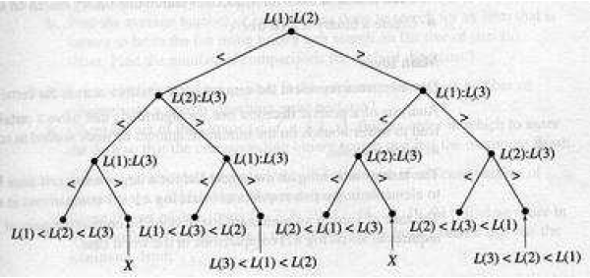
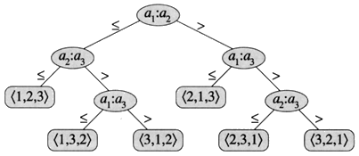
A binary tree of depth d has at most m ≤ 2^{d+1} -1 nodes
A binary tree with m nodes has depth d ≥ ⎣log ₂ m⎦
Number of leaf nodes n!

Slide 63

A binary tree with m nodes has depth d ≥ ⎣log ₂ m⎦
Number of comparisons in the sorting process is bounded by the height of the binary tree, which is ≥ log n!
So, minimum comparisons required is bounded by O(n log n)

