Slide 1
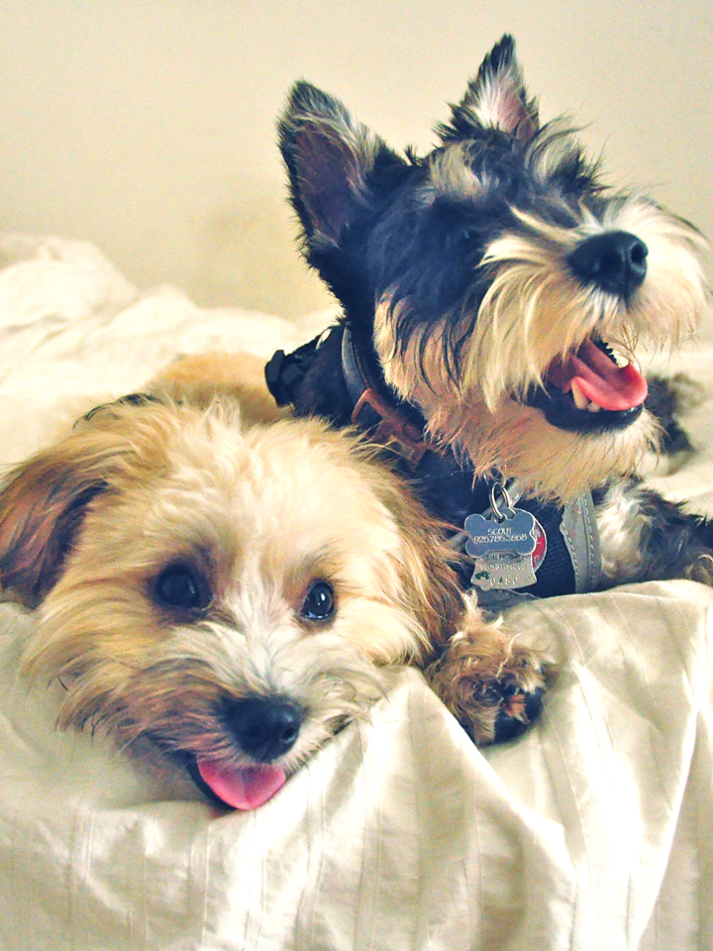
Cow
Created with a trial version of Syncfusion Essential Presentation

