Slide 1
ABC Phones
Credit Portfolio:
From Raw Snapshots to Reliable Insights
133%
44.8%
+5pp
Loan-book growth across 2025 (8.8K → 20.5K loans)
but credit quality deteriorating
Latest delinquency rate — collection rate fell
10pp from Q1 to Q4 (69 → 60%)
Default-rate gap for loans without complete
customer profiles vs the rest of the book
Annex DE Case Study - Dismas Mike · Slide 1 of 10

Slide 2
What we found in the data
Three sources, real-world inconsistencies, ~50% customer-side coverage gap
71,448
20,742
3,985
~50%
credit rows across 5 quarterly snapshots
unique loans (1 row per loan per snapshot)
NPS responses, 100% match credit
credit loans w/ no DOB/income/gender
Top quality issues identified
Issue | Detail | Resolution
Filename ↔ data drift | Credit_Data_-_30-03-2025.csv contains DATE = 3/31/2025 | Caught by schema_and_freshness check (CRITICAL)
No CUSTOMER_ID anywhere | Joins are loan-to-loan only via LOAN_ID / Loan Id | Documented gap; multi-loan customers not trackable
Column-name typo | DOB sheet uses 'Loan Id ' (trailing space) | Stripped on ingest
DOB conflicts | 471 loans have multiple DOBs across 3 providers | Resolution rule: TransUnion → SmileID → SpinMobile, then most recent createdAt
Income column ambiguity | 4 income fields likely overlap — naive sum double-counts | Use 'Received' as canonical total; documented
Excel padding | All customer sheets padded to 1,048,575 rows (Excel cap) | dropna(how='all') on ingest
Inconsistent enum casing | BALANCE_DUE_STATUS: 'Arrears' vs 'up to date' vs 'advance' | Lowercased on ingest
Annex DE Case Study · ABC Phones Credit Portfolio – Dismas Mike

Slide 3
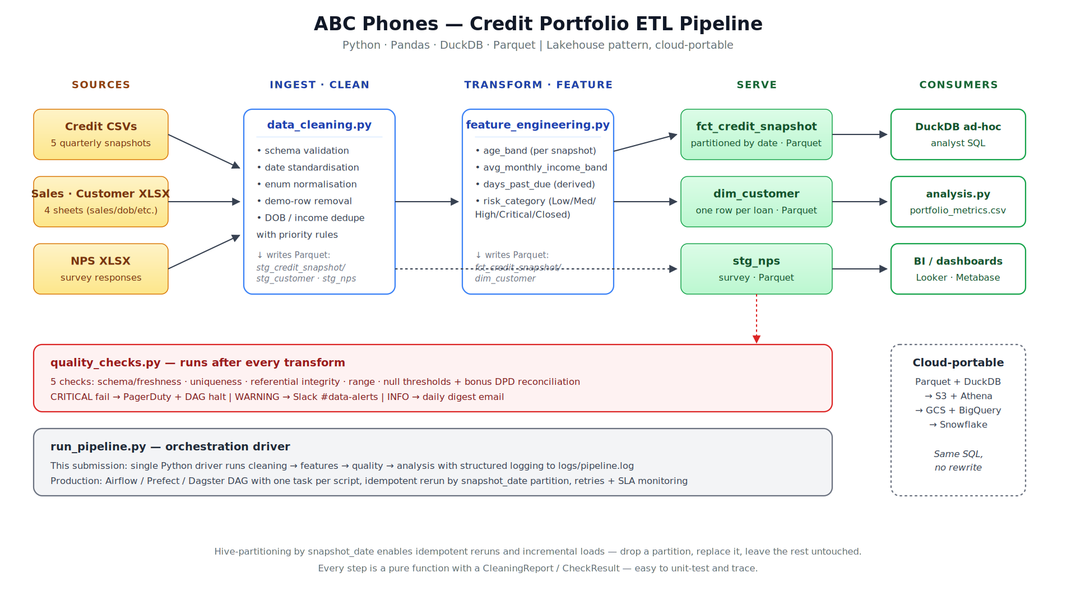
ETL architecture
Lakehouse pattern on a laptop today, lifts to S3+Athena / GCS+BigQuery / Snowflake
Annex DE Case Study · ABC Phones Credit Portfolio – Dismas Mike

Slide 4
Key engineering decisions
Each call is small but compounds into a robust pipeline
Hive partitioning by snapshot_date
DuckDB over Pandas-only
Each snapshot is its own Parquet partition. Reruns drop & replace one folder; the rest stays untouched. Idempotent without locking.
Cleaning stays in Pandas (row-wise logic). Analytics moves to SQL via DuckDB on the Parquet files. Same SQL ports to BigQuery/Snowflake.
Pure-function stages
Source values preserved alongside derived
Every clean_* and check_* function returns (df, report). No globals, no in-place mutation. Trivially unit-testable.
We keep both days_past_due (source) and days_past_due_derived (ours). The reconciliation gap itself is a quality check — not a bug to hide.
Schema contract on ingest
Late-arriving / reprocessing strategy
Expected columns are codified in EXPECTED_CREDIT_COLS. Missing or extra cols halt the pipeline before bad data reaches analysts.
Replay any snapshot independently — `python run_pipeline.py --only cleaning` rebuilds one partition. Nothing else recomputes.
Annex DE Case Study · ABC Phones Credit Portfolio

Slide 5
Data quality framework
Five checks + one bonus, each with severity, cadence, and a real alerting route
Check | Severity | Cadence | Alert route
1. Schema & freshness — files arrive, columns match contract, internal DATE = filename | CRITICAL | real-time | PagerDuty + halt DAG
2. Uniqueness of (loan_id, snapshot_date) | CRITICAL | daily | PagerDuty + halt DAG
3. Referential integrity — every credit/NPS loan_id exists in dim_customer | WARNING | daily | Slack #data-alerts
4. Range checks — age 18-100, income > 0, NPS 0-10, DPD ≥ 0 | WARNING | daily | Slack #data-alerts
5. Null thresholds — critical fields < 1%, soft fields < 60% | WARNING | daily | Slack #data-alerts
+ DPD reconciliation — derived vs source within 7-day tolerance | INFO | weekly | Daily digest email
REAL EXAMPLE FROM THE DATA
Filename ↔ internal date mismatch
Credit_Data_-_30-03-2025.csv contains an internal DATE column with value 3/31/2025 — silent date drift that would land in PAR-30 quarter-end metrics.
→ Caught automatically by check #1 with severity=CRITICAL on first run. Alert routed to PagerDuty; DAG halted before downstream tasks ran.
Annex DE Case Study · ABC Phones Credit Portfolio

Slide 6
Feature engineering
Four derived fields per the brief; risk_category is where the judgement shows
Four required features
risk_category logic
age_band
Standard PAR-bucket framework adapted to ABC Phones' status taxonomy
from DOB at each reporting date — 18-25, 26-35, 36-45, 46-55, 55+, plus explicit 'Unknown' bucket so coverage stays visible
CRITICAL
Write Off / Lost Write Off OR DPD ≥ 90
avg_monthly_income_band
received_total ÷ duration_months → 8 bands per brief. 'Received' used as canonical total to avoid sub-channel double-counting
HIGH
DPD 31-89 OR L2 ∈ {PAR 30, FMD}
days_past_due
MEDIUM
DPD 1-30 OR L2 ∈ {PAR 7, FPD, Inactive}
(reporting_date − next_invoice_date), clamped to 0 when no arrears. Source value retained for reconciliation
risk_category
LOW
DPD = 0 AND L2 = Active
the credit-risk judgement call → see right
CLOSED
L2 = Paid Off (out of active book)
RETURNED
L2 = Return (out of active book)
Mirrors IFRS-9 staging logic and standard microfinance PAR-bucketing.
Annex DE Case Study · ABC Phones Credit Portfolio – Dismas Mike

Slide 7
Portfolio health: book grew fast, quality slipped
Five quarterly snapshots, 2025-01-01 through 2025-12-30
59.5%
Active-loan collection rate (latest) — down from 69.4% Q1
Take-aways
Book size more than doubled in 2025 (133% growth in active loans).
Delinquency, PAR 90, and write-off rates all climbed in parallel — not a one-off.
Collection rate fell 10 percentage points — the leading indicator.
Pattern is consistent with rapid origination outpacing underwriting controls.
Annex DE Case Study · ABC Phones Credit Portfolio -Dismas Mike

Slide 8
Where the risk really lives
Loans without complete customer profiles default ~5pp more than the rest of the book
THE FINDING
Loans with no DOB on file (46% of latest book) default at 49.6% — almost 5pp above portfolio average.
Loans WITH complete profiles (older borrowers, higher income) consistently perform 8-12pp better.
This isn't only a data gap — it's a credit-decisioning gap. The pipeline approves loans without complete profiles, and those loans default more.
Annex DE Case Study · ABC Phones Credit Portfolio – Dismas Mike

Slide 9
Credit × NPS — and one fix that helps both
Each NPS response joined to the customer's most recent credit snapshot
RECOMMENDATION
Fix the lock-after-payment issue
12-17% of NPS respondents across every risk segment report 'phone locked despite paying on time'
This drives both outcomes the business cares about: customer dissatisfaction (Critical-risk NPS = -23.7) AND avoidable arrears flags when the locking system runs ahead of payment reflection.
Fix: a 24-hour grace window before remote-locking, plus a reconciliation job that lifts locks within 1 hour of payment confirmation.
→ improves NPS and reduces 'fake' delinquency simultaneously — a rare win-win in collections design.
Annex DE Case Study · ABC Phones Credit Portfolio –Dismas Mike.

Slide 10
Where this goes next
Three data improvements ABC Phones should make + the production-roadmap delta
DATA IMPROVEMENTS
PRODUCTION ROADMAP DELTA
1
Introduce a stable customer_id
Orchestration
run_pipeline.py → Airflow / Prefect / Dagster DAG; one task per stage; SLAs
Hash of national ID or phone, propagated from KYC into credit and NPS. Unlocks lifetime-value, repeat-borrower risk, and household-level analysis.
Storage
Local Parquet → S3 / GCS, same Hive partitioning
Compute
DuckDB → Athena or BigQuery — same SQL, no rewrite
2
Standardise on ISO-8601 + a YAML schema spec
Transforms
Python + SQL → dbt (lineage, docs, tests for free)
Versioned alongside the data; documents the unit of every numeric column (Duration in months, balance in KES, etc.). Eliminates ambiguity discussed in Slide 2.
Quality
Custom Python checks → Great Expectations / dbt tests / Soda
3
Replace daily snapshots with an event stream
Alerting
Mocked log routes → PagerDuty + Slack SDKs, on-call rota
Emit payment_made, status_changed, arrears_updated events; derive snapshots downstream. Removes the filename-vs-internal-date drift class of bugs entirely.
Lineage
Add → OpenLineage events from each task
Thank you · Dismas Mike— Data Engineer Case Study

