Slide 1


Slide 2
<HTML>
HyperText Markup Language

Slide 3
HTML describes the
structure of pages
<html>
<body>
<h1>This is the Main Heading</h1>
<p>This text might be an introduction to the rest of the page. And if the page is a
long one it might be split up into several sub-headings.</p>
<h2>This is a Sub-Heading</h2>
<p>Many long articles have sub-headings so to help you follow the structure of what
is being written. There may even be sub-sub-headings (or lower-level headings).
</p>
<h2>Another Sub-Heading</h2>
<p>Here you can see another sub-heading.</p>
</body>
</html>

Slide 4
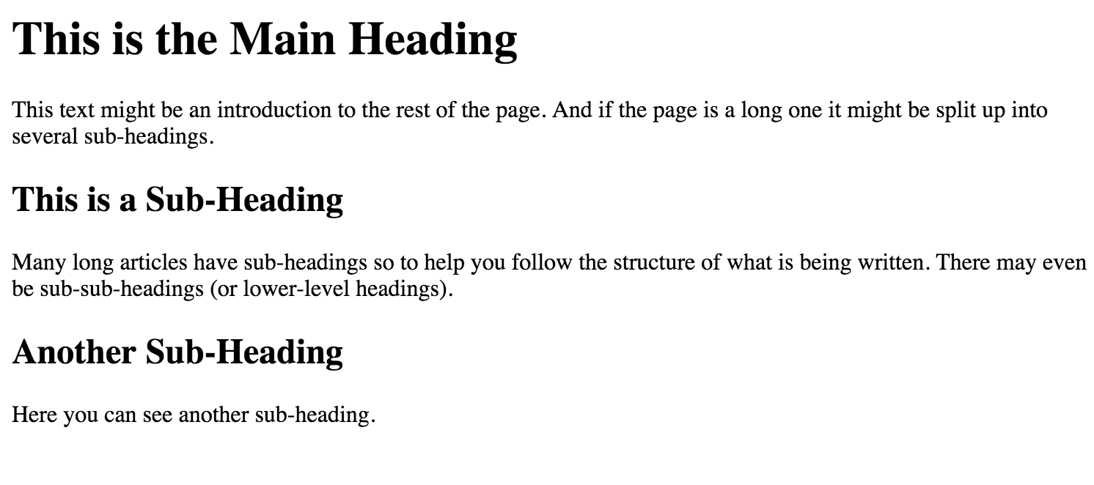

Slide 5
The HTML code is made up of characters that live inside angled brackets called HTML elements.
Elements are usually made up of two tags: an opening and closing tag. (*NOTE* The closing tag has a forward slash in it.)
Tags act like containers. They tell the browser something about the information that lies between their opening and closing tags.
Notes:
Terms element and tag are often used interchangeably. However, strictly speaking, an element comprises the opening tag AND closing tag AND any content that lies between them.

Slide 6
A closer look at tags
<p>
opening tag
</p>
Closing tag

Slide 7
<html></html> indicates that anything between the tags is HTML code. All HTML code must start with this tag.
<body></body> indicates that anything between the tags should be shown inside the main browser window.
<p></p> represents paragraph text
Other tags: <head></head>, <title></title>
Notes:
<head> comes before body. This contains information about the page rather than info shown within the browser. <title> is found there.
<title> appears at the top of the browser page and within the tab.
For paragraphs, must state a new tag for each new paragraph. Can’t just press enter and assume that the format will stick.

Slide 8
Headings
HTML has six levels of headings
<h1></h1> is used for main headings
<h2></h2> is used for subheadings and so on…
Notes:
Browsers display the contents of headings at different sizes. h1 is the largest and h6 is the smallest.
There are default text sizes specific to each browser but CSS can be used to change these sizes.

Slide 9
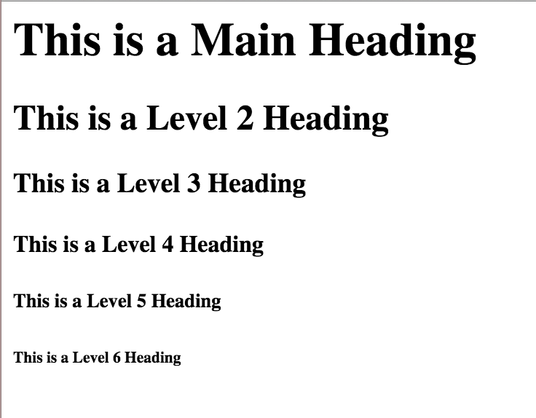
<html>
<head>
<title>Headings</title>
</head>
<body>
<h1>This is a Main Heading</h1>
<h2>This is a Level 2 Heading</h2>
<h3>This is a Level 3 Heading</h3>
<h4>This is a Level 4 Heading</h4>
<h5>This is a Level 5 Heading</h5>
<h6>This is a Level 6 Heading</h6>
</body>
</html>

Slide 10
Lists
<ol></ol> - ordered list
<ul></ul> - unordered list
<li></li> - list
Other tags: <dl></dl>, <dd></dd>, <dt></dt>
Notes:
Ordered lists are numbered.
Unordered lists use bullet points.
Each item in the list is placed between <li> tags.
<dl> is definition list, <dt> definition term, <dd> definition
Lists can be nested by places a list element within a list element.

Slide 11
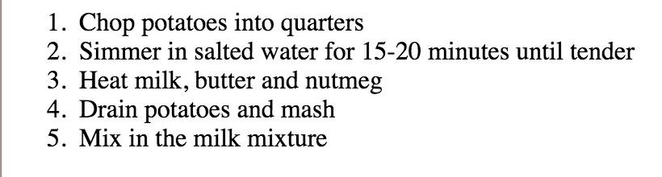
<html>
<head>
<title>Ordered Lists</title>
</head>
<body>
<ol>
<li>Chop potatoes into quarters</li>
<li>Simmer in salted water for 15-20 minutes until tender</li>
<li>Heat milk, butter and nutmeg</li>
<li>Drain potatoes and mash</li>
<li>Mix in the milk mixture</li>
</ol>
</body>
</html>

Slide 12
Links
Links are created using the <a></a> tag. Users can click on anything between the tags.
You can specify what page to link to using the href attribute.
<a href = “http://www.imdb.com”>IMDB</a>
Notes:
The link text (text between the tags) should be descriptive but concise. Not just “click here.” Good link text would be words that are searched for. Example, “places to stay” can be replaced with “hotels in New York City.”
href - an attribute name whose value is the web address. It can also be linked with a specific part of the same page by using an ID selector (which will be discussed in part CSS).

Slide 13
Attributes
Attributes provide additional information about the contents of the element.
They appear in the opening tag of the element and are made up of two parts: a name and a value, separated by an equals sign.
<p lang = “en-us”>Paragraph in English</p>
<p lang = “fr”>Paragraphe en Francais</p>
Notes:
Name indicates what kind of extra info is being supplied about the element’s content.
Value is the info.
The majority of attributes can only be used on certain elements, although a few, such as lang, can appear on any element.

Slide 14
Images
<img /> is used to add an image
*NOTE* This is an empty element - meaning there are no opening/closing tags.
An empty element usually has only one tag.
Notes:
Great images help make the difference between a basic site and a really engaging one.

Slide 15
<html>
<head>
<title>Images</title>
</head>
<body>
<h1><img src="images/logo.gif" alt="From A to Zucchini" /></h1>
<figure>
<img src="images/chocolate-islands.jpg" alt="Chocolate Islands" title="Individual Chocolate Cakes" />
<p>
<figcaption>
This recipe for individual chocolate cakes is so simple and so delectable!
</figcaption>
</p>
</figure>
</body>
</html>
Notes:
src tells the browser where it can find the image file
alt provides a test description of the image if it cannot be seen (Useful for the blind who use readers)
title provides additional info about the image. Can see this when the mouse hovers over the image.

Slide 16
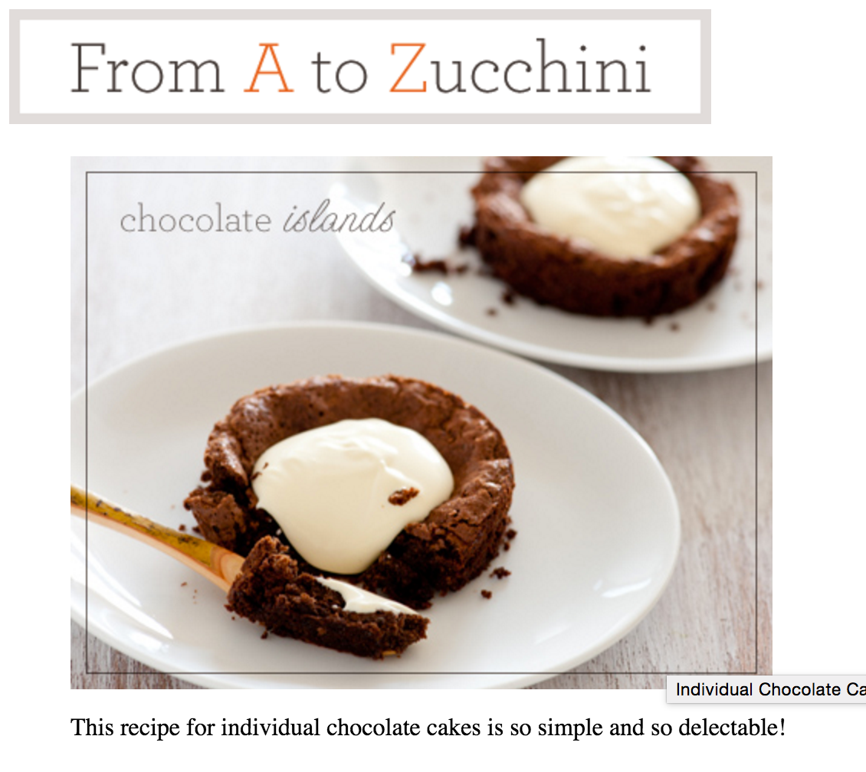

Slide 17
CSS:
Cascading style sheet

Slide 18
CSS allows creation of rules that style each HTML element.
A rule contains two parts: a selector and a declaration.
The declaration is also made up of two parts: a property and a value, separated by a colon.
h1, h2, h3 {
font-family: Arial;
color: yellow; }
Above, headings 1,2,3 are chosen to style.
Notes:
CSS controls design. Specifies how the element should appear.
Imagine there is an invisible box around every HTML element.

Slide 19
Selectors indicate which element the rule applies to. The same rule can apply to more than one element if element names are separated with commas (as seen in the previous slide).
Declarations indicate how the elements referred to in the selector should be styled.
Properties indicate the aspects of the element to be changed.
Values specify the settings for the chosen properties.

Slide 20
Linking CSs to html
<link /> can be used in an HTML document to tell the browser where to find the external CSS file used to style the page. *NOTE* This is an empty element.
<style></style> this internally places CSS code within the HTML code.
These tags live inside <head></head>
Notes:
Why use external style sheets?
All web pages can share the same stylesheet. Therefore, only one sheet needs to be edited for all web pages to display the change.
Keeps HTML code smaller
Once the CSS stylesheet is downloaded, the rest of the pages load more quickly.
Good practice.

Slide 21
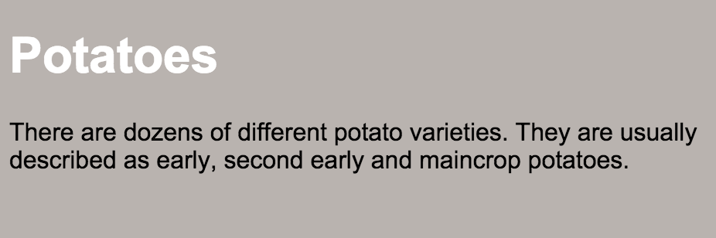
<!DOCTYPE html>
<html>
<head>
<title>Using External CSS</title>
<link href="css/styles.css" type="text/css" rel="stylesheet" />
</head>
<body>
<h1>Potatoes</h1>
<p>There are dozens of different potato varieties. They are usually described as early, second early and main crop potatoes.</p>
</body>
</html>

Slide 22
…
<head>
<title>Using Internal CSS</title>
<style type="text/css">
body {
font-family: arial;
background-color: rgb(185,179,175);}
h1 {
color: rgb(255,255,255);}
</style>
</head>
….

Slide 23
selectors
There are several ways to select what element should be edited.
Type selector matches elements names.
p {} or h1, h2, h3 {}
Targets paragraph or headings 1,2,3 elements.
ID selector matches an element whose id attribute has a value that matches the one specified after the hash symbol.
#introduction {}
Targets the elements whose id = “introduction”

Slide 24
selectors
Child selector matches an element that is a direct child of another.
li>a {}
Targets any <a> elements that are children of list elements.
Class selector matches an element whose class attribute has a value that matches the one specified after the period.
.note {} or p.note {}
Targets elements whose class = note or their paragraph elements.
Universal selector applies to all elements in the document.
* {}
Targets all elements.

Slide 25
color
The color property is used to change the color of text. There are 3 ways to indicate choice of colors.
RGB values expresses how much red, green and blue are used to make up the color
color: rgb(100, 100, 90);
Hex codes are 6 digits codes that represent the color.
color: #ee3e80;
Color names, there are 147 predefined color names.
color: DarkCyan;

Slide 26
Other Color properties
background-color changes the background color of a box.
opacity
hsl represents hue, saturation, lightness
Notes:
Saturation is the amount of gray in a color.
Lightness is the amount of white or black in a color.

Slide 27
Text
font-family specifies the typeface of text
font-size can be described in pixels (px), percentage (%) or EMS (em). For most properties, pixels are used.
font-weight creates bold text.
font-style creates italic or oblique text.
text-transform is used to change the case of text to uppercase, lowercase, or capitalize.
Notes:
Pixels - very precise control over how much space the text takes up.
Percentage - Default text in browsers is 16px so 200% would be 32px. If a rule is given a default of 75% then the font is 12px then another rule is applied within that same box of 200%, now it’s 24px.
EMS - is equivalent to the width of a letter m

Slide 28
Text
text-decoration property values include underline, overline, line-through and blink.
line-height is the vertical spacing between words.
letter-spacing, word-spacing control gap between letters or words.
text-align, vertical align control the placement of text. Text-align shifts left/right while vertical align shifts up/down.
Notes:
Increasing line-height makes the vertical gap between lines of text larger, which can increase readability.

Slide 29
text:Pseudo-elements
Pseudo-elements are specified at the end of a selector.
For links, we may want to display it a certain way before and after it has been visited, when the mouse hovers over it, or when it is clicked.
Notes:
:active gives a feel as if actually pressing on something.

Slide 30
a:link {
color: deeppink;
text-decoration: none;}
a:visited {
color: black;}
a:hover {
color: deeppink;
text-decoration: underline;}
a:active {
color: darkcyan;}

Slide 31
Boxes
Control box sizes of elements.
width, height
overflow tells the browser what to do if the content contained in the box is larger than the box itself.
Every box has a border (may be set to hidden or 0px).
Margins sit outside the edge of the border
Padding is the space between the border and the content.
Notes:
percentages of width/height are relative to the size of the containing box
overflow: hidden or scroll. Hidden hides the content that overflows while scroll places a scroll bar in the box.

Slide 32
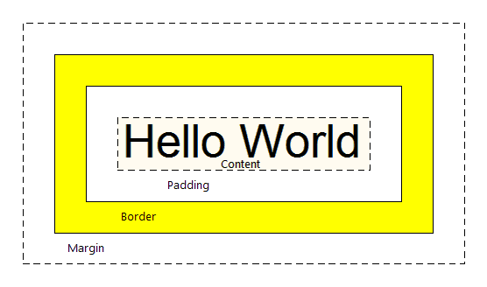

Slide 33
Boxes
Margins and padding are very important to increasing readability and design. It places white space between separate boxes and content within boxes.
border-width, border-style, border-color
padding or padding-top, padding-right, padding-bottom, padding-left
margin or margin-top, margin-right, margin-bottom, margin-right
Notes:
Borders, padding and margin are added to a specified width/height.
Boxes can be centered by setting left and right margins to auto.
display inline, block, inline-block, none and visibility hidden, visible.

Slide 34
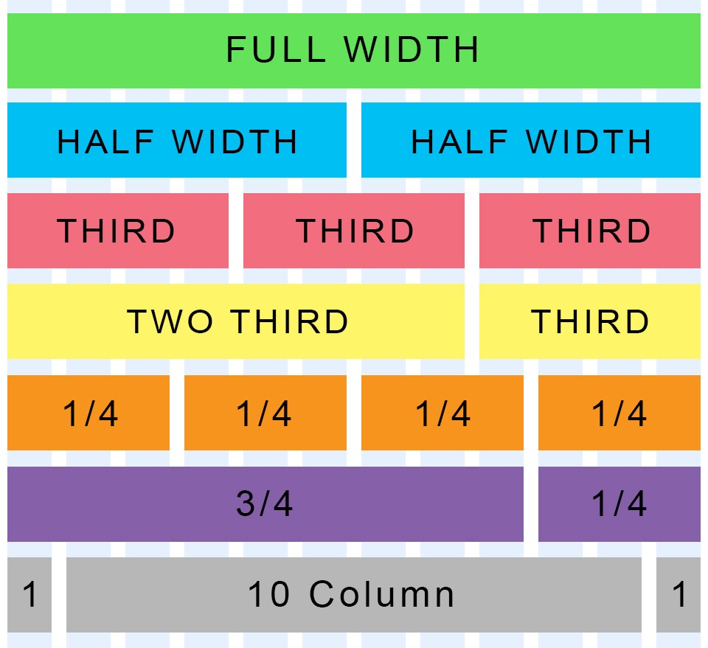
layout
Control the position of boxes/elements.
The 960 pixel grid is
widely used by web
designers to structure
their pages
proportionally.
Notes:
12 equally sized columns, 60 pixels each. With 10 pixels margin between each column.

Slide 35
layout positioning schemes
Normal flow means every block-level element appears on a new line.
Relative positioning moves the element from the position it would be in normal flow. Shifts it left, right, up or down.
Absolute positioning positions the element in relation to its containing element. It is taken out of normal flow.
Fixed positioning is a form of absolute positioning. Positions in relation to the browser window.

Slide 36
layout
position: static, relative, absolute, or fixed
z-index helps with the overlapping of elements by controlling which element sits on top. An element with z-index:10 will sit on top of z-index: 5.
float is a very useful feature for designing layout. Positions the element to the left or right of the page and everything else will flow around it. Float can be used to create columns.
Notes:
Lastly, when designing pages, we must consider the screen size we want to display to. Desktop screens are large while mobile devices are small. Resolution also affects how the page actually looks.

