Slide 1


Slide 2
javascript

Slide 3
HTML/CSS Refresher
<p class = “fruit”>peach</p>
.fruit { color: pink; }
Notes:
Elements are usually made up of two tags: an opening and closing tag, which act like containers.
Attributes provide additional information about the contents of the element. They appear in the opening tag and are made up of two parts: a name and a value. Name indicates what kind of extra info is being supplied. Value is the info.
HTML & CSS properties use name/value pairs.
Selectors indicate which element the rule applies to.
Declarations made up of two parts: Properties indicate the aspects of the element to be changed. Values specify the settings for the chosen properties.

Slide 4
how to write a script
A script is a series of instructions that a computer can follow step-by-step.
Define the goal.
Tasks of a hotel cleaner.
Goal: rooms are cleaned
Design the script.
Check each room
Does the room need tidying?
YES: Execute steps.
NO: Go to next room.
Code each step.
Remove used bedding.
Wipe all surfaces
Vacuum
….etc.
Notes:
Define the task you want to achieve.
Split the goal out into a series of tasks. Create a flowchart.
Write each step in a programming language that the computer understands.

Slide 5
Objects, events, methods
Objects can have its own properties, events and methods.
Properties describe characteristics of the object.
An event is a computer’s way of saying, “Hey, the user just interacted with the page by clicking a button!” It’s an alert due to an interaction.
Methods are used to retrieve information or update the values of properties in an object. Performs tasks.
Notes:
Computers create models of the world using data.
Object is like a container of info.
Programmers choose which events they respond to. Different parts of the script will run according to which event is chosen.

Slide 6
Object type: Hotel
properties:
name = Blue Lake
rooms = 42
bookings = 21
events:
book - reservation is made
cancel - reservation is canceled
methods:
checkAvailability()
makeBooking()
cancelBooking()

Slide 7
Linking javascript to html
<script></script> is used to link external javascript (js) files OR internally place javascript code within the HTML code.
Javascript runs where it is found in the HTML. Therefore, Javascript is placed in the body.

Slide 8
variables
Variables store data.
Declare and assign a value to a variable.
var quantity = 3;
Assign numeric, string, or boolean data to var.
Notes:
Before a variable can be used, it must be declared.
Strings written with double or single quotes.
Boolean values: true/false. All lowercase.
Naming conventions similar to java. Camel-case.
quantity declared and assigned in one statement. Short cut.

Slide 9
arrays
Arrays are a special type of variable. It stores a list of values.
var colors;
colors = [‘white’, ‘black’, ‘silver’];
Access items in array via index.
var white = colors[0];
Notes:
Unlike java, arrays in javascript can hold multiple vars (string-boolean-numeric mix) since it isn’t a strongly typed language.
Can hold arrays within array.
*side note* Can iterate through an array with for loops. Javascript also supports if conditions. Therefore, arithmetic and comparison operators also supported.

Slide 10
functions
As long as a function is declared, it can be called.
sayHello();
function sayHello() {
document.write(‘Hello!’);
}
Declare a function with the keyword function, followed by the function’s name and a code block (in curly braces).
Notes:
The interpreter runs through a script before executing each statement, so it will know that a function is declared even if the calling is written before the function.
interpreter - reads the javascript and translates it into instructions the browser understands.

Slide 11
functions
var wallWidth = 3;
var wallHeight = 5;
var area = getArea(wallWidth, wallHeight);
function getArea(width, height) {
return width * height;
}
Notes:
This is just one way to declare a function. There are many ways. A lot of tricks you can do.
Scope - there’s local scope which is local to the function, meaning they only exist within the curly braces of the function they are declared in. And there is global scope, meaning they exist throughout the entire script.

Slide 12
object
One way to declare an object:
var hotel = {
name : Blue Lake,
rooms: 120,
booked: 77
};
When an object is passed into a function, it’s typical to see this.property notation. Keyword this refers to the object.

Slide 13
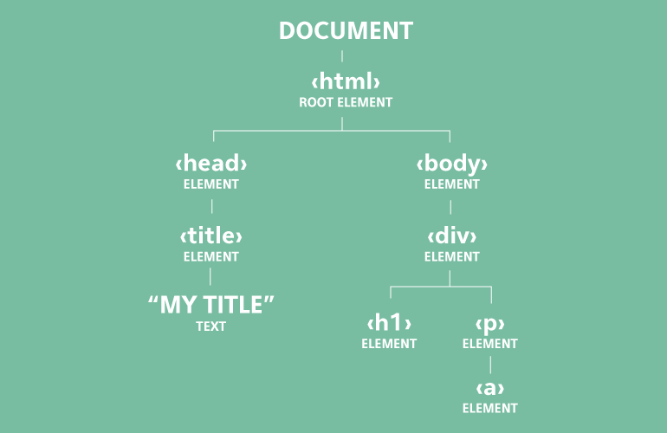
document object model
Notes:
DOM tree
Document node - represents the entire page. Root.
Element nodes - HTML elements
Attribute nodes - HTML element attributes
Text nodes - text within the HTML element

Slide 14
document object model
We can access and update nodes in the DOM tree using built-in methods.
getElementByID(‘id’)
getElementsByClassName(‘class’)
querySelector(‘css selector’)
querySelectorAll(‘css selector’)
var itemOne = getElementById(‘one’);
itemOne.className = ‘cool’;
itemOne.textContent = ‘ice’;
Notes:
getElementById selects an individual element given the value of its id attribute.
getElementsByClassName selects one or more elements given the value of the their class attribute.
querySelector returns only the first of matching elements.
querySelectorAll returns all matching elements.
Many methods available and various ways of picking the same node.
Methods available to remove/add nodes.

Slide 15
events
Attach event listeners to DOM elements. This will trigger a function or script when interaction occurs on the element.
element.addEventListener(‘event’, functionName, event flow);
Various built-in events: click, focus, submit, etc.
event flow - HTML elements nest inside other elements. So when clicking on a link element, you are also clicking on its parent elements. Event flow is typically set to false.
Notes:
Event bubbling: false - starts at the most specific node and flows outwards.
Event capturing: true - starts at the the least specific node and flows inwards.

