Slide 1
Bosonic Error Correction Codes Simulation Methods
A summary of my master’s project
Jean-Baptiste Bertrand
July 6th 2026

Slide 2
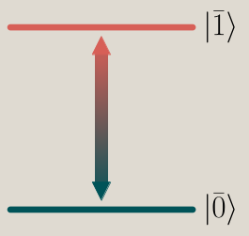
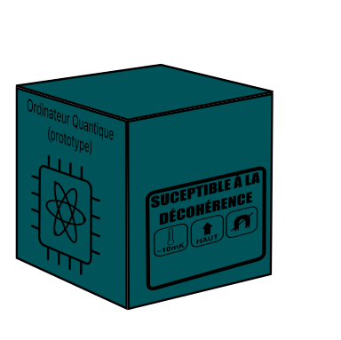
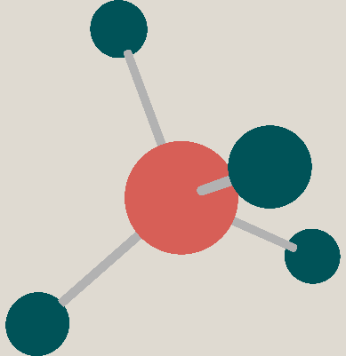
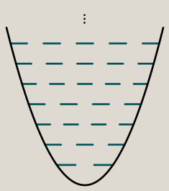

Bosonic Quantum Computers
Quantum system simulations
Encryption
Harmonic oscillator

Slide 3
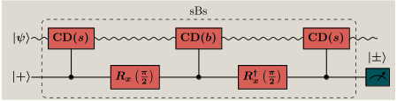

The spefic context
GKP codes
Error correction

Slide 4
Many oscillators systems
Systèmes avec plusieurs cavités

Slide 5
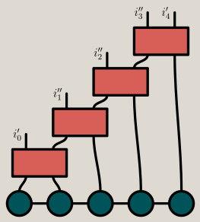

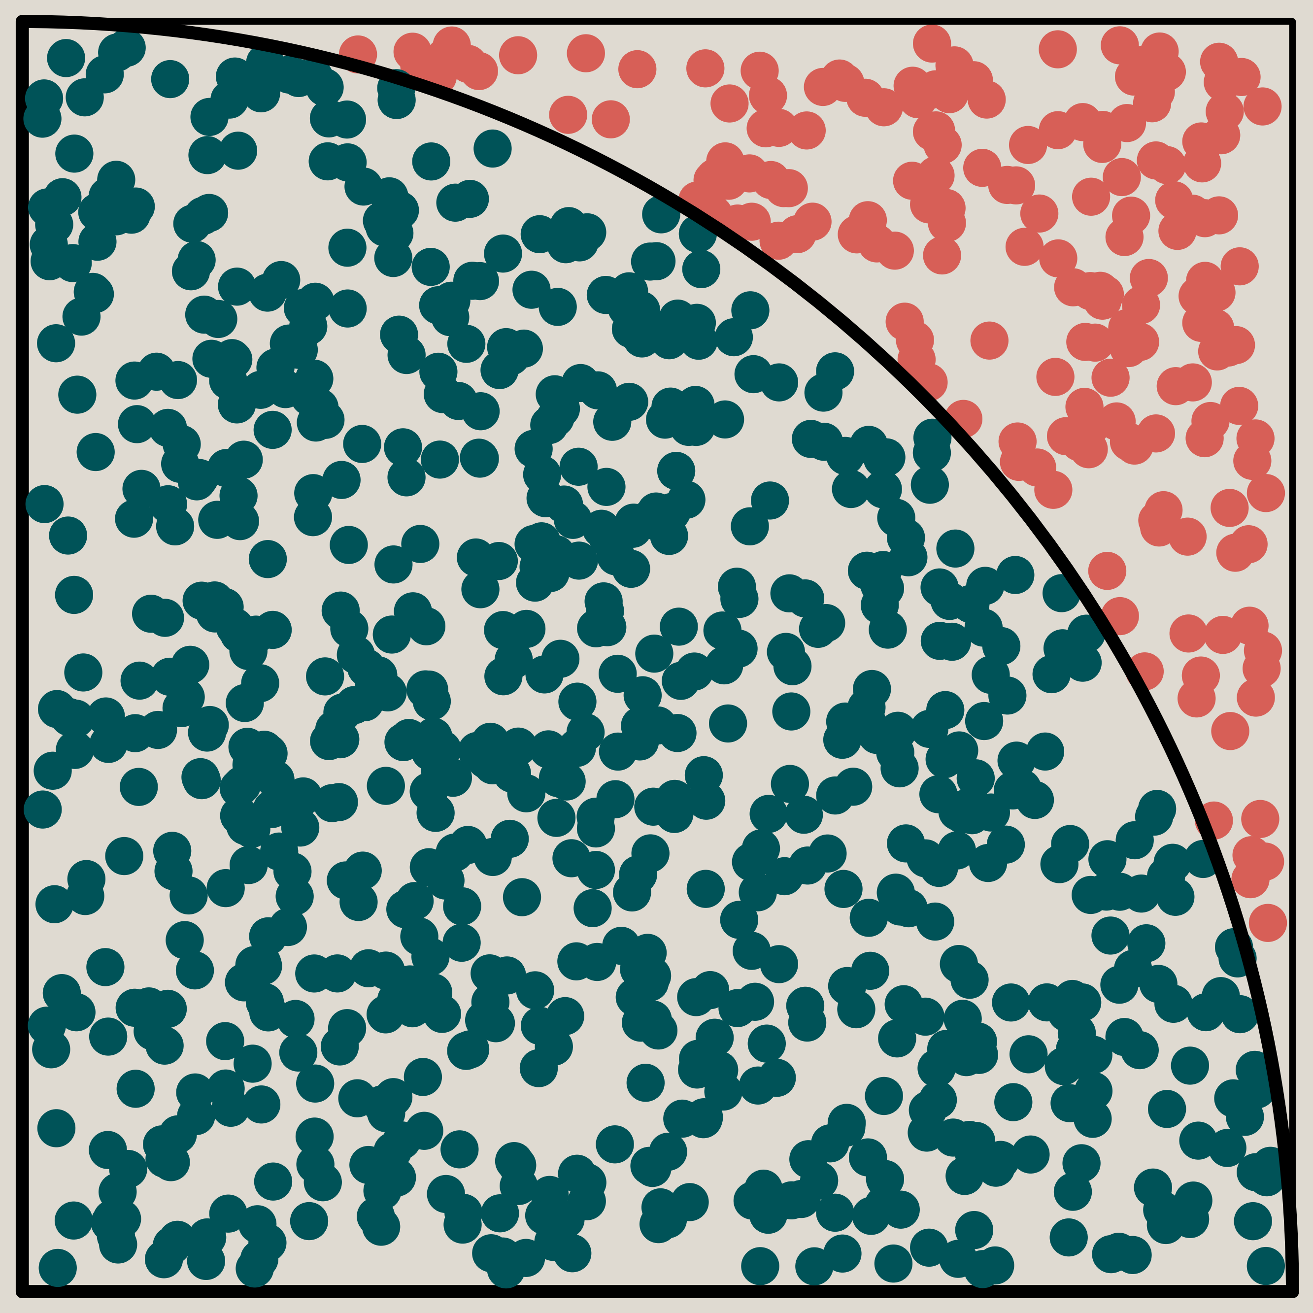
How to do it
Tensor Networks
Monte Carlo
Basis Choice

Slide 6
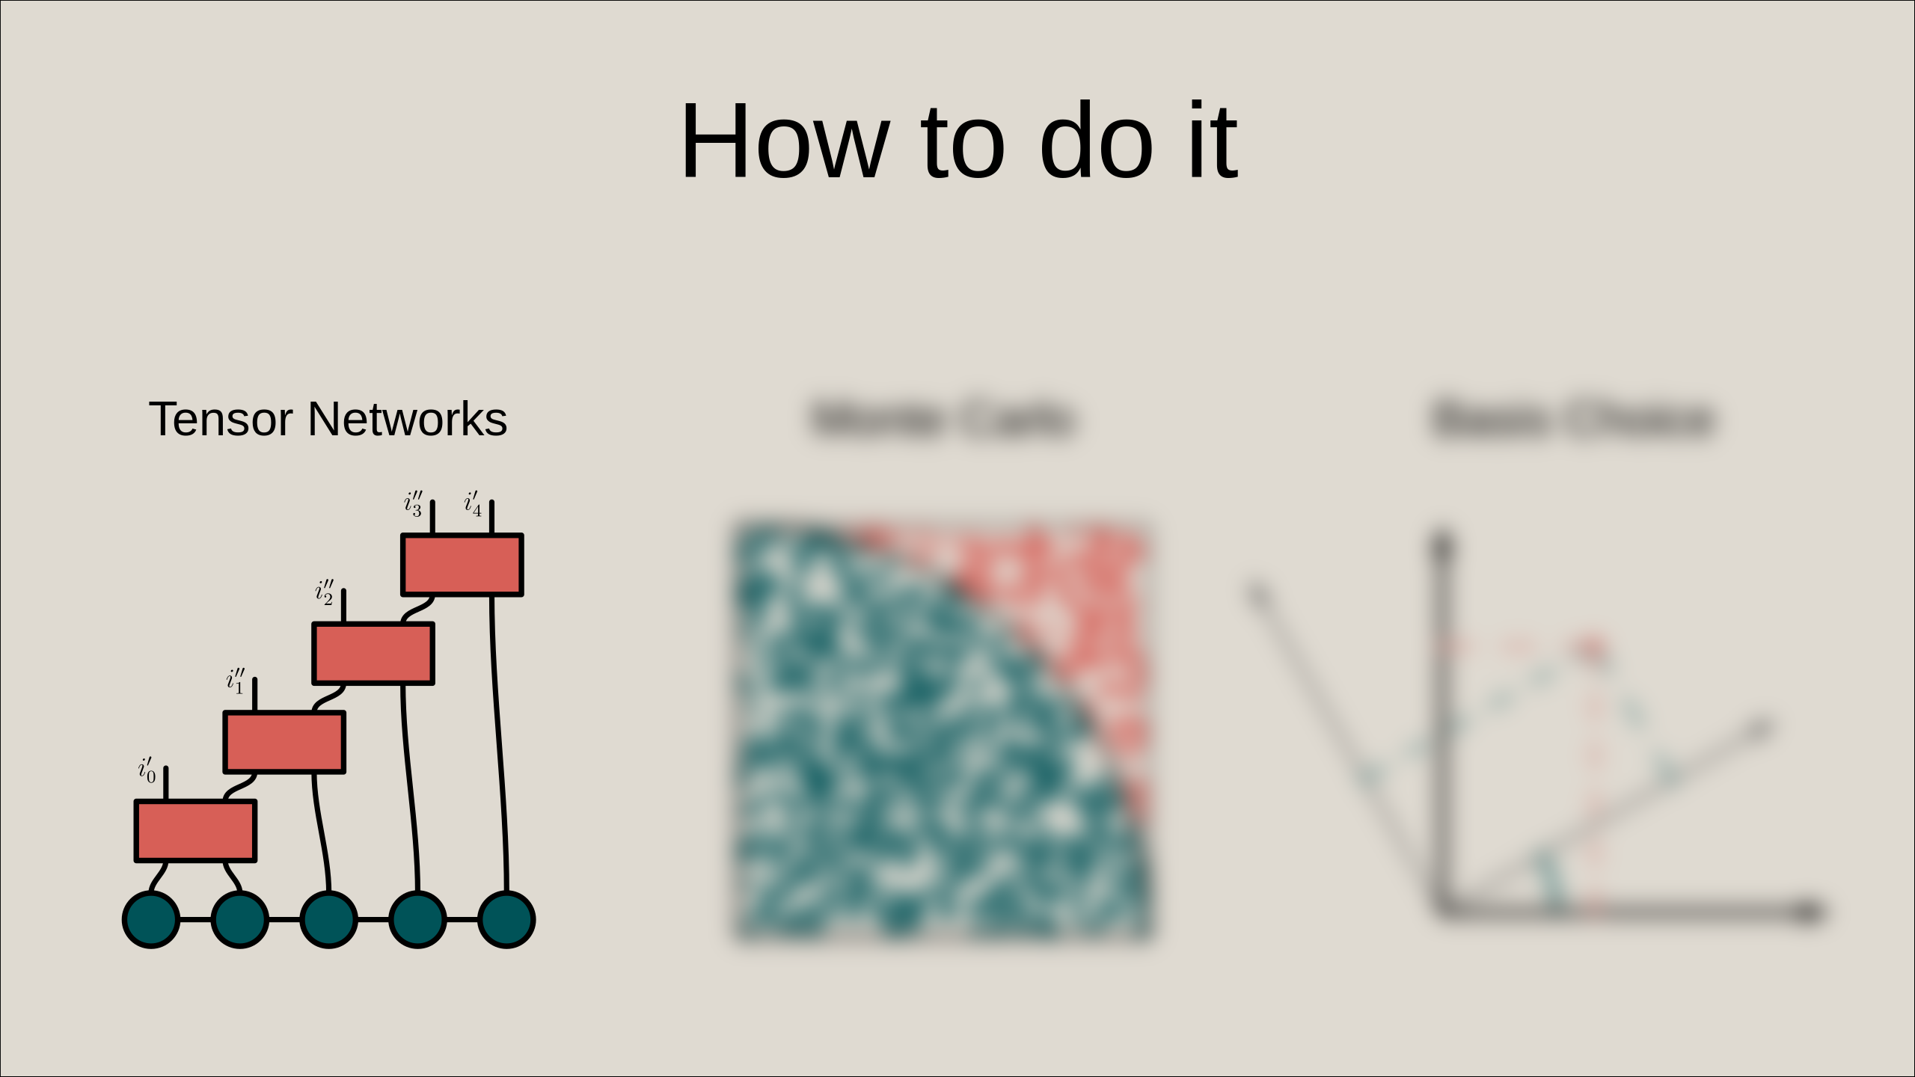

Slide 7
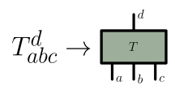


A method of abstraction
(visual and numerical)
[1]Collura M et al. 2024 Tensor Network Techniques for Quantum Computation
[2]Berezutskii A et al. 2025 Tensor networks for quantum computing (arXiv)
[3]Biamonte et al. (2017)

Slide 8



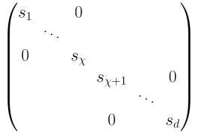

Matrix product state (MPS)
vector
Terms reorganisation
d=d1·d2
d1·χ

Slide 9



Efficient representation
SVD

Slide 10
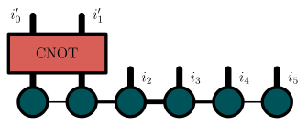

Tensor Networks in the project
Acts on cavities as if they were qubits
and should create about as much entenglement!
Notes:
Tensor networks are good at quantum because you can
Using Tensor networks is common to simulate quatum system but more so for simulating TLS qubits: I am using it to simulate bosonic qubits :)

Slide 12
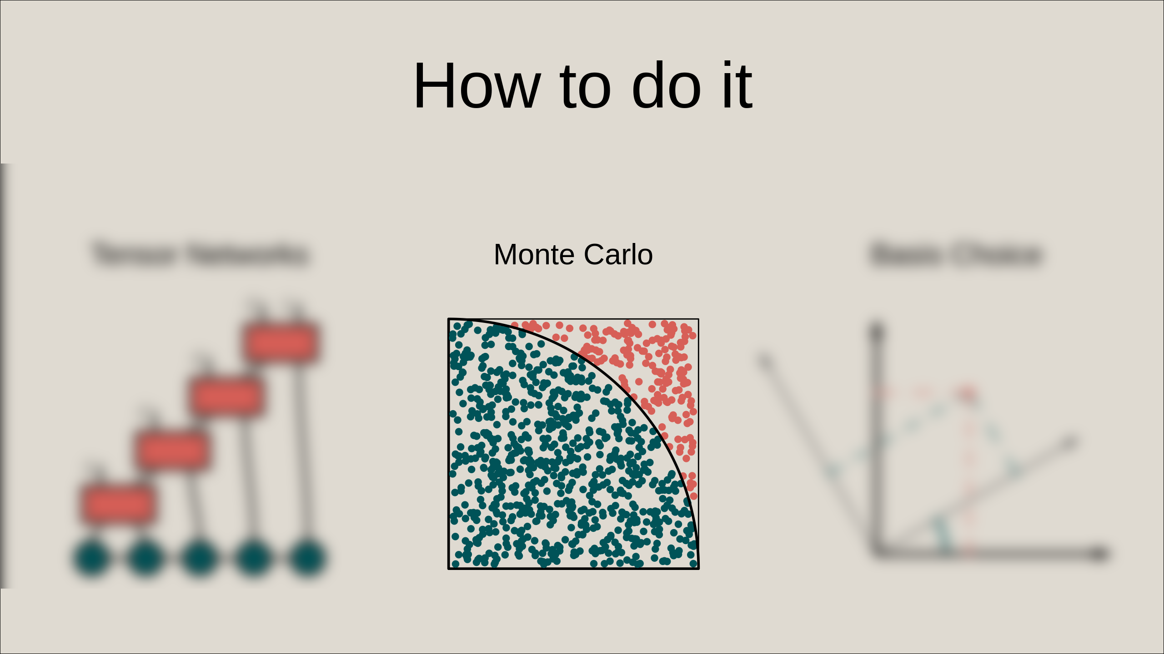

Slide 13
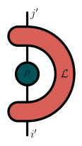


Open quantum system
d⁴
d²
Notes:
In order to minimise even further the number of elements I have to keep track of, I use MC

Slide 14
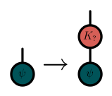
Open quantum system
In the case of photon loss
[4]Milz et al. Open Syst. Inf. Dyn. (2017)
Notes:
In order to minimise even further the number of elements I have to keep track of, I use MC

Slide 15

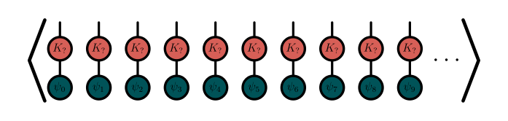

Open quantum system
d⁴
d²
N
For N sufficiently large, the average value of any observable will be the same as if mesured on a density matrix submitted to equivalent noise
Notes:
In order to minimise even further the number of elements I have to keep track of, I use MC

Slide 17


Slide 18
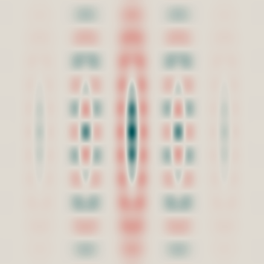

The sBs protocol
Leaves GKP states alone
Corrects error
[6]Royer et al. PRX Quantum (2022)

Slide 19







La base sBs
sBs
sBs
sBs
[7]Hopfmueller et al. (2024)

Slide 20
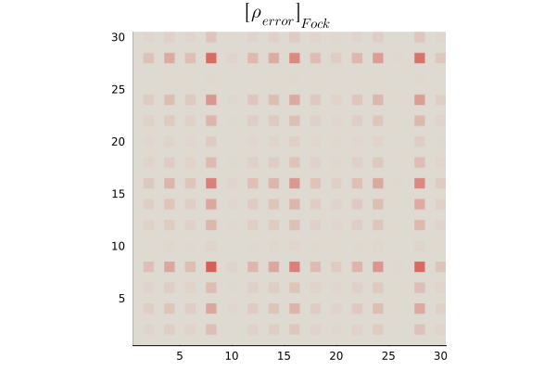
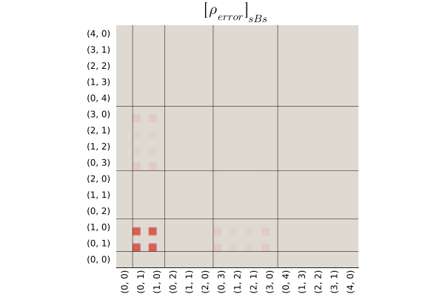
The sBs basis
A lot of element ≈0
Same matrix,
different bases
[7]Hopfmueller et al. (2024)

Slide 22




Slide 23
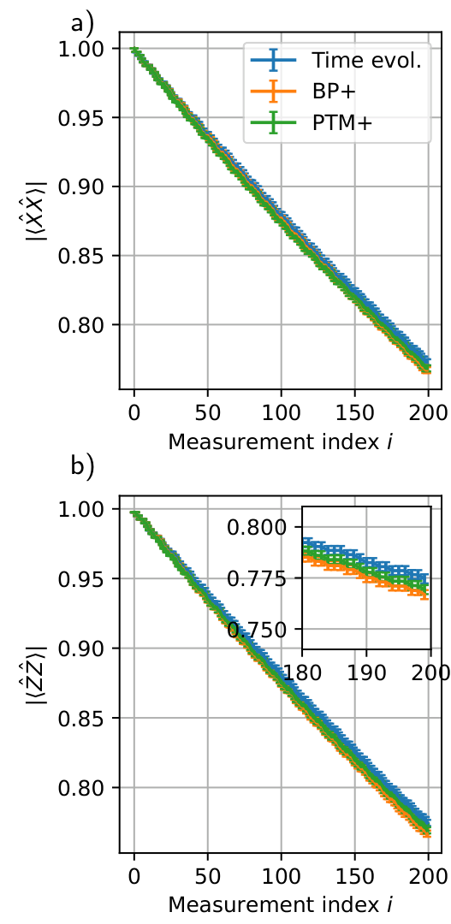
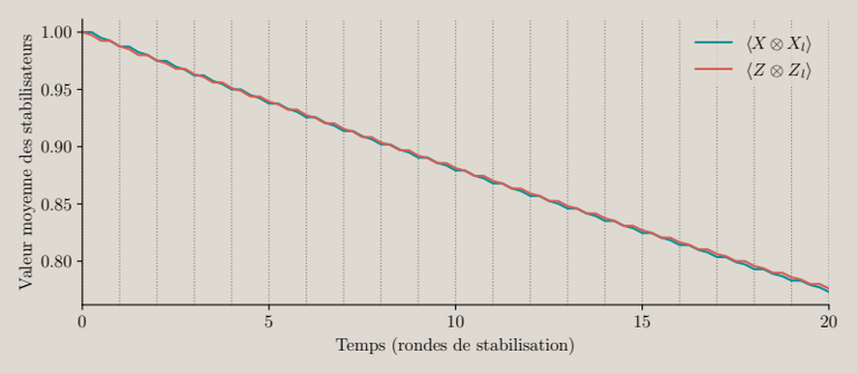
Result reproduction:
Bell Pair Stabilisation
[7]Hopfmueller et al. (2024)

Slide 24
What can be acomplished
naive (without tensor networks) no noise → 34GB of RAM naive (without tensor networks) with noise → ?? of RAM
My simulation with noise → ~2GB of RAM (per core)

Slide 25
A typical problem
One logical qubit is encoded
Three harmonic oscillators

Slide 26
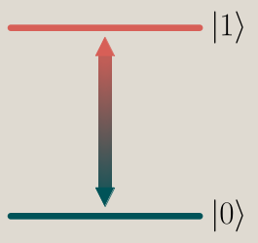
Emergent differences
Is there an emergent difference between using three phyisical qubits or using three harmonic osillator in a repetition code?
VS

Slide 27
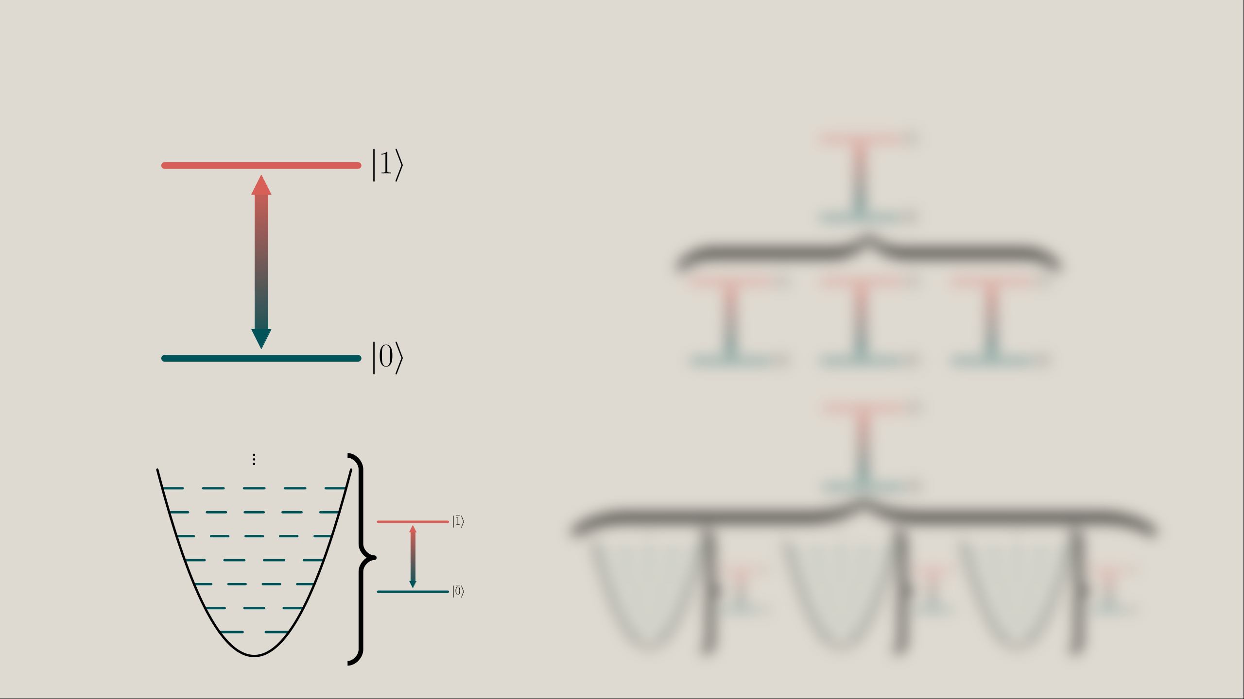
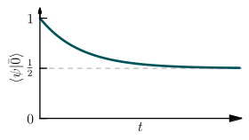
Ajusting the noise
The noise is ajusted as to be effectivly the same on system A and B

Slide 28
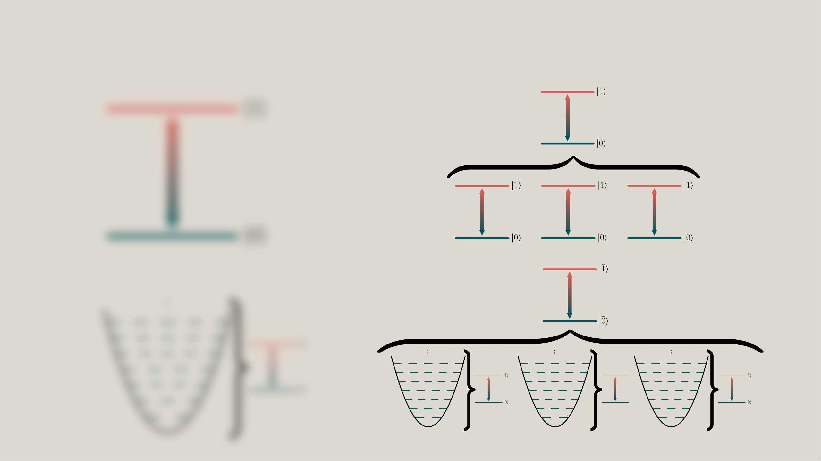
Adjusting the noise
The performance difference between system C and D comes from concatenation

Slide 29
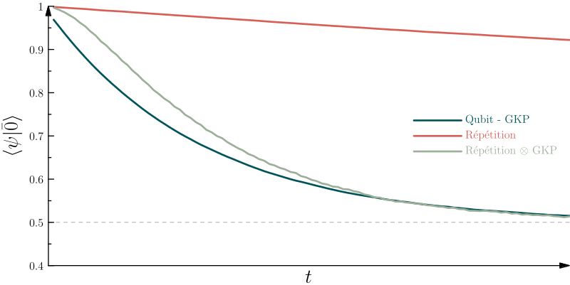
Comparing the different systems
The concatenation seems to have non trivial effects!

Slide 30


Where the difference comes from

Slide 31
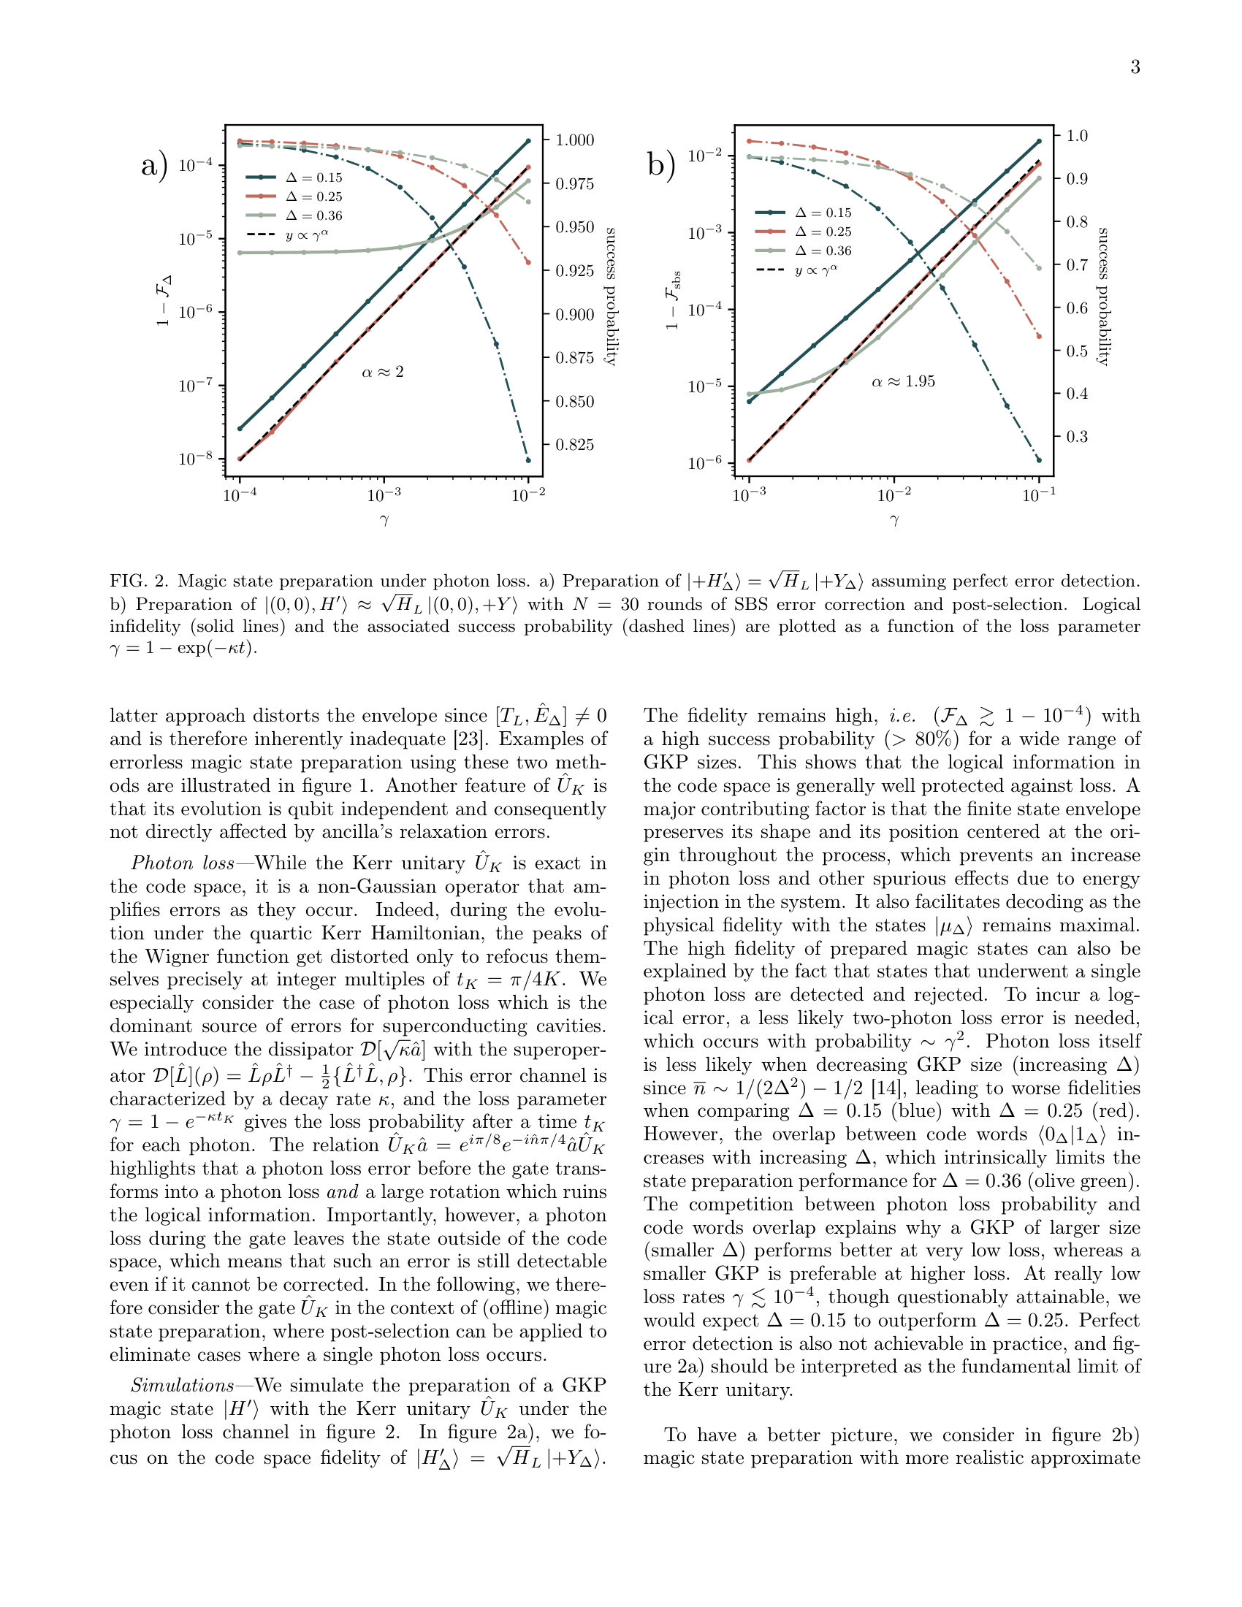
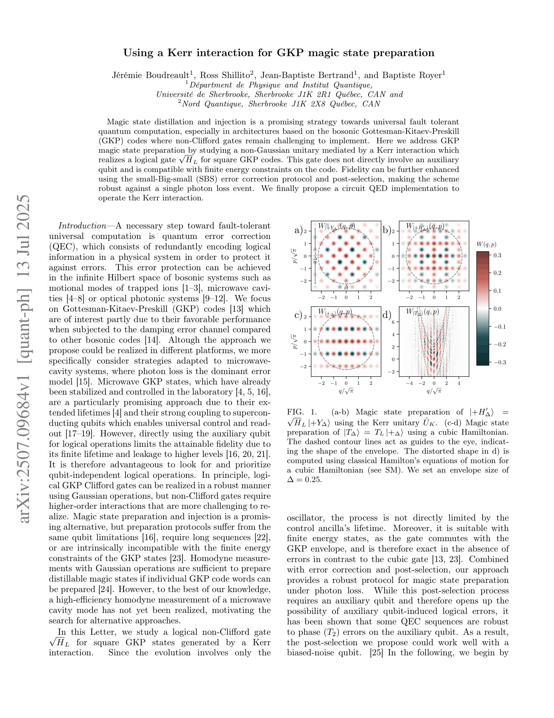
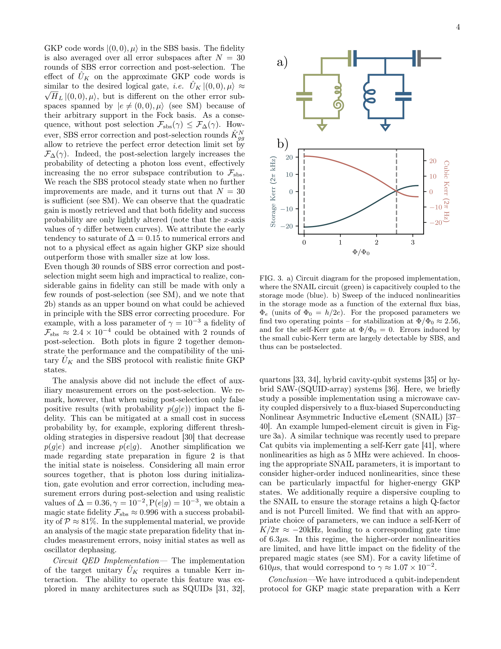
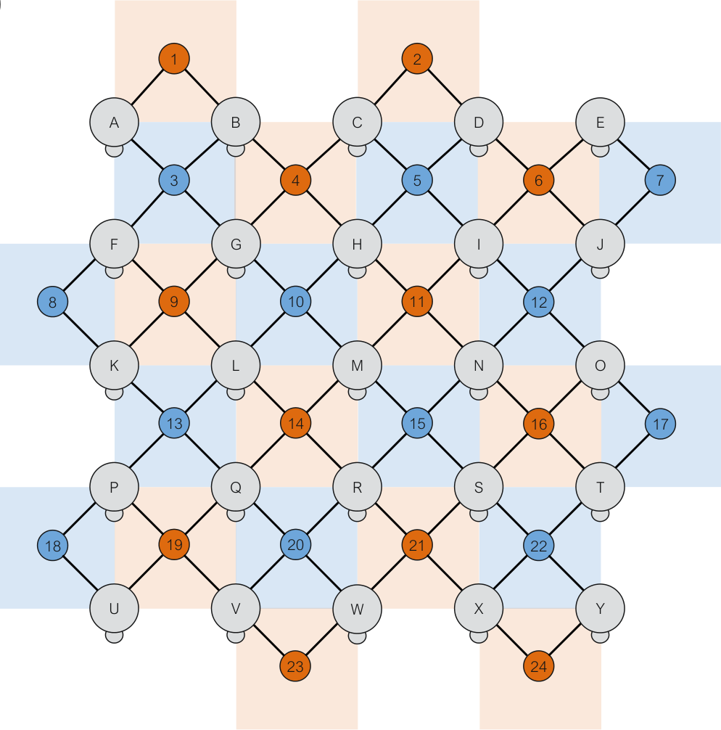

Collabarations the project lead to
[7]Hopfmueller et al. (2024)
Conjoint collaboration with Benjamin Lanthier on a similar project
Boudreault, J., Shillito, R., Bertrand, J.-B. & Royer, B. Using a Kerr interaction for GKP magic state preparation. Phys. Rev. Lett. 136, 120601 (2026).

Slide 32
A few highlight achivements
Simulate noisy multi bosonic system with efficient use of memory
Reproduce results from other frameworks acurately
Simulate realistic “low level noise”

Slide 33
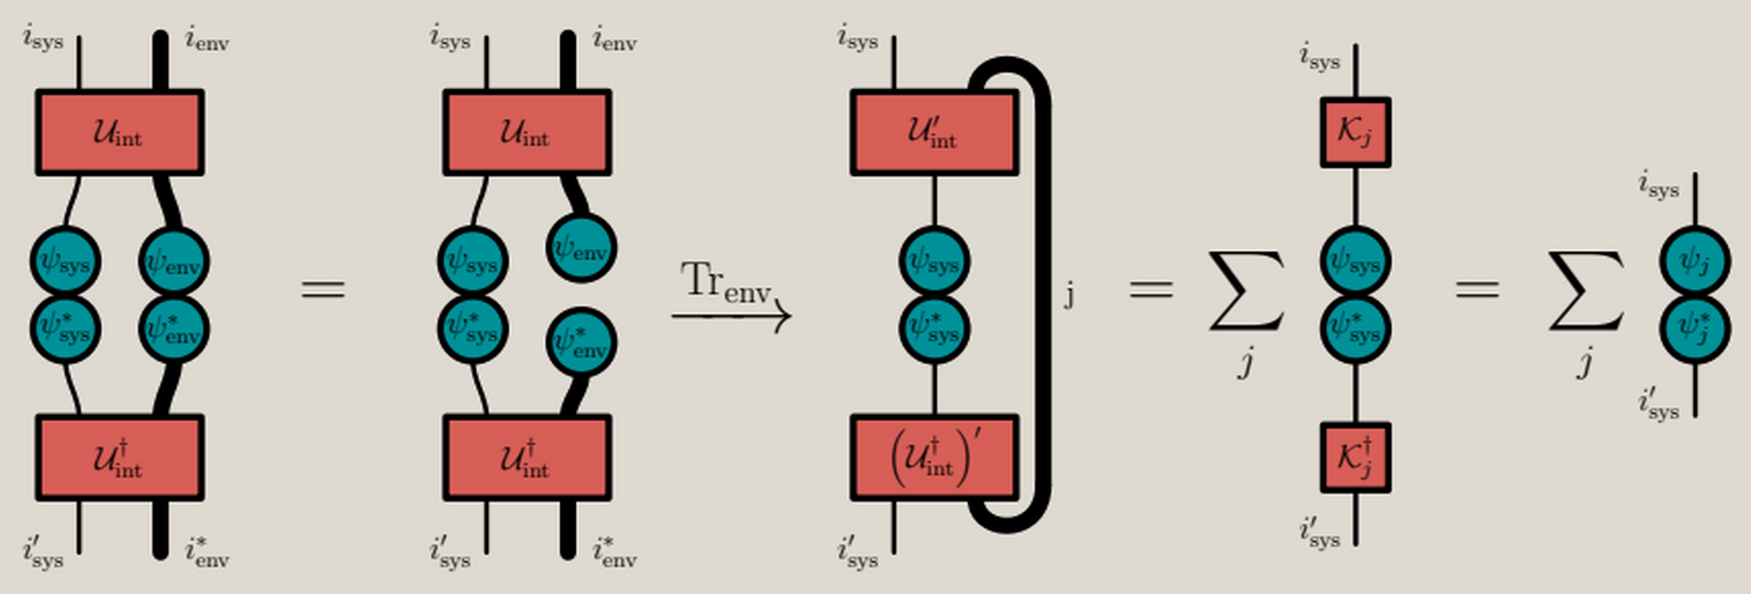
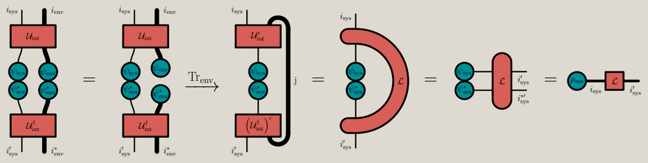

Slide 34
Plan de la présentation
But: investiguer des méthodes pour simuler des ordinateurs quantiques basé sur les codes bosoniques
Mise en contexte du défi
Présentation des méthodes qui ont été investiguées
Présentation des gains en performance
Le genre de problème qu’on veut résoudre : un exemple

Slide 35
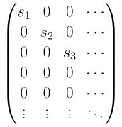
Singular value Decomposition
Similar to diagonalisation
Can be done on any complex matrix, even rectangular ones
M
U
S
m
=
m
m
V
n
n
n
n
m
n
S
=
Singular values are always real and non-negative
Singular values are order in decreasing order

Slide 36
The basic concept
The system starts in the logical state 0
Noise is applied to the system
The system eventually looses the contained information

Slide 37
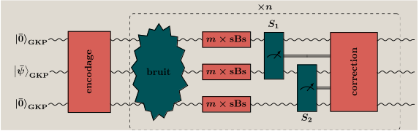
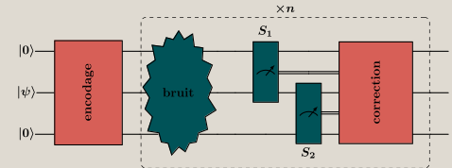
Where the difference comes from

