Slide 1
Introduction to Tensor Networks
by Jean-Baptiste Bertrand

Slide 2



A pictural representation introduced by Roger Penrose
i
rank n tensor n legged blob
j
T
T
T
A
i
d
T
a
c
b

Slide 3
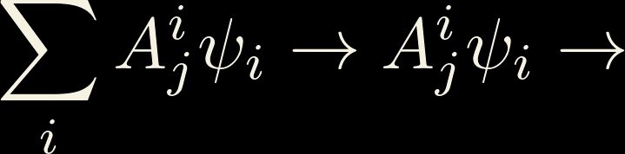


Examples
j
T
i
j
i
j
k
i
k
A
B
C
v
v
T

Slide 4
Orientation nuances

Slide 5
Orientation nuances

Slide 6
Slightly more complex example: Inventing Krauss operators
E
E

Slide 7

Slightly more complex example: Inventing Kraus operators
E
E
i

Slide 8
It looks pretty but why is it useful​​​​?
It looks pretty but why is it useful​​​​?
Tensor Networks also have useful algorithms
associated with them

Slide 9


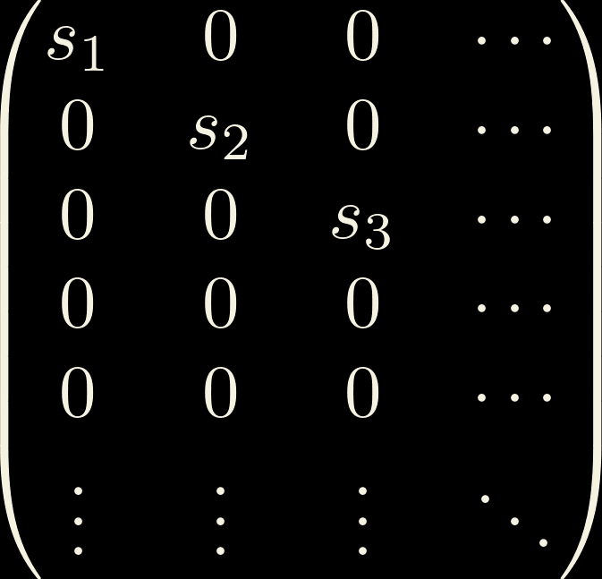
Singular Value Decomposition
Similar to a diagonalisation
Can be performed on any complex matrix, including rectangular ones
m
=
m
m
n
M
U
S
V
n
m
n
n
S
=
Uniquely defined when singular values are ordered in a specific way
Singular values are always real and positive

Slide 10





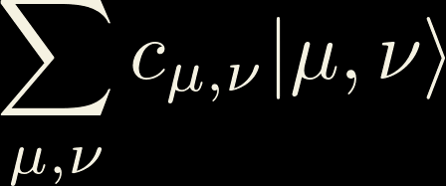
Splitting Hilbert space
i
E.g. :

Slide 11

Hilbert space is a small(er) place!
i
j
i
j
=
=
U
S
V
i
j
i
j
≈
U
V
=
U
V

Slide 12
Systems that are no too entengled
Schmidt decomposition
SVD
Singular values are the coefficient of Schmidth decomposition!
The size of the bond is the same thing as the number of coefficient in Schmidt decomposition!

Slide 13



Matrix Product States/Tensor Trains
i
j
i
j
j
i
i
=
=
U
S
=
U
V
U
V

Slide 14
Systems that are no too entangled
Very
fast
Very
Acurate

Slide 15
Why use certain structure over others?
There is always a trade off between accuracy
and computational efficiency. Some physical systems
will be more affected by certain approximation
MPS
TTN
PEPS

Slide 16
MPS
TTN
PEPS
- Efficiently contractable
- Conceptually simple
- Bad for 2D systems
- Bad for long range
entanglement
- Efficiently Contractable
- Slighty slower than MPS
- Represents long range
entanglement
- Not efficiently
Contractable
- Represents 2D
systems well

Slide 17
How does that relate to what we’re doing?

Slide 18
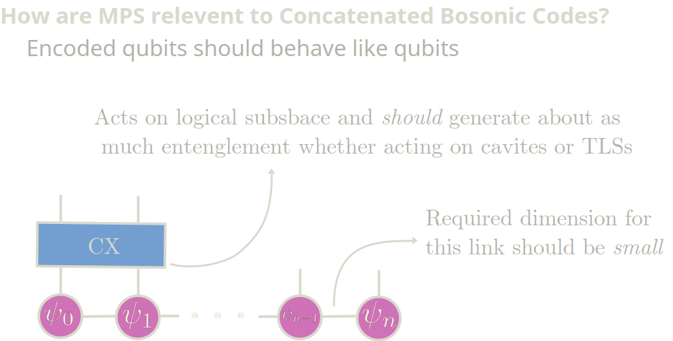

Slide 19
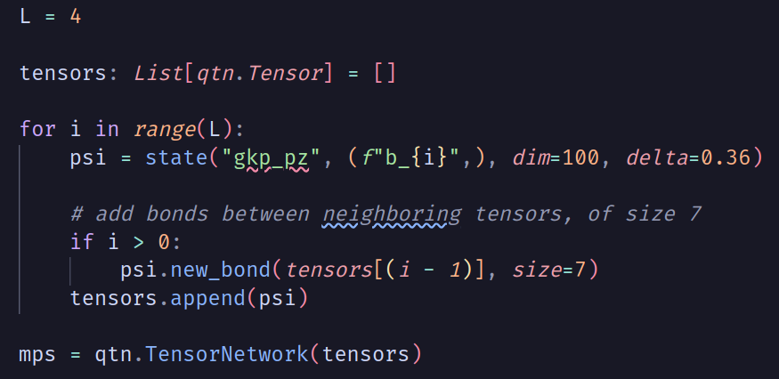
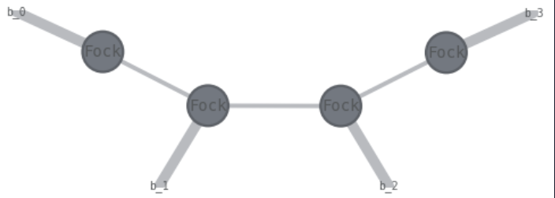
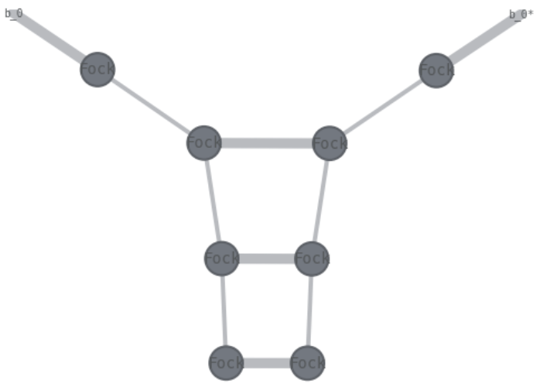
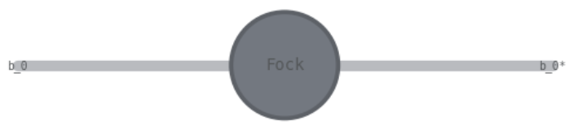
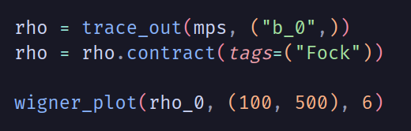
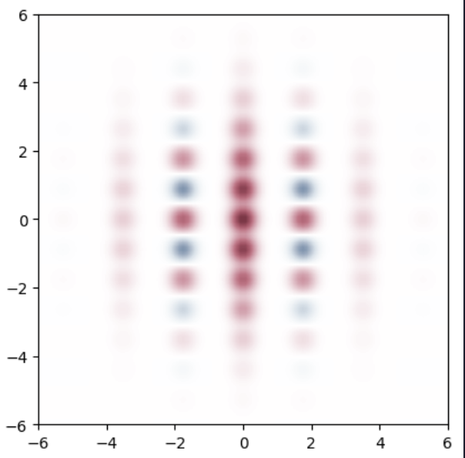
Examples of what I’m doing

Slide 20
Area Law

Slide 21
Contraction order

Slide 22
Gauge Freedom?

