Slide 1
Dealing numerically with large numbers
Jean-Baptiste Bertrand
August 18th, 2025

Slide 2
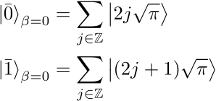
Exemple problem: representing |GKP⟩ numerically

Slide 3
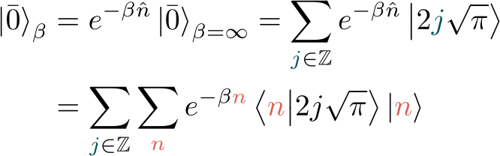

Finite energy states

Slide 4
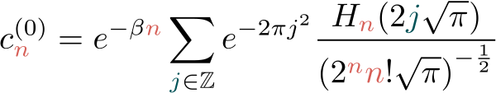
Finite energy states

Slide 5

Why can this be problematic?
Everything diverges very fast in n
Floats or Ints might be unable to represent such large numbers

Slide 6
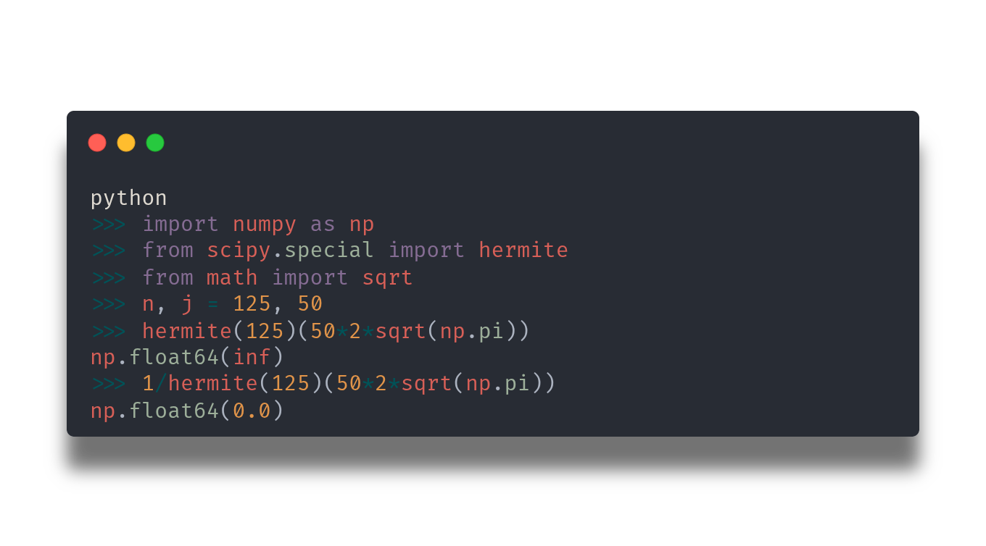
Python example

Slide 7
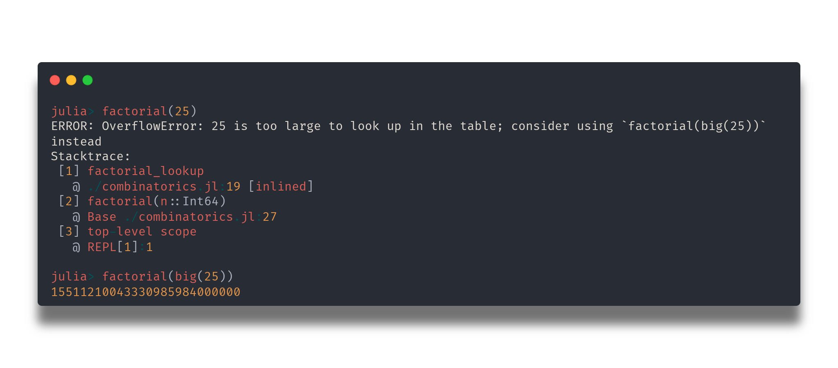
Solutions: big()(or decimal() in python)
Caveats:
- Potentially much slower
- Might not work with all function

Slide 8


Solutions: take the log!
a is too big? Compute log(a) instead !

Slide 9
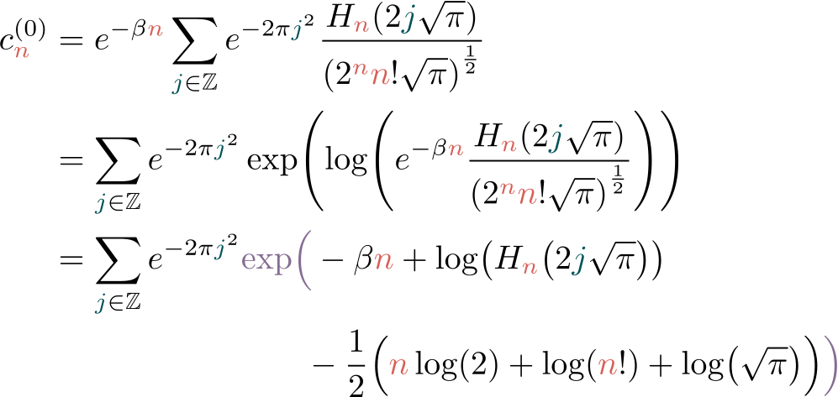
Applying this to the GKP coefficients

Slide 10
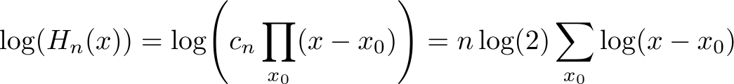
Applying this to the GKP coefficients

Slide 11

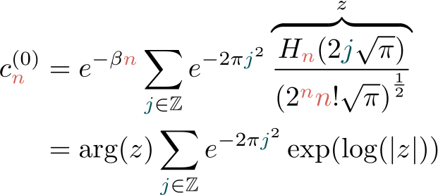
⚠️

Slide 12
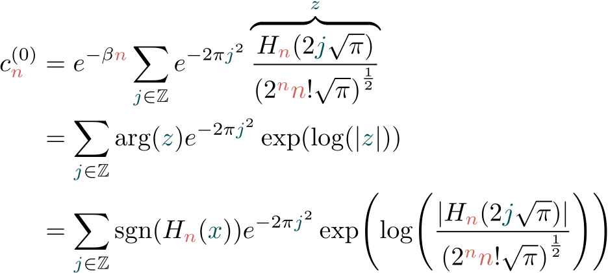
Applying this to the GKP coefficients

Slide 13
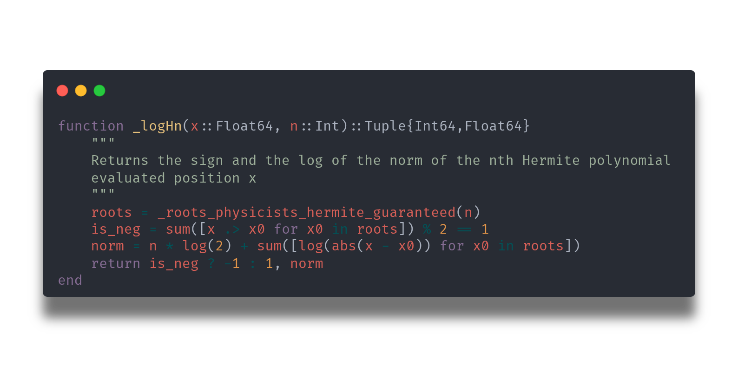
Applying this to the GKP coefficients

Slide 14
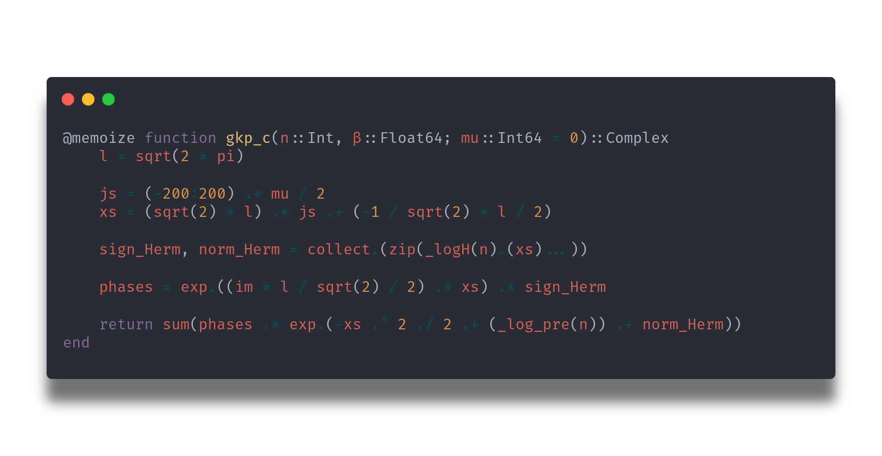
Applying this to the GKP coefficients

