Slide 1
Introduction to Tensor Networks
by Jean-Baptiste Bertrand

Slide 2



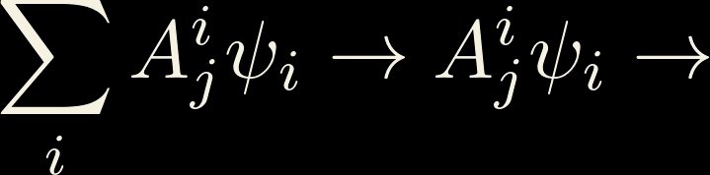
A pictural representation intoduced by Roger Penrose
i
rank n tensor n legged blob
j
T
T
T
T
j
i
T
i

Slide 3

Contractions
j
T
j
i
i
j
k
i
k
A
B
C

Slide 4
Orientation nuances

Slide 5
Orientation nuances

Slide 6
It looks pretty but why is it useful​​​​?

Slide 7


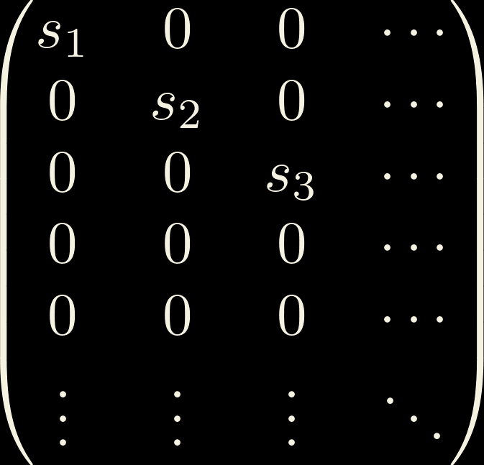
Singular Value Decomposition:
m
=
m
U
m
S
V
n
M
n
n
n
n
S
=

Slide 8


Hilbert space is a small(er) place!
i
j
i
j
=
=
U
S
V
i
j
i
j
d
≈
U
V
=
U
V

Slide 9





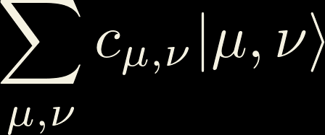
Splitting Hilbert space
i
E.g. :

Slide 10



MPS/Tensor Trains
i
j
i
j
j
i
i
=
=
U
S
=
U
V
U
V

Slide 11
Why MPS/Tensor Trains

