Slide 1
Using tensor networks to simulate concatenated bosonic codes
by Jean-Baptiste Bertrand

Slide 2
End Goal

Slide 3
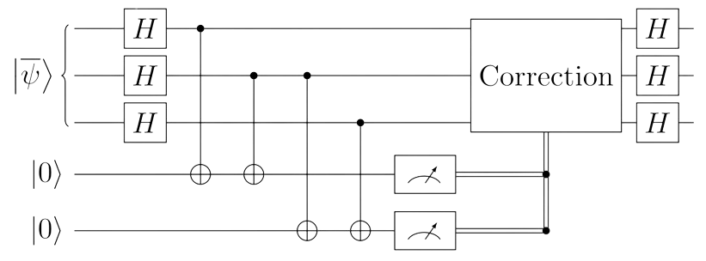
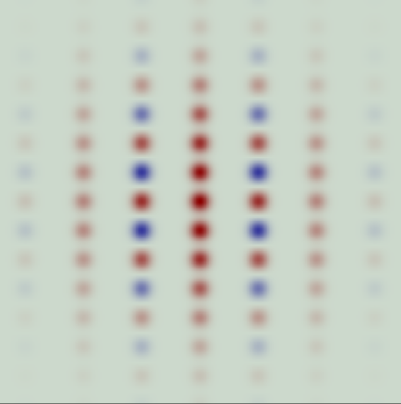
Simulate system with large number off cavities
(Hilbert space is a big place)
e.g. :
{
sBs
sBs
x3
sBs

Slide 4
Means/Theory
Tensor networks

Slide 5



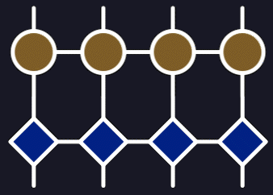
Using the ITensors package to represent physical systems
Repersenting operators by tensors
Repersenting systems with MPS/MPO
ITensors.jl

Slide 6



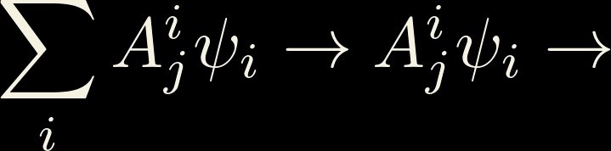
Tensor Networks Revision/Introduction
A pictural representation
i
rank n tensor n legged blob
j
T
T
T
T
j
i
T
i

Slide 7

Tensor Networks Revision/Introduction
Contractions
j
T
j
i
i
j
k
i
k
A
B
C

Slide 8





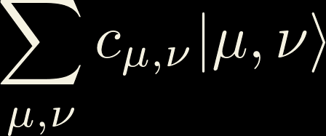
Tensor Networks Revision/Introduction
Splitting Hilbert space
i
E.g. :

Slide 9


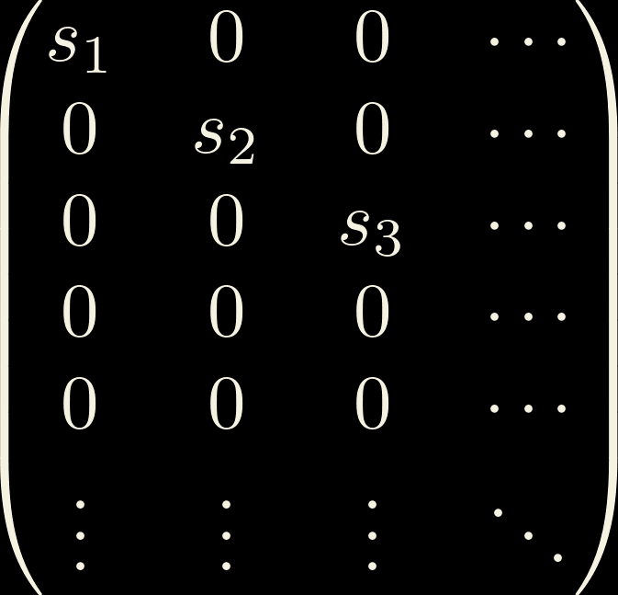
Tensor Networks Revision/Introduction
Singular Value Decomposition:
m
=
m
U
m
S
V
n
M
n
n
n
n
S
=

Slide 10



Tensor Networks Revision/Introduction
MPS/Tensor Trains
i
j
i
j
j
i
i
=
=
U
S
=
U
V
U
V

Slide 11


Tensor Networks Revision/Introduction
Hilbert space is a small(er) place!
i
j
i
j
=
=
U
S
V
i
j
i
j
d
≈
U
V
=
U
V

Slide 12
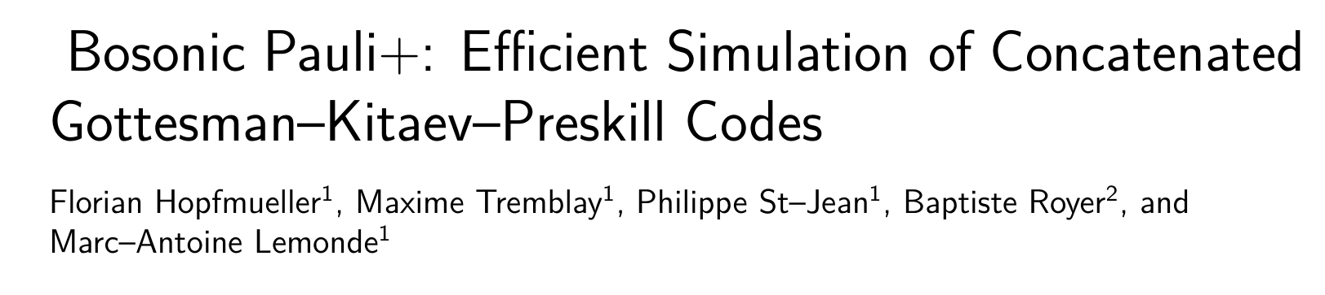
Means/Theory
BP+ / sBs basis

Slide 13

The sBs/BP+ basis
Decompostion of the Hibert space into a logical and an
error subspace
GKP subpsace
Defined from sBs

Slide 14

The sBs/BP+ basis
Generating the error space

Slide 15



The sBs/BP+ basis
Generating the error space

Slide 16
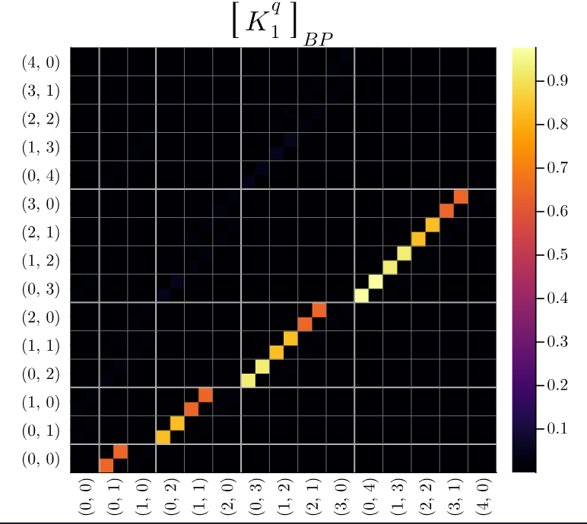
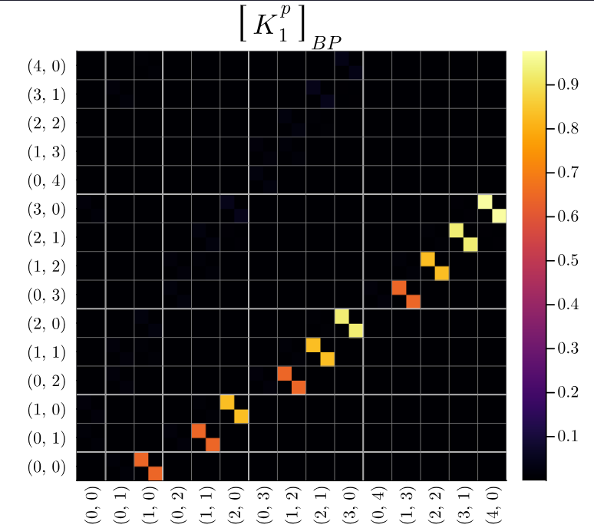
The sBs/BP+ basis
BP+ examples

Slide 17
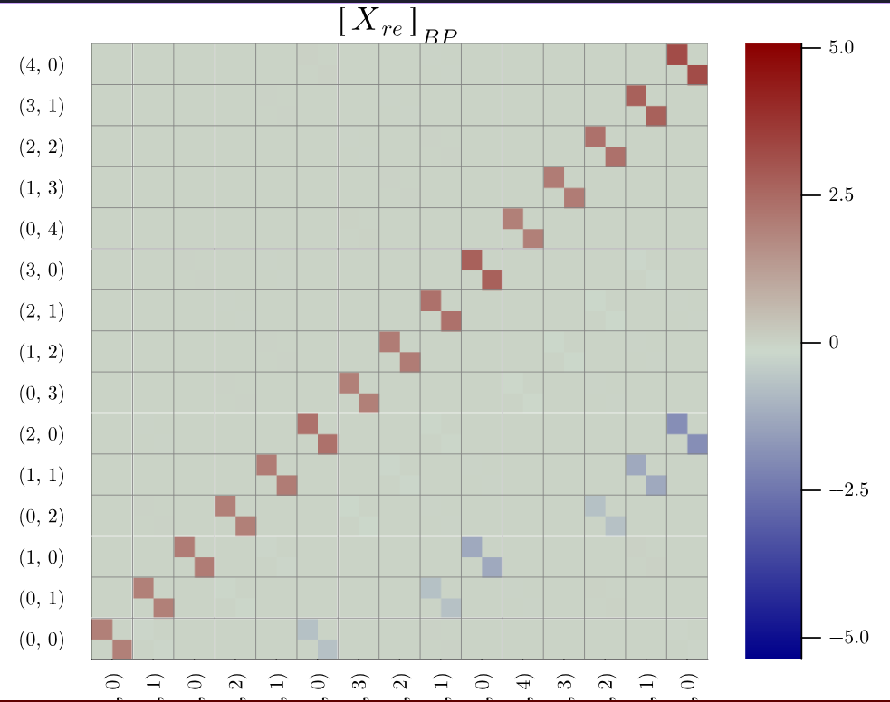
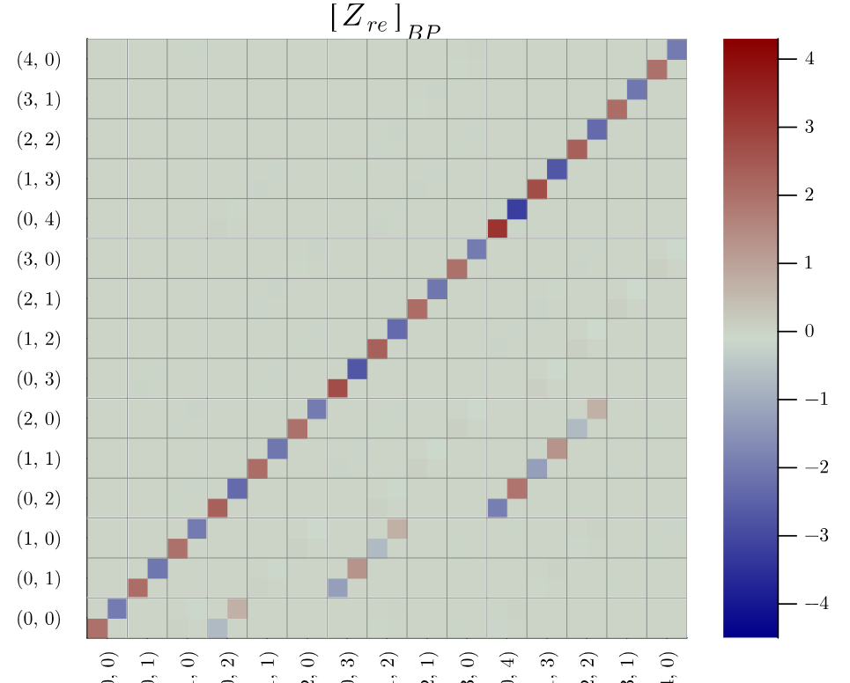
The sBs/BP+ basis
BP+ examples

Slide 18
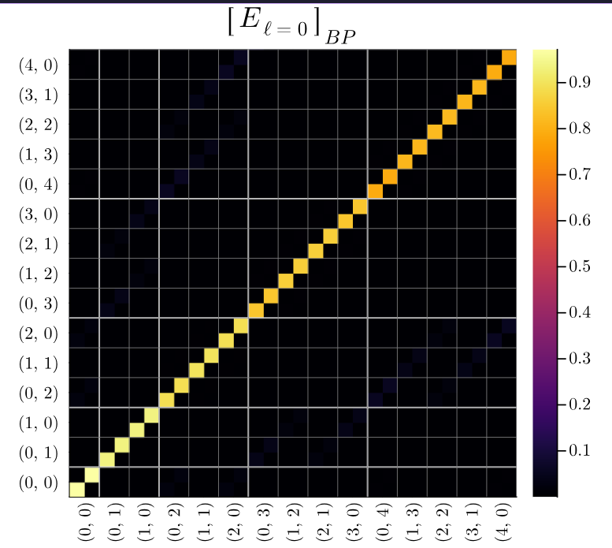
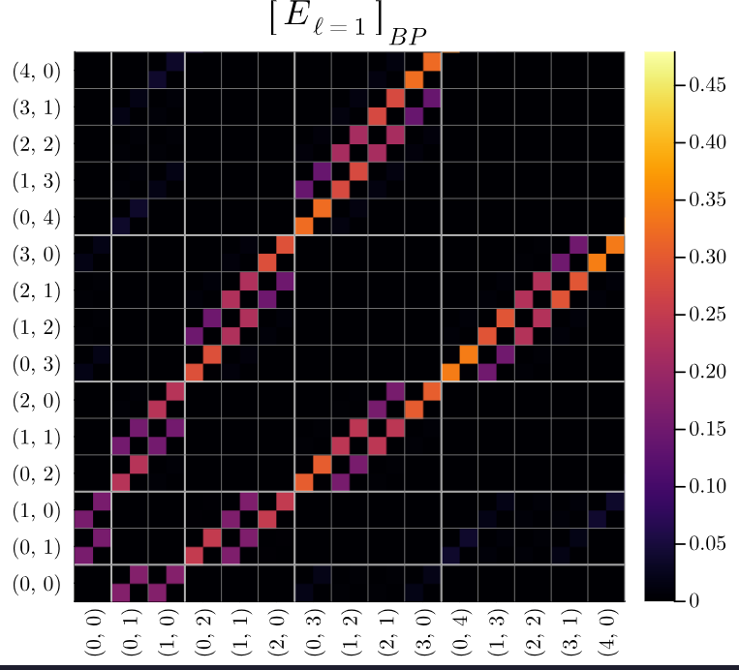
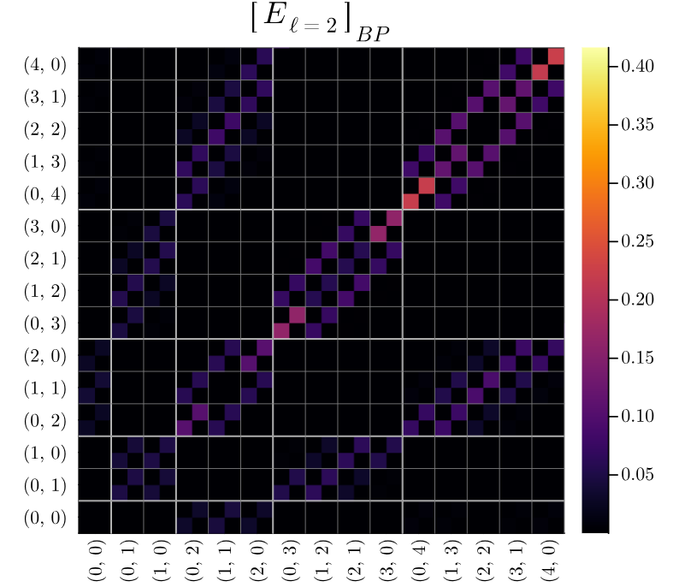
The sBs/BP+ basis
BP+ examples

Slide 19
Applying Tensor Networks
to Concatenated Codes

Slide 20

How are MPS relevent to Concatenated Bosonic Codes?
Encoded qubits should behave like qubits
Acts on logical subsbace and should generate about as
much entenglement whether acting on cavites or TLSs
Required dimension for
this link should be small
CX

Slide 21




How are MPS relevent to Concatenated Bosonic Codes?
Using BP+: sBs disantangles logical and error space
Possibility of reducing these dimentions

Slide 22
Means/Theory
Monte-Carlo

Slide 23


Non-Unitary Gates with Monte Carlo
Density matrix are large!

Slide 24
Non-Unitary Gates with Monte Carlo
Density matrix are large!
Simulations use quantum trajectories
Non unitary gates are simulated by jump operators
sBs measurement is selected randomly

Slide 25
Simulations/Results

Slide 26

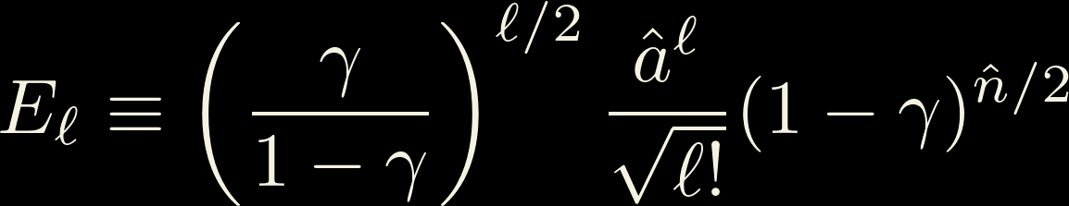

Gauge and Entanglement entropy
A simple MC simulation
Photon loss channel randomly applies
photon loss Krauss operator
n times

Slide 27
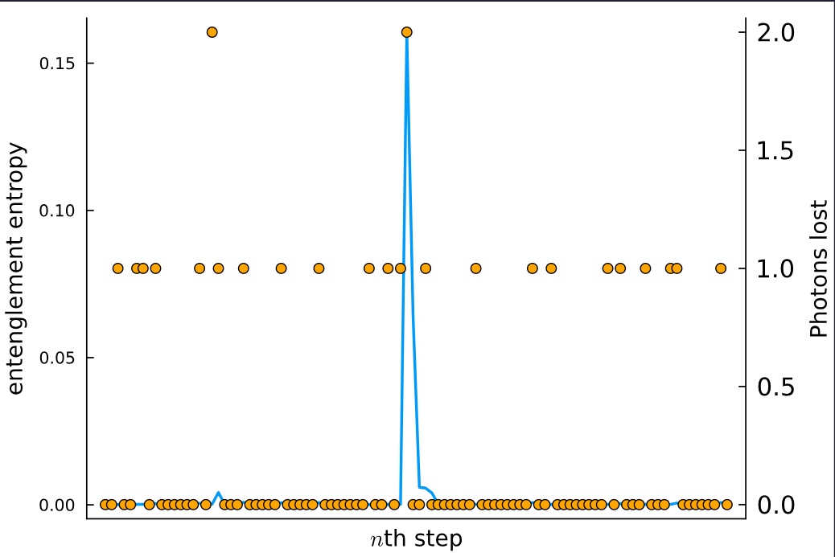
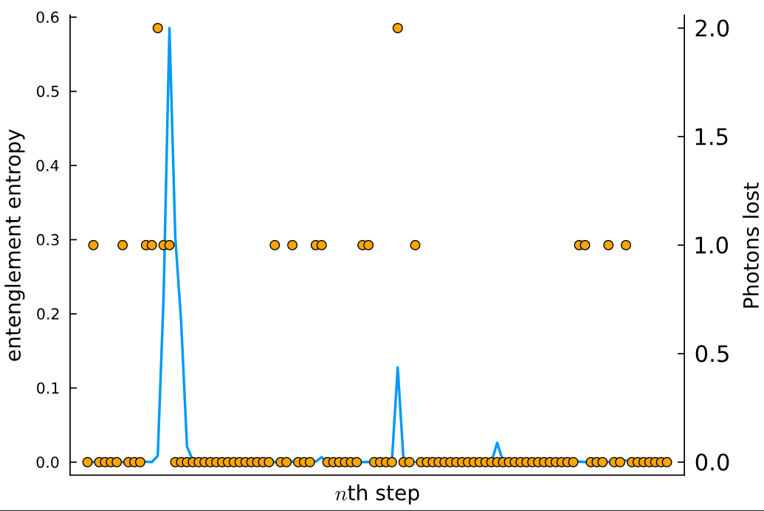
Gauge and Entanglement entropy
A few trajectories examples

Slide 28
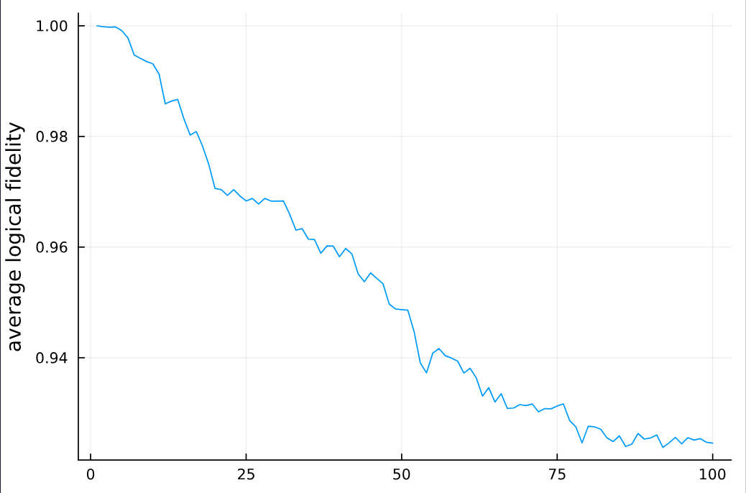
Gauge and Entanglement entropy
Averaged over 100 runs

Slide 29

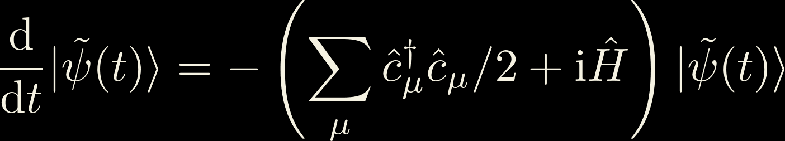
Gauge and Entanglement entropy
A simple MC simulation
Gate is applied via non-unitary time
evolution:
n times
Probablity of jump is given by norm of
the state

Slide 30
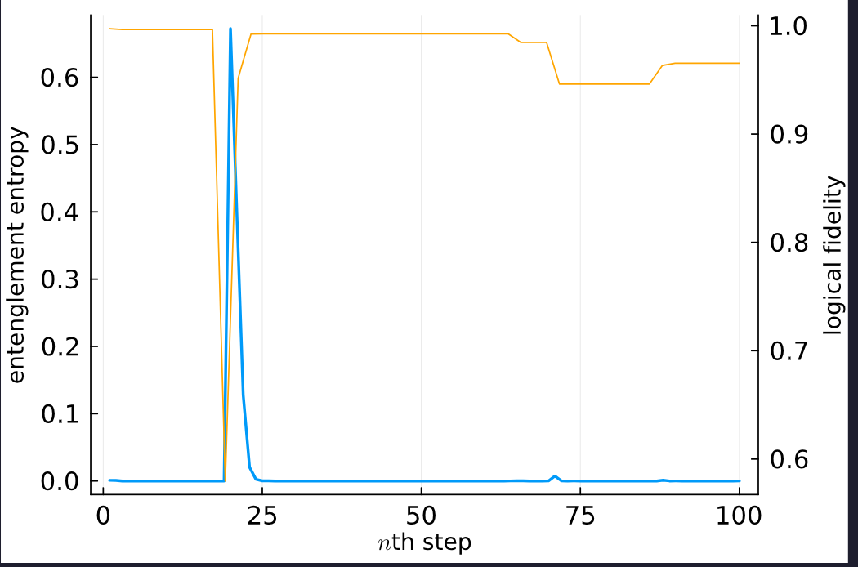
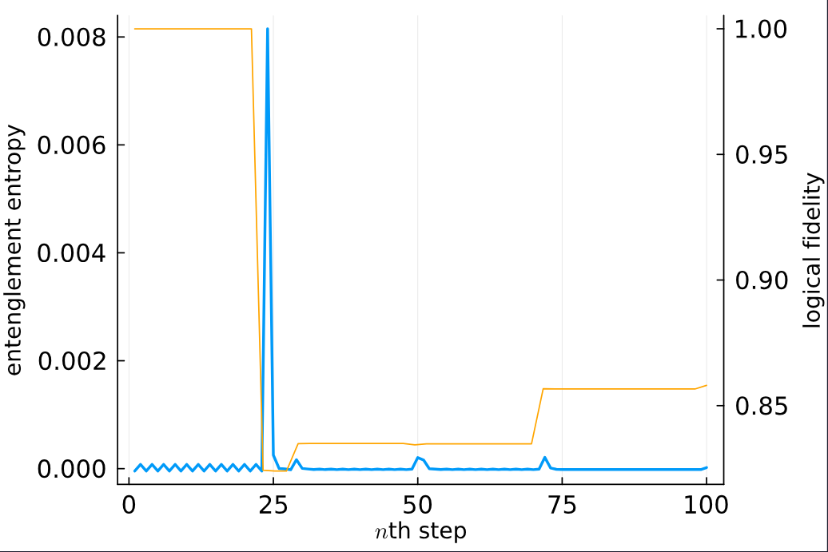

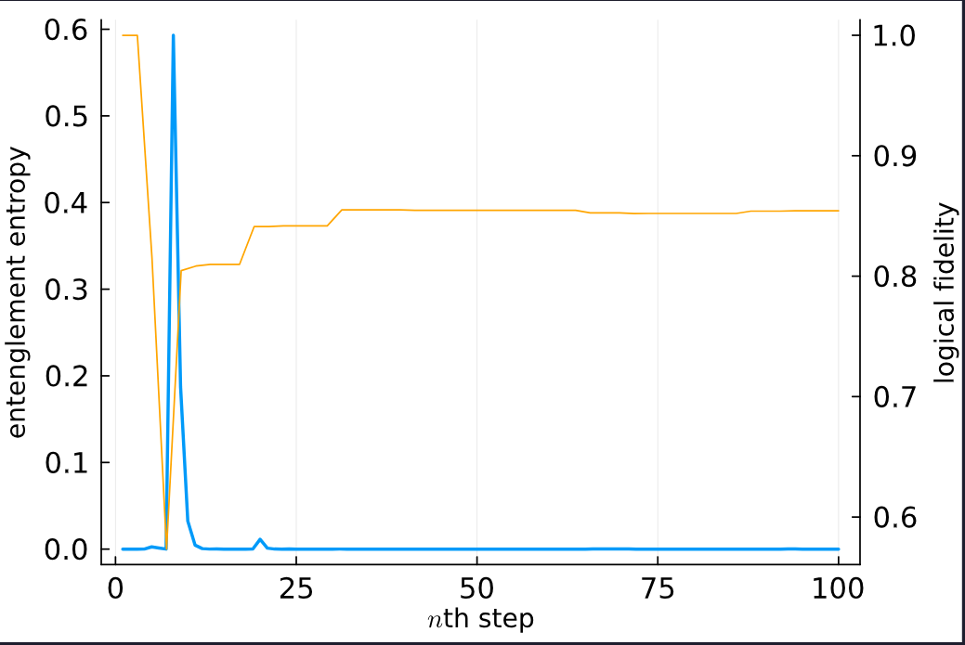
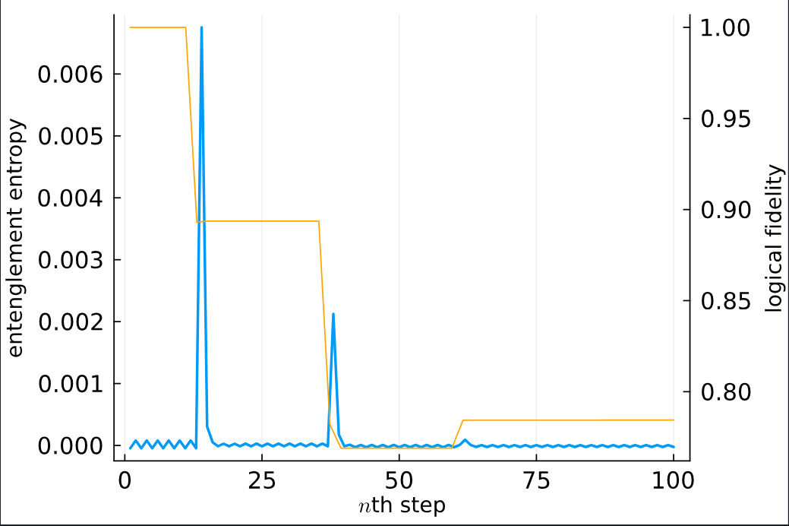

Gauge and Entanglement entropy
A few trajectory examples

Slide 31
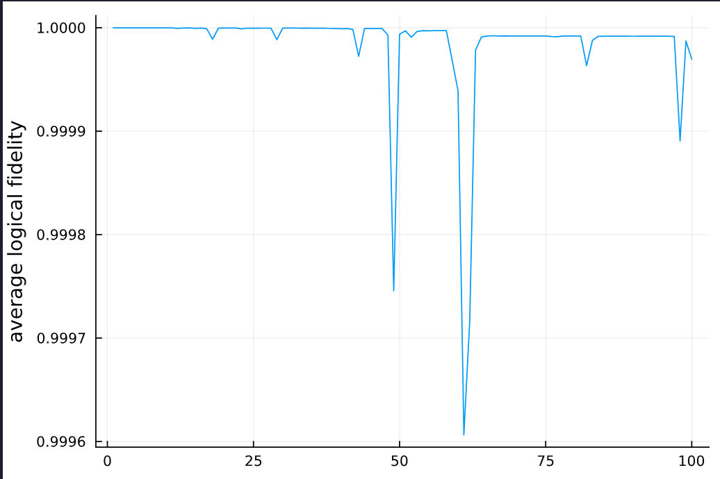
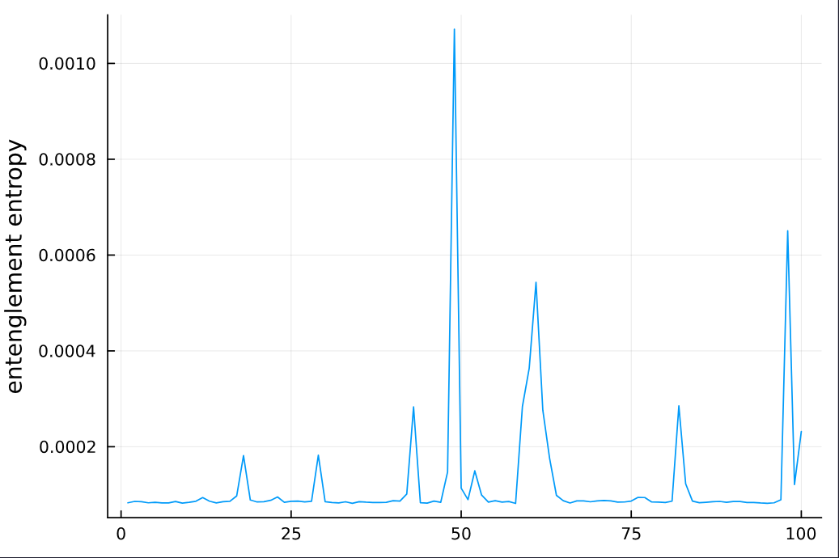
Gauge and Entanglement entropy
Average over 100 runs

Slide 32
Gauge and Entanglement entropy
A few trajectory examples

Slide 33
Coming soon

Slide 34
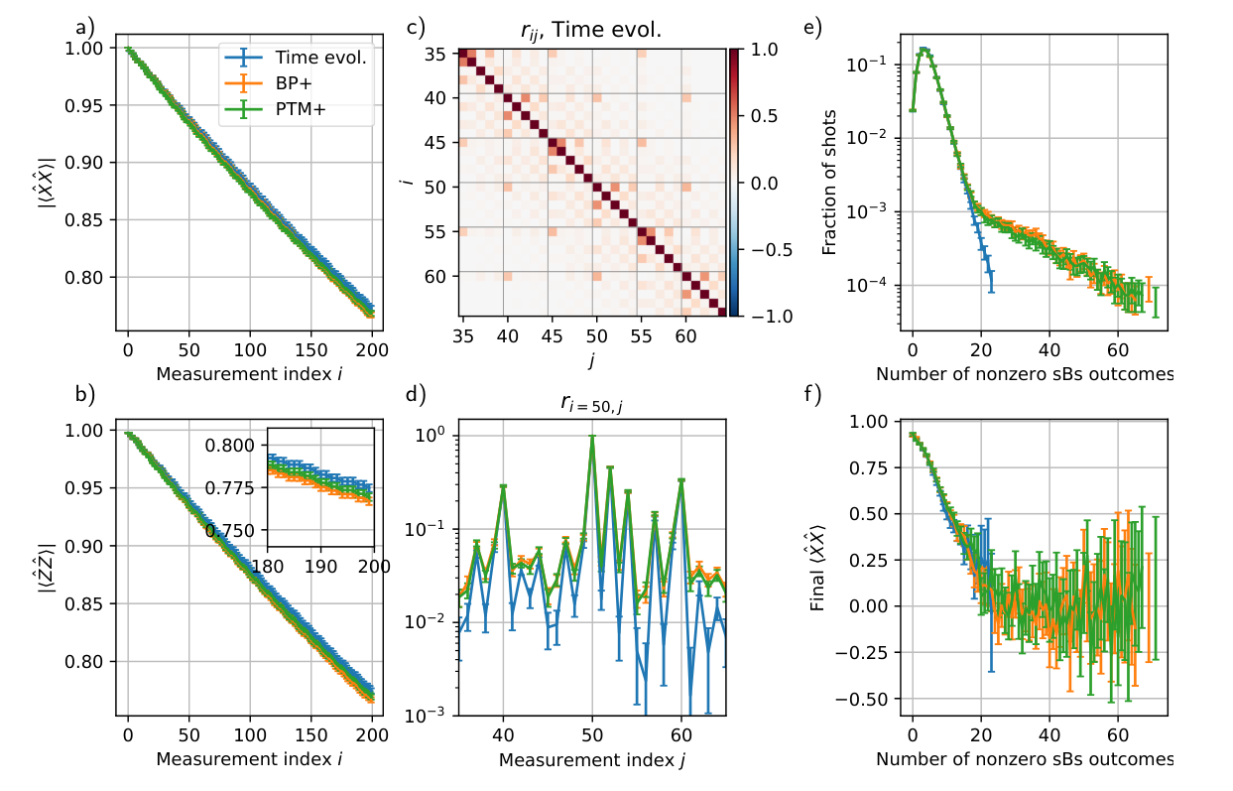
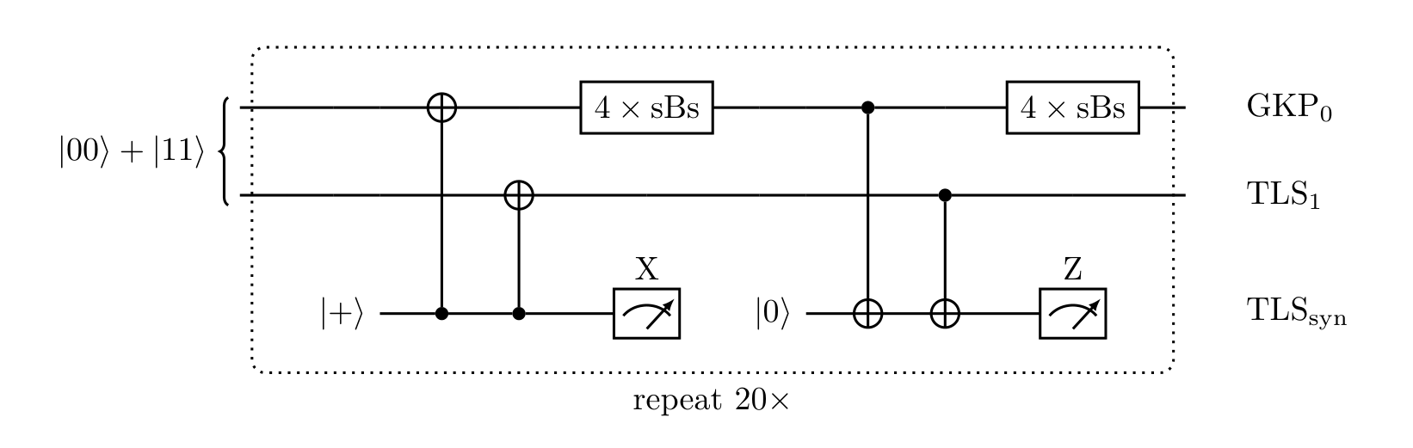
Simulations to run
Comparaison with BP+

Slide 35
Simulations to run
Simple repetition code
{
sBs
sBs
x3
sBs

Slide 36
Simulations to run
Simple repetition code: specifics to look for
Studying the effect of bond dimention
Studying the entenglement between logical and gauge subspace

Slide 37
Simulations to run
More complex codes?
Magic state preparation
More complicated code

Slide 38
Simulations to run
More complex codes?
Comments?
Suggestions?

