Slide 1
Using tensor networks to simulate concatenated bosonic codes
by Jean-Baptiste Bertrand

Slide 2
End Goal

Slide 3
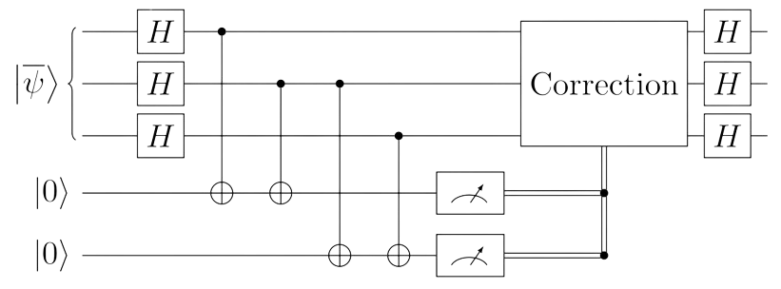
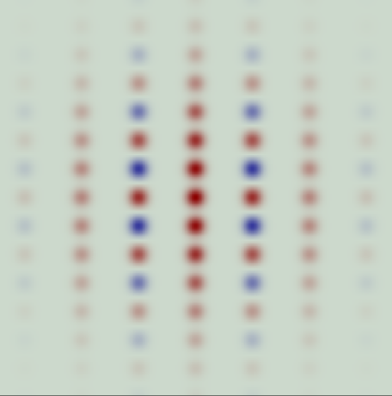
Simulate system with large number off cavities
e.g. :
{
sBs
sBs
x3
sBs

Slide 4
Means

Slide 5


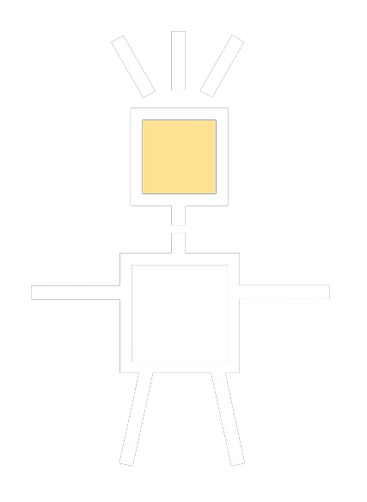

Using the ITensors package to represent physical systems
Repersenting operators by tensors
Repersenting systems with MPS/MPO
ITensors.jl

Slide 6


Why use tensor networks?
Great memory saving some techniques (e.g. SVD)
i
j
i
j
=
=
U
S
V
i
j
i
j
d
≈
U
V
=
U
V

Slide 7
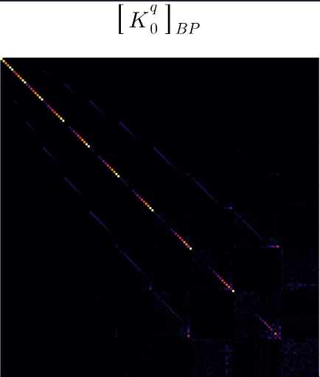
Other means
Combine the use of tensor network with other thecnique
(e.g. sBs basis)

