Slide 1
Developing a Machine Learning Based Assistance System to Endure Time and Cost Burden of Bangladeshi Diabetic and Hypertensive Patients
Presented by :
Md. Amdad Hossain
ID : 1704100
Supervised by:
Dr. Mahfuzulhoq Chowdhury
Associate Professor , Department of CSE,CUET
Notes:
1
10/9/18

Slide 2
Contents
Introduction
Motivation
Objectives
Application
Challenges
Contributions
Related Works
Proposed Methodology
Dataset Preparation
Experimental Result
Mobile Application Features
Mobile Application Evaluation
Limitations
Conclusion
References

Slide 3
Introduction
Diabetes and hypertension are two of the most common life long diseases
Diabetes and hypertension can cause a variety of symptoms, including high blood sugar, weight loss, fatigue, headache, and dizziness
It can have a significant time and cost burden on individuals, families, and healthcare systems

Slide 4
Motivation
The system would use machine learning to analyze patient data and suggest personalized treatments
The system can improve the quality of life for patients
The system would provide remote monitoring and decision-making support to rural healthcare workers

Slide 5
Objectives
To provide personalized treatment recommendations
The system aims to reduce the financial burden on patients
The system also reduces time burden with quick and accurate assistance
.

Slide 6
Applications
Personalized mobile apps with health dashboards to track vital health parameters
The medication reminder function to ensure that treatment programmes are followed on time
Organizational health monitoring programs for diabetics and hypertensives

Slide 7
Challenges
Data collection and preparing the dataset is very challenging
Picking the right model and integrating it with the mobile application
The Android database schema needs to be API and platform compatible, so it's difficult to design

Slide 8
Contributions
To gather data for potential future research purpose
To design and select the best model suited for predicting a patient is diabetic and hypertensive or not and system to reduce the time and cost
Developing an Android app to provide personalized suggestions for diabetic and hypertensive patients

Slide 9
Related Works
[7] M. S. Islam, M. R. Islam and M. M. Islam, ‘Machine learning based de- cision support system for diabetes management,’ Diabetes and Metabolic Syndrome: Clinical Research and Reviews, vol. 13, no. 1, pp. 123–130, 2019.
They built a machine learning-based decision support system for diabetes management using decision trees, random forests, and support vector machines, with an accuracy of 85%
Limitations:
The dataset was limited by a small sample size
The paper does not consider the impact of cultural factors on diabetes management
The system is not able to provide real-time feedback to patients

Slide 10
Related Works (Cont.)
[12]D. LaFreniere, F. Zulkernine, D. Barber and K. Martin, ‘Using machine learning to predict hypertension from a clinical dataset,’ in 2016 IEEE symposium series on computational intelligence.
The authors was applied to explore the application of machine learning techniques for predicting hypertension using a clinical dataset and the accuracy of this paper is 82%
Limitation:
The authors didn’t develop any application for users to interact with the system to know the results
The specific algorithm used in the study is not mentioned
The study may be limited by potential biases in the clinical dataset

Slide 11
Related Works (Cont.)
[11] L. Jia, Z. Wang, S. Lv and Z. Xu, ‘Pe_dim: An efficient probabilistic ensemble classification algorithm for diabetes handling class imbalance missing values,’ IEEE Access, vol. 10, pp. 107 459–107 476, 2022 .
The authors introduced a novel algorithm called Pe_dim that aims to address class imbalance and missing values in the classification of diabetes and the accuracy of this paper is 93%
Limitation:
The algorithm does not perform well when the data is highly imbalanced
Pe-dim is computationally expensive to train
Limited evaluation on diverse datasets

Slide 12
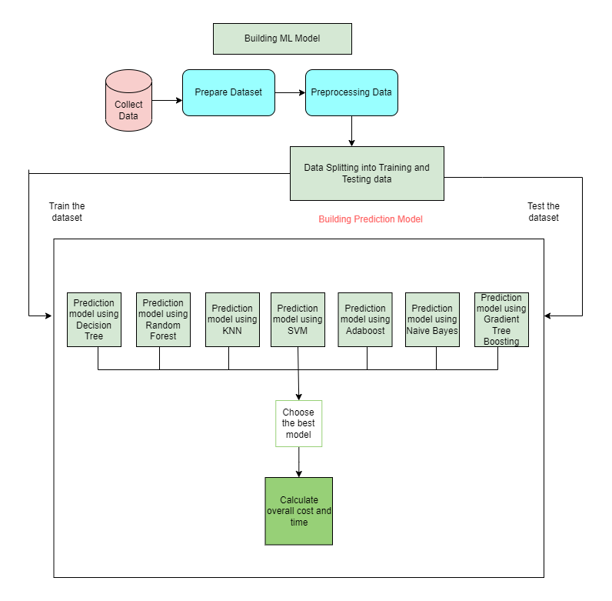
Proposed Methodology
Figure 1: Machine Learning Model Framework

Slide 13
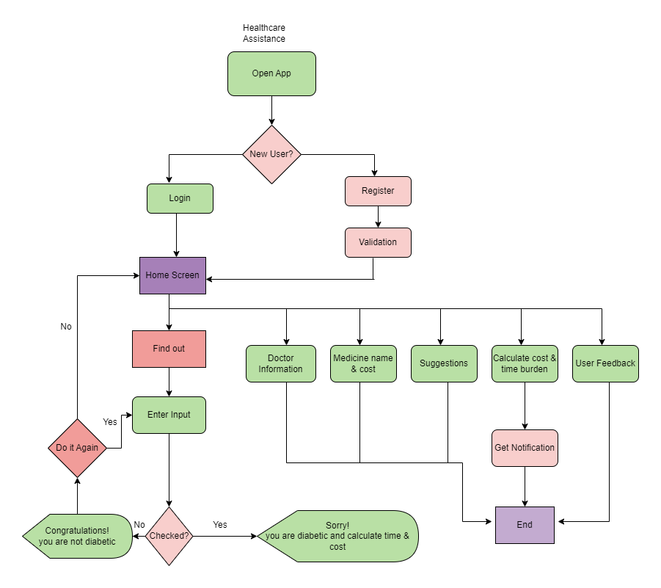
Proposed Methodology (Cont.)
Figure 2: Process Flow Diagram of Mobile App

Slide 14
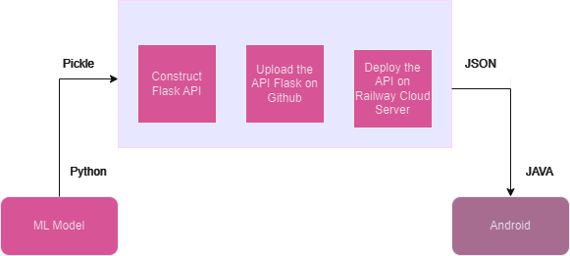
Proposed Methodology (Cont.)
Figure 3: Process Flow Diagram of ML model to Android App

Slide 15
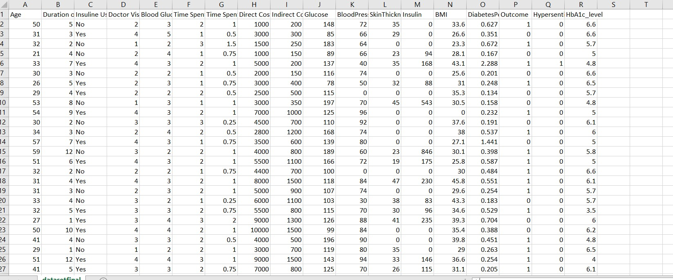
Dataset preparation
Features of Dataset :
The total number of collected data is 779 & has 18 features
The dataset created from these collected data is used for data analysis and classification model generation
Figure 4: Dataset Sample

Slide 16
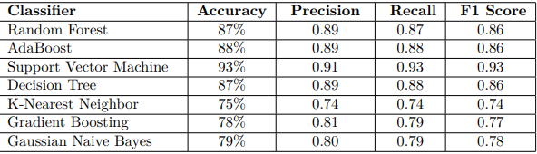
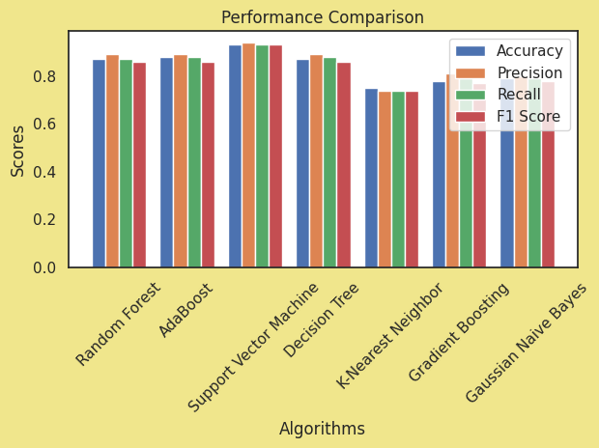
Experimental Result
Figure (a): Evaluation using Accuracy
Figure (b): Accuracy comparison
Figure 5: Comparison of Machine Learning Models using various Metrics

Slide 17
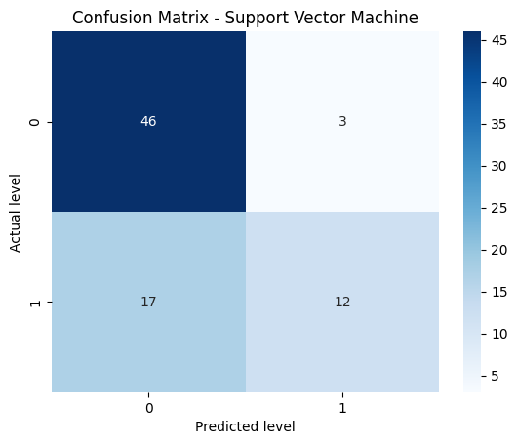
Experimental Result (Cont.)
Figure 6: Confusion Matrix for Best Algorithm (SVM)

Slide 18
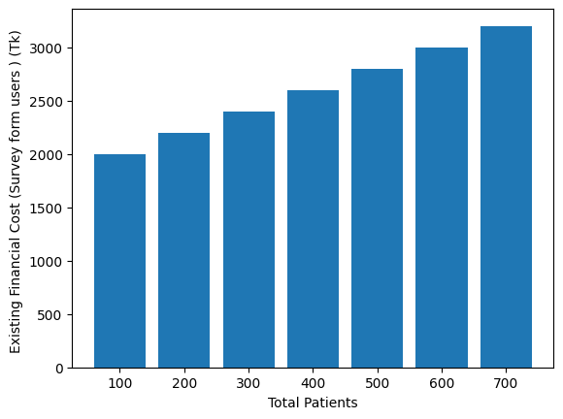
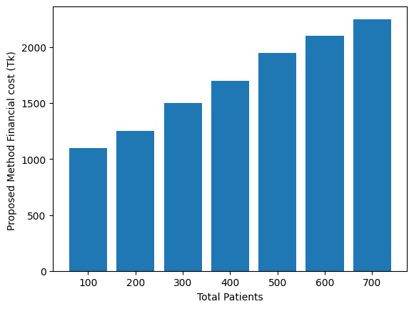
Experimental Result (Cont.)
Figure 7: Comparison of Existing cost and Proposed method cost

Slide 19
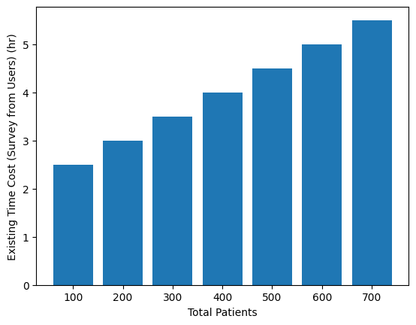
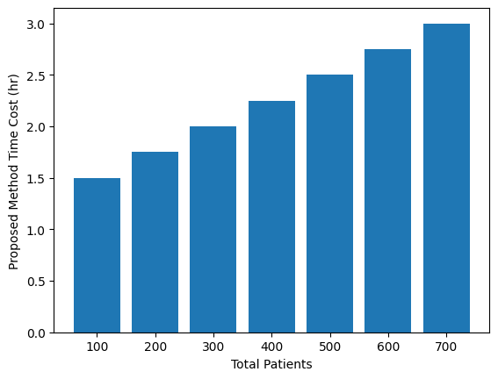
Experimental Result (Cont.)
Figure 8: Comparison of Existing time cost and proposed method time cost)

Slide 20
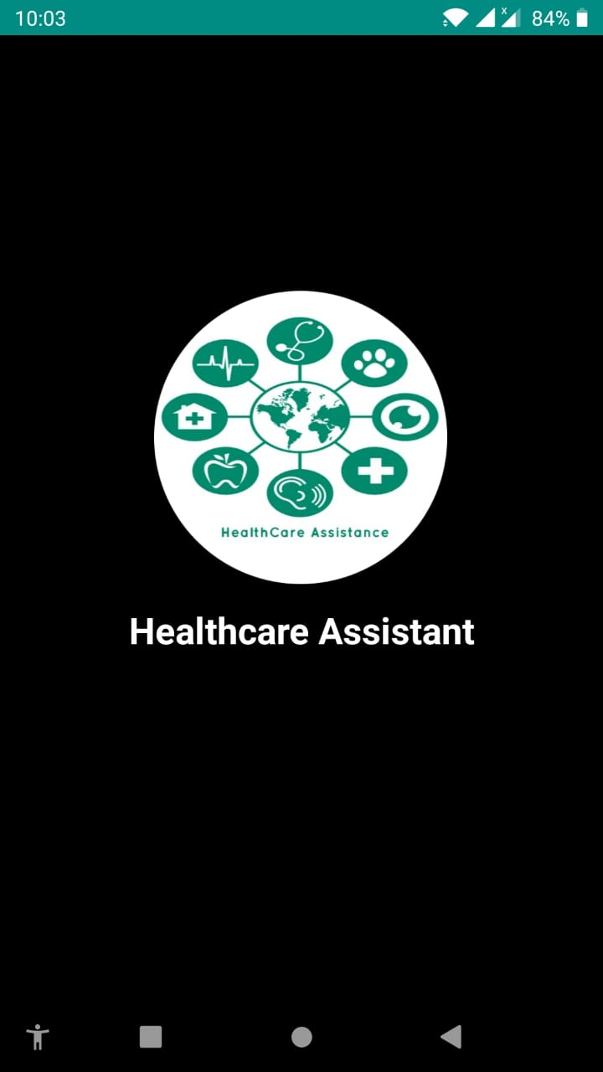
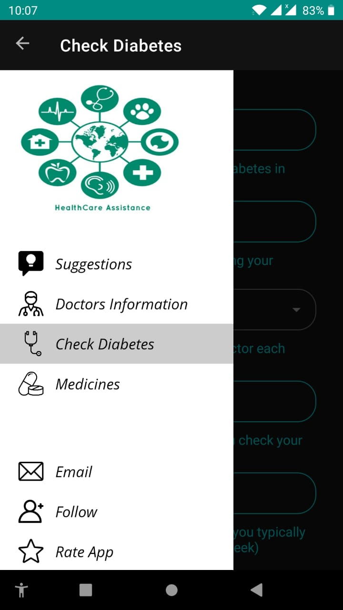
Mobile Application Features
Figure 9: App open and Home Page

Slide 21
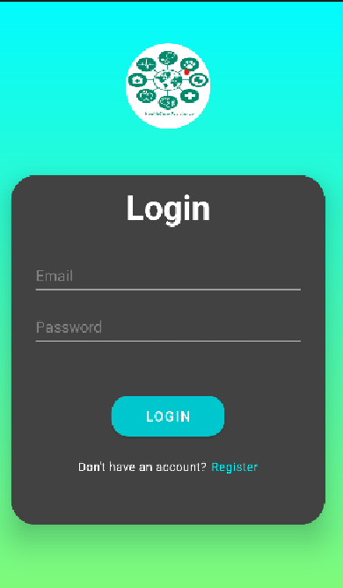
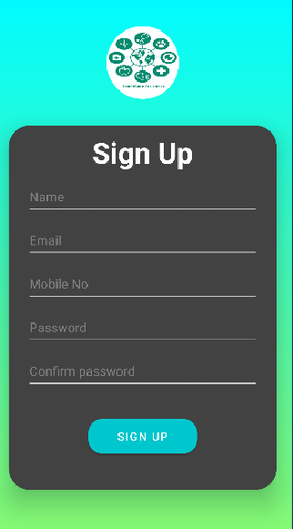
Mobile Application Features (Cont.)
Figure 10 : Login and Signup page

Slide 22
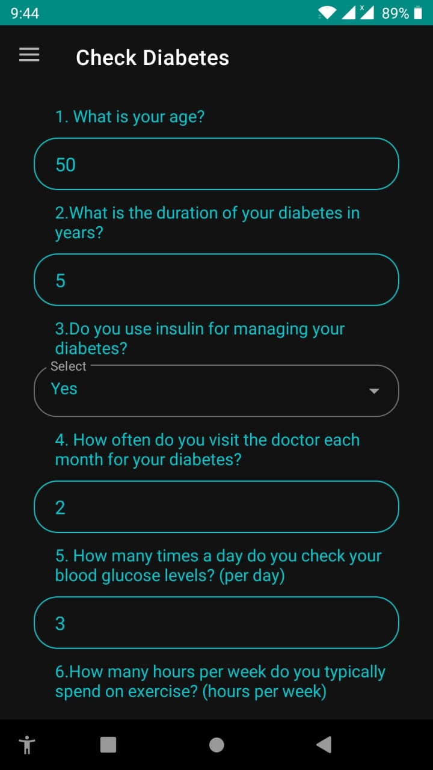
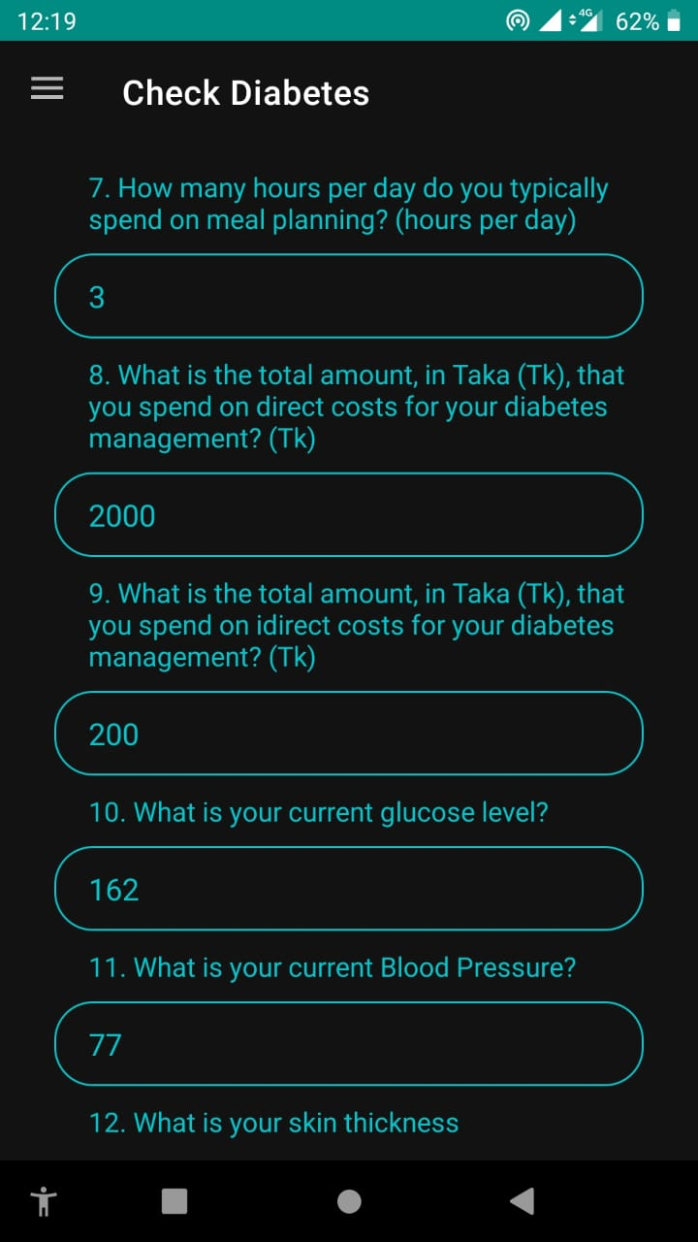
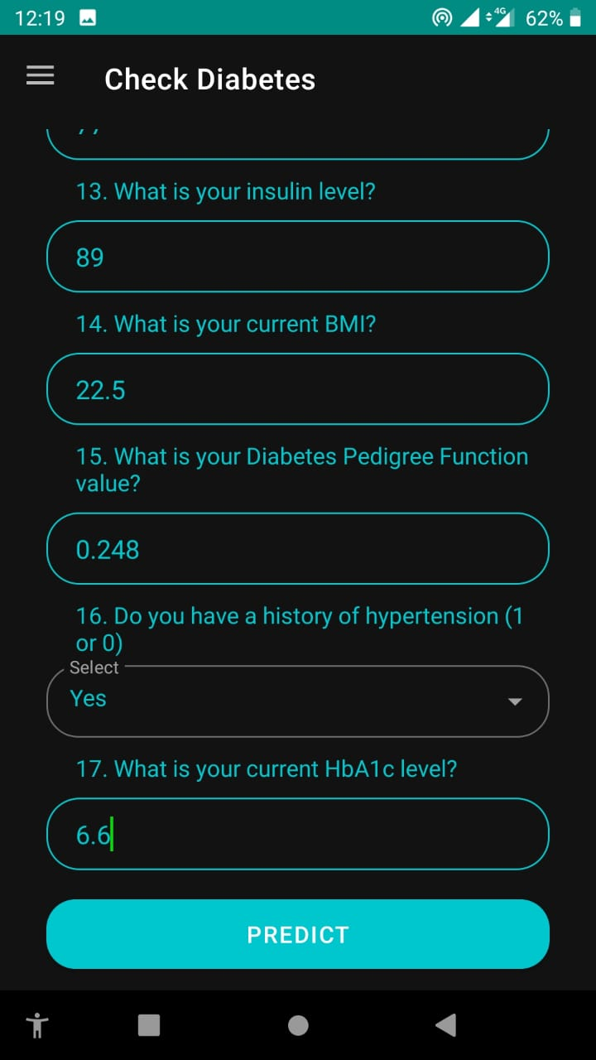
Mobile Application Features (Cont.)
Figure 11: prediction Page

Slide 23
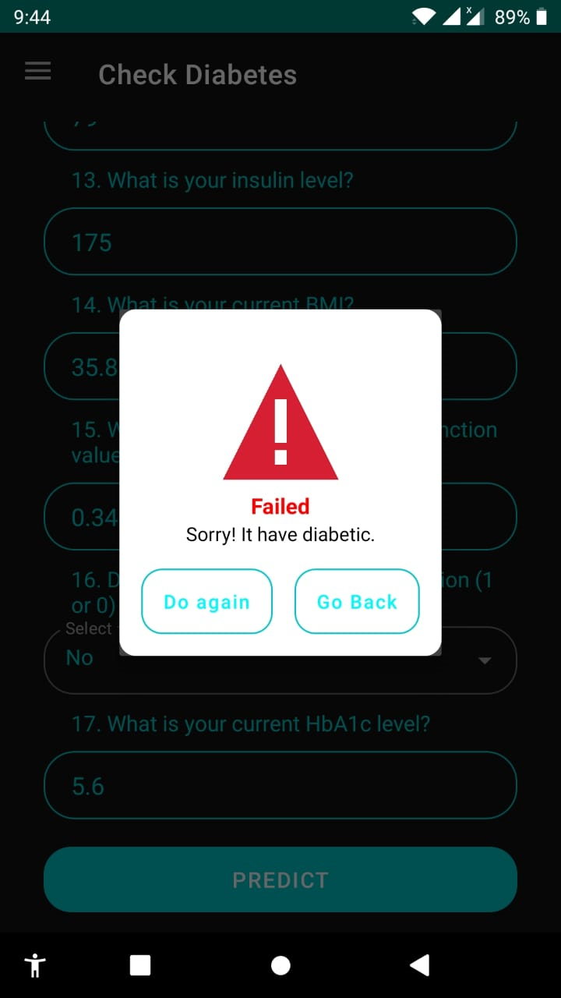
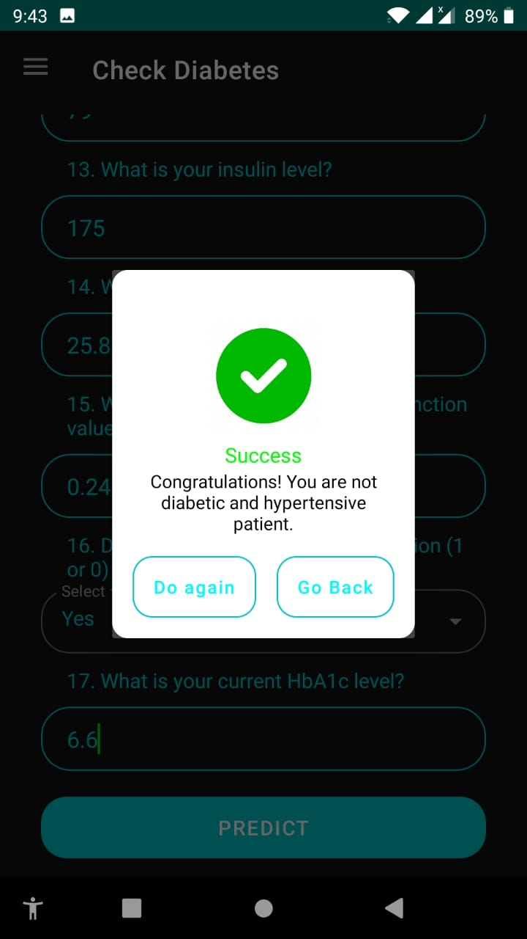
Mobile Application Features (Cont.)
Figure 12: Prediction Page(Continued)

Slide 24
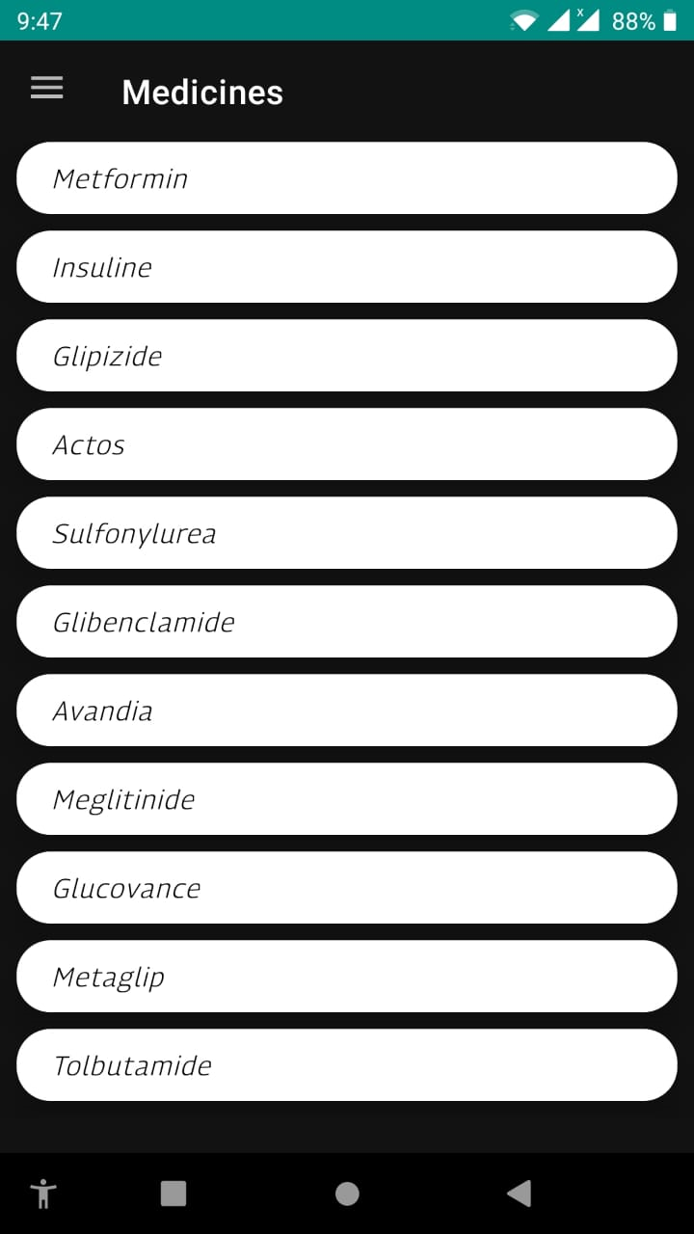
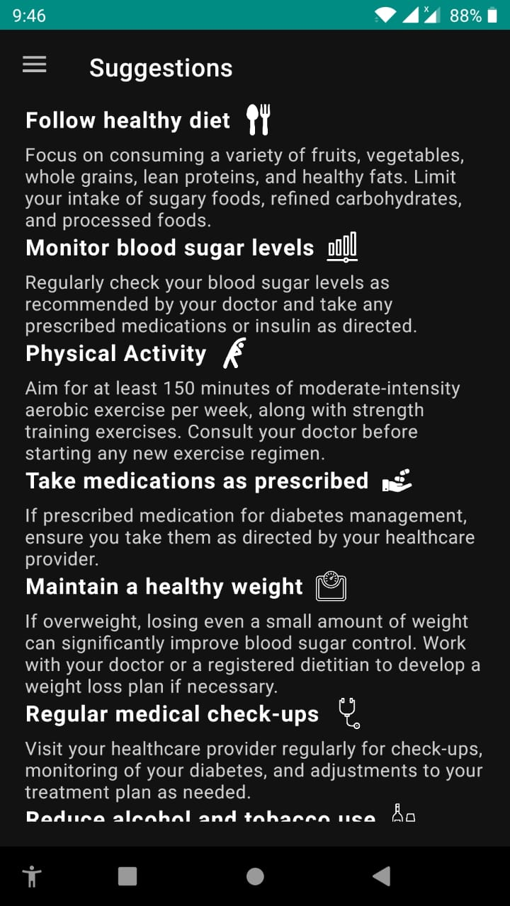
Mobile Application Features (Cont.)
Figure 13: Suggestion Page

Slide 25
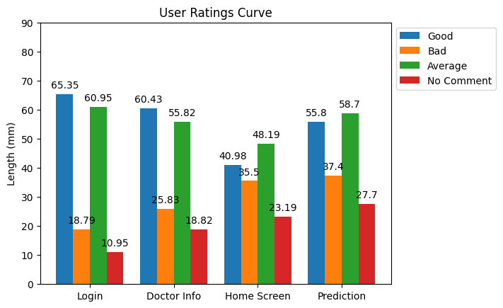
Mobile Application Evaluation
Figure 14: User ratings of our mobile application

Slide 26
Limitations
Data could only be collected from few sources
PKL files can be large, which can make them slow to load and save
Fast API can be complex and not as secure as some other frameworks

Slide 27
Future Works
A larger dataset would have led to more precise and generalizable findings
Implement advanced encryption to protect data at rest and in transit
Improve app usability and user experience by adding new features

Slide 28
Conclusion
Machine learning algorithms can be used to build predictive models that can aid in early detection, risk assessment, and personalized treatment planning for individuals at risk of diabetes and hypertension
To reduce the time and cost burden of diabetic and hypertensive patients in Bangladesh
Android apps can provide personalized treatment recommendations based on patient data

Slide 29
References
[1] M. Nour and K. Polat, ‘Automatic classification of hypertension types based on personal features by machine learning algorithms,’ Mathematical Problems in Engineering, vol. 2020, 2020 .
[2] F. Haque et al., ‘Performance analysis of conventional machine learning algorithms for diabetic sensorimotor polyneuropathy severity classification using nerve conduction studies,’ Computational Intelligence and Neuroscience, vol. 2022, 2022 .
[3] M. Bader Alazzam, F. Alassery and A. Almulihi, ‘Identification of diabetic retinopathy through machine learning,’ Mobile Information Systems, vol. 2021, 2021 .
[4] E. Adane, A. Atnafu and A. Y. Aschalew, ‘The cost of illness of hypertension and associated factors at the university of gondar comprehensive specialized hospital northwest ethiopia, 2018,’ ClinicoEconomics and Outcomes Research, pp. 133–140, 2020 .
[5] L. Zhang, L. Li and H. Zha, ‘Adaboost: Still a powerful machine learning tool,’ Journal of Zhejiang University-SCIENCE C, vol. 13, no. 5, pp. 349– 367, 2012.
[6] M. S. Rahman et al., ‘Awareness, treatment, and control of diabetes in bangladesh: A nationwide population-based study,’ PloS one, vol. 10, no. 2, e0118365, 2015.
[7] M. S. Islam, M. R. Islam and M. M. Islam, ‘Machine learning based decision support system for diabetes management,’ Diabetes and Metabolic Syndrome: Clinical Research and Reviews, vol. 13, no. 1, pp. 123–130, 2019.
[8] W. H. Organization et al., ‘National guidelines for management of hypertension in bangladesh,’ 2013.

Slide 30
References
[9] M. J. Husain et al., ‘Cost of primary care approaches for hypertension management and risk-based cardiovascular disease prevention in bangladesh: A hearts costing tool application,’ BMJ open, vol. 12, no. 6, e061467, 2022.
[10] M. Maniruzzaman, M. J. Rahman, B. Ahammed and M. M. Abedin, ‘Classification and prediction of diabetes disease using machine learning paradigm,’ Health information science and systems, vol. 8, pp. 1–14, 2020.
[11] L. Jia, Z. Wang, S. Lv and Z. Xu, ‘Pe_dim: An efficient probabilistic ensemble classification algorithm for diabetes handling class imbalance missing values,’ IEEE Access, vol. 10, pp. 107 459–107 476, 2022.
[12] D. LaFreniere, F. Zulkernine, D. Barber and K. Martin, ‘Using machine learning to predict hypertension from a clinical dataset,’ in 2016 IEEE symposium series on computational intelligence (SSCI), IEEE, 2016, pp. 1– 7.
[13] M. A. Makroum, M. Adda, A. Bouzouane and H. Ibrahim, ‘Machine learning and smart devices for diabetes management: Systematic review,’ Sensors, vol. 22, no. 5, p. 1843, 2022.
[14] V. Mohan, Y. K. Seedat and R. Pradeepa, ‘The rising burden of diabetes and hypertension in southeast asian and african regions: Need for effective strategies for prevention and control in primary health care settings,’ International journal of hypertension, vol. 2013, 2013.
[15] S. I. Ayon and M. M. Islam, ‘Diabetes prediction: A deep learning approach,’ International Journal of Information Engineering Electronic Business, vol. 11, no. 2, pp. 1–12, 2019. doi: 10.5772/intechopen.88705.

Slide 31
References
[16] [Online]. Available: https : / / www . android . com / intl / en _ ca/
[17] C. Khawas and P. Shah, ‘Application of firebase in android app developmenta study,’ International Journal of Computer Applications, vol. 179, no. 46, pp. 49–53, 2018.
[18] Tiangolo, Fastapi, https://fastapi.tiangolo.com/, [Online; accessed 2023-05-19.
[19] T. Lv, P. Yan and W. He, ‘Survey on json data modelling,’ in Journal of Physics: Conference Series, IOP Publishing, vol. 1069, 2018, p. 012 101.
[20] Scikit-Learn Contributors, Scikit-Learn - randomforestclassifier, Scikit-Learn, 2023. [Online]. Available: https://scikit-learn.org/stable/modul/ generated/sklearn.ensemble.RandomForestClassifier.html (visited on 13th Jul. 2023).
[21] C. M. Bishop, Pattern Recognition and Machine Learning. Springer, 2006.
[22]Scikit-Learn,https://scikitlearn.org/stable/modules/generated/sklearntree.DecisionTreeClassifier.html, Online; accessed 2023-05- 18.
[23] G. Guo, H. Wang, D. Bell, Y. Bi and K. Greer, ‘Knn model-based approach in classification,’ in On The Move to Meaningful Internet Systems 2003: CoopIS, DOA, and ODBASE: OTM Confederated International Conferences, CoopIS, DOA, and ODBASE 2003, Catania, Sicily, Italy, November 3-7, 2003. Proceedings, Springer, 2003, pp. 986–996.

Slide 32
THANK YOU!!

Slide 33
Appendix
Data Validation:
Validated by:
DR. Khandaker Mahmudul Rahman
MBBS,MD,FCPS (Endocrinology and Medicine Specialist)
Sir Salimullah Medical College Mitford Hospital

