Slide 1
Converting tidyverse Code to data.table: A Case Study
Amdom Weldeabezgi

Slide 2
Description of the task
Main objectives of the tasks
Generate a dataframe with information on COVID-19 vaccines (any type).
Multiple rows per person are allowed, depending on the number of COVID-19 vaccines.
A task to recreate an R function that was based on tidyverse package.

Slide 3
How? using the data.table package
With the goal of maintaining similar functionality as before
leverage the power and efficiency of data.table
The general aim
- **Problem**The tidyverse code consisted of multiple steps including data cleaning,manipulation, and transformation. Converting the code to use data.tablerequired a deep understanding of both tidyverse and data.table packages

Slide 4
Why use data.table
Preferred when working with large datasets:-
Efficiency: known for its efficiency with large datasets.
It uses memory and computational resources much more efficiently, leading to faster execution times.-
Syntax: more expressive, which makes the code easier to read and write once you are familiar with it.- In-place modification: data.table allows for modifying data in place without making copies of the data. This is especially useful when dealing with large datasets where duplicating data can be computationally expensive

Slide 5
The approach and expected result
Main steps in solving this task: -
Understanding the current function logic and flow implemented using tidyverse
Profiling the existing function: *profvis* to identify the bottlenecks
Identify areas of the function that are contributing to the slow performance.
Gradually replacing each tidyverse function with the equivalent data.tablefunction –
Testing at each step for while experimenting with alternative code to ensure improvements in performance without –

Slide 6
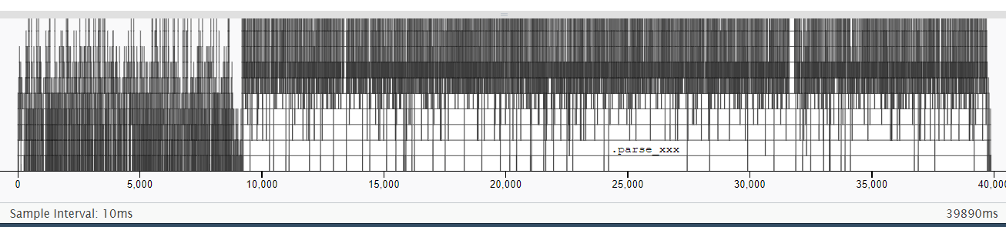

Slide 7
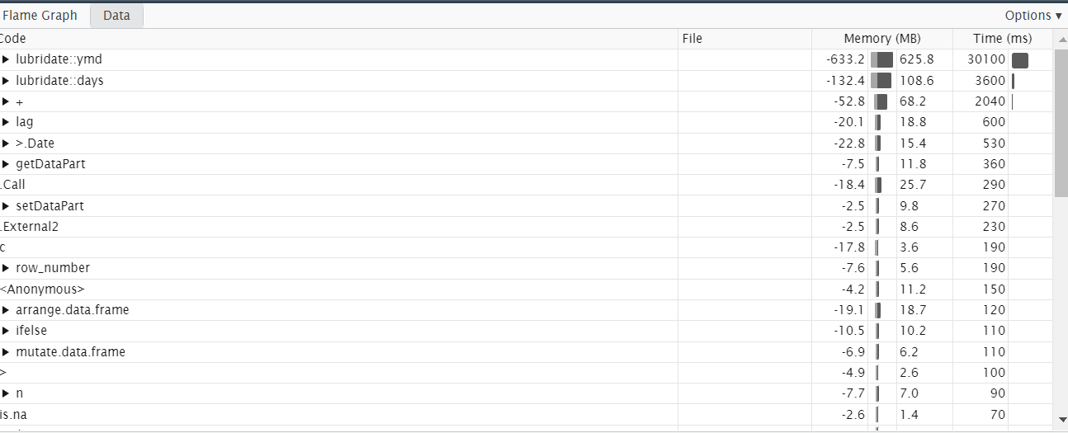


Slide 8
What is the expected result?
Baseline original function:
summary(df_out)
person_id vx_date mrna_dose_no covid19_vax_no vx_manufacturer
Length: 58646 Min. :2020-12-28 0:13079 Min. :1.000 Length:58646
Class :character 1st Qu.:2021-03-19 1:22316 1st Qu.:1.000 Class :character
Mode :character Median :2021-05-18 2:18760 Median :2.000 Mode :character
Mean :2021-06-06 3: 4491 Mean :1.789
3rd Qu.:2021-08-07 3rd Qu.:2.000
Max. :2022-10-02 Max. :6.000

Slide 9
Test on smaller dataset for functionality
Example: for date fromat
head(df$vx_admin_date); head(df$vx_record_date)
[1] "2023-06-14" NA "20151024" "20190927" "20200910" "20210930"
[1] "20210218" "20210311" "20210111" "20210201" "2023-07-10" "2023-07-15“
df[, c("vx_admin_date", "vx_record_date") := lapply(.SD, anytime::anydate), .SDcols = c("vx_admin_date", "vx_record_date")]

Slide 10
Maintaining functionality
Going through each chunk of code - breaking down the problem
Rigorous testing after each change
Ensuring data type format are maintained
Expected result check at each step

Slide 11
Assumption
The refactored function was assumed to deliver the same results as the original function:
While improving execution speed and memory usage
Input data would remain in the same format – somehow
and structure as the existing function was designed to handle
Any changes to the input data may require further modifications to the function

Slide 12
Considerations
Keeping the function code as clean and readable as possible
Documentation through commenting to allow for easier future modifications and understanding.
Exploit capabilities of data.table where applicable:
Modifying data in place,
Use of expressive and concise syntax

Slide 13
Final solution
Incrementally, tidyverse functions replaced with its data.table equivalent, one at a time- Testing for consistent results at each step
Major modifications interms of performance:-
Date format: `anytime::anydate` together with `lapply`
Formatting applied to the required rows – instead of to all the rows
Creation of the 'vx_date' date, we had to utilize the "ifelse" function and the , and then convert them back to numeric values and back to dateformat.
Use of .SDcols and setorder() to group and sort the data by 'person_id' and 'vx_manufacturer’.

Slide 14
Final solution
In terms of the final output, the function delivers a data.table containing columns for 'person_id', 'vx_date', 'mrna_dose_no', 'covid19_vax_no', and 'vx_manufacturer’.
It retains the same functionality as the original, but with improved performance, making it more suitable for large datasets.
The new function runs 480ms (or approximately 0.48 seconds).
This is aprox. 83 times faster than the original

Slide 15
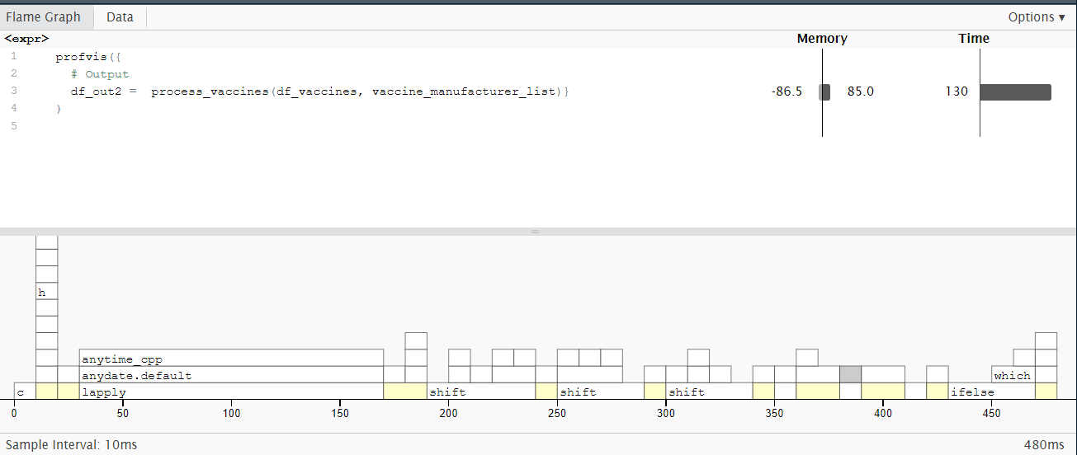

Slide 16
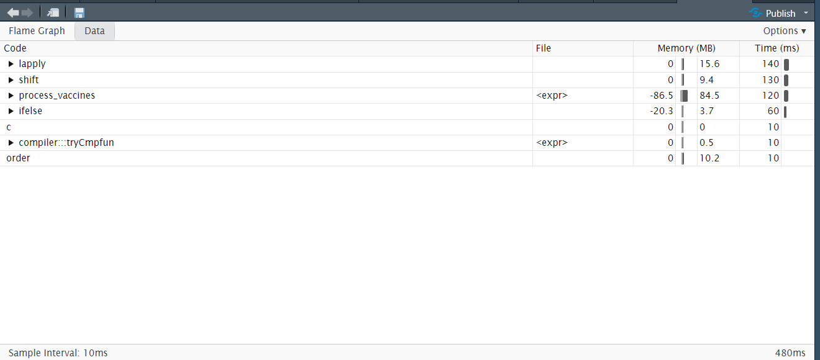

Slide 17
Functionality test on Final
summary(df_out2)
person_id vx_date mrna_dose_no covid19_vax_no
Length:58646 Min. :2020-12-28 Min. :0.000 Min. :1.000
Class :character 1st Qu.:2021-03-19 1st Qu.:1.000 1st Qu.:1.000
Mode :character Median :2021-05-18 Median :1.000 Median :1.000
Mean :2021-06-06 Mean :0.777 Mean :1.538
3rd Qu.:2021-08-07 3rd Qu.:1.000 3rd Qu.:2.000
Max. :2022-10-02 Max. :1.000 Max. :3.000
vx_manufacturer
Length:58646
Class :character
Mode :character

Slide 18
Challenges
Minor
Understanding and translating it with equivalent functions
Example: checking list and ulisting would create error, unless ifelse is used ``` Warning message:In `[.data.table`(df, , `:=`((list_cols), lapply(.SD, unlist)), : length(LHS)==0; no columns to delete or assign RHS to. ```
date format and the order of formatting
df_vaccines[vx_atc == "J07BX03" | vx_type == "covid19", # filter as described in the codebook vx_date := ifelse(!is.na(vx_admin_date), lubridate::ymd(vx_admin_date), lubridate::ymd(vx_record_date))]

