Slide 1


ERASMUS HARDGAINERS RECEPIES Project
Amedeo Carraro, Aidan Guskov, Matteo Rambaldi

Slide 2
TABLE OF CONTENTS
01
02
03
04
05
06
OUR TEAM
INTRODUCTION
PROJECT IMPLEMENTATION
EVALUATION AND VISUALIZATION
FUTURE WORK
CONCLUSION

Slide 3

01
OUR TEAM

Slide 4
Our team
Amedeo carraro
Master in Artificial Intelligence and Robotics
University of Padua, Italy
AIDaN GUSKOV
MATTEO RAMBALDI
Master in Mechanical Engineering and Business Administration
RWTH Aachen University, Germany
Master in Artificial Intelligence and Robotics
University of Padua, Italy

Slide 5

02
introduction

Slide 6
introduction
Streamlining Meal Preparation with NLP: An Erasmus Semester Project
Embarking on an Erasmus semester involves personal and academic growth.
Amidst the excitement of new experiences, managing time for grocery shopping and cooking remains a challenge.
Limited budgets, time constraints, and cooking skills add complexity.
As part of the Natural Language Processing (NLP) course, we realized the potential to streamline meal preparation.
Our goal: leverage NLP techniques to ease culinary challenges.

Slide 7

03
Project implementation

Slide 8
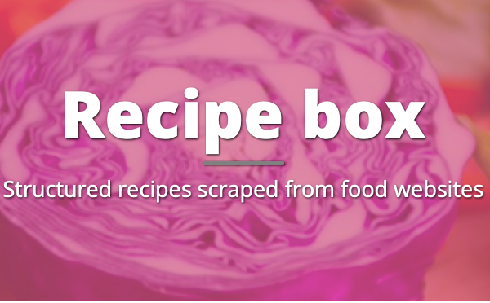
Dataset
Three .json datasets with ~125.000 recipes scraped from various websites as foodnetwork.co.uk, etc…
In each dataset every recipe is in the form:
{
”recipe key": { "title": ” ", "ingredients": [ ” " ], "instructions": ” ",
"picture_link": ” ”
}
In the end we used only one of the three dataset, with 39801 recipes, since the computational power required otherwise will be not sustainable.
Example
{
"rmK12Uau.ntP510KeImX506H6Mr6jTu": {
"title": "Slow Cooker Chicken and Dumplings",
"ingredients": [
"4 skinless, boneless chicken breast halves ADVERTISEMENT",
"2 tablespoons butter ADVERTISEMENT",
"2 (10.75 ounce) cans condensed cream of chicken soup ADVERTISEMENT",
"1 onion, finely diced ADVERTISEMENT",
"2 (10 ounce) packages refrigerated biscuit dough, torn into pieces ADVERTISEMENT",
"ADVERTISEMENT"
],
"instructions": "Place the chicken, butter, soup, and onion in a slow cooker, and fill with enough water to cover.\nCover, and cook for 5 to 6 hours on High. About 30 minutes before serving, place the torn biscuit dough in the slow cooker. Cook until the dough is no longer raw in the center.\n",
"picture_link": "55lznCYBbs2mT8BTx6BTkLhynGHzM.S"
}

Slide 9
Data loading and preprocessing
Data loading
- Used pandas DataFrame for efficient data parsing and manipulation
- Extracted and organized 39,801 recipe entries from JSON files
Data cleaning
- Removed rows with missing titles, ingredients, instructions, or images
- Cleaned extraneous text (e.g., "ADVERTISEMENT") to ensure consistency
outcome
- Robust, clean dataset ready for training and evaluating the Recipe Model (RM)
- After this preliminary data acquisition and preprocessing we create three different approach for create the train and evaluation dataset for our fine tune model

Slide 10
Data loading and preprocessing
SOLUTION 1
SOLUTION 2
SOLUTION 3
without concanate together all the ingredients
without cleaning the quantities of the ingredients
structuring training example as prompts:
f ”### Title: {title}\n ### Ingredients: {ingredients}\n ### Instructions: {instructions}”
concatenating together all the ingredients
without cleaning the quantities of the ingredients
structuring training example as prompts:
f”### Ingredients: ingredients\n ### Generate Title
and Instructions:\n ### Title:title\n ### Instructions:
instructions”
concatenating together all the ingredients
cleaning the quantities of the ingredients
structuring training example as prompts:
f”### Ingredients: ingredients\n ### Generate Title
and Instructions:\n ### Title:title\n ### Instructions:
instructions”

Slide 11
Data loading and preprocessing
SOLUTION 1
SOLUTION 2
SOLUTION 3
Example
### Title: Chocolate Chip Cookie Dough Ice Cream ### Ingredients: ['1 (16 ounce) package refrigerated chocolate chip cookie dough ', '1 quart vanilla ice cream ', '1/2 cup hot fudge sauce ', '1/2 cup caramel sundae syrup ',] ### Instructions: Cut cookie dough into small pieces. Place half of the cookie dough pieces on bottom of 9x5 inch loaf pan. Top with half of the ice cream. Repeat layers. Cover and freeze for at least 4 hours before serving.
Example
### Ingredients: 1/4 cup all-purpose flour for coating , 1/2 teaspoon salt , 1/4 teaspoon ground black pepper , 1/2 teaspoon dried oregano , 4 skinless, boneless chicken breast halves - pounded 1/4 inch thick , 4 tablespoons butter , 4 tablespoons olive oil , 1 cup sliced mushrooms , 1/2 cup Marsala wine , 1/4 cup cooking sherry , ### Generate Title and Instructions: ### Title: Chicken Marsala ### Instructions: In a shallow bowl or pie plate, mix together the flour, salt, pepper, and oregano. Coat the chicken with the mixture; set aside. In a large skillet over medium heat, melt the butter with the olive oil. Add the chicken breasts to the pan and cook until brown on both sides and cooked through, about 5 minutes per side. Remove from the pan and keep warm. Pour off any excess fat in the pan. Saute the mushrooms in the same pan until tender, about 3 minutes. Return the chicken to the pan along with any juices that have accumulated. Stir in the Marsala and sherry. Simmer until the sauce has reduced by half, about 5 minutes.
Example
### Ingredients: brown sugar , sea salt , paprika , ground black pepper , onion powder , garlic powder , ground cumin , dried sage , crushed red pepper, or to taste , chili powder, or to taste , dried thyme, or to taste , ### Generate Title and Instructions: ### Title: Brown Sugar Rubbed Pork Chops ### Instructions: 1. In a small bowl, mix together the brown sugar, sea salt, paprika, black pepper, onion powder, garlic powder, cumin, sage, red pepper flakes, chili powder, thyme, and oregano until well blended. 2. Place pork chops in a shallow dish and sprinkle both sides with rub mixture. Cover and refrigerate for at least 30 minutes. 3. Preheat an outdoor grill for medium-high heat and lightly oil the grate. 4. Grill pork chops for 5 to 7 minutes per side, or until no longer pink in the center and the juices run clear. An instant-read thermometer inserted into the center should read at least 145 degrees F (63 degrees C).

Slide 12

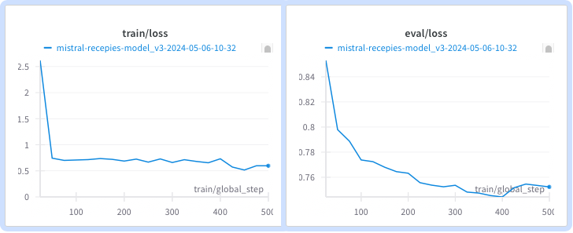
Tokenization and training
Model used Mistral-7B-v0.1 (Transformer-based pre-trained model)
- AutoTokenizer: Efficient management and use of tokenizers linked to pre-trained models
- Dataset divided into title, ingredients, instructions
- Prompts formatted for optimal training:
- First Try: Title, Ingredients, Instructions
- Final: Generate Title and Instructions from Ingredients
- Limited computational resources used 200 initial rows (80% training, 20% evaluation)
- Training steps capped at 500 for convergence without overfitting
- Model saved and evaluated every 25 steps
- Organized checkpoints/logs in separate directories for efficient monitoring and analysis

Slide 13
Quantization and compression
Model prepared for 4-bit training using QLoRA, quantizing the weights of the model
Finetuned with LoRA (Low-Rank Adaptation) by injecting trainable low-rank matrices into each layer of the architecture
LoRAConfig: sets compression ratio, target modules, and dropout rate for balanced compression and accuracy
Model and data parallelism with multi-GPU support for efficient training and inference
Trained model loaded via PEFT(Parameter-Efficient Fine-Tuning), fine-tuning only a small number of parameters while freezing the others
Tokenized prompts fed into the fine-tuned model using the `generate` method for coherent text output
parameter | value | description
r | 32 | Compression ratio that controls the rank of the adaptation matrix
Lora alpha | 64 | Scaling factor to adjust the learning rate for LoRA weights
Target Modules | "q_proj", "k_proj", "v_proj", "o_proj", "gate_proj", "up_proj", "down_proj", "lm_head" | List of target modules for quantization
Bias | "none" | Indicates whether to apply bias correction ("none", "all", or "lora_only")
Lora Dropout | 0.05 | Dropout rate for LoRA layers during training
Post-launch support | "CAUSAL_LM" | Specifies the task type, indicating causal language modeling

Slide 14

04
Evaluation & visualization

Slide 15
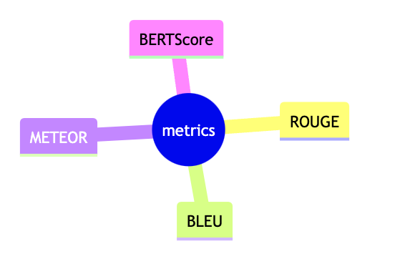
Evaluation metrics
Consistent structure: Title, Ingredients, and Instructions for comprehensive analysis
BLEU: measures n-gram precision between generated and reference texts
ROUGE-1: evaluates unigram recall for text overlap
METEOR: combines exact and semantic similarity using synonyms and stems
Visualizations of BLEU, ROUGE-1, and METEOR scores provide clarity on model performance
Lexical (BLEU, ROUGE-1) and semantic (METEOR) evaluations ensure holistic analysis

Slide 16
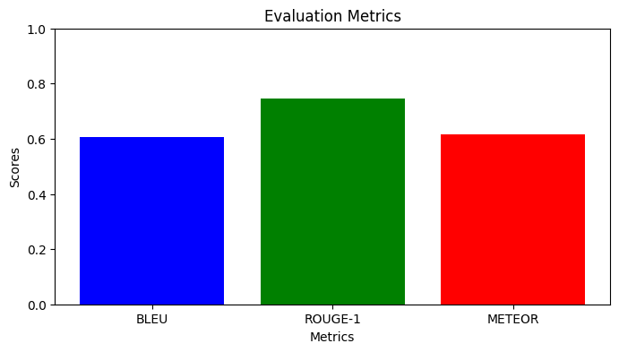
Evaluation process
Model generates titles and instructions from ingredient lists
Tokenized data is processed as PyTorch tensors for efficient GPU inference
Parameters: `max_new_tokens=100` (limit output length) and `repetition_penalty` (avoid repetition)
Quality assessed via creativity, coherence, and relevance to ingredients
Metrics visualized through Matplotlib bar charts for direct comparison and iterative refinement
Evaluation metrics Recipes Model version 1

Slide 17
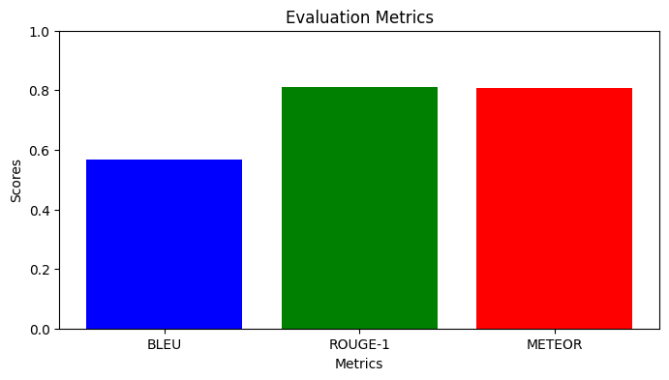
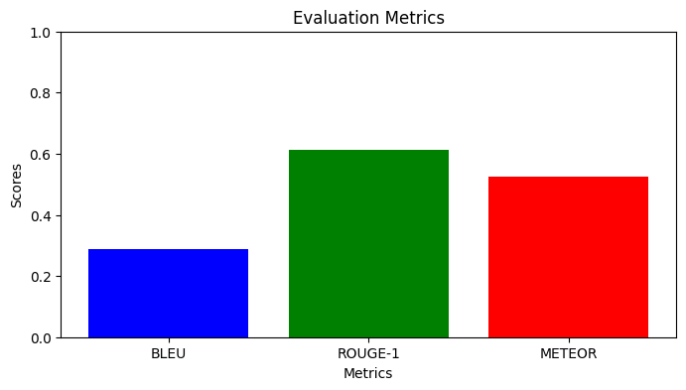
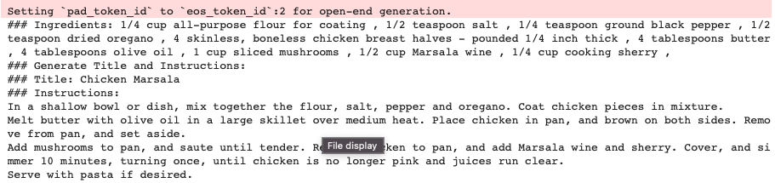
Evaluation process
Evaluation metrics Recipes Model version 2
Evaluation metrics Recipes Model version 3

Slide 18
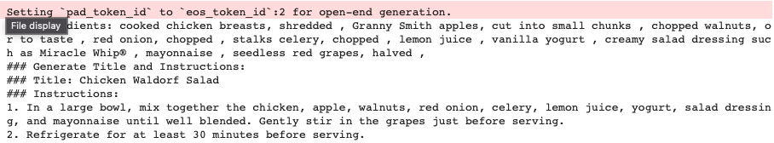
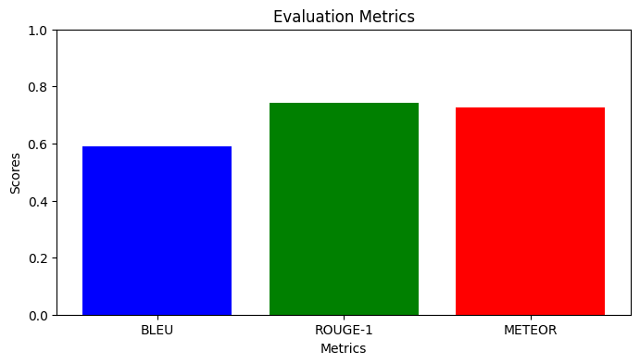
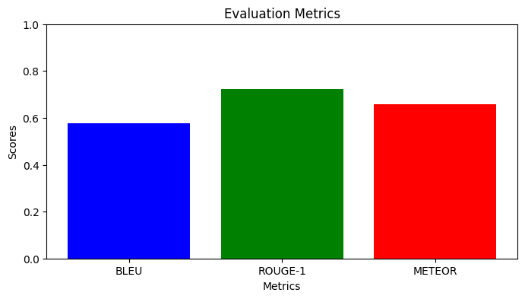
Evaluation process
Evaluation metrics Recipes Model version 4
Evaluation metrics Recipes Model version 5

Slide 19

05
Future work

Slide 20

Future enhancements
Complete Recipe Suggestions: recommend recipes based on partial or available ingredients
Meal Planning: suggest future recipes using ingredients from current meals to minimize waste
Track and optimize macronutrient intake for personalized nutrition
Exclude allergens based on user data for safe, personalized suggestions
Equipment-Based Adjustments: tailor recipes to available kitchen utensils or appliances (e.g., stove-top alternatives)

Slide 21
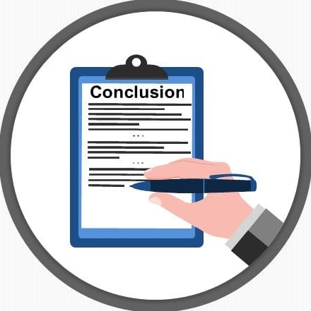
06
conclusion

Slide 22
conclusion
Initial GPU Setup:
Used T4 GPU via Google Colab but faced limitations around 300 rows.
Upgrade to Colab Pro:
Switched to Google Colab Pro, successfully testing on up to 10,000 rows.
Online GPU Rental: Rented GPUs (NVIDIA RTX 4090 and NVIDIA H100) to accelerate final testing.
Final Testing Configuration:
NVIDIA RTX 4090 (24 GiB, 1 GPU, 16 CPUs) - NVIDIA H100 (80 GiB, 1 GPU, 31 CPUs)
Satisfactory Responses:
Testing yielded satisfactory responses, with optimization providing the best possible model.
Metric Performance: Despite constraints, the model performed well according to evaluation metrics.
Limitations:
Couldn't train on the entire dataset or multiple datasets due to limited computational resources.
Faster Testing: Streamlined workload and achieved quicker results.

Slide 23

THANKS!
Do you have any questions?

