Slide 1
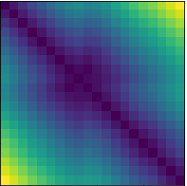
distance matrix
+ Sum over matrix lines
→ Conv2d 1x1 + ReLU
→ Conv1d 5x5 + ReLU
→ Conv1d 5x5 + ReLU + MaxPool
→ UpConv1d 5x5 + ReLU
→ Concatenate
time
8 channels (ch)
+
timeseries
input
(GPS track)
lon
8 ch
16 ch
1 ch
output
(Dive Prediction)
lat
coverage
16 ch
32 ch
time
32 ch

Slide 2
Distance Matrix Encoder (DME)
+ Sum over matrix lines
→ Conv2d 1x1 + ReLU
→ Conv1d 5x5 + ReLU
→ Conv1d 5x5 + ReLU + MaxPool
→ UpConv1d 5x5 + ReLU
→ Concatenate
distance matrix
time
input
(GPS track)
+
8 channels (ch)
timeseries
8 ch
U-Network (UNet)
16 ch
1 ch
output
(Dive Prediction)
20 sucessive positions
lon
lat
16 ch
32 ch
coverage
time
20 associated diving probabilities
32 ch

Slide 3
input
(GPS track)
U-Network (UNet)
output
(Dive Prediction)
Distance Matrix
time

