Slide 1
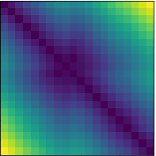
distance matrix
+ Sum over matrix lines
→ Conv2d 1x1 + ReLU
→ Conv1d 5x5 + ReLU
→ Conv1d 5x5 + ReLU + MaxPool
→ UpConv1d 5x5 + ReLU
→ Concatenate
+
time
timeseries
input
(GPS track)
lon
8 ch
U-Network
16 ch
1 ch
output
(Dive Prediction)
lat
coverage
16 ch
32 ch
time
32 ch

