Slide 1
Model Formalisms for Seabird Trajectory Simulation
March 2021
Amédée Roy

Slide 2

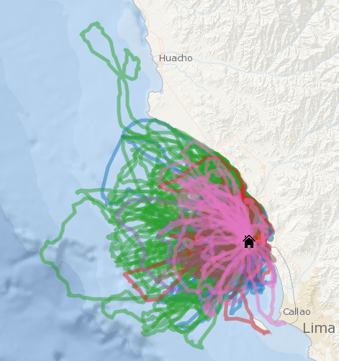
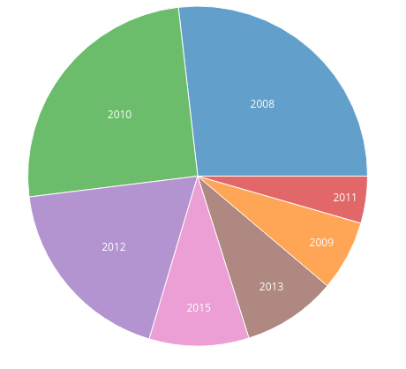
Introduction
Materials & Methods
Results
Discussion
Dataset
Foraging Trips of SV
- 1 species - 7 fieldworks - 179 deployments - 560 trips
Data Formatting
- round trips only - no night-long resting - 15s re-interpolation - diving probabilities estimation
Ecological question - inter-annual variability

Slide 3
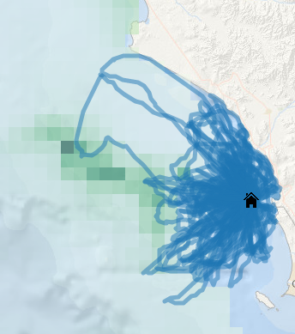
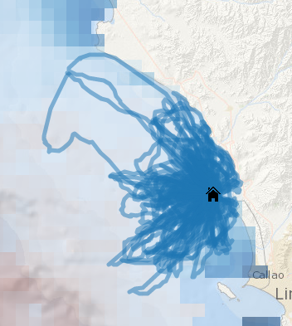
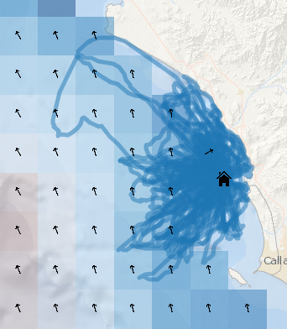
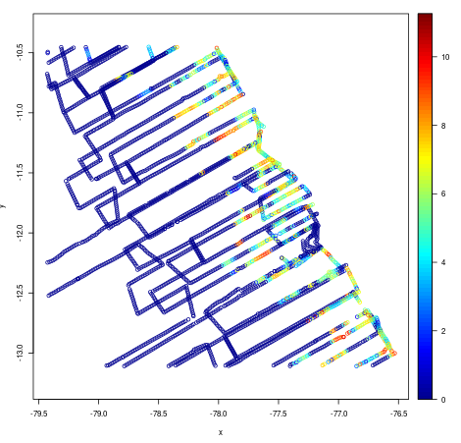
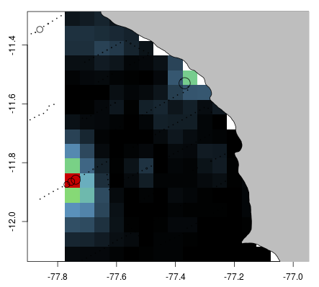
Introduction
Materials & Methods
Results
Discussion
Environmental data
CHL - MODIS (0.04°)
SST - MODIS (0.04°)
Wind - ASCAT (0.12°)
Satellital data
- Daily satellital observations - Daily models for interp.
Acoustic data
- Yearly survey data
Acoutic survey data (raw + kriged)

Slide 4
Introduction
Materials & Methods
Results
Discussion
Social interactions
Simultanate deployments
- Few simultanate trips (max ~5)
- Very low proportion of real observable birds..
- Yet patterns in directions

Slide 5
Introduction
Materials & Methods
Results
Discussion
Problem formulation
1. Agent-based formulation
Behaviour Cloning (supervized learning on state/actions pairs)
(state)
(policy)
(action)
x(t)
F
dx/dt
GAIL (GAN for simulation of state/actions pairs)
noise
x(t)
G
dx/dt
D
0,1?
x(t)

Slide 6
Introduction
Materials & Methods
Results
Discussion
Problem formulation
2. Global formulation
noise
Sequential Trajectory (GAN)
x(t)
G
dx/dt
x(1), ..., x(t)
D
0,1?
noise
G
x(1), ..., x(t)
Global Trajectory (GAN)
D
0,1?

Slide 7
Introduction
Materials & Methods
Results
Discussion
Latent Representation
- State x(t) : time-series of with window n
- Environmental conditions E fixed for a trajectory
- Positions coordinates Xt
E
H (CNN encoding)
Yt
Xt
latent representation
one-hot vector
x(t) = ((Xt-n, Yt-n), ..., (Xt, Yt))

Slide 8
Introduction
Materials & Methods
Results
Discussion
Latent Representation
- State x(t) : time-series of with window n
- Environmental conditions E fixed for a trajectory
- Positions coordinates Xt
E
H (RNN encoding)
Yt
X1, ..., Xt
...
latent representation
one-hot vector
x(t) = ((Xt-n, Yt-n), ..., (Xt, Yt))

Slide 9
Introduction
Materials & Methods
Results
Discussion
Model Evaluation

Slide 10
Introduction
Materials & Methods
Results
Discussion
Results

Slide 11

Introduction
Materials & Methods
Results
Discussion
Discussion

