Slide 1




$$z$$
$$x_{t+1}$$
[$x_{0}$, ... , $x_{n}$]
$$x_{t}$$
$$z$$
[$x_{0}$, ... , $x_{n}$]
[$x_{0}$, ... , $x_{n}$]
True / False

Slide 2
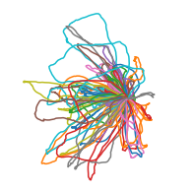




(A)
(B1)
Simulated tracks
$$z$$
$$h_{t+1}$$
[$x_{0}$, ... , $x_{n}$]
[$x_{0}$, ... , $x_{n}$]
$$h_{t}$$
$$z$$
G($z$)
00
(B2)
Real tracks
D($x_{0}...x_{n}$)
True / False
$$z$$
[$x_{0}$, ... , $x_{n}$]
[$x_{0}^{i}$, ... , $x_{n}^{i}$]
(B3)
[$x_{0}$, ... , $x_{n}$]
True / False

Slide 3
(A)
(B)
Simulated tracks
[$x_{0}$, ... , $x_{n}$]
(LSTM)
$$X$$
$$y_{t+1}$$
$$Y$$
$$z$$
G($z$)
$$y_{t}$$
00
D($x_{0}...x_{n}$)
True / False
Real tracks
[$x_{0}^{i}$, ... , $x_{n}^{i}$]
(CNN)
$$X$$
$$Y$$

Slide 4





Simulated tracks
[$x_{0}$, ... , $x_{n}$]
$$z$$
G($z$)
D($x_{0}...x_{n}$)
True / False
Real tracks
[$x_{0}^{i}$, ... , $x_{n}^{i}$]

Slide 5






Generator
Discriminator
$$z_{0}$$
$$x_{0}$$
$$x_{0}$$
$$p_{0}$$
LSTM
$$...$$
$$...$$
$$...$$
$$...$$
True / False
$$z_{n}$$
$$x_{n}$$
$$x_{n}$$
$$p_{n}$$
$$x_{0}$$
$$x_{0}$$
CNN
$$z_{0}$$
$$...$$
$$z_{n}$$
$$...$$
$$...$$
True / False
$$x_{n}$$
$$x_{n}$$

Slide 6


Generator
Discriminator
$$z_{0}$$
$x_{1}$ - $x_{0}$
$$x_{0}$$
$$p_{0}$$
$$h_{1}$$
$$h_{1}$$
LSTM
$$...$$
$$...$$
$$...$$
$$...$$
True / False
$$...$$
$$...$$
$$z_{n}$$
$x_{n+1}$ - $x_{n}$
$$x_{n}$$
$$p_{n}$$
$$h_{n}$$
$$h_{n}$$
$$h_{C}$$
$$h_{D}$$
$$h_{D}$$
$$h_{C}$$
$$h_{B}$$
$$x_{0}$$
$$x_{0}$$
$$h_{B}$$
$$h_{A}$$
CNN
$$h_{A}$$
$$...$$
$$...$$
True / False
$$z_{0}$$
$$...$$
$$z_{n}$$
$$x_{n}$$
$$x_{n}$$

Slide 7
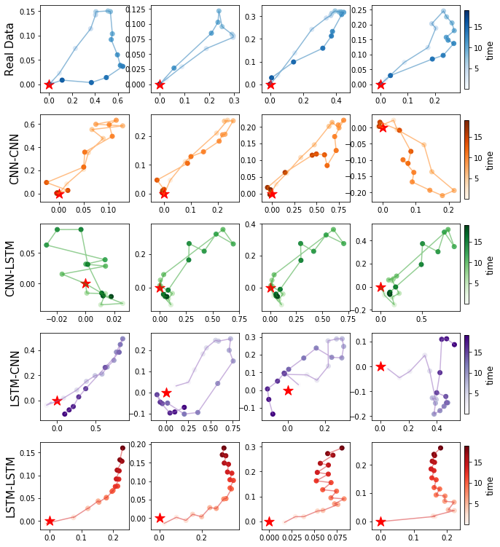

Slide 8
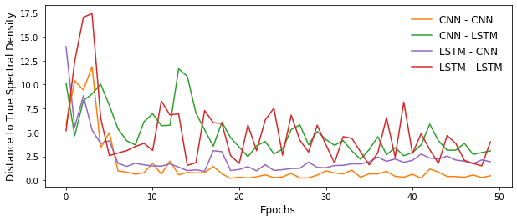

Slide 9
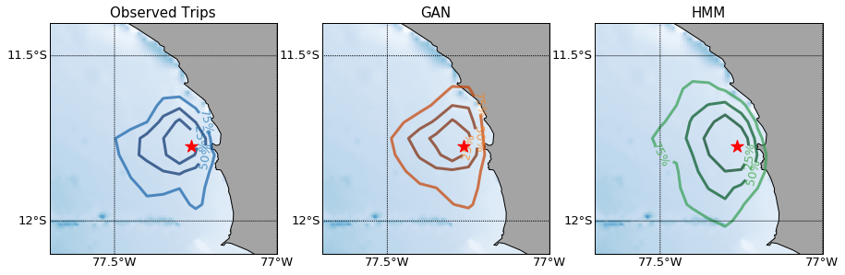
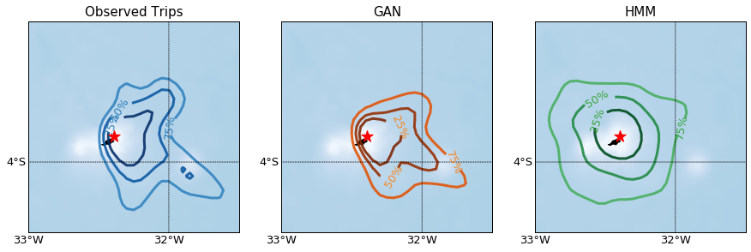
(A)
(B)

Slide 10
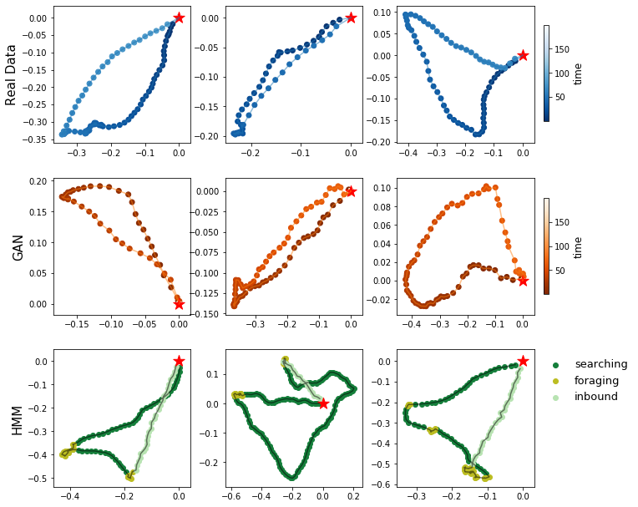
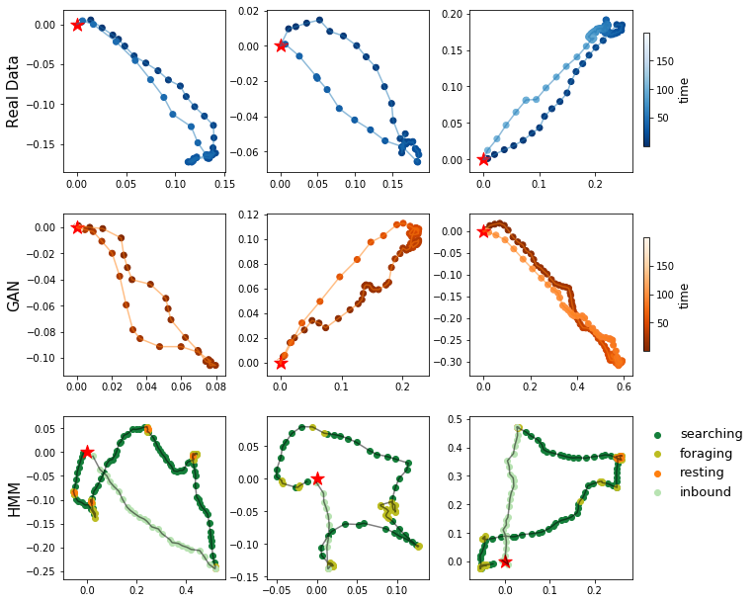
(A)
(B)

Slide 11
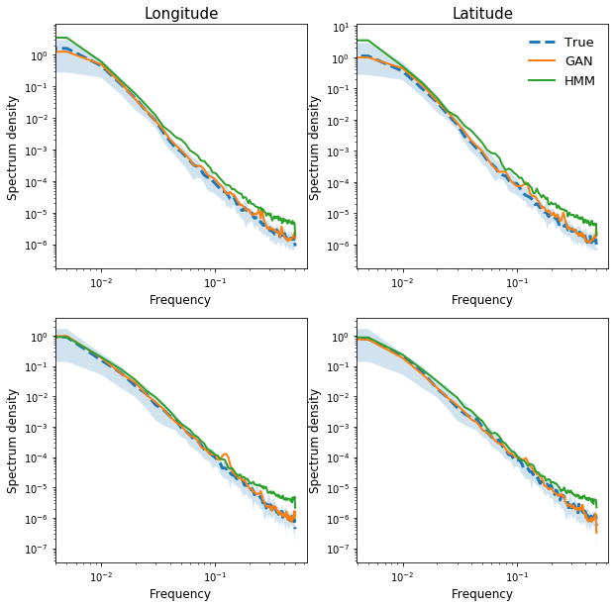
(A)
(B)

Slide 12
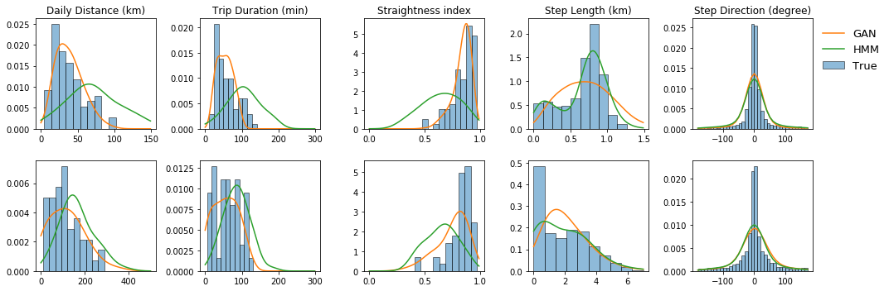
(A)
(B)

