Slide 1
Office Queue Management
Team P10

Slide 2
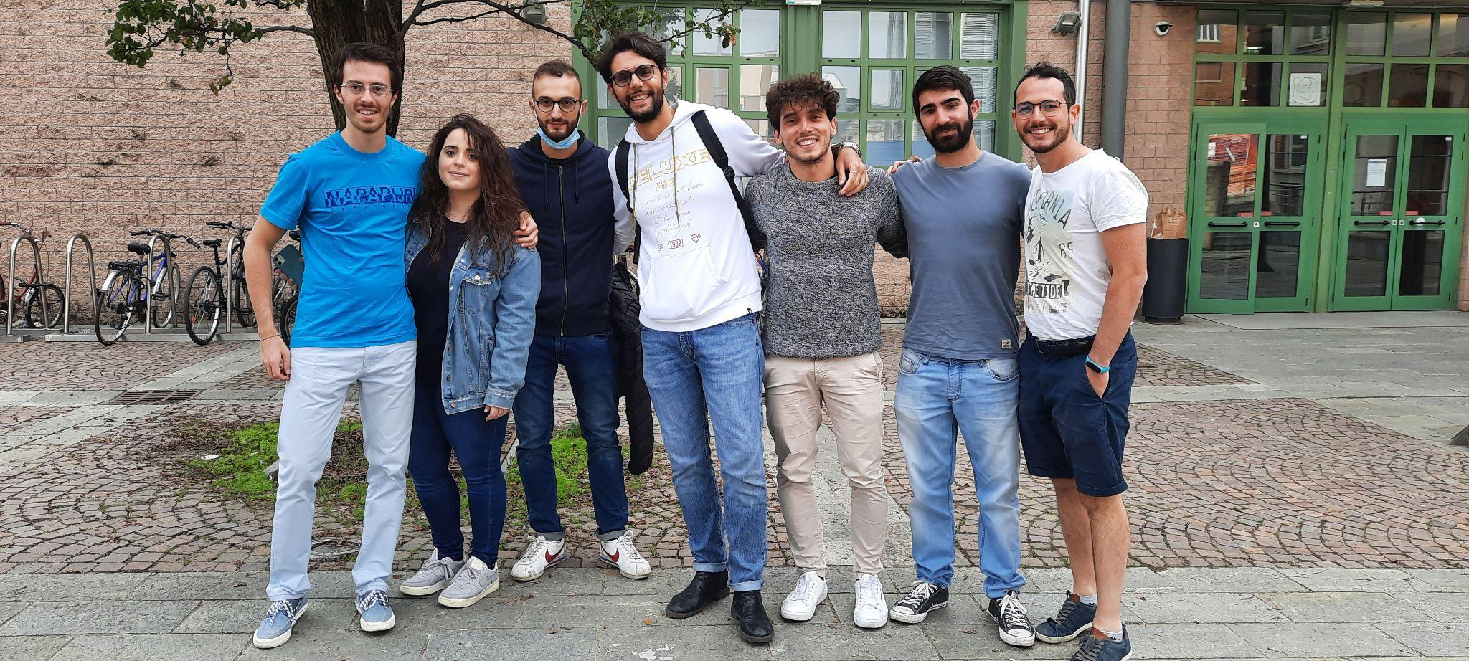
P10 team members
Alessandro Morelli
Basilico Michele
Chimirri Armando
Damino Desirè
Frolli Andrea
Morelli Alessandro
Romano Gabriele
Sarpa Amedeo

Slide 3

Stories
As a customer I want to select a type of service So that I can receive a ticket to be served. Story points : 5
As an officer I want to call the next client So that I can serve him. Story points : 8
As a customer I want to see the estimated waiting time So that I know when I could be served. Story points : 2
As a customer I want to check queues changes So that I can know queue length related to my requested service. Story points : 5
As a customer I want to check the main display So that I can see the called number. Story points : 3

Slide 4
Stories out of the Sprint
As a manager I want to query the system So that I can see the statistics. Story points : 8
As a manager I want to configure the system. Story points : 13

Slide 5
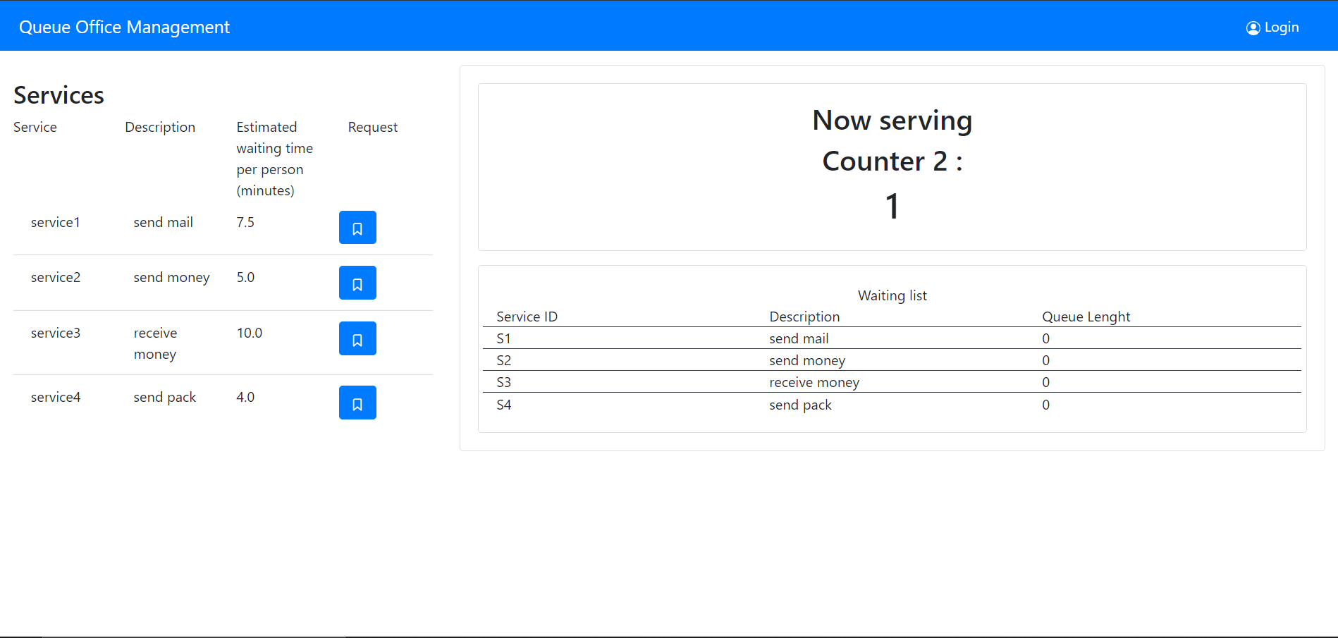
As a customer I want to select a type of service, so that I can receive a ticket to be served.

Slide 6
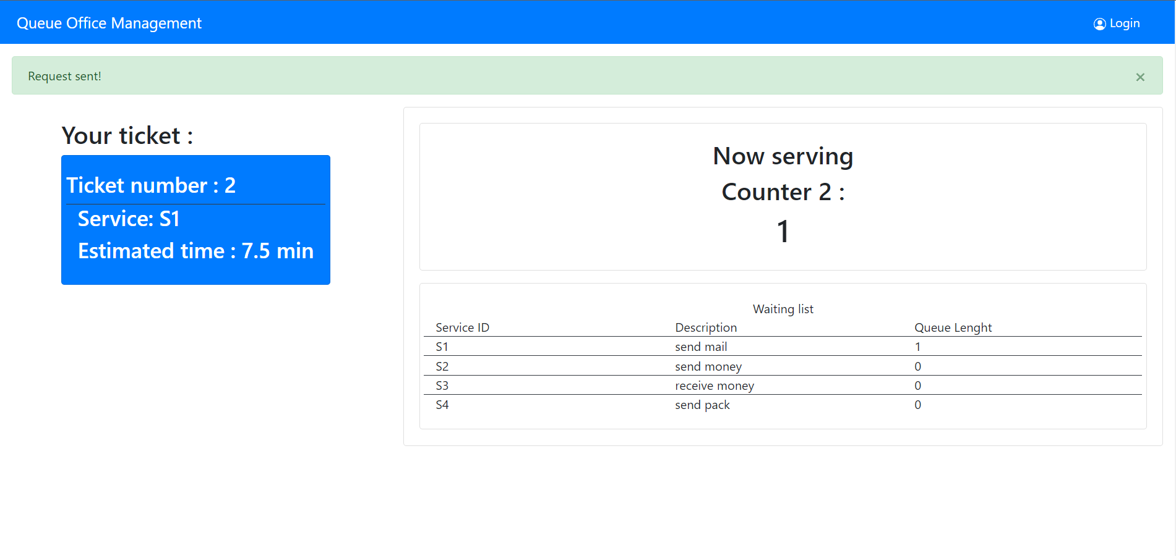
As a customer I want to see the estimated waiting time, so that I know when I could be served.

Slide 7
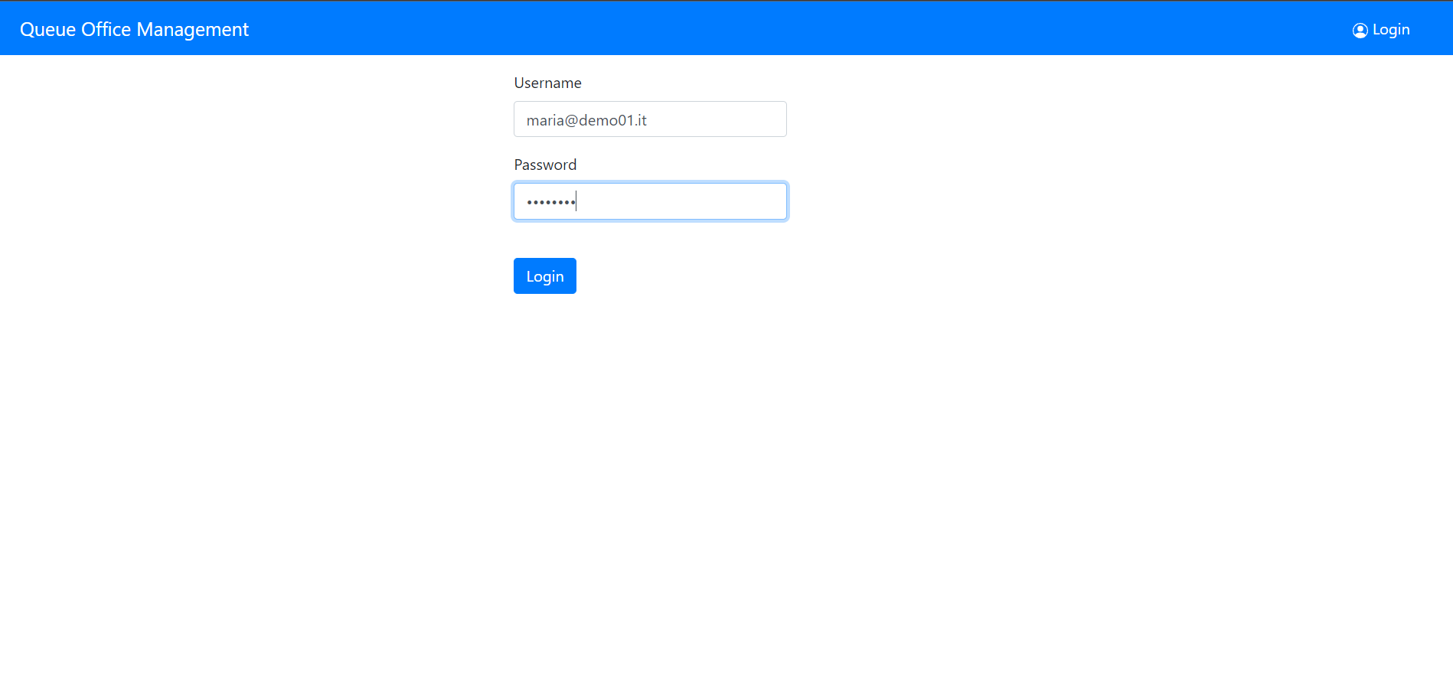
As an officer I want to call the next client, so that I can serve him.

Slide 8
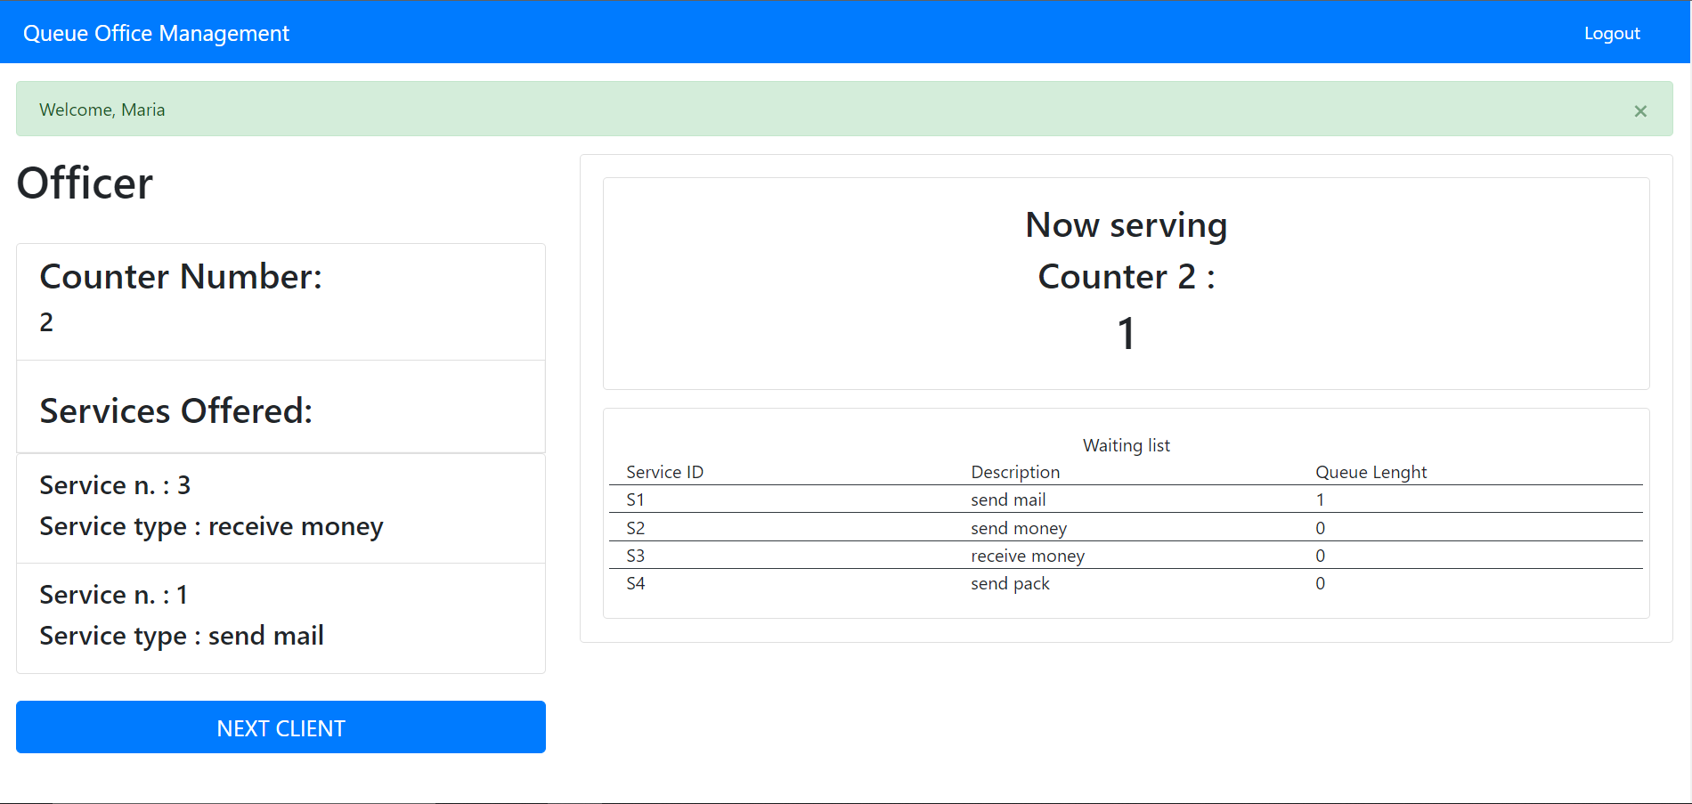
As an officer I want to call the next client, so that I can serve him.

Slide 9
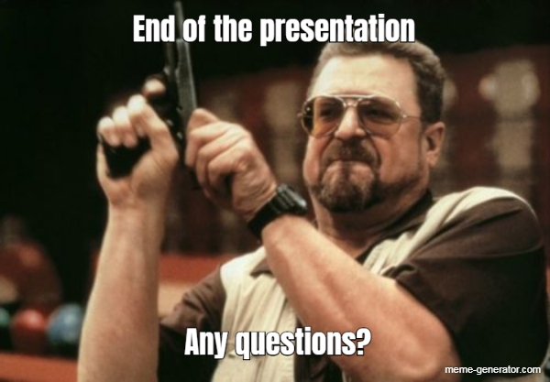
Thank you

