Slide 2
Testo

Slide 3
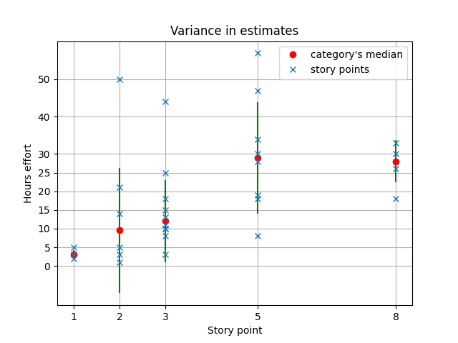
Chart Variance in Estimates
The most significant results come from the category of estimated user stories 5 :
There there is the highest number of bad estimated stories and the median is even higher than those with estimate 8.
Furthermore, the two user stories whose effort was about 30h, therefore similar to the median, and which according to the graph are well estimated, for the team, on the other hand, the two were

Slide 4
User stories bad estimates
User Story | #Sprint | Total Effort | Estimation
Create helm chart and deploy the rewards | 3 | 50h | 2 | Under
Restyle of user interface | 3 | 57h | 5 | Under
Create a reward | 3 | 25h | 3 | Under
Filter functionalities by role | 3 | 8h | 5 | Over
Request for activity grains | 4 | 47h | 5 | Under
See Alten grais point | 4 | 5h | 1 | Under
Accept or deny request | 4 | 44h | 3 | Under
Give Alten grains | 5 | 18h | 8 | over

Slide 5
User Story | #Sprint | Total Effort | Estimation
Create helm chart and deploy the rewards | 3 | 50h | 2 | Under
Restyle of user interface | 3 | 57h | 5 | Under
Create a reward | 3 | 25h | 3 | Under
Filter functionalities by role | 3 | 8h | 5 | Over
Request for activity grains | 4 | 47h | 5 | Under
See Alten grais point | 4 | 5h | 1 | Under
Accept or deny request | 4 | 44h | 3 | Under
Cancel request | 4 | 18 | 3 | Under
Learn react query and apply to the projecy | 4 | 34 | 5 | under
Give Alten grains | 5 | 18h | 8 | over
Send notification | 5 | 28h | 5 | Under
Print notification | 5 | 30h | 5 | under
Give feedback when an user performs an action | 5 | 15h | 3 | Under
Filter of the view of pending requests | 5 | 3h | 3 | Over
Event date in requests for activites | 6 | 21h | 2 | Over
Validation popup for activities | 6 | 14h | 2 | over
User stories bad estimates

Slide 6
Pearson correlator
We indivituated 8 more bad estimated stories, and one that for the the algorithm is bad estimated, for us is not
Here there is the link of github repository, under the folder timesheets you can find for each sprint the effort in hours spent by each person and for each sotry bad estimates for the team, feedbacks provided by the developers
Oss that the number of team members was not the same on each sprint, beacuse our supervisors sometimes take one/two of us to do some other stuff. This aims to train the team to deal with any unexpected events that may occur during the sprint.

Slide 7
Pearson correlator
pearsonn
Indicator | Inaccurate stories
New functionalities | 0.158
New technologies | 0.59
Spike | 0.48

Slide 8
Testo
Now with the team, following the analysis and discussion of the results seen so far, we have estimated the remaining user stories of the catalog.
Further updates coming soon

