Slide 1


E-commerce Customer Behaviour Analysis and Insights​
Jarvin Mutatiina
Supervisor
Imad Abo Dehn
Team Leader - Trainee
Ameen Abass
Trainee
Majd Al-Batran
Trainee
Sakaria Abukar
Trainee

Slide 2

agenda
Introduction
Data Overview
Data Processing with Spark
Analysis & Insights
Orchestration with Airflow
CI/CD Pipeline with GitHub Actions
Challenges & Solutions
Conclusion
Q&A
Notes:
Before diving into the content, let me quickly walk you through today's agenda. We will start with an introduction, where I'll provide an overview of the objectives of this project. Then, we'll move on to the data overview, where I'll describe the type of data used for this e-commerce customer behavior analysis.
Following that, I'll explain how we processed the data using Spark, which enabled us to handle large datasets efficiently. Then, we'll delve into the main part of the presentation: the analysis and insights drawn from the data.
After that, I'll talk about how we used Airflow for orchestration and GitHub Actions for CI/CD pipelines, ensuring smooth automation and collaboration.
We'll also cover the challenges faced during the project and the solutions implemented to overcome them. Finally, I'll wrap up with a conclusion, and then we can open the floor for any questions.

Slide 3


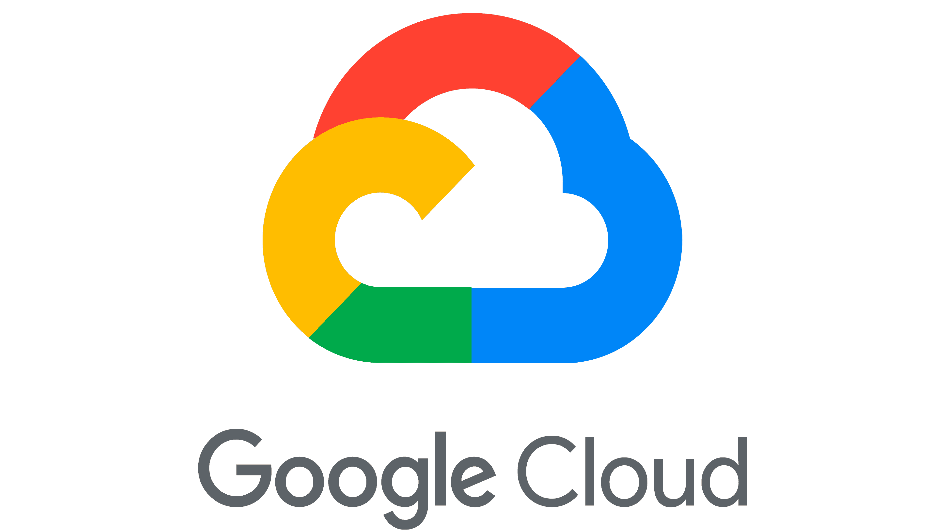

Introduction
Objective:
Analyze e-commerce customer behavior to derive insights that can improve business decision-making.
Scope:
Data Processing with Spark
Orchestration with Airflow
Deployment with GitHub Actions and GCP.
Notes:
In this presentation, our objective is to analyze e-commerce customer behavior and extract actionable insights that can help businesses make more informed decisions. Understanding how customers interact with online platforms is crucial for improving conversion rates, retention, and overall business performance.
The scope of this analysis revolves around three main areas:
Data Processing with Spark – We leveraged Spark to process and analyze large-scale customer data efficiently.
Orchestration with Airflow – Airflow was used to manage the workflow and schedule different data pipelines seamlessly.
Deployment with GitHub Actions and Google Cloud Platform (GCP) – We integrated continuous integration and deployment (CI/CD) pipelines using GitHub Actions, and the solution was deployed on GCP to ensure scalability and performance.
These tools and frameworks allowed us to create a robust infrastructure for the analysis.

Slide 4
Data Overview
Dataset Description:
Customer transactions including age, city, items purchased, and total spend.
Columns in this file:​
Customer ID - Integer
Gender – String
Age – Integer
City – String
Membership Type – String
Total Spend – Numeric
Items Purchased – Integer
Average Rating – Numeric
Discount Applied – Boolean
Days Since Last Purchase – Integer
Satisfaction Level – String
Data Source:
Stored in Google Cloud Storage, sourced from Kaggle.
Key Variables:
Discount Applied, Membership Type, Satisfaction Level and Total Spend.
Notes:
Let’s take a closer look at the dataset used for this analysis.
Dataset Description:
The data captures customer transactions and includes features like customer demographics (age, city), the items purchased, total spend, and other relevant attributes that provide a holistic view of customer behavior on the platform.
Data Source:
The dataset was sourced from Kaggle and stored in Google Cloud Storage for easy access and scalability during the analysis.
Key Variables:
Some of the key variables we focused on for our analysis include:
Discount Applied: To determine the effect of discounts on purchasing decisions.
Membership Type: Categorizing customers based on their membership levels.
Satisfaction Level: A key factor in understanding customer retention.
Total Spend: This was crucial to analyze customer lifetime value.
Columns in the File:
Here is a breakdown of the main columns in the dataset:
Customer ID, Gender, Age, and City give us the basic demographic information.
Membership Type, Total Spend, and Items Purchased provide insight into customer engagement.
Other columns, such as Average Rating and Satisfaction Level, help us understand customer feedback and their experience with the platform.
This structured data enabled us to perform various types of analyses that we’ll discuss in the upcoming slides.

Slide 5
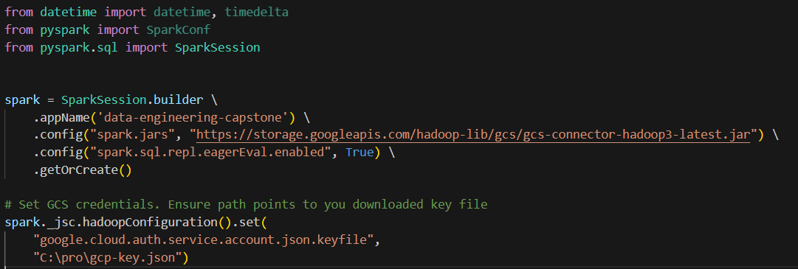
Data Processing with Spark
Spark Setup:
Configuring Spark with GCP connector to read and write data.
Notes:
Purpose: We're configuring Spark to seamlessly interact with Google Cloud Platform (GCP) for reading and writing data.
Key Components:
Libraries: Importing necessary libraries like datetime, pyspark, and SparkSession for data manipulation and Spark configuration.
SparkSession: Creating a SparkSession instance, which is the entry point for all Spark applications.
GCP Connector: Setting up the GCP connector to establish a connection between Spark and your GCP storage bucket.
Credentials: Ensuring that you have the correct GCP service account credentials in place to authorize access.

Slide 6
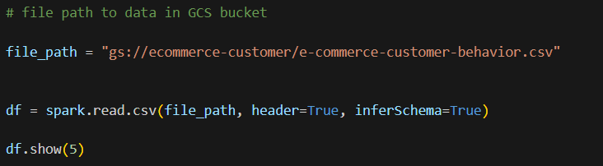
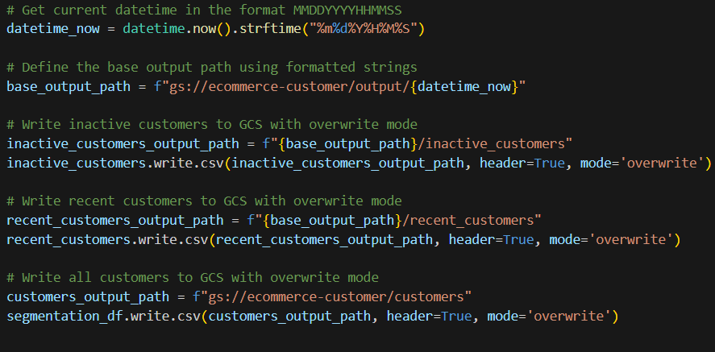
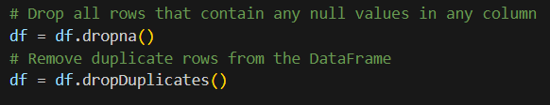
Data Processing with Spark
ETL Pipeline:
1. Extract: Read data from GCP.​
3. Load: Write transformed data back to GCP.​
2. Transform: cleaning the data.​​
Notes:
Now that we've loaded the data, let's move on to the data transformation phase.
ETL Pipeline (continued):
Data Extraction: We'll now extract the e-commerce data from Google Cloud Storage into a Spark DataFrame,
Transform:
Data Cleaning: We'll clean the data by removing null values and duplicate rows. This ensures data quality and consistency.
Data Preparation: in the next step, we'll perform additional transformations to prepare the data for analysis.
Load:
Output Paths: We defined the output paths to store the transformed data back in Google Cloud Storage.
Writing Data: Using Spark's write operations, we'll save the cleaned and transformed data to the specified output paths.
By completing this ETL pipeline, we'll have a clean and well-structured dataset ready for analysis

Slide 7
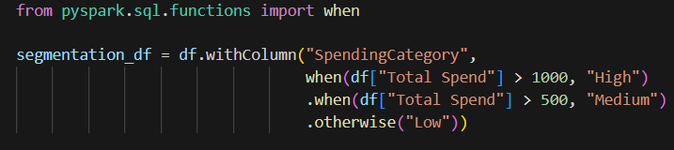
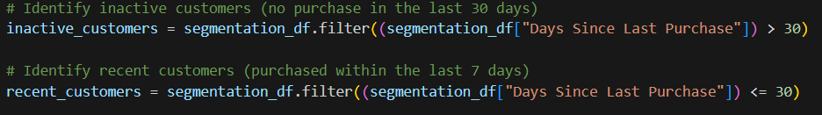
Analysis & Insights
Customer Segmentation:
Segmenting customers based on spending habits and activity
Adding a new column " Spending Category"
Notes:
Now that we've prepared the data, let's move on to the analysis phase. We'll start by segmenting customers based on their spending habits and activity.
Customer Segmentation:
Spending Category: We'll create a new column called "SpendingCategory" to categorize customers into three groups: "High," "Medium," and "Low" spenders based on their total spend.
Code Snippet: The code snippet demonstrates how to use Spark SQL's "when" function to assign categories based on spending thresholds.
Identifying Customer Segments:
Inactive Customers: We'll identify customers who haven't made a purchase in the last 30 days.
Recent Customers: We'll also identify customers who have made a purchase within the last 30 days.
By segmenting customers in this way, we can gain valuable insights into different customer behaviors and tailor our marketing strategies accordingly.

Slide 8
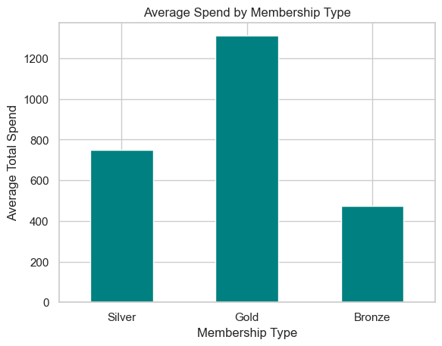
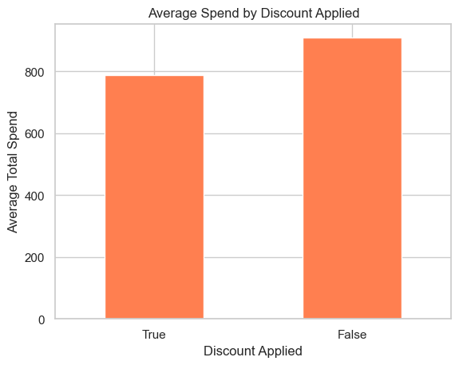
Analysis & Insights
Spending Behaviour Analysis:
Plotting Average Spend by Membership Type
Plotting Average Spend by Discount Applied
Notes:
Now, let's visualize our customer segmentation results to gain a better understanding of spending behavior.
Spending Behavior Analysis:
Average Spend by Membership Type: The bar chart shows the average total spend for each membership type. As expected, Gold members have the highest average spend, followed by Silver and Bronze members.
Average Spend by Discount Applied: Contrary to expectations, our data shows that customers tend to spend more when a discount is not applied. This could be due to several factors, such as limited-time offers, or perceived product quality and It's important to consider these factors when developing pricing strategies and promotional campaigns.
Limited-Time Offers: The absence of a discount might create a sense of urgency, encouraging customers to purchase items they might have otherwise hesitated on.
Discount Perception: Customers may perceive discounts as a sign of lower-quality products, leading them to choose non-discounted items.

Slide 9
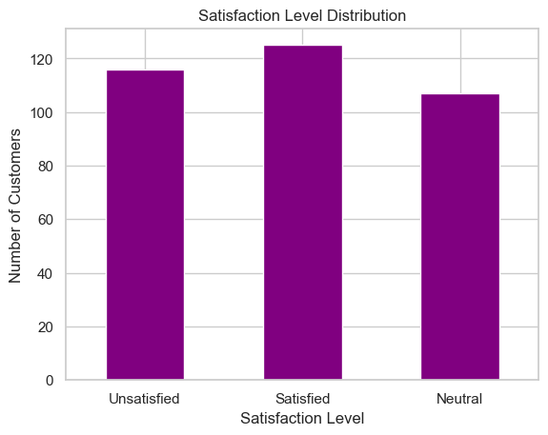
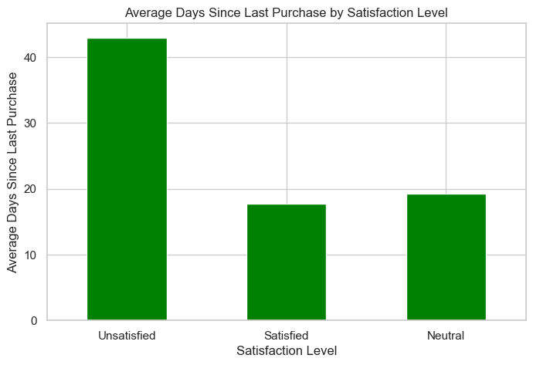
Analysis & Insights
Satisfaction Analysis:
Churn Prediction Indicators:
Satisfaction Level Distribution
Average Days Since Last Purchase by Satisfaction Level
Notes:
Let's continue our analysis by examining customer satisfaction and exploring potential indicators of churn. Satisfaction Analysis (continued):
Satisfaction Level Distribution: The bar chart provides a clear overview of customer satisfaction levels. While a majority of customers are satisfied, there's still a significant portion that are unsatisfied or neutral. This indicates room for improvement in terms of customer experience.
By understanding this distribution, we can identify areas where we need to focus on enhancing customer satisfaction and loyalty.
Average Days Since Last Purchase by Satisfaction Level: This bar chart reaffirms the previous finding. Unsatisfied customers tend to have a significantly higher average number of days since their last purchase compared to satisfied and neutral customers. This suggests that customer dissatisfaction is a strong predictor of churn.
By identifying these at-risk customers, we can take proactive steps to address their concerns and prevent them from churning.

Slide 10
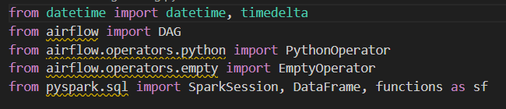
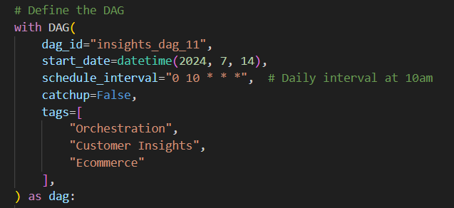
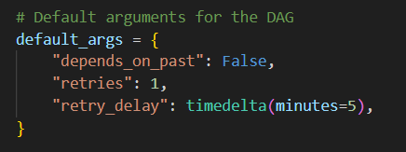
Orchestration with Airflow
DAG Components 1:
Library imports:
DAG definition:
DAGs are scheduled to run daily at 10 AM.
DAG arguments:
Notes:
DAG Configuration:
The DAG (insights_dag_11) is scheduled to run daily at 10 AM starting from July 14, 2024, with retries and delays configured in case of failure.
Tags are added for better categorization in the Airflow UI: "Orchestration", "Customer Insights", and "Ecommerce".

Slide 11
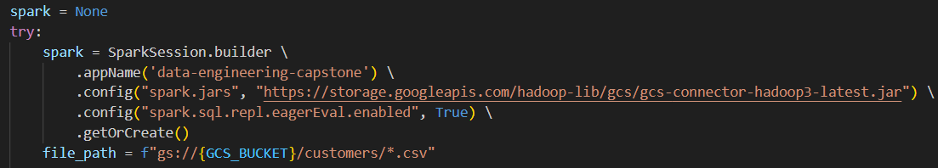

Orchestration with Airflow
DAG Components 2:
ETL Task "etl_with_spark()" steps:
Configuring Spark:
Extract:
Notes:
PySpark ETL Process:
Reading Data from GCS (read_data):
A PySpark DataFrame is created by reading CSV files from the specified GCS bucket using the Spark read.csv method.
Transforming Data (calculate_highest_spend):
The function groups the data by City and SpendingCategory, and calculates aggregated statistics such as the average age, average items purchased, and average and total spend.
The results are sorted in descending order based on average spend.
Writing Data to GCS (write_to_gcs):
The processed data is converted to a Pandas DataFrame and then written to a CSV file in GCS. The filename includes a timestamp for uniqueness.
ETL Workflow (etl_with_spark):
Initializes a Spark session with a GCS connector.
Reads, processes, and writes customer data, handling potential errors and ensuring Spark is stopped at the end of the process.

Slide 12
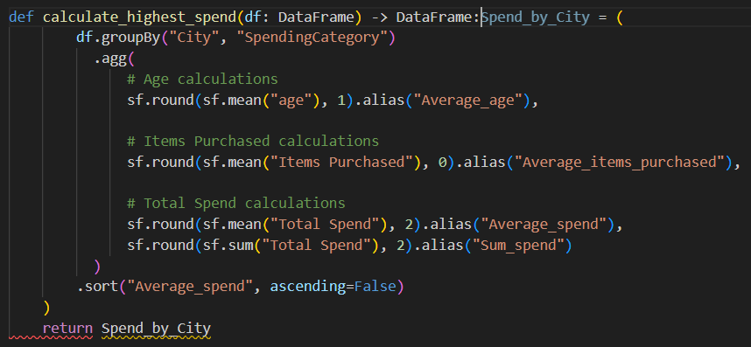

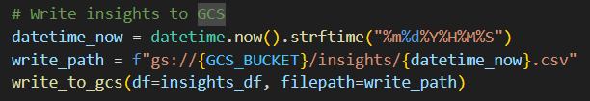

Orchestration with Airflow
DAG Components 3:
ETL Task "etl_with_spark()" steps:
Transform:
Load:

Slide 13
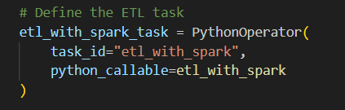


Orchestration with Airflow
DAG Components 2:
ETL Task definition:
Tasks pipeline:
Empty Task definition:
Notes:
Tasks:
etl_with_spark_task: Executes the etl_with_spark function using a PythonOperator.
does_nothing: A simple placeholder task using EmptyOperator, which can be replaced or expanded later as needed.
Task Dependencies:
The ETL task runs first, and upon completion, the does_nothing task is executed.

Slide 14

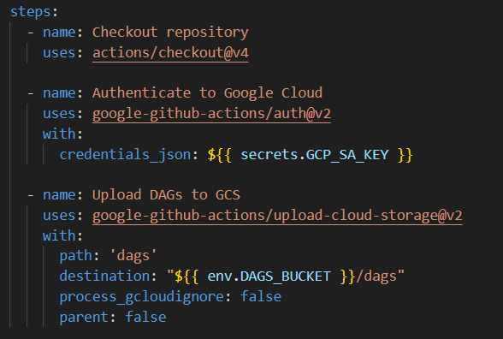
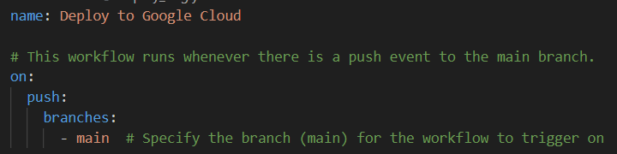
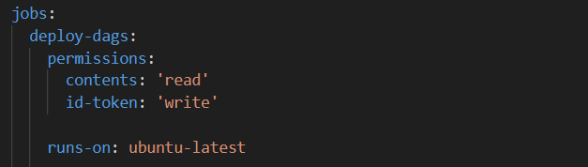
CI/CD Pipeline with GitHub Actions
Workflow Setup:
3. Environment Variable (env):
Configuring GitHub Actions to deploy DAGs to GCP.
Code Snippets:
YAML configuration for GitHub Actions.​
4. Steps:
Event Trigger (on push):
2. Job (deploy-dags):
Notes:
1.Event Trigger (on: push): The workflow triggers when a push event occurs on the main branch.
2.Job (deploy-dags):
It runs on the latest Ubuntu machine (runs-on: ubuntu-latest).
Grants necessary permissions (contents: read and id-token: write) to interact with the repository and authenticate with Google Cloud.
3.Environment Variable (env):
DAGS_BUCKET is set to the GCS bucket name where the DAGs will be uploaded.
4.Steps:
Checkout Repository: Uses the actions/checkout@v4 action to pull the repository's code.
Authenticate to Google Cloud: Uses the google-github-actions/auth@v2 action to authenticate with Google Cloud using a service account key stored as a secret (GCP_SA_KEY).
Upload DAGs to GCS: Uses the google-github-actions/upload-cloud-storage@v2 action to upload the DAGs directory to the specified GCS bucket.
This setup is solid for automating DAG deployment to GCS via GitHub Actions.

Slide 15
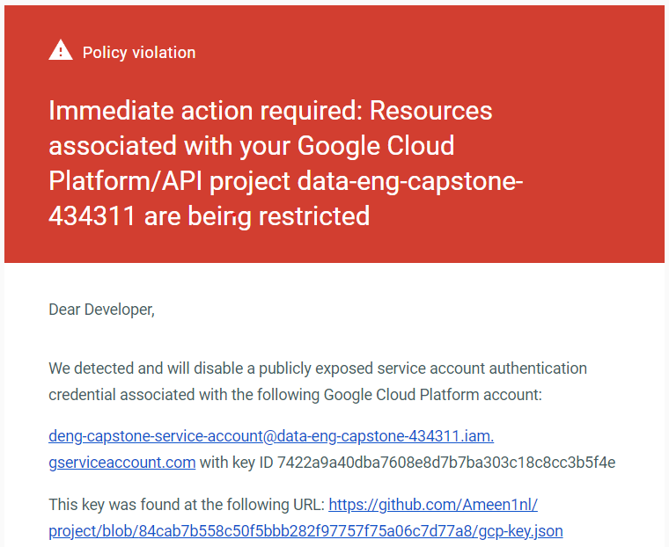
Challenges & Solutions
Deployment:
Overcame issues with CI/CD setup and Airflow deployment.
Overcame issues with Git version control
Security:
Overcame issue with secure handling of GCP credentials.

Slide 16

Conclusion
Summary:
In conclusion, our analysis of customer data has revealed valuable insights into satisfaction levels, spending patterns, and membership behavior.
Recommended actions:
Prioritize customer satisfaction.
Optimize discount strategies.
Enhance membership benefits.
Segment customers.
Notes:
Key findings include:
Satisfaction: While most customers are satisfied, there is a significant group of unsatisfied customers.
Spending: Discounts have a positive impact on spending, and Gold members consistently spend more than Silver or Bronze members.
Loyalty: Unsatisfied customers are more likely to repurchase, suggesting opportunities to improve retention.
Recommended actions:
Prioritize customer satisfaction: Invest in initiatives to address the concerns of unsatisfied customers and improve overall satisfaction.
Optimize discount strategies: Continuously evaluate the effectiveness of discount programs and explore new strategies to maximize customer spending.
Enhance membership benefits: Consider offering additional benefits to Silver and Bronze members to encourage higher spending and improve loyalty.
Segment customers: Use customer data to identify distinct segments and tailor marketing and product offerings to their specific needs.

Slide 17
Q&A
Thank you for
your time and attention
Thank you

