Slide 1
CHARITY CONNECT
Online Charity Management System with Multi-Tier Verification
Project Evaluation Presentation
â€¢ Domain: Full-Stack Web Development & Social Humanitarian Technology
â€¢ Architecture: React.js (Frontend) + Node.js/Express.js (Backend) + MySQL (Database)
â€¢ Features: Unified Donor/Beneficiary Portal, Document Authentication, Item Pledging
â€¢ Evaluation Date: Today

Slide 2
INTRODUCTION
Project Overview & Problem Statement
CHALLENGES IN CHARITY TODAY
â€¢ Unverified Social Media Appeals: Anyone can post fake aid requests, leading to widespread donation scams.
â€¢ Lack of Document Verification: Traditional drives lack formal validation of medical bills, identity proofs, or low-income claims.
â€¢ Fragmented Communication: Donors, beneficiaries, and volunteers operate in silos without centralized coordination.
â€¢ Zero Accountability: Donors rarely know if pledged items or money actually reached the intended recipient.
THE CHARITY CONNECT SOLUTION
â€¢ Centralized Web Ecosystem: A secure, automated platform bridging Donors, Beneficiaries, Verification Teams, and Admins.
â€¢ Single Dual-Purpose Account: Users can both apply for emergency assistance and donate resources without switching accounts.
â€¢ Mandatory Proof Review: Verification teams inspect uploaded identity files before appeals become publicly visible.
â€¢ Real-Time Handover Tracking: Full accountability from initial request submission to final delivery.
Charity Connect - Online Charity Management System | Project Evaluation

Slide 3
OBJECTIVES
Project Objectives & Strategic Goals
1. Eliminate Fraudulent Appeals
Implement a strict verification workflow requiring official identity and medical proof documents before requests are published.
2. Unified User Experience
Provide a single, seamless portal where any citizen can act as both a recipient and a generous donor.
3. Categorized Aid Distribution
Support targeted relief across 5 vital categories: Food, Clothing, Medicine, Education, and Shelter supplies.
4. End-to-End Handover Tracking
Digitally record and track the collection, status updates, and physical delivery of pledged supplies to beneficiaries.
5. Administrative Governance
Equip administrators with tools to accredit verification teams, moderate user privileges, and generate audit reports.
6. Transparency & Public Trust
Restore donor confidence through verifiable records, real-time counters, and zero platform exploitation.
Charity Connect - Online Charity Management System | Project Evaluation

Slide 4
SYSTEM COMPARISON
Existing System vs. Proposed System
Feature / Dimension | Existing Manual System | Proposed Charity Connect Platform
Aid Application | Physical office visits, paper forms, informal messages | 100% online application with document upload from home
Fraud Prevention | Minimal or no verification; prone to deceptive appeals | Mandatory document review by accredited verification team
Account Architecture | Fragmented or isolated roles across platforms | Single unified login for both donating and requesting aid
Donation Pledging | Vague monetary claims with high administrative leakage | Itemized pledging (e.g., exact kg of food, books, medicine)
Handover & Tracking | No tracking; donors are unaware of final delivery | Real-time lifecycle tracking (Pending -> Approved -> Fulfilled)
Charity Connect - Online Charity Management System | Project Evaluation

Slide 5
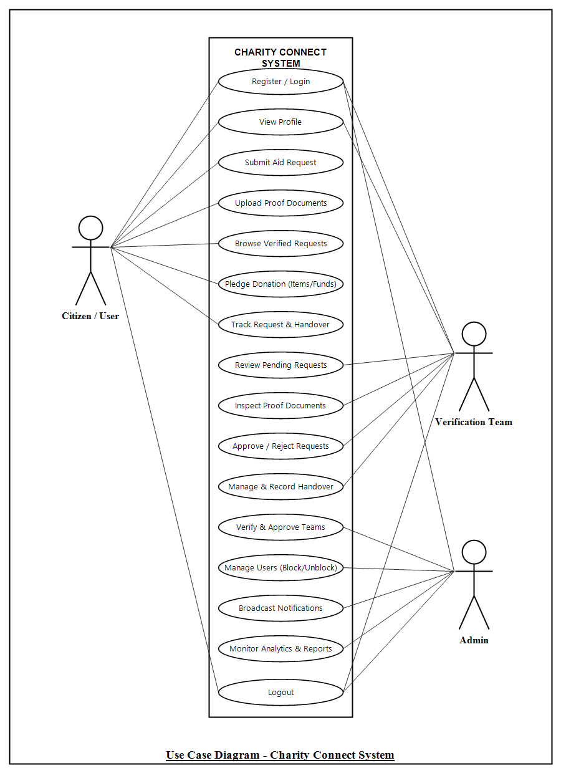
ARCHITECTURE
System Architecture & Use Case Flow
MULTI-TIER ARCHITECTURE & WORKFLOW
1. Presentation Layer (React.js + Bootstrap 5):
â€¢ Responsive left-sidebar navigation drawer for seamless multi-portal browsing.
â€¢ Interactive donor discovery with category badges (Food, Clothes, Medicine, etc.).
2. Application Layer (Node.js + Express.js REST APIs):
â€¢ User, Team, Admin, Request, and Donation modular controllers.
â€¢ Multer middleware for secure proof document uploads (PDF, PNG, JPG).
3. Data Persistence Layer (MySQL Database):
â€¢ Relational integrity with foreign key constraints across users, pledges, and teams.
â€¢ ACID compliant transactions ensuring zero record loss during donation handovers.
Core Verification Flow: Request Submitted -> Document Stored -> Team Review -> Status Updated -> Public Pledging -> Handover Completed.
Charity Connect - Online Charity Management System | Project Evaluation

Slide 6
MODULES
Module Description - 3 Core User Roles
1. CITIZEN / USER MODULE
2. VERIFICATION TEAM MODULE
3. ADMINISTRATOR MODULE
â€¢ Single unified account for both Donors and Beneficiaries.
â€¢ Apply for aid with category, description, and required items.
â€¢ Upload identity cards and medical/need justification proofs.
â€¢ Browse verified charity requests and filter by urgency/category.
â€¢ Pledge donations (item quantities or financial assistance).
â€¢ Real-time status tracking from Pending to Approved and Fulfilled.
â€¢ Register with identification credentials (requires Admin approval).
â€¢ Access centralized queue of pending charity assistance requests.
â€¢ Inspect, download, and validate uploaded proof documents.
â€¢ Approve authentic applications for public listing on portal.
â€¢ Reject fraudulent claims with constructive feedback remarks.
â€¢ Coordinate donation collection and confirm physical handover.
â€¢ Central dashboard with live platform statistics and metrics.
â€¢ Review and approve/reject Verification Team registrations.
â€¢ Manage user accounts with status controls (Active vs. Blocked).
â€¢ Real-time monitoring of all charity appeals and item pledges.
â€¢ Broadcast system-wide announcements and emergency alerts.
â€¢ Maintain audit logs and generate compliance summary reports.
Charity Connect - Online Charity Management System | Project Evaluation

Slide 7
DATABASE ARCHITECTURE
Database Schema: User & Stakeholder Tables
Table: Admin
Table: Team (Verification Volunteers)
FIELD NAME | DATA TYPE | DESCRIPTION
id | INT | PRIMARY KEY, AUTO_INCREMENT
name | VARCHAR(255) | NOT NULL
email | VARCHAR(255) | UNIQUE, NOT NULL
password | VARCHAR(255) | NOT NULL (Hashed)
created_at | TIMESTAMP | DEFAULT CURRENT_TIMESTAMP
FIELD NAME | DATA TYPE | DESCRIPTION
team_id | INT | PRIMARY KEY, AUTO_INCREMENT
name | VARCHAR(255) | NOT NULL
email | VARCHAR(255) | UNIQUE, NOT NULL
phone | VARCHAR(20) | NOT NULL
password | VARCHAR(255) | NOT NULL
status | ENUM | 'PENDING','APPROVED','REJECTED'
created_at | TIMESTAMP | DEFAULT CURRENT_TIMESTAMP
Table: Users (Dual Donor & Beneficiary Role)
FIELD NAME | DATA TYPE | CONSTRAINTS | BUSINESS PURPOSE
id | INT | PRIMARY KEY, AUTO_INCREMENT | Unique identifier for citizen/donor/beneficiary
name, email, phone | VARCHAR(255), VARCHAR(20) | NOT NULL, UNIQUE Email | Citizen contact & authentication credentials
password, address | VARCHAR(255), TEXT | NOT NULL (Hashed) | Encrypted login key and delivery residence address
status, created_at | ENUM, TIMESTAMP | 'Active', 'Blocked' | Account status governed by admin + timestamp
Charity Connect - Online Charity Management System | Project Evaluation

Slide 8
DATABASE ARCHITECTURE
Database Schema: Request & Donation Tables
Table: Charity_request (Aid Applications)
Table: Donation (Pledges & Handovers)
FIELD NAME | DATA TYPE | DESCRIPTION
Charity_id | INT | PRIMARY KEY, AUTO_INCREMENT
user_id | INT | FOREIGN KEY -> users(id)
category | VARCHAR(100) | Food, Clothes, Medicine, etc.
title | VARCHAR(255) | Appeal Headline / Title
description | TEXT | Detailed need justification
document | VARCHAR(255) | Uploaded proof file path/URI
status | ENUM | 'PENDING','APPROVED','REJECTED'
Created_at | TIMESTAMP | DEFAULT CURRENT_TIMESTAMP
FIELD NAME | DATA TYPE | DESCRIPTION
Donation_id | INT | PRIMARY KEY, AUTO_INCREMENT
Doner_id | INT | FOREIGN KEY -> users(id)
request_id | INT | FOREIGN KEY -> charity_request(Charity_id)
Item_name | VARCHAR(255) | Contributed item description
quantity | INT | Quantity pledged / donated
donation_status | ENUM | 'PENDING','COMPLETED'
Donated_at | TIMESTAMP | DEFAULT CURRENT_TIMESTAMP
RELATIONAL INTEGRITY & BUSINESS RULES:
â€¢ Referential Cascades: user_id links every charity request directly to an authenticated applicant in users.
â€¢ Dual Foreign Key Binding: Each donation binds Doner_id (from users) and request_id (from charity_request).
â€¢ Audit Trail: Every table includes automatic TIMESTAMP tracking for regulatory reporting and handover verification.
Charity Connect - Online Charity Management System | Project Evaluation

Slide 9
TECHNICAL SPECIFICATIONS
Technology Stack Used
FRONTEND ARCHITECTURE
BACKEND & API LAYER
DATABASE & PERSISTENCE
DEV TOOLS & ENVIRONMENT
â€¢ React.js (Single Page Application)
â€¢ Bootstrap 5 & Custom CSS (Responsive UI)
â€¢ Bootstrap Icons (Visual Navigation)
â€¢ HTML5 / ES6+ JavaScript
â€¢ Axios / Fetch API (HTTP Communication)
â€¢ Node.js Runtime Environment
â€¢ Express.js RESTful API Framework
â€¢ Multer (Multi-part Document Uploads)
â€¢ CORS & Body-Parser Middleware
â€¢ Modular MVC Controller Architecture
â€¢ MySQL 8.0 Relational DBMS
â€¢ mysql2 Promise-based Connection Pool
â€¢ InnoDB Engine (ACID Transactions)
â€¢ Strict Foreign Key Constraints
â€¢ Static File Storage for Proof Documents
â€¢ Visual Studio Code (IDE)
â€¢ Postman API Testing Suite
â€¢ Git & GitHub Version Control
â€¢ Microsoft Edge / Chrome DevTools
â€¢ Node Automated API Runner
Charity Connect - Online Charity Management System | Project Evaluation

Slide 10
FUTURE ENHANCEMENTS
Future Scope & Enhancements
1. Payment Gateway Integration
Incorporate Razorpay or Stripe to allow direct, secure monetary donations alongside item-based contributions with automated 80G tax receipts.
2. Real-Time SMS & Push Alerts
Implement Twilio and Firebase Cloud Messaging (FCM) to notify donors when their pledged aid is physically handed over to the beneficiary.
3. Geo-Location & Relief Camp Mapping
Integrate Google Maps API to visually display nearby emergency distribution centers, collection hubs, and disaster-affected zones.
4. Native Mobile Application
Develop a React Native cross-platform mobile app equipped with barcode/QR code scanners for verification team field workers during handovers.
5. AI-Powered Proof Fraud Detection
Deploy OCR and computer vision algorithms to automatically detect digitally manipulated or duplicate medical certificates and identification cards.
Charity Connect - Online Charity Management System | Project Evaluation

Slide 11
CONCLUSION & SUMMARY
KEY PROJECT TAKEAWAYS:
â€¢ Successfully built an end-to-end, production-ready Full Stack Charity Management Platform.
â€¢ Solved the critical trust deficit in online fundraising through mandatory document authentication.
â€¢ Empowered communities with a single unified account for both giving and receiving humanitarian aid.
â€¢ Fully tested REST APIs and a responsive React SaaS interface ready for real-world deployment.
Thank You!
Questions & Discussion

