Slide 1
PIP4004 - INTERNSHIP Review-3 Presentation Attendance Management System
Student Details
Name | Ameena Sardar
Roll No | 20221LCS0036
Section | 8CSE14
Batch No. | 118
Under the Supervision of,
Saurabh Sarkar
School of Computer Science and Engineering
Presidency University
Name of the Program: CSE
Name of the HoD: Dr. Asif Mohammed H.B
Name of the Program Project Coordinator:
Name of the School Internship Coordinators: Mr. Md Zia ur Rahman

Slide 2
About Brand Street
MISSION
Empowering brands to reach their full potential through innovative strategies, creative excellence, and unwavering dedication to client success.
VISION
To be the catalyst for transformative growth, shaping brands that inspire and resonate with audiences worldwide.
VALUE
We strive for excellence in all that we do, setting high standards and consistently delivering exceptional results.

Slide 3
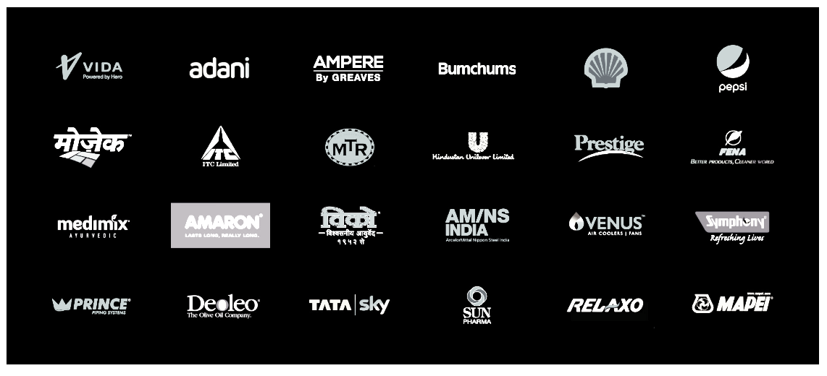
About Company Clients

Slide 4
About Company Services
Consumer Marketing Cultivating enduring brand affinity through strategic consumer engagement
Trade Marketing Orchestrating market dominance, influencing trade dynamics with precision.
Rural Marketing Delving into rural landscapes, crafting resonant campaigns for heartland markets.
Digital Marketing Navigating the digital realm with strategic process, maximizing brand visibility and engagement.
Creative Services Architecting brand narratives with meticulous creativity and finesse.
Merchandising Elevating brand presence through meticulously curated merchandising solutions.

Slide 5
Working domain or the technology
1. What Are Web Technologies?
Web technologies refer to the tools, frameworks, and programming languages used to develop and maintain websites and web applications. These technologies enable web pages to be interactive, responsive, and dynamic.
2. Features of Web Technologies
Cross-Platform Compatibility – Websites and apps work across devices (PCs, mobiles, tablets).
Responsive Design – Ensures a smooth experience across different screen sizes.
Interactivity – JavaScript enables animations, form validations, and real-time updates.
Security – Secure authentication, encryption, and protection from cyber threats.
SEO (Search Engine Optimization) – Helps websites rank higher in search engines.

Slide 6
Working domain or the technology
4. Importance of Web Technologies
Global Connectivity – Businesses and individuals can reach a worldwide audience.
E-Commerce & Digital Transactions – Secure platforms for online shopping.
Cloud Computing & Web Apps – Web-based services like Google Docs, Netflix, etc.
Automation & AI Integration – Chatbots, recommendation systems, and analytics.
Scalability – Websites and apps can handle increasing traffic and data efficiently.

Slide 7
About your team and reporting Manager
Team of 3
Ameena Sardar
Lakshmi M
Sravan
Reporting Manager
Name: Farheen Naaz
Email: farheen@thebrandstreet.in
Phn No: 9900415630
Brand Street India

Slide 8
Introduction
Attendance Management System is software developed for daily student attendance in schools, colleges and institutes. If facilitates to access the attendance information of a particular Employee in a particular industry. The information is sorted by the operators, which will be provided by the employee for a particular working day. This system will also help in evaluating attendance eligibility criteria of employee.

Slide 9
Objective
The Main Objective of Attendance Management System is to go with computerized system, instead of old-fashioned manual process. As compared to manual process online system easily help management to analyze student’s attendance details as per requirement.
Reports are easily generated: Various reports such as Student wise attendance, Day wise attendance, Class wise attendance, Month Wise Class Attendance etc can be easily generated. Current and back-dated reports can be available instantly.

Slide 10
Process Flow
Step 1: Login Process
Users must enter their Username and Password.
The system verifies credentials before granting access.
If incorrect, an error is displayed.
Step 2: Viewing Attendance Records
Once logged in, admins or teachers can access the Attendance Records Page.
This page contains student registration numbers, attendance status, and timestamps.
The data can be exported as CSV or printed.

Slide 11
Step 3: Managing Courses/Units
The system allows users to view, add, and manage courses.
Attendance is linked to specific courses.
Admins can assign students to courses.
Step 4: Managing Student Information
Student details such as Name, Registration Number, Course, and Attendance Record can be updated.
Upon successful update, a confirmation message is displayed.
Step 5: Exporting Reports
Attendance reports can be saved as CSV files.
Print Preview allows direct hard copy printing.

Slide 12
Software & Technologies Used
Front-End:
HTML, CSS, JavaScript – For UI design.
Bootstrap – To enhance UI responsiveness.
Back-End:
PHP – For handling server-side logic and database operations.
MySQL – Database for storing attendance records and user data.
XAMPP – A local server solution that includes Apache, MySQL, and PHP for testing the system.
Development Tools:
Visual Studio Code / Sublime Text – For code editing.
phpMyAdmin – For managing MySQL database.

Slide 13
Advantages of Proposed System/Work
Accurate data thereby helps to provide accurate performance and payroll data.
Control Cost, It saves money by putting an end to inaccurate time reporting, buddy punching,
absenteeism, tardiness, time abuse, and overpayment.
It takes time to process paper sheets and time cards, create schedules, authorize leave and
overtime, and create payroll manually.
Flexible to use.
Highly secure systems and architecture.

Slide 14
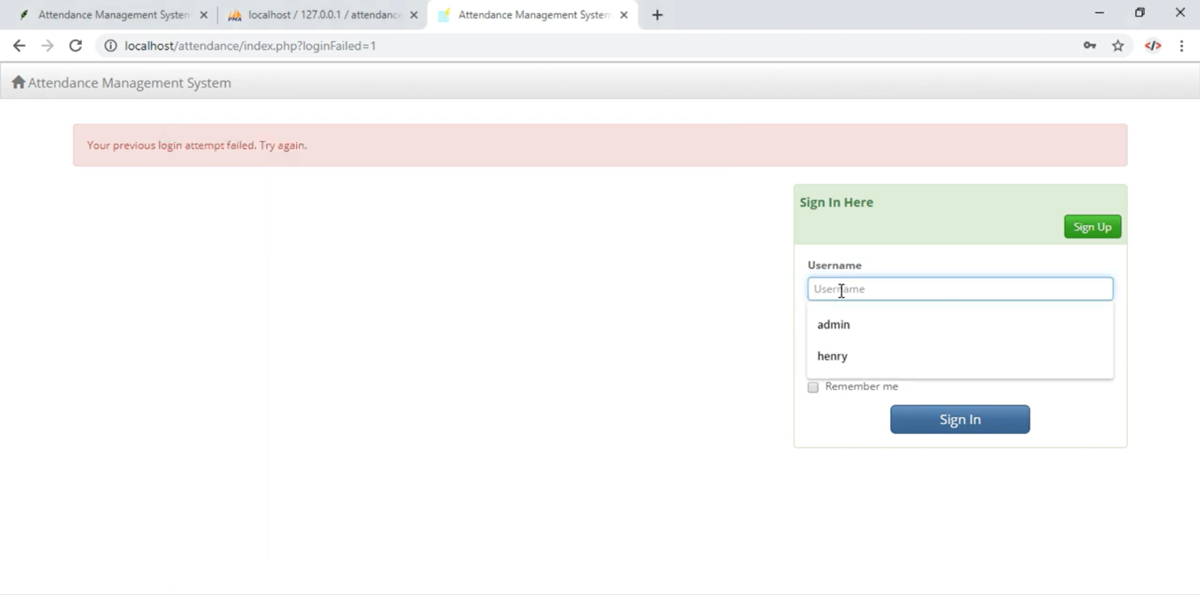
Login:

Slide 15
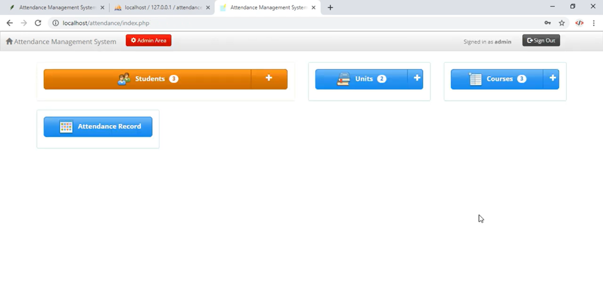
Home Page:

Slide 16
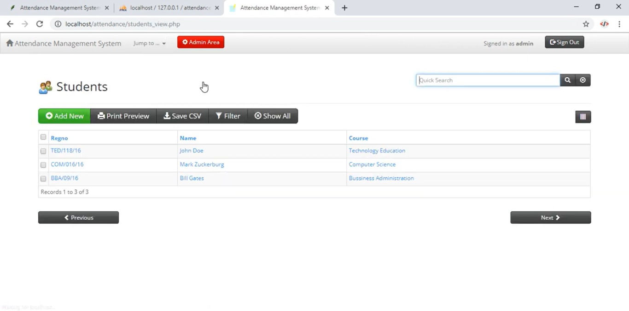
Students Page:

Slide 17
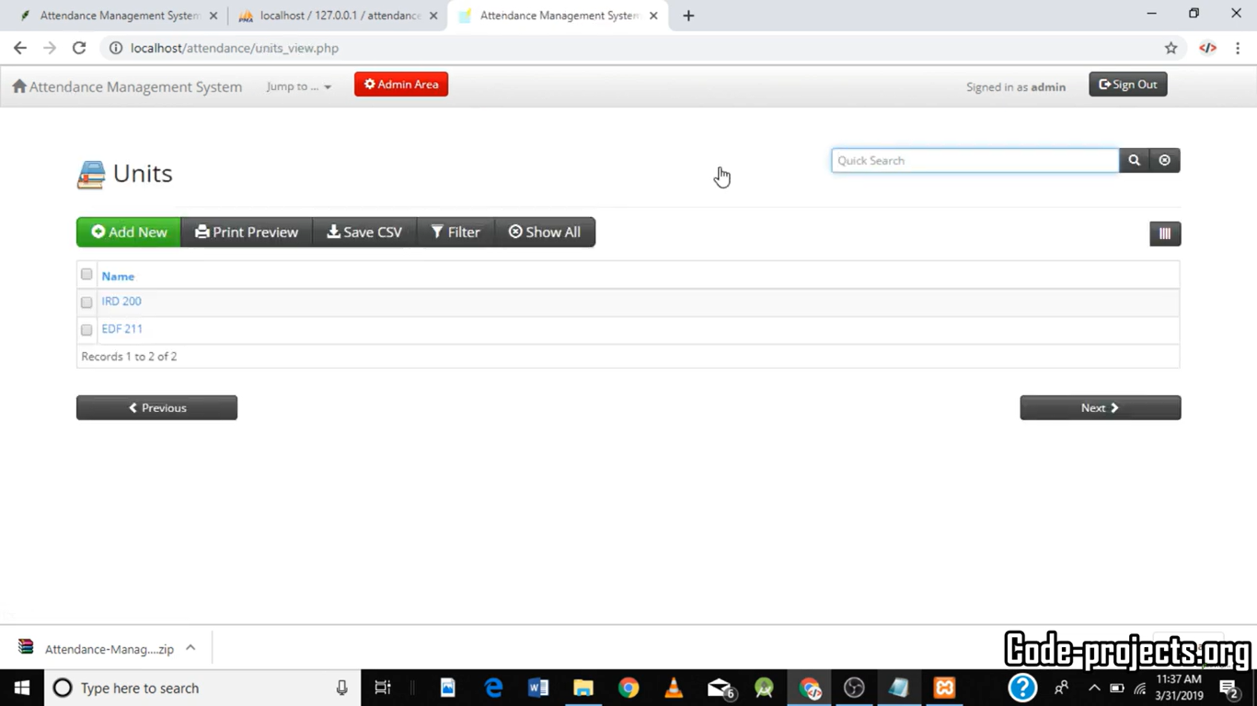
Units Page:

Slide 18
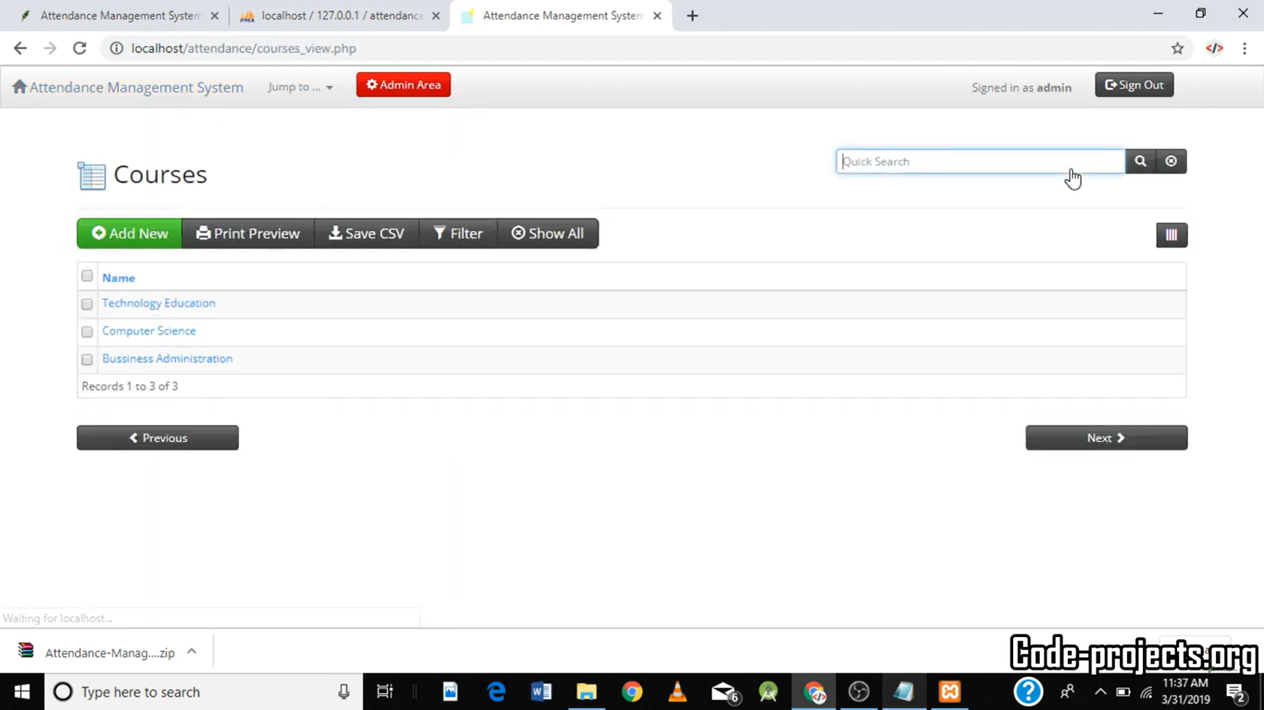
Course Page:

Slide 19
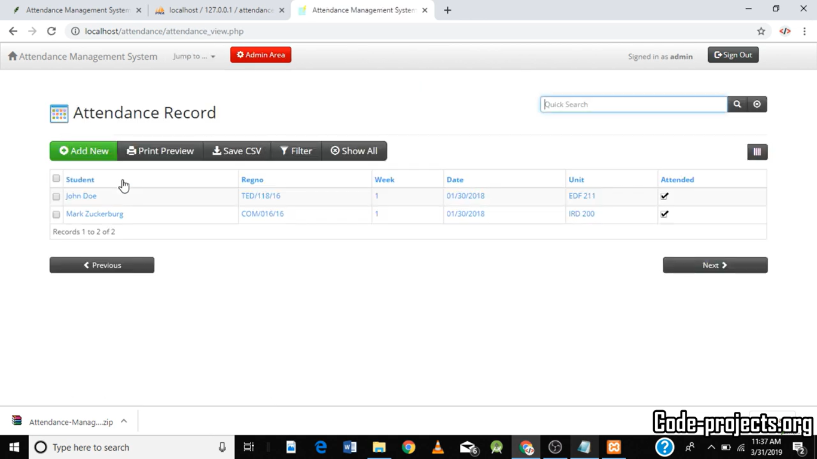
Attendance Record:

Slide 20
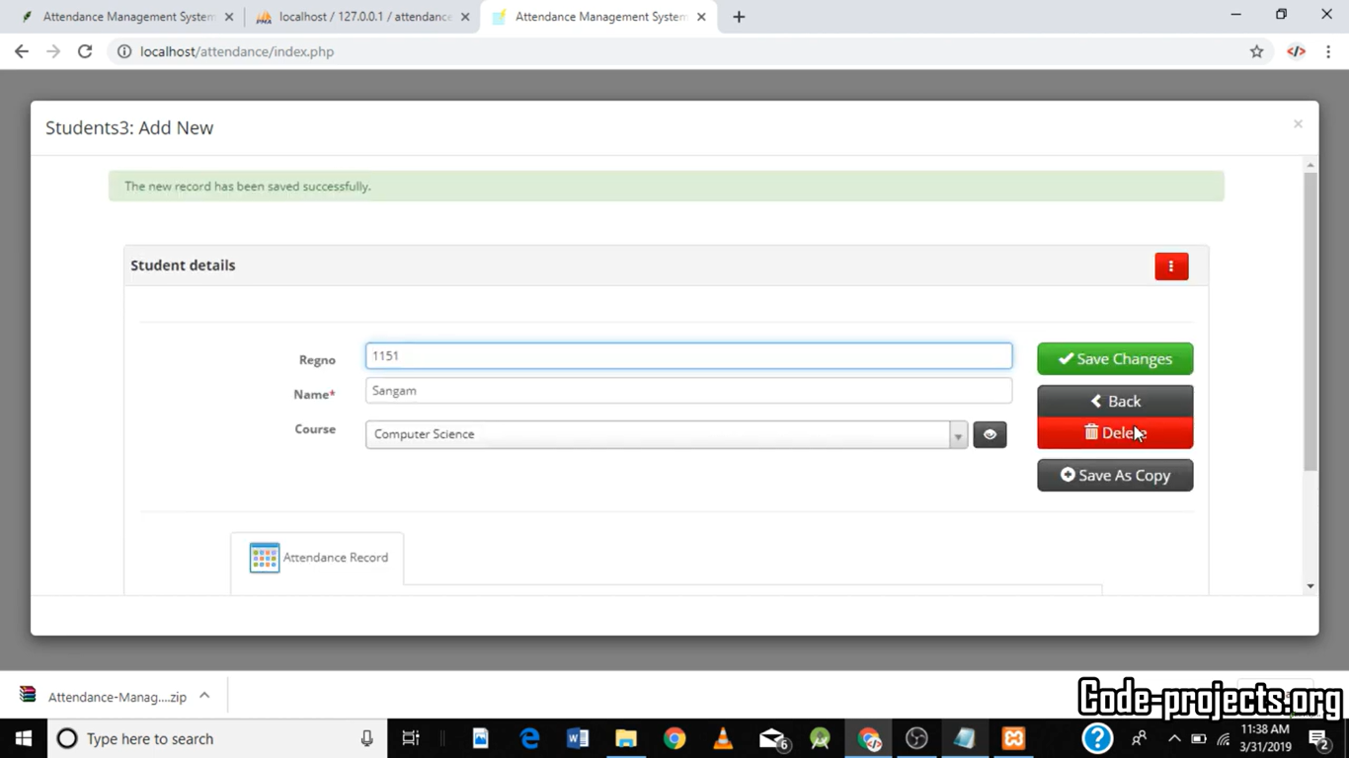
Adding/Deleting Students:

Slide 21
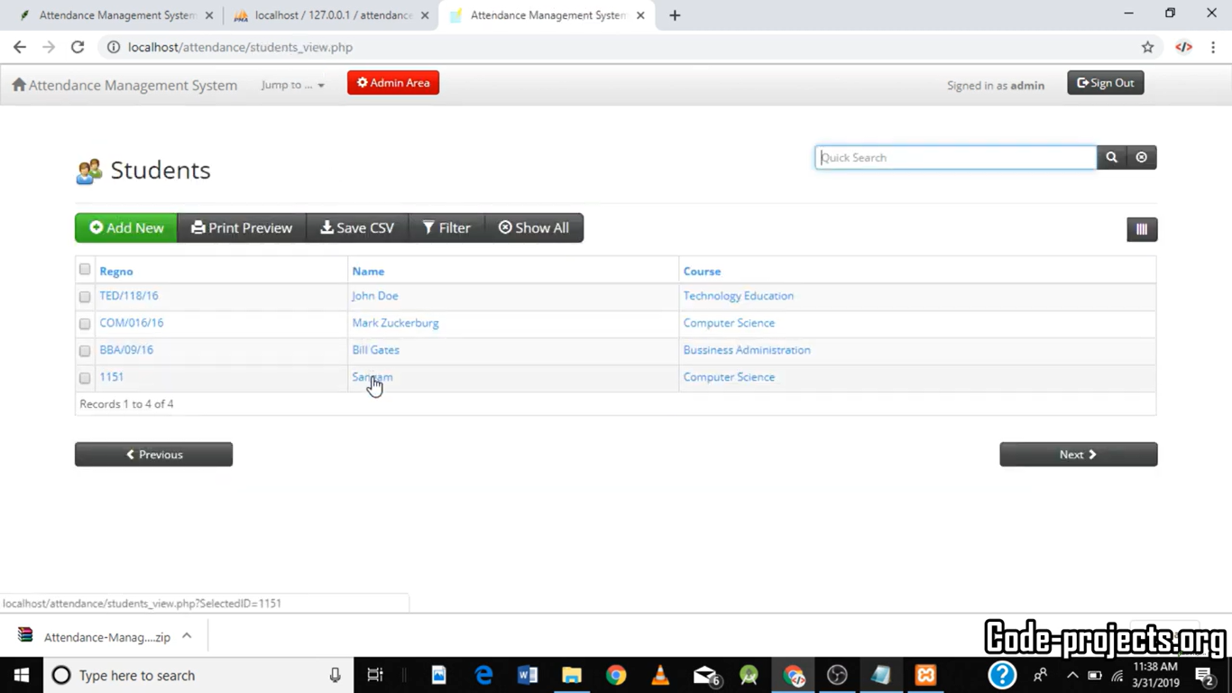
New Student Record added:

Slide 22
Internship Road Map
Note: Write in the below table what u will be achieving in each review
Review 0
6 Feb 2025
Topic Finalization
Review 1
20 Feb 2025
Literature review about the project
Review 2
27 March 2025
Front end
implantation of the project
Review 3
25 April 2025
Project
has been
completed

Slide 23
Conclusion
The Attendance Management System simplifies attendance tracking and reduces errors in manual record-keeping. Using PHP, MySQL, and HTML, the system enables easy management of attendance with features like CSV export, print preview, and course tracking. This system is ideal for educational institutions and organizations seeking efficient attendance tracking solutions.
Next Steps:
Further improvements can include biometric or RFID-based attendance tracking.
Implementing mobile app integration for better accessibility.
Adding email notifications for attendance alerts.

Slide 24
Github Link
https://github.com/ameenasardar/Internship.git

Slide 25

Q&A

Slide 26
Thank you !!

