Slide 1
PIP4004 - INTERNSHIP Review-1 Presentation Real Time Vehicle Tracking System
Student Details
Name | Ameena Sardar
Roll No | 20221LCS0036
Section | 8CSE14
Batch No. | 118
Under the Supervision of,
Dr. Abdul Khadar A
Associate Professor
School of Computer Science and Engineering
Presidency University
Name of the Program: CSE
Name of the HoD: Dr.Asif Mohammed H.B
Name of the Program Project Coordinator:
Name of the School Internship Coordinators: Mr. Md Ziaur Rahman

Slide 2
Content
About Company or Organization
Working domain or the technology
About your team and reporting Manager
Challenges Faced in Internship
Objectives of the work
Literature Review
Proposed System
Problem Statement
System Requirements
Advantages of Proposed System/Work
Internship Roadmap
Github Link

Slide 3
About Company
MISSION
Empowering brands to reach their full potential through innovative strategies, creative excellence, and unwavering dedication to client success.
VISION
To be the catalyst for transformative growth, shaping brands that inspire and resonate with audiences worldwide.
VALUE
We strive for excellence in all that we do, setting high standards and consistently delivering exceptional results.

Slide 4
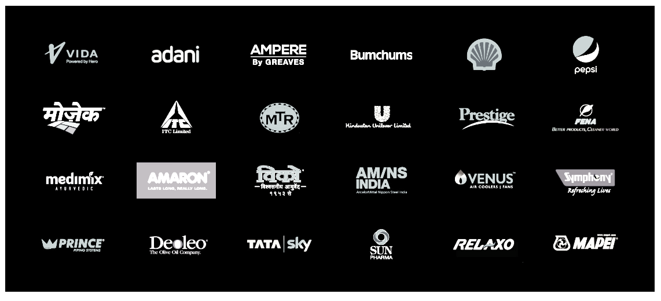
About Company Clients

Slide 5
About Company Services
Consumer Marketing Cultivating enduring brand affinity through strategic consumer engagement
Trade Marketing Orchestrating market dominance, influencing trade dynamics with precision.
Rural Marketing Delving into rural landscapes, crafting resonant campaigns for heartland markets.
Digital Marketing Navigating the digital realm with strategic process, maximizing brand visibility and engagement.
Creative Services Architecting brand narratives with meticulous creativity and finesse.
Merchandising Elevating brand presence through meticulously curated merchandising solutions.

Slide 6
Working domain or the technology
1. What Are Web Technologies?
Web technologies refer to the tools, frameworks, and programming languages used to develop and maintain websites and web applications. These technologies enable web pages to be interactive, responsive, and dynamic.
2. Features of Web Technologies
Cross-Platform Compatibility – Websites and apps work across devices (PCs, mobiles, tablets).
Responsive Design – Ensures a smooth experience across different screen sizes.
Interactivity – JavaScript enables animations, form validations, and real-time updates.
Security – Secure authentication, encryption, and protection from cyber threats.
SEO (Search Engine Optimization) – Helps websites rank higher in search engines.

Slide 7
Working domain or the technology
4. Importance of Web Technologies
Global Connectivity – Businesses and individuals can reach a worldwide audience.
E-Commerce & Digital Transactions – Secure platforms for online shopping.
Cloud Computing & Web Apps – Web-based services like Google Docs, Netflix, etc.
Automation & AI Integration – Chatbots, recommendation systems, and analytics.
Scalability – Websites and apps can handle increasing traffic and data efficiently.

Slide 8
About your team and reporting Manager
Team of 3
Ameena Sardar
Lakshmi M
Sravan
Reporting Manager
Name: Farheen Naaz
Email: farheen@thebrandstreet.in
Phn No: 9900415630
Brand Street India

Slide 9
Challenges Faced in Internship
Choosing topic
Scoping up with the team as it was a new environment

Slide 10
Objectives of the work
Purpose of Web Technologies
The main purpose of web technologies is to develop scalable, interactive, and secure web applications that enhance user experience and provide seamless access to digital services. These technologies power websites, e-commerce platforms, cloud-based applications, and AI-driven web services.
Usage of Web Technologies
Website Development
E-Commerce and Online Shopping
Social Media Platforms
Cloud Computing and SaaS (Software as a Service)
AI-Powered Web Services (Chatbots, Recommendation Systems)
Web APIs and Integration
Progressive Web Applications (PWAs)
Online Education and Learning Platforms

Slide 11
Literature Review
Real-time vehicle tracking systems have been widely studied and implemented in various sectors like logistics, transportation, fleet management, and public safety. The system typically integrates GPS (Global Positioning System), GSM (Global System for Mobile Communications), and web-based applications for seamless tracking.
Key Research Insights:
GPS & GSM-Based Tracking: Earlier studies focused on integrating GPS for location tracking and GSM modules for data transmission to remote servers.
IoT and Cloud Integration: Modern approaches leverage IoT devices, cloud computing, and big data analytics for better efficiency and real-time decision-making.
AI & Predictive Analytics: Some systems incorporate AI to predict vehicle movement patterns and optimize routes.
Security Challenges: Existing systems face security risks like data breaches, GPS spoofing, and unauthorized access.

Slide 12
Proposed System / Work
The proposed Real-Time Vehicle Tracking System (RTVTS) is a web application that provides live tracking of vehicles using GPS and a mapping API (Google Maps, OpenStreetMap, etc.). It includes:
GPS Module: Installed in vehicles to collect location data.
Data Transmission: The collected data is sent to a backend server via GSM, GPRS, or IoT networks.
Web Interface: Users can view vehicle locations on an interactive map.
Real-Time Alerts: Notifications for geofencing breaches, unexpected stops, or delays.
Historical Tracking: Allows users to analyze past vehicle movements.

Slide 13
Problem Statement
Managing and monitoring vehicle movement in real time is a major challenge for logistics, public transport, and personal tracking. Issues include:
Inefficient Fleet Management: Lack of real-time insights leads to delays and fuel wastage.
Security Risks: Theft or unauthorized use of vehicles is difficult to detect without live tracking.
Route Optimization Challenges: Without real-time tracking, finding the best routes is inefficient.
Lack of User-Friendly Interfaces: Many existing systems have complex, non-intuitive designs.

Slide 14
System Requirements
Hardware Requirements:
GPS module (like SIM808, Neo-6M, etc.)
GSM/GPRS module for data transmission
Cloud or on-premise server for data storage
Web-based user interface (PC/mobile support)
Software Requirements:
Frontend: React.js, Angular, or Vue.js
Backend: Node.js with Express, Django, or Flask
Database: MongoDB, MySQL, or Firebase
Mapping API: Google Maps API, OpenStreetMap
Hosting: AWS, Firebase, or DigitalOcean

Slide 15
Advantages of Proposed System/Work
Real-Time Tracking: Enables instant monitoring of vehicle locations.
Improved Security: Reduces theft risks with live tracking and alerts.
Optimized Routes: Helps in fuel savings and better time management.
User-Friendly Web Interface: Allows easy access from any device.
Data Storage & Analysis: Keeps logs of past trips for future analysis.
Scalability: Can be extended to support AI-based route optimization.

Slide 16
Internship Road Map
Note: Write in the below table what u will be achieving in each review
Review 0
6 Feb 2025
Review 1
20 Feb 2025
Review 2
Review 3

Slide 17
Github Link
https://github.com/ameenasardar/Internship.git

Slide 18

Q&A

Slide 19
Thank you !!

