Slide 1
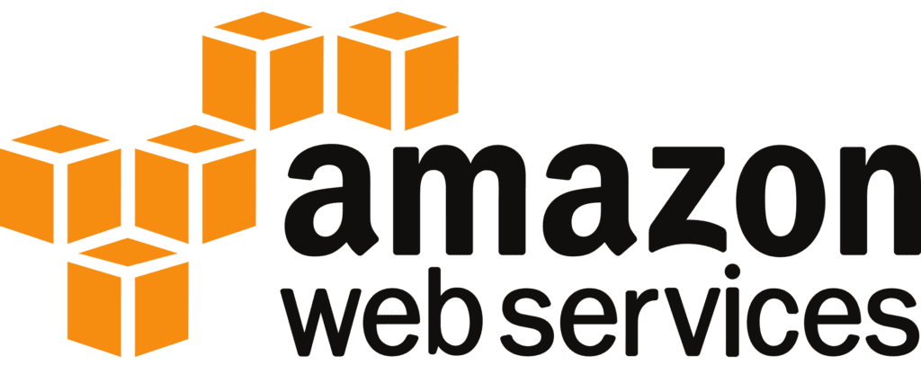

Simple Notification Service (SNS)

Slide 2


AGENDA
What is Amazon SNS?
How SNS Works
Key Features of Amazon SNS
Key SNS Integrations
Security in Amazon SNS
Monitoring and Metrics in SNS
Conclusion

Slide 3
What is Amazon SNS?
Simple Notification Service
Definition:
Amazon SNS (Simple Notification Service) is a fully managed messaging service for publish/subscribe messaging that allows you to send messages to a large number of subscribers or other services.
Purpose:
SNS is used for sending notifications to a variety of endpoints, such as email, SMS, or HTTP endpoints, and it also integrates with other AWS services for event-driven architectures.

Slide 4
How SNS Works
Publish/Subscribe Model: Publishers send messages to a topic, and subscribers (e.g., applications, email, SMS, Lambda functions) receive those messages.
Topics: Topics are communication channels to which publishers send messages. Subscribers can be added to topics to receive messages.
Message Fan-Out: A single message published to a topic can be distributed to multiple subscribers simultaneously.

Slide 5
Key Features of Amazon SNS
Flexible Message Delivery: Supports multiple delivery methods: SMS, email, mobile push notifications, HTTP/HTTPS endpoints, and AWS Lambda for serverless event-driven architectures.
Durable Messaging: SNS provides durability by storing messages redundantly across multiple Availability Zones to prevent data loss.

Slide 6
Message Filtering: Enables filtering of messages based on message attributes, allowing subscribers to receive only the messages that match their filter criteria.
Security: SNS uses Identity and Access Management (IAM) to control access to topics, ensuring that only authorized users and applications can publish or subscribe to topics.
FIFO Topics (Introduced recently): SNS now supports FIFO (First-In-First-Out) topics to ensure the order of message delivery and avoid message duplication.

Slide 7




Key SNS Integrations
AWS Lambda:
Amazon SQS:
SNS can trigger AWS Lambda functions to process messages, enabling serverless workflows.
SNS can send messages to SQS queues, which are then processed asynchronously by applications.
Amazon CloudWatch:
Amazon EventBridge:
SNS can integrate with AWS EventBridge for building highly event-driven systems across different AWS services.
SNS can be integrated with CloudWatch alarms to notify users when specific thresholds are exceeded, such as high CPU usage or low disk space.

Slide 8
Security in Amazon SNS
Encryption:
SNS supports encryption at rest using AWS KMS (Key Management Service) to protect messages stored in SNS topics.
Access Control:
Use IAM policies to control who can publish to or subscribe to topics, ensuring secure message delivery.
VPC Endpoints:
SNS supports VPC endpoints, allowing you to publish messages from within your VPC without requiring access to the public internet.

Slide 9
Monitoring and Metrics in SNS
Amazon CloudWatch:
SNS is integrated with CloudWatch, allowing you to monitor important metrics such as:
Number of messages published.
Number of messages delivered to subscribers.
Number of failed message deliveries.
Latency of message delivery.
Error Handling:
SNS provides dead-letter queues (DLQs) to capture messages that couldn't be delivered, ensuring that no messages are lost even in case of delivery failures.

Slide 10
Benefits of Using Amazon SNS
1. Scalable and Reliable: SNS scales automatically to handle a large volume of messages and subscribers, with high durability.
2. Multi-Protocol Messaging: Supports a variety of protocols like HTTP/S, Lambda, email, SMS, and mobile push notifications, making it versatile for various applications.
3. Cost-Effective: Pay only for the messages published and delivered, making it cost-efficient for both small and large applications.
4. Event-Driven Integration: SNS is ideal for triggering actions in real-time based on events, especially when integrated with Lambda, SQS, and other AWS services.

Slide 11
Amazon SNS is a flexible and scalable notification service that supports multiple communication protocols like SMS, email, HTTP, and Lambda. It’s used for system alerts, real-time notifications, mobile push notifications, and event-driven applications, making it a versatile solution for a wide range of use cases in modern cloud applications.
CONCLUSION

