Slide 1
2024-MSDS-105

Slide 2
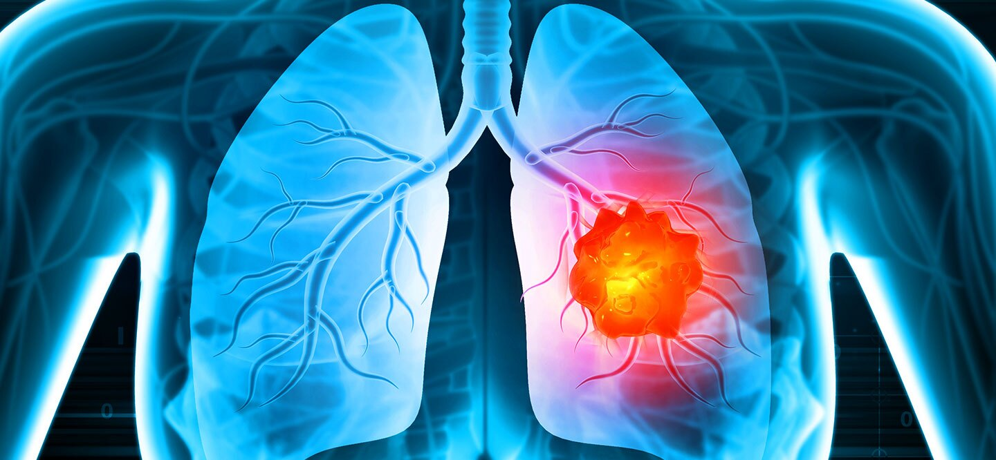
Lung Cancer Prediction Modal

Slide 3
Problem Statement:
The key focus of my study is to identify:
The primary factors contributing to lung cancer.
The age groups most affected by these factors.

Slide 4
Feature Engineering Dataset
1. Handling Null Values
2. Removal of Outliers
3. Identification of Correlation.
4. Feature Encoding
5. Feature Scaling

Slide 5
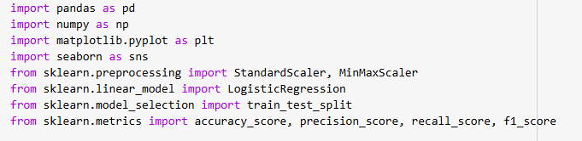
Libraries include:

Slide 6
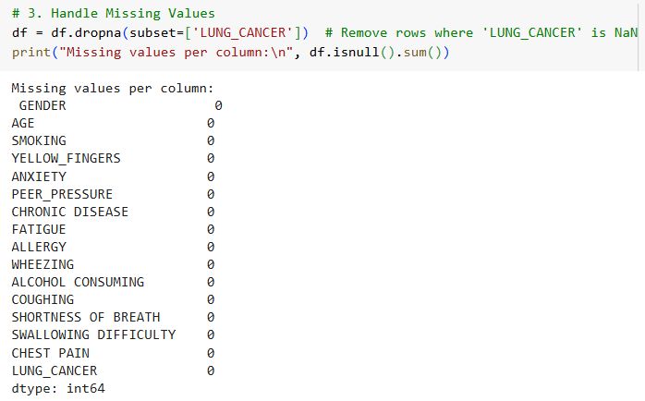
Handling Missing Values

Slide 7
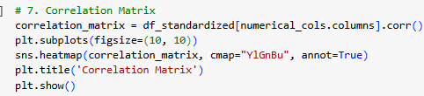
Correlation Analysis

Slide 8
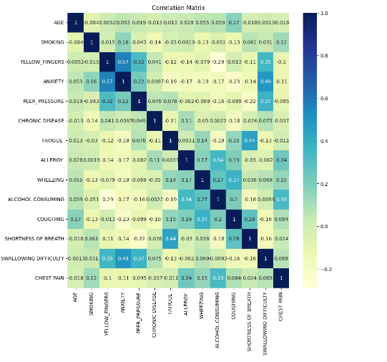

Slide 9
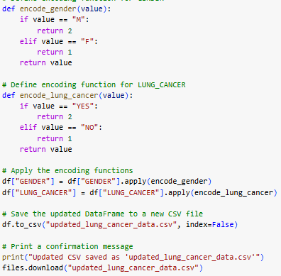
Feature Encoding

Slide 10
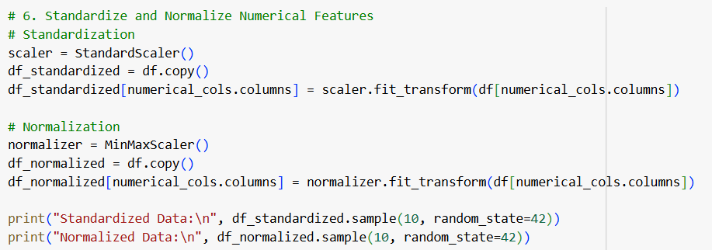
Feature Scaling
Standardized numerical features using StandardScaler.
Normalized data using MinMaxScaler.

Slide 11
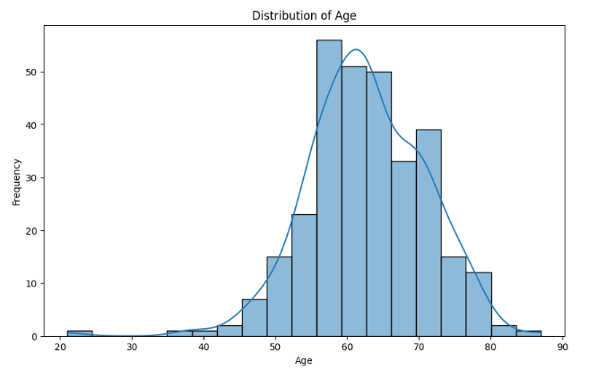
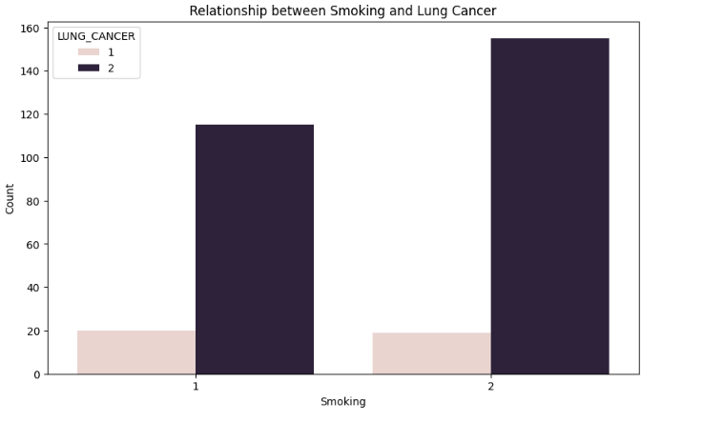
Exploratory Data Analysis
Explored distributions of 'AGE', 'SMOKING', and 'LUNG_CANCER'.
Visualized relationships between features and the target variable.

