Slide 1
Project in Parallel Distributed Programming
Students
Haytham Ghabrees 318426574 Haytham.gh@campus.Technion.ac.il
Ameer Badran 318176716 Ameer-Badran@campus.Technion.ac.il

Slide 2
General Overview
The project is an implementation of an image classifier, that acts like an engine, it receives an image, and returns the object presented in the image received. It can be said then that the purpose of the project is to make available webservice for users to upload images or take with their web camera and to get the result for the object in the photo.
Different entities were used to connect all the dotes that represent the final project. IBM cloud was used to save images and to implement the code responsible for the classification serves, which is built over OpenWhisk open source, using serverless computing for easy maintenance.
And as a UI, we developed a webpage which will be the page the user sees while using the serves, and this all is containerized by docker, and given to the user as a ready to use package.

Slide 3
Logical Architecture Between Separate Entities
Apache Openwhisk
The action uses other micro services in the IBM foundry to complete its task
IBM Micro Services
Trigger
The fitting action is activated according to the rules
Trigger is connected to cloud foundry and reacts when a new object is stored.
Docker Action
IBM Cloud Foundry
The action saves the file containing the results to the cloud foundry
Result File is sent back and displayed for the user on the webpage
User Interface (webpage)
Package
Client
IMG
Sends Package

Slide 4
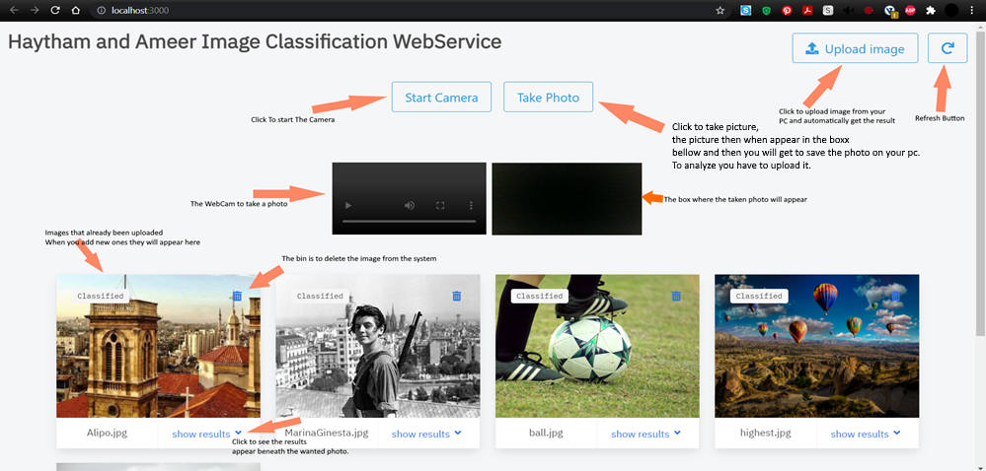
Technologies Used & Components
- IBM cloud foundry: used to save image files and the files containing the result of the classification for each photo. It presents itself as the main connector between all the entities, it communicates with the UI and it communicates with the actual package that classifies the image.
User Interface: for UI we decided to go with a webservice which will be used by the user to upload images and get results. View of The Webservice For The User:

Slide 5
Triggers & Actions: the IBM functions offers two features called triggers and actions, which can be used to fulfill certain purposes related to the cloud foundry. The trigger connects to the cloud foundry and reacts to certain behaviors(aka. Rules), in our case entering a new image object to the foundry’s database or removing one. The trigger at the same time is connected to an action, and it is activated by the trigger once it reacts, in our case classifying the newly entered image, or removing an existing image.
IBM Micro Services: there is micro services provided for usage, one example is the MAX-object-detector, which is a micro service written over OpenWhisk, which uses means of artificial intelligence and deep learning to identify objects in photo and classify them, based on a training group of a considerable size.
- Docker: used for packaging the environment and the code that represents the user interface. By using docker to create containers, the packages can run in any environment, regardless of the differences between them, that being operating systems or any other difference. It also make it easier for users to use service.

Slide 6
Difficulties During The Development Process
The main difficulties in the development process were mainly in the way that everything should connect with each other, since it was a whole new field to deal with.
And it toke several tries to decide on the final architecture of the product, since many of the early versions later proved to be a dead end.
To build the connection between the IBM cloud foundry and the triggers and the actions. And later to use this connection to establish the code in the actions to classify images.
And later difficulties were found were the connection between the frontend (UI) and the backend (which is all the cloud entities), to upload images to the cloud, to get results back, while using separate technologies to work together at the end of the project.
We think this difficulty happened because the different new things in which we had no experience before this, and to learn all these things together and manage to build the project.

Slide 7
Current & Possible Future Extensions
The main idea in the project was to build a classifier for images. And during the process we came to realize that we needed more than just the simple idea to make this project more user friendly, more fulfilling and to have different interesting aspects.
So the idea became to build a webservice that any user can use, and we managed to do that. And then we decided to add another two features, the first is to provide the possibility of taking a photo while using the service and uploading it at the same moment, instead of just using an already existing photo. The other is to add the time of which each photo toke for classification.
For future extensions, we think that many things can be done. Like developing an application for mobile phones to use the service with. To add extra options to upload photos from, like a photo you saw on social media, or even to develop the idea into videos, and to classify screenshots from videos and to create a design of continuous classification on a live video.

Slide 8
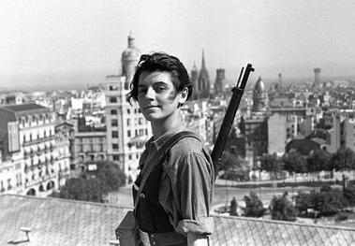
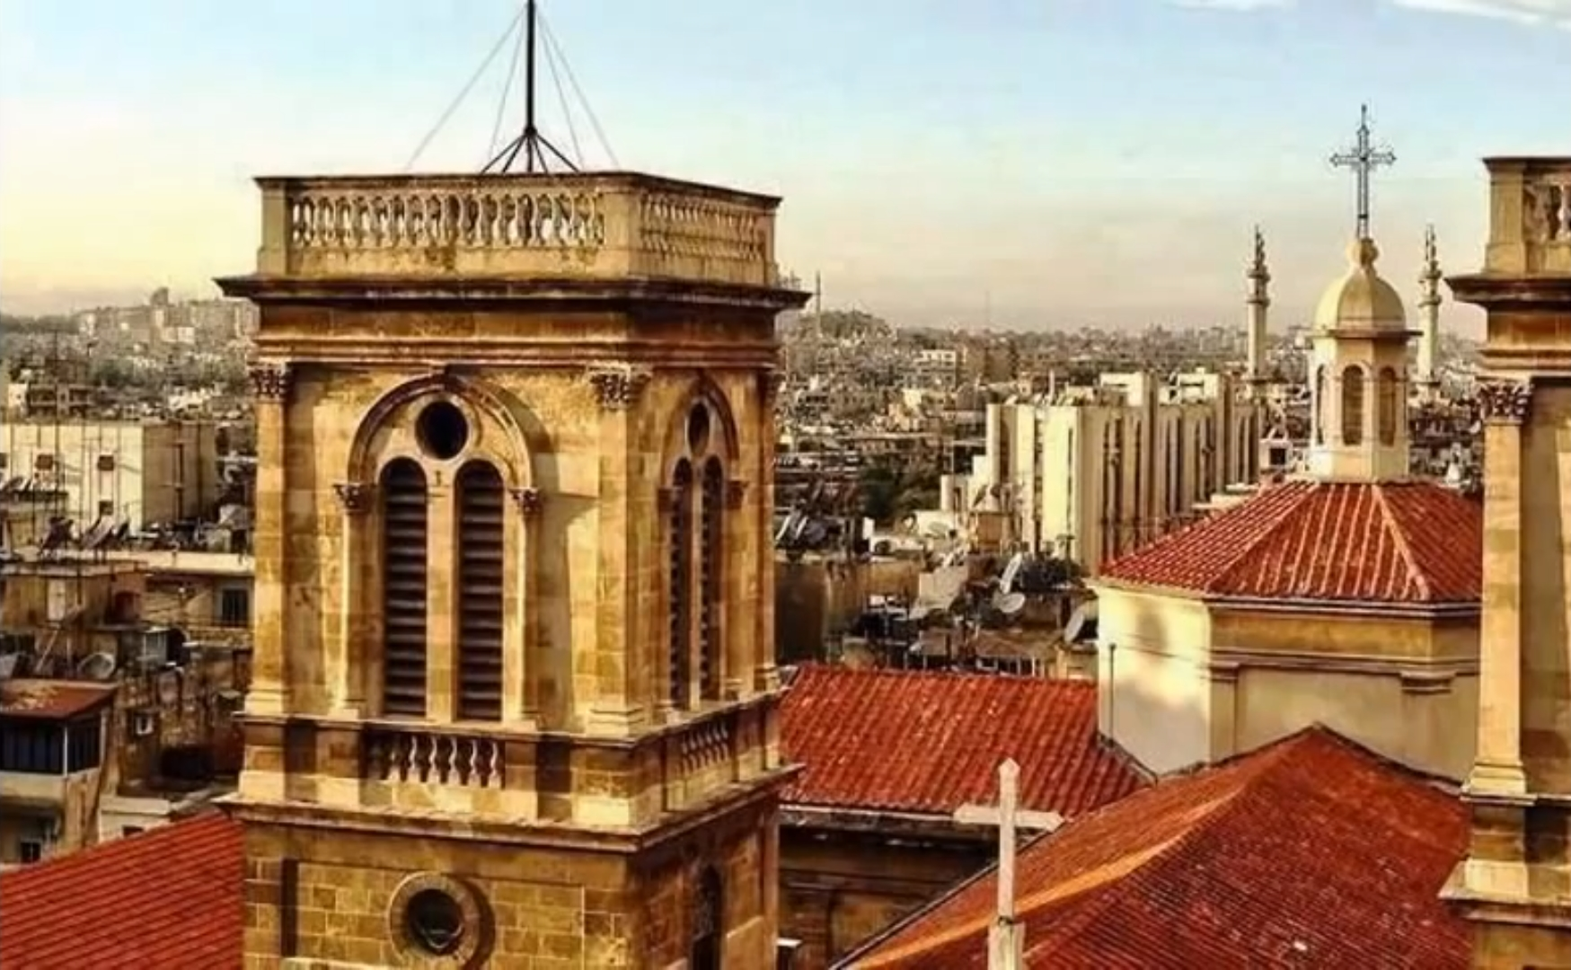

Results We Got
We got interested in seeing what decides the time of which the photo gets classified, and what’s the factor that most influencing.
And after a couple of tests, we got that the bigger the size of the file, and the highest the resolution, the longer it toke. The following images are an example:
Size: 20.1 KB Size: 858 KB Size: 185 KB
Quality: very low Quality: medium Quality: HD
Time of Calculation: 1.077 seconds Time of Calculation: 1.411 seconds Time of Calculation: 1.341 seconds
Notice how the small size low quality picture toke only 1 second, but the second because it’s a big file it toke 1.411 seconds. But the third photo is a much smaller file, but because it has a very high quality it toke 1.341which is not that far from the second picture.

Slide 9
Conclusion
The project toke a while to finish, and it had some very edgy sides to deal with. But we think that it provided a good understanding and learning experiences, and it made us learn many new things that we have no experience in before.
We think the project can be enhanced further than this, and to get developed into a more sophisticated app that can be easily used by every user in everyday life.
We would like to thank our mentors Roy Friedman and Ohad Eytan for their help and guidance. We hope to see this product become much more someday.

