Slide 1


UBIS Plus
A French-Swedish physicist, and professor of atomic physics at Lund University in Sweden. She leads an attosecond physics group which studies the movements of electrons in real time, which is used to understand the chemical reactions on the atomic level.

Slide 2
UBIS Plus
This project aims on providing many features to students and teachers that can help them do their tasks easier, It is most focused on using the AI to provide these features although some of them can be done without the AI, I implement it into a WhatsApp bot so it can be used as a new way to reach the university information other than the website and the mobile app but it can be added in them too

Slide 3
UBIS Plus
This AI has been designed for Istanbul Aydin University but a similar project can be made for any other university since the academic system is kind of similar everywhere, It uses students and courses information with special tools to provide a unique experience for every student depending on what courses he takes so it can be better than the general AIs when it comes to studying helping because this AI has more information and tools about the student courses than the general AIs

Slide 4

UBIS Plus
Presentation content
How it works
Working features
Features ideas
FAQ
Comparison

Slide 5
UBIS Plus
How it works
1. Prepare the database
Firstly, we need to prepare the database so we can work with it, For me this was a little bit challenging cause I'm a student without any special access over the university database so I had to write a code that bypasses all of the bot restrictions in the university website, It opens all of the pages one by one and take all of the available data using students accounts
When a student wants to use my bot, the bot will ask them to provide their university username and password to be able to use it
Then the bot will combine all of the data that it can get from these accounts to build my own database so I can use it to provide the features
This will be much easier and simpler if I had access to the university database directly

Slide 6
How it works
2. Creating tools
Almost all of the work is in this step, these tools are basically the skills that the AI will have, The better tools we code the better AI we get, For example if we build a tool that converts the file type and passes it to the AI then the AI will be able to convert file types, So by creating many useful tools the AI will be able to do many useful things

Slide 7
How it works
3. Passing the tools to the AI
This step requires a lot of testing because here we will pass these tools to the AI with the description about what it does and how to use it, so we need to test the AI in different situations to make sure that it uses the right tool in the right way at the right time

Slide 8
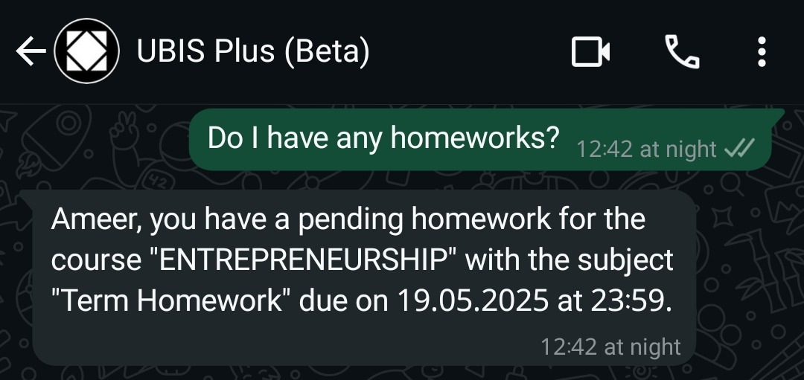
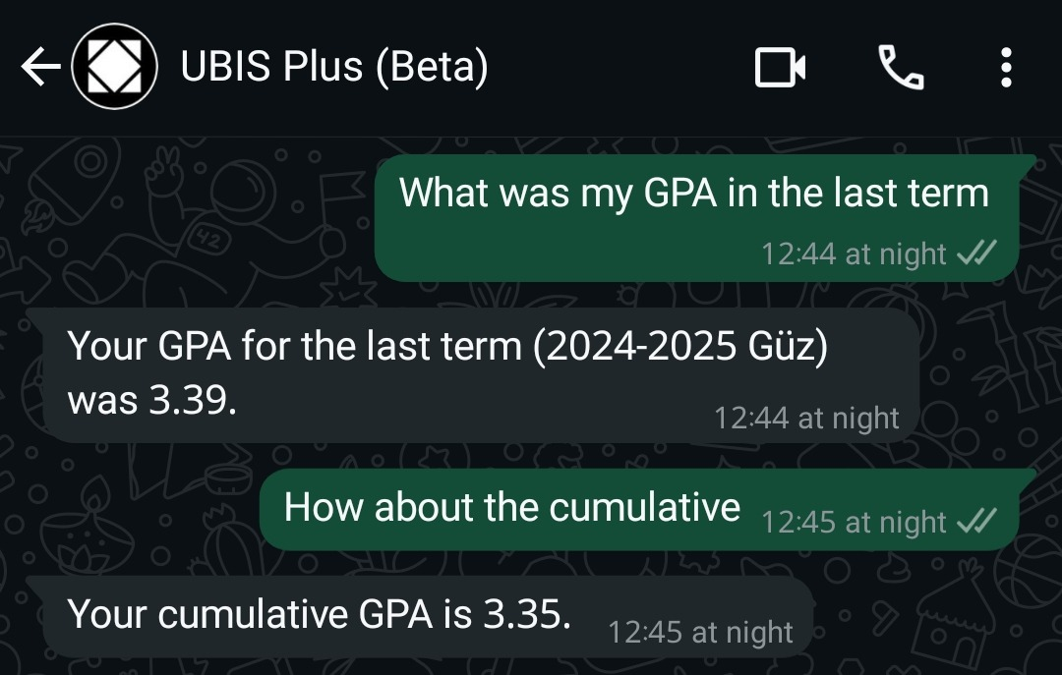
Working features
These are some features that are already done and there are students using it, I will talk about 5 in a few details, and mention another 5 by just the example, but there are more than that

Slide 9
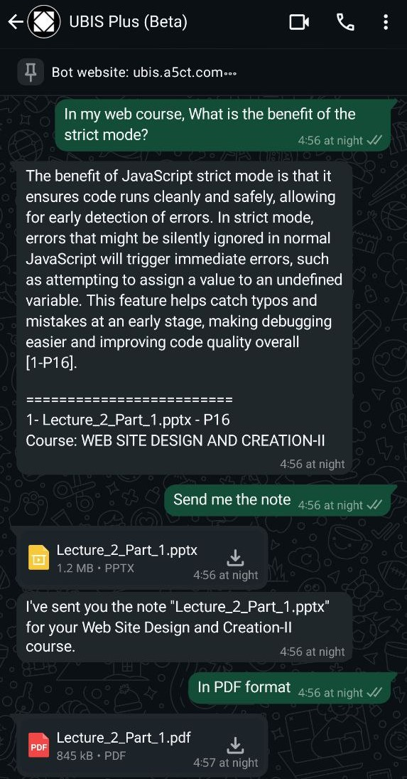
Working features
1. AI version of the university website
Students can ask the AI about the same information that already exists on the university website, so just like how there is a website and a mobile app, this is the WhatsApp version
What was the problem?
There are a lot of pages on the university website, so sometimes it can be a little bit hard to find what you are looking for, especially if it's something that you don't usually check
How this AI can help?
You can ask about what you are looking for, and the AI will check your information and give you what you wanted to check about

Slide 10
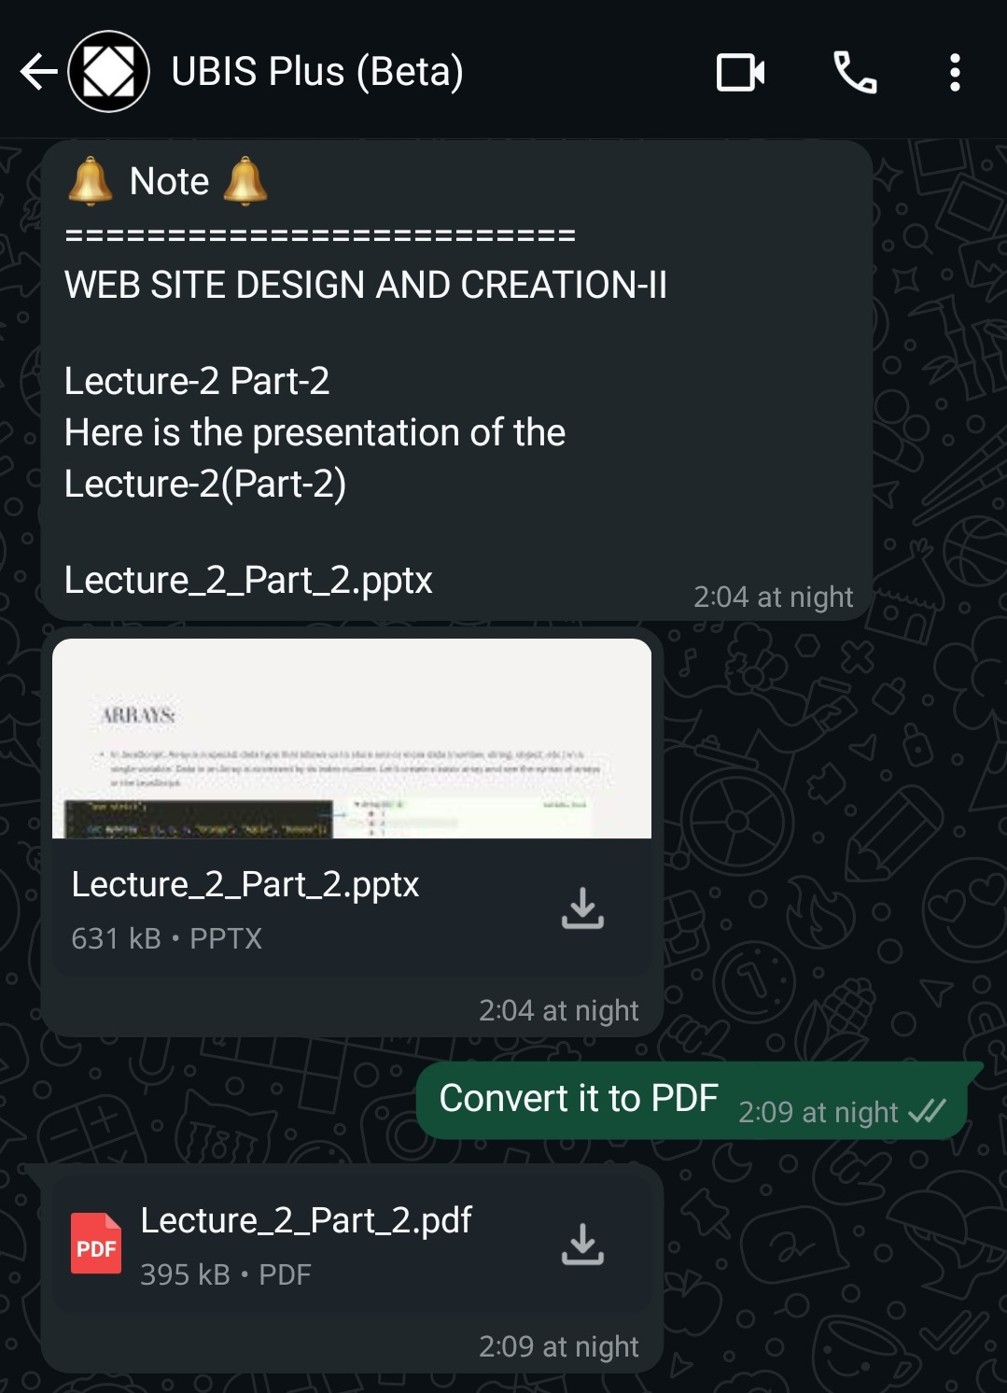
Working features
2. Notes AI
This is probably the most important feature in this project
The AI is able to read all of the course's notes and provide answers based on that, with the source from which file and page it found the answer
What was the problem?
Searching in all of the notes for the answer will take a lot of time, and there's no easy solution for that because searching the internet or asking the general AIs will not give the exact answer that you have in the notes
How this AI can help?
It will give the answer based on information that in your notes and also gives you the note file and page so you can directly go and read more about that subject, And also you can ask in any language even if it's not the note language and the AI will answer in your language so it's note translation as well

Slide 11
Working features
3. Interactive notifications
Getting the notifications inside WhatsApp and being able to use any of the other features directly after receiving the notification
What was the problem?
Students can miss the notifications from the university app because they usually don't open it a lot, so when they get a lot of notifications on their phones and clear them in one click, that means they will not be aware of the university notification, which sometimes it's about an exam or something important

Slide 12
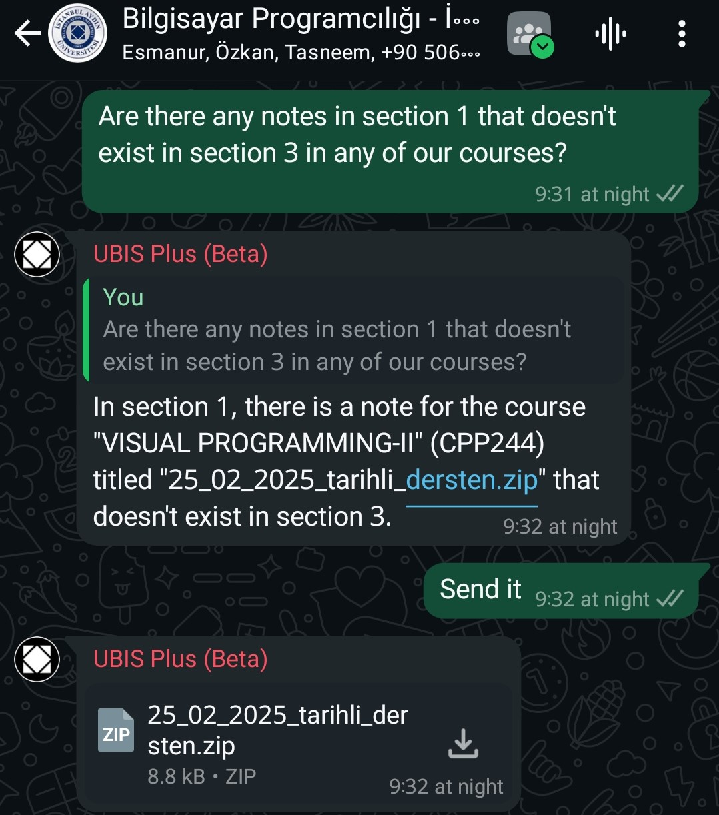
Working features
3. Interactive notifications
How this AI can help?
Everyone opens the messaging apps multiple times a day so having the notification in it will make sure that the student will notice it and also the AI can read what was the last notification so he can understand if the student directly talks about it, And many students ask the AI to summarize the note directly after they see the notification so that increases the chance that they will at least read what the note is talking about

Slide 13
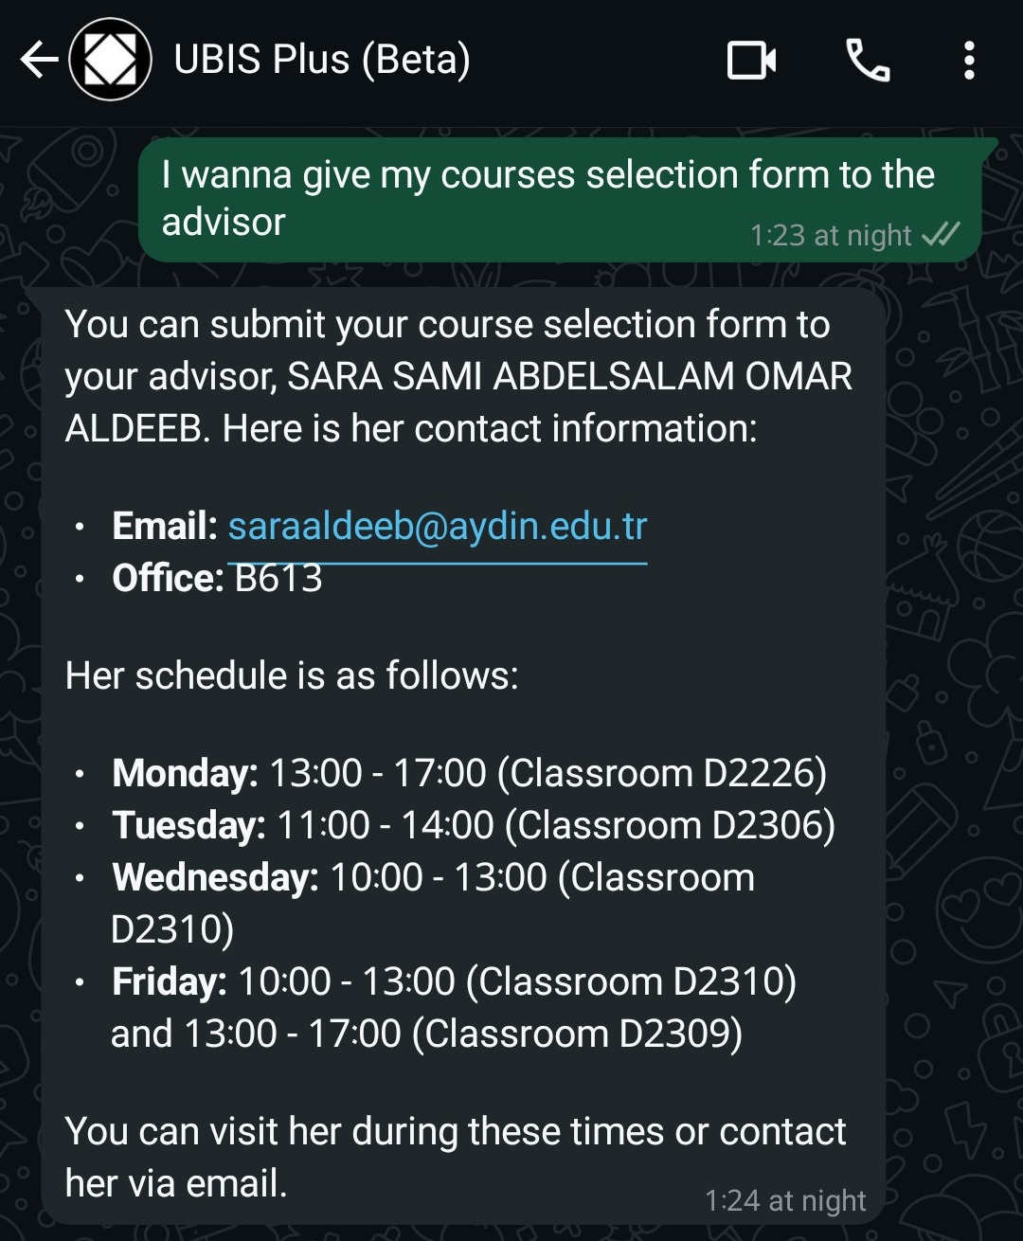
Working features
4. Get data from other sections
For this feature, it's useful, but I'm not sure if teachers allow it or not
The student can ask for the other sections' schedule and notes so he can attend with the other sections if he misses his section's lecture
What was the problem?
Sometimes the student misses his lecture, and most teachers will probably let him attend the other sections' lectures, but he has to ask for their schedule, which might change, so he may go to the wrong time
How this AI can help?
In general, the AI answers based on the student section data, but if the student specifies that he wants the data from another section, the AI will let him get that data

Slide 14
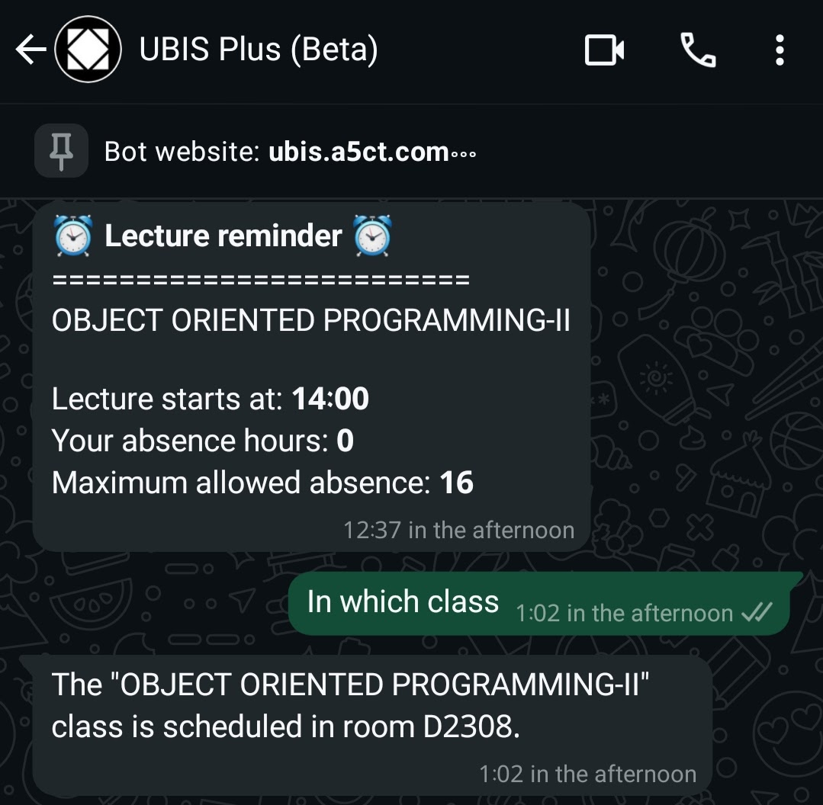
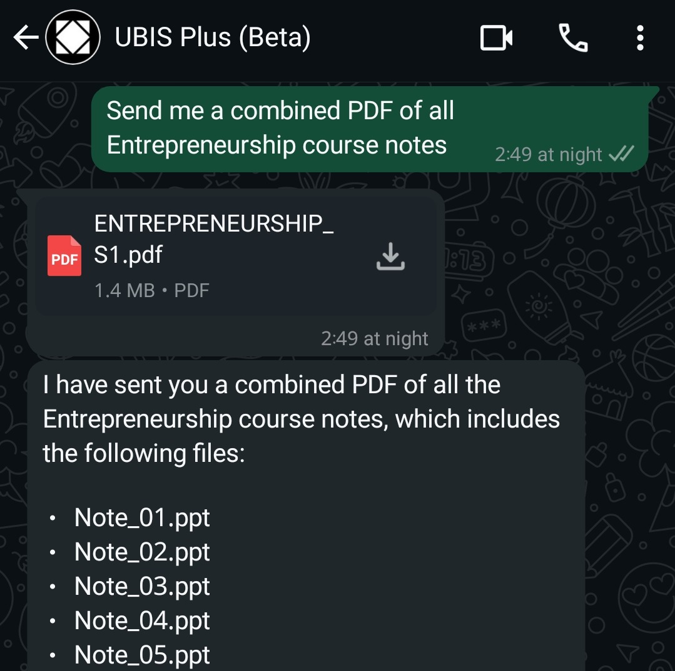
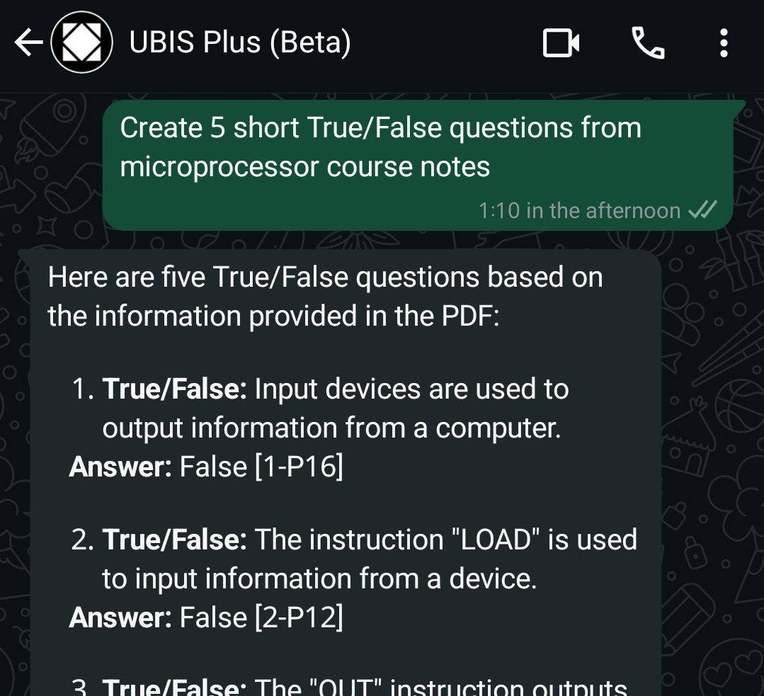
Working features
5. Teacher finder
By combining the schedule of all people registered in the bot, I can create the teacher's schedule so the student can find their teachers more easily. This can be much easier if I had access to the university database directly
What was the problem?
The university platform doesn't even provide the teacher's office, and even if the student knows the teacher's office, it is still hard to find them in it since they are teaching in different classes most of the time
How this AI can help?
By combining all of the students' schedules, the AI can tell you where you can find the teacher right now. For this feature, it kind of works without the AI. He basically just runs it, which can be replaced with a button in the university app, better than the bot

Slide 15
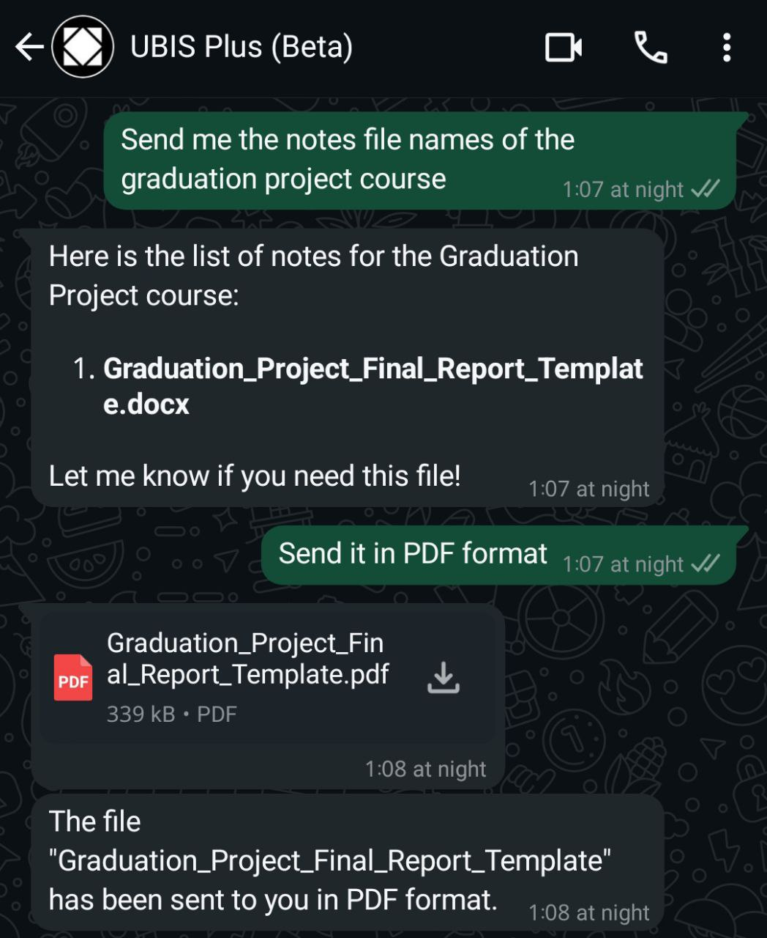
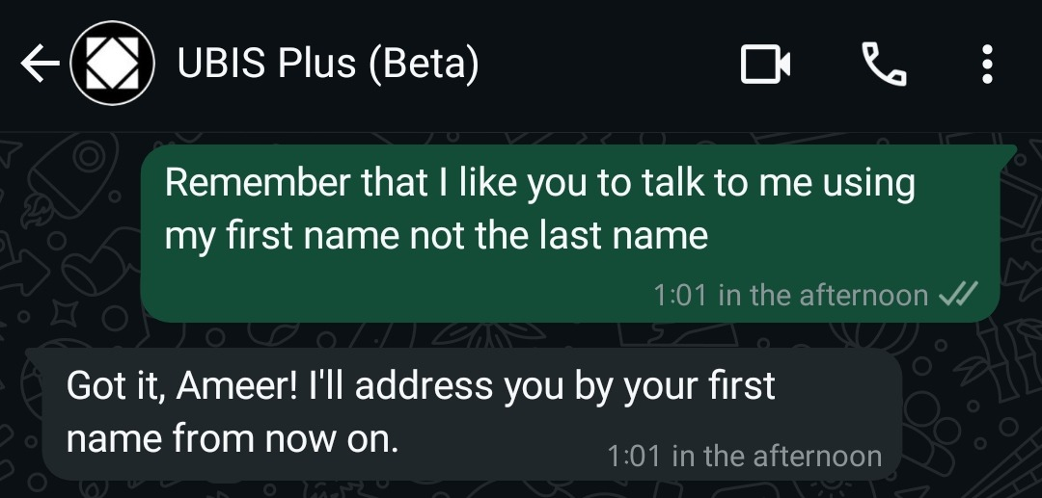
Working features
Some other features
6. Lecture & absence reminder
8. Questions generator (For Teachers)
7. Combine notes

Slide 16
Working features
Some other features
10. Notes file conversion
9. Customizable

Slide 17
Features ideas
These are just ideas that can be done if the university supports this project by making me part of the university developers' team so it's not ready for now but I will talk about it to show that I have a lot of ideas that can improve the university system, I will talk about 10 features ideas without giving too much details

Slide 18
Features ideas
1. Automatic login in WhatsApp
In the university database, they have every student's number because they ask for it during registration.
So, we can use that database to send them the new notifications to their numbers over WhatsApp, so they can notice the new AI feature and use it without any login
2. No password login on the website version
Since we have every student in the WhatsApp version so we can make the website version show a QR code and when the student sends that QR to the WhatsApp it will automatically login on the website version so there will be no need for a password anymore and this will also add an extra layer of security against the bot attacks since the current security is not enough, I mean I already bypass the bot restrictions to make this project and it was easy to do that, Of course this exra layer will not protect from bot attacks completely but it will make it harder

Slide 19
Features ideas
3. Empty classes finder
Sometimes the classroom has some kind of problem that needs to be fixed like in the electric, board or other devices and fixing it takes time while there are already some other classes who are empty for the upcoming few hours so by using the schedule of all departments, we can detect these empty classes and send it to the teacher when he asks for it, And this feature can help with preparing the schedules as well
4. Exam papers checker
By giving the AI the right answer and the student answer and asking it to check how much percentage of the information that the student's answer covers of the right answer we will get a suggested score for this exam question which can help teachers to check the exams papers faster, we can automate that so it will be easy to do that steps but of course we will not let the AI give the final score but it will just suggest a score to help the teacher

Slide 20
Features ideas
5. Clubs section in the university platform
This one is very important if the university wants to take the clubs seriously cause for now it's a mess, I don't even know in which clubs I'm registered because there's no way to check that so It should be inside the university platform so students can register and quit and check the events and other clubs related things in one place
6. Students notes section
For now, there's no way for students to share their summary notes of the course other than the students’ group, So we can add a section for that on the university platform and maybe rewarding students who share their notes to encourage more students to do that, The rewards can be some extra points or maybe some discount coupons for the stores inside the university

Slide 21
Features ideas
7. Add friends on the university platform
We can provide many features inside this one, For example friends can see each others schedule or maybe they can make a score points competition and show it in a beautiful way similar to the gaming achievements competition, In gaming this feature encourages the competition and most students are gamers so maybe providing a similar thing in the university platform can encourage them to study harder, And a lot more ideas can be added to the friends’ feature
8. Tester before exams
By using the information in the course notes, we can generate a small exam that can tell the student how ready he is for the exam

Slide 22
Features ideas
9. The average score of every exam
This is actually a basic feature that should already exist by now, but for now, students get the average score only at the final, but in the quiz and midterm, they can't see the average, and also, they can't see their position in the class, even after the final score
10. Sharing session between Teacher and Students
This one will be hard to make, but it will be very useful because, for now, we lose a lot of time in the lecture waiting for students to do what the teacher just did on his PC, so if he can share his session and let the students continue from where he stopped, that will be very helpful

Slide 23
Frequently Asked Questions
1. How much it costs to run it
Well, to calculate that, I need to know how many students there are and how much they will use the AI on average, and how many notes we have for all courses
But in general, most of it is pay-as-you-go.
That means the more messages the students send to it, the more it will cost, but that also means they like it and they benefit from it, that's why they use it more, so in that case, it will be worth it
And in general, we are not talking about expensive prices, especially now after the competition between DeepSeek and OpenAI, they are both lowering the prices, so we can benefit from that
And also, we can host it locally, so it will be free in this case, but this will require a strong server, and it will not be as good as using it without hosting it locally

Slide 24
Frequently Asked Questions
2. Security concerns
First of all, we are not passing the whole university database to the AI. We are just giving it access to what we choose, so we can control that and not give it any sensitive data
Secondly, For any highly sensitive data we can let the AI deal with it without letting him see it, So it will be like the AI giving an order to our server to send this student his receipt and our server will reply to the AI saying the mission has been done so the AI will understand that the data has been sent but he didn't get any access to that data

Slide 25
Frequently Asked Questions
2. Security concerns
Third, we are talking about using services from big companies that control the data of millions of people, so it's not like dealing with some random people. And also, the university is already using different services from other companies, like using the Email service from Microsoft, and there is a lot of sensitive data in these emails
And lastly, we can use the open source DeepSeek and host it locally so we don't have to pass any data to anyone, but this is not a good idea since we will face a lot of unnecessary problems by using this way, so I suggest the solution of the second point over this one

Slide 26


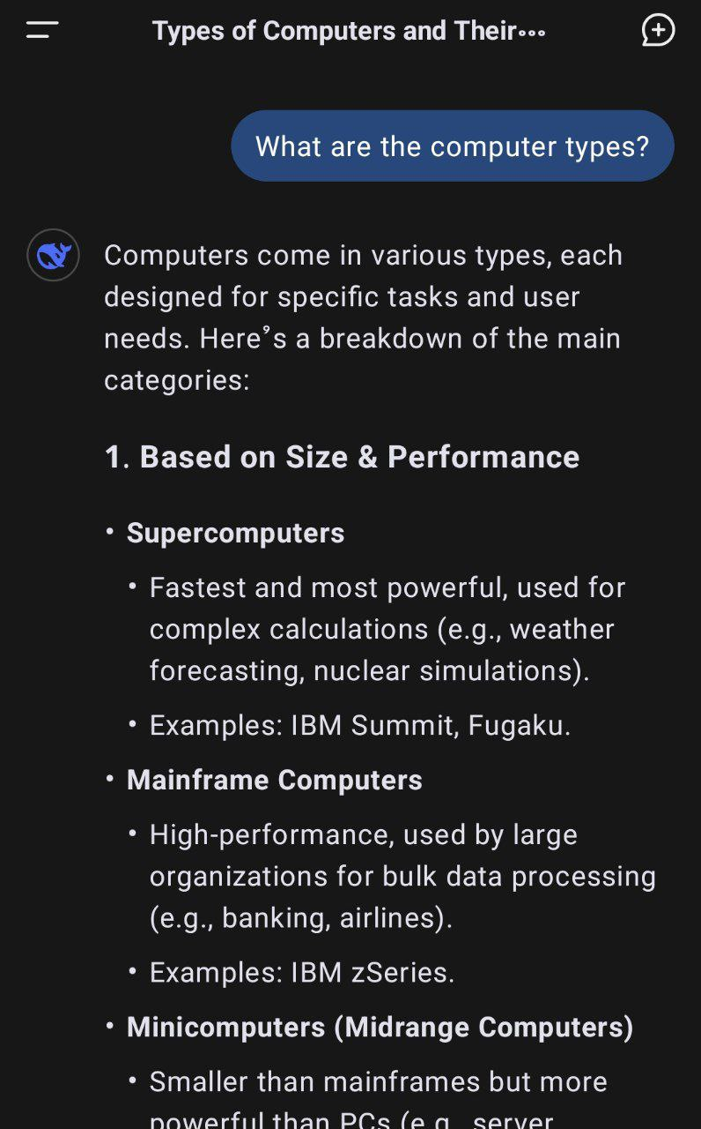
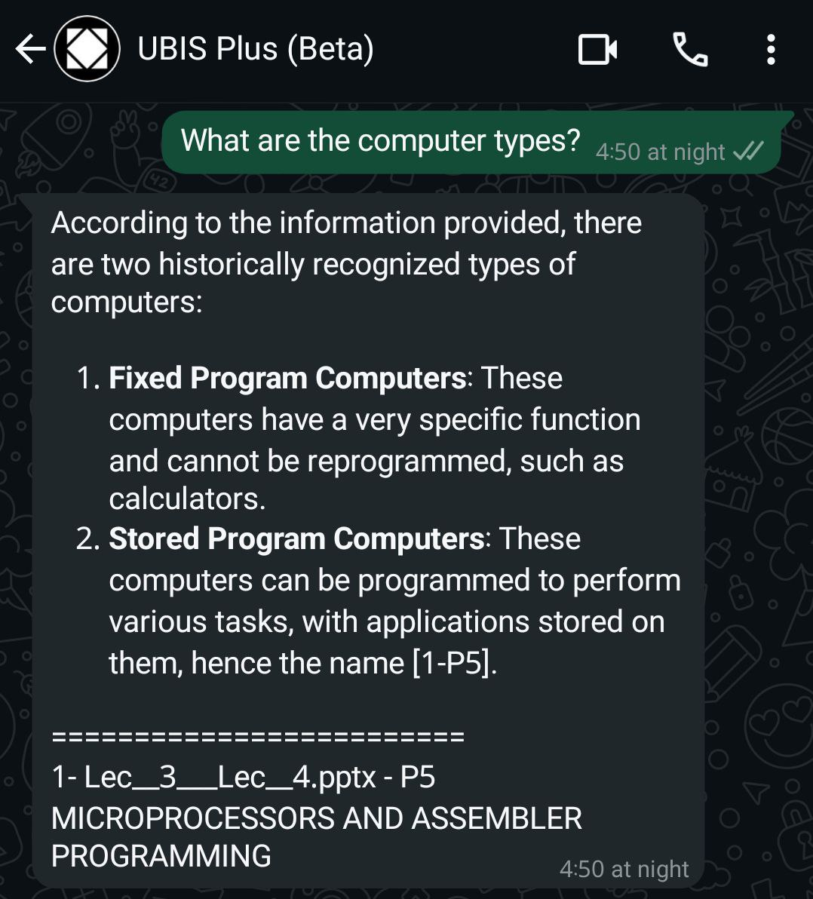
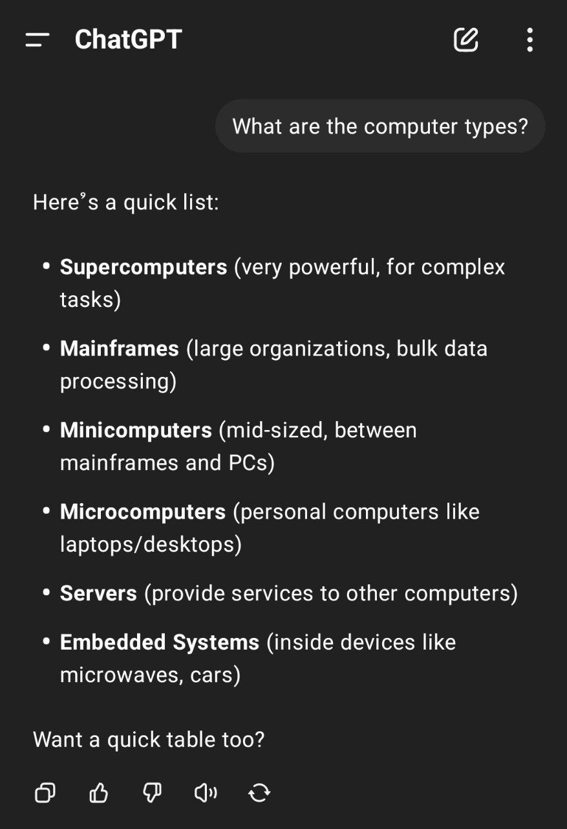
Comparison
Please note that this comparison doesn't show that my AI is better than other large companies because I already built my AI by using their service, Instead this comparison shows how my AI can provide a better answer when it comes to the questions related to the course notes because other AIs don't have access to these notes so my AI can help more when it comes to questions related to the student's courses
DeepSeek
UBIS Plus
ChatGPT

Slide 27
Comparison
As you see, the general AIs provide general answers that are not related to what we are studying in our course
DeepSeek
UBIS Plus
ChatGPT

Slide 28
UBIS Plus
DeepSeek
ChatGPT
Turkey’s First University with a Personal AI Mentor
Nice promotion title, right?

Slide 29
UBIS Plus
Turkey’s First University with a Personal AI Mentor
Nice promotion title, right?
By reaching this point, I think I have proved the following points:-
1. I have a lot of ideas to improve the university system. I talked about 20 in this presentation, and I have a lot more.
2. I can turn these ideas into real working features, just like the 10 working features that I mentioned.
3. When I talk about new ideas, I know what I'm talking about, and I know it's possible to make it, and it's not only a dream. The working features one day were just ideas that I talked about with my teachers, then I turned them into real features.

Slide 30
UBIS Plus
Turkey’s First University with a Personal AI Mentor
By reaching this point, I think I have proved the following points:-
1. I have a lot of ideas to improve the university system. I talked about 20 in this presentation, and I have a lot more.
2. I can turn these ideas into real working features, just like the 10 working features that I mentioned.
3. When I talk about new ideas, I know what I'm talking about, and I know it's possible to make it, and it's not only a dream. The working features one day were just ideas that I talked about with my teachers, then I turned them into real features.
Now you understand what I can offer for your university and what you can expect from me. Now, if you like this project, you can tell me what I can expect from working for you.
What’s your offer?

Slide 31

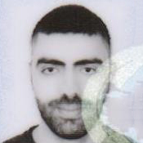
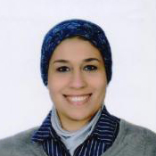
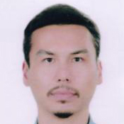
UBIS Plus
Turkey’s First University with a Personal AI Mentor
Now you understand what I can offer for your university and what you can expect from me. Now, if you like this project, you can tell me what I can expect from working for you.
What’s your offer?
SELÇUK ŞENER
selcuksener@aydin.edu.tr
ÖMER AYDIN
omerfaydin@aydin.edu.tr
SARA ALDEEB
saraaldeeb@aydin.edu.tr
İHSAN İÇİUYAN
ihsaniciuyan@aydin.edu.tr

Slide 32
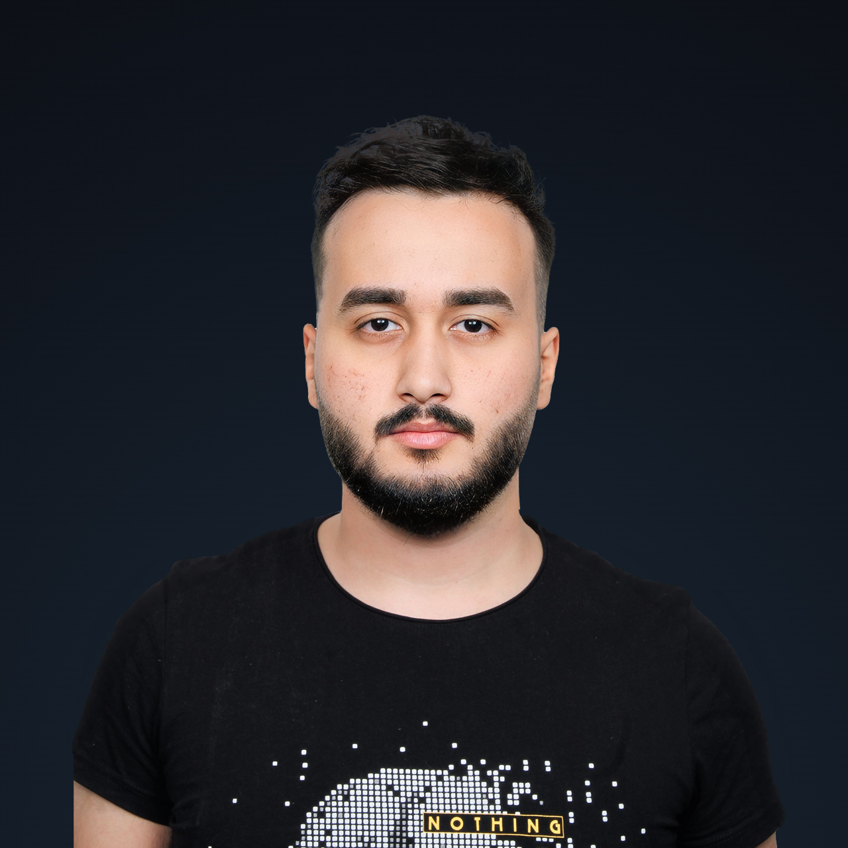
UBIS Plus
Turkey’s First University with a Personal AI Mentor
Thanks to
SELÇUK ŞENER
selcuksener@aydin.edu.tr
ÖMER AYDIN
omerfaydin@aydin.edu.tr
SARA ALDEEB
saraaldeeb@aydin.edu.tr
İHSAN İÇİUYAN
ihsaniciuyan@aydin.edu.tr
AMEER ADELI
admin@a5ct.com

Slide 33
SELÇUK ŞENER
selcuksener@aydin.edu.tr
ÖMER AYDIN
omerfaydin@aydin.edu.tr
SARA ALDEEB
saraaldeeb@aydin.edu.tr
İHSAN İÇİUYAN
ihsaniciuyan@aydin.edu.tr
Created by
AMEER ADELI
admin@a5ct.com

