Slide 1


Shell DigData Project
By Ameer Ali Saleem and Aadam Ul Haq

Slide 2
Our Approach
Start with some Exploratory Data Analysis to find trends in the train data or any points for concern.
From the analysis, build a naïve model to maximise profit.
Sophisticate the model using some Machine Learning techniques.
Run the test data through the model and see any conclusions reached.
Consider where the model went well and how it could be improved in the future

Slide 3
Step 1: Exploratory Data Analysis (EDA)

Slide 4
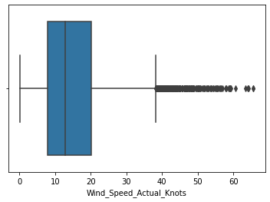
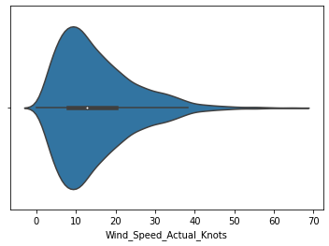
EDA (Hourly Data)
After looking at the data initially with Pandas, we noticed some values were negative so we set these values to zero as they seemed to be a mistake and were close to zero.
We then created a box plot and a violin plot to ascertain what the most common wind speeds were per day. We noticed that the wind speed was averaging roughly 13 knots per hour, with the mode being about 10 knots per hour.

Slide 5
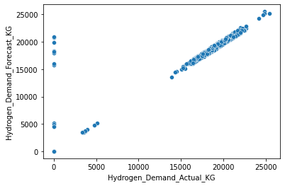
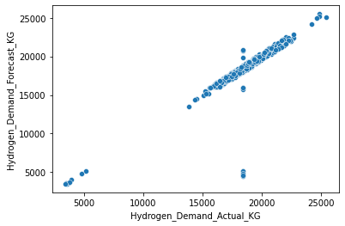
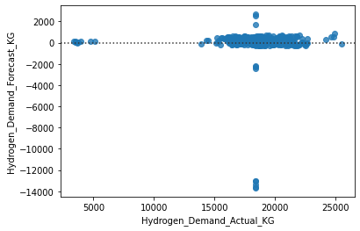
EDA (Daily Data)
Within the daily data, we quickly noticed there was no negative or missing data points. We continued to look at the forecasted demand of hydrogen per day compared to the actual demand and produced a scatter plot that seemed to show a linear relationship.
We noticed that there were several days in which demand was zero (weeks at a time) which was likely a mistake so we have initially replaced these data points with the average demand (excluding these zero points) to produce the other two graphs of a scatter plot and a residual plot.
The linear regression had an equation of y=0.99x-0.5 with an R^2 value of 0.87, indicating a very strong linear relationship.

Slide 6
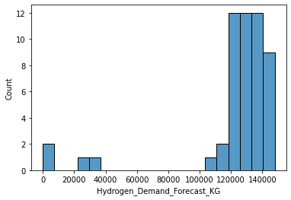
EDA (Weekly Data)
Again for the weekly data we noticed there was no missing data, however noticed two weeks of zero data. These weeks were the same weeks with zero data in the hourly and daily data so we again took it as a mistake within the data set.
We created a histogram of the demand of hydrogen per week to have an indication of how much is expected. We noticed two data points (21/3 and 19/09) had much lower demand so this was a cause for later investigation.

Slide 7
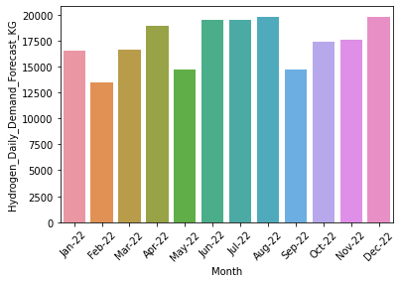
EDA (Monthly Data)
Finally, we investigated the monthly data to see if there was a trend in demand for certain months over others. Surprisingly, we discovered that the forecast demand per month was somewhat consistent throughout the year. There is a slight trend that every three months or so there is a step up in forecast. This may need to be investigated further later.

Slide 8
Step 2: Feature Engineering

Slide 9
Feature Engineering - Hydrogen
Before we continued coding a strategy, we had to first create and adjust columns in the data set, as well as further investigate some correlations between variables. This would enable us to create a more refined strategy later on.
Firstly we created a column of the amount of hydrogen generated per day (kg) from the amount of energy produced, taking into account the loss of energy in the conversion. This assisted us in comparing the difference between the demand of hydrogen per day compared to the amount of hydrogen produced if all energy were compared to hydrogen.
We then introduced a ‘Leftover’ column. This was the calculation of the amount of (Hydrogen Generated (kg) - Demand).
Finally, we also created a column of the maximum possible demand. This was the maximum between the forecasted demand and the actual demand. This helped us figure out a worst case scenario later when we enter a naïve strategy.

Slide 10
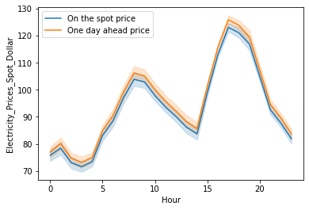
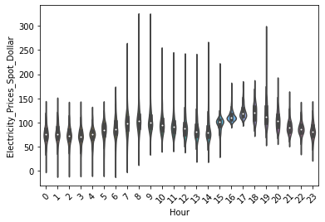
Feature Engineering (2)
Next, we investigated the spot price of electricity compared to the price one day ahead.
We converted our hourly data to a datetime column and investigated what the most profitable hour of the day is from the time series and violin plot.
Clearly, the price the day ahead is almost always higher than the spot price. Therefore, it makes more sense for us to buy electricity on the spot when needed. Moreover, if we buy electricity, we can see that the early hours of the day are the best times to buy, so we could accrue more profit if we were to take this into account.

Slide 11
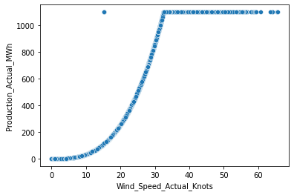
Feature Engineering (3)
Finally, we decided to take a closer look at the correlation between wind speed and actual energy produced.
We produced a scatter plot of the wind speed to the energy produced. From the graph, we can see that the energy produced is capped after wind speed is above 30 knots. This means that for 30 knots and above, we are producing the maximum amount of energy. This could be incorporated into a future strategy.

Slide 12
Step 3: Strategy 1 (Naïve Model)

Slide 13
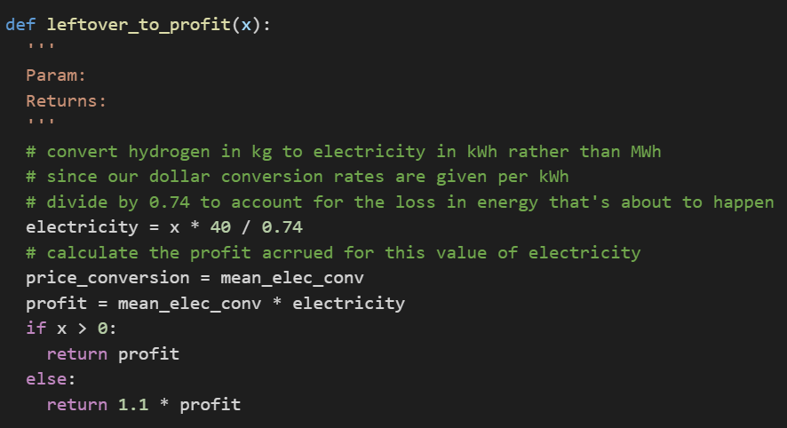
Strategy 1: Naïve Model
Our first model is that we always ensure that 10 tonnes of hydrogen is always present within the tank. If we ever fall below 10 tonnes, we would buy up the remainder demand for that day. If we ever go above 10 tonnes, we would sell the remaining for that day.
For the purposes of this naïve model, we implemented the following:
We restrict buying and selling to the end of the day
We aggregate daily hydrogen and then buy, sell and store as required
We take the price for buying and selling to be the average price

Slide 14
Strategy 1: Naïve Model
The profit from the training data using this strategy amounted to $145,036,137,738.77.
Although this seems alarmingly high, we realised that it is a reasonable value. This is because if all the energy were sold to the grid, with none given to hydrogen, we would have a profit of $180,171,029,508. This is a very large upper bound so our answer seems reasonable as it is 2 orders of magnitude beneath this upper bound.
There are many improvements and sophistications we can make above this naïve model, which is how we developed our second strategy.
One of the main issues with this strategy is that we assume we are generating hydrogen at every hour of every day. In reality, this hydrogen generation cannot be done as we are also selling energy to the grid. This would correspond to the electrolyser converting hydrogen to energy, however it cannot do this at the same time as energy being transferred to hydrogen.
Another issue is that we do not consider the different hours in a day and they do not influence any of the decisions taken.
Taking these both into account, the next strategy will become a lot more accurate.

Slide 15
Step 4: Strategy 2 (More Accurate Model)

Slide 16
Strategy 2: More Accurate Model
For the second strategy, we will try and fix the issue with the debt of hydrogen we have in the tank, and also approach the problem on an hourly basis. In particular, the strategy will:
Consider demand each day, again taking the maximum value between the forecast demand and actual demand.
Produce hydrogen from midnight until we have accumulated enough to satisfy the demand for the day. Then we will switch the electrolyser off (state 0) and sell all remaining production for that day
If we have a deficit of hydrogen on a particular day, we will buy that energy from the grid at the end of the day, so we maintain 10 tonnes of hydrogen in the tank at all times.
Clearly this takes into account more information than the first strategy. Additionally, we will never run out of hydrogen and will always satisfy demand so there will be no issues in terms of running out of hydrogen.
Later on, if this were extended to a larger time scale, we would eventually fill up all 86 tonnes of hydrogen in the container due to us always gaining a little bit of hydrogen whenever we have a day in which production exceeds demand. This would be a simple case of selling a lot of hydrogen once we reach near the 86 tonne limit.

Slide 17
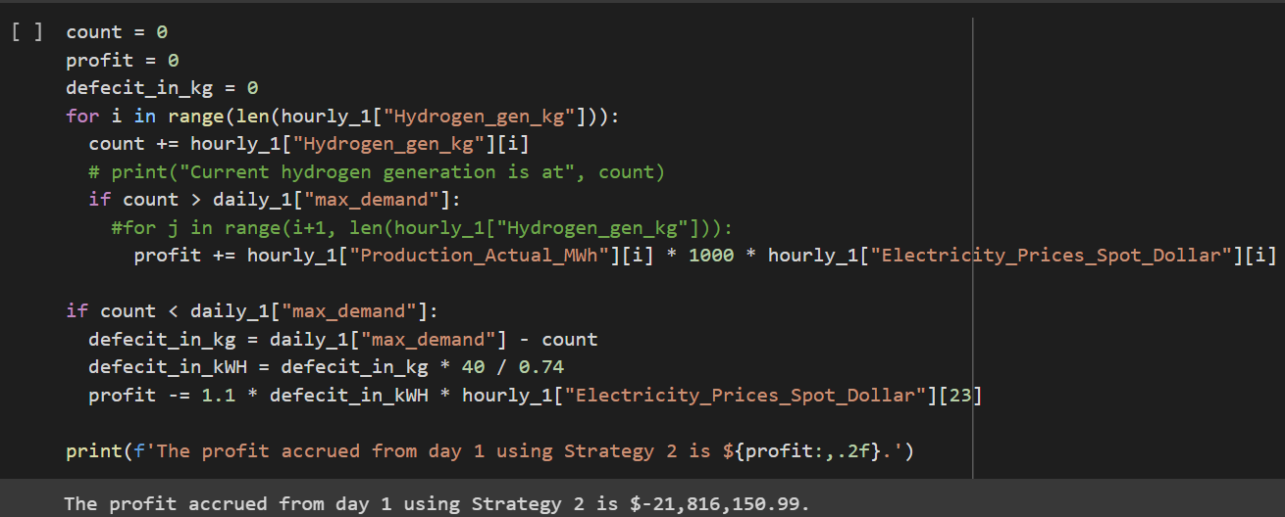
Strategy 2: More Accurate Model
When implementing strategy 2, we firstly only coded the first day to see if the strategy would work, and then tested it by hand to double check the calculation was correct.
This could also be extended to work for any day we wanted to check, so we did so for the first five days to double-check the method and confirm the validity of our final answer.

Slide 18
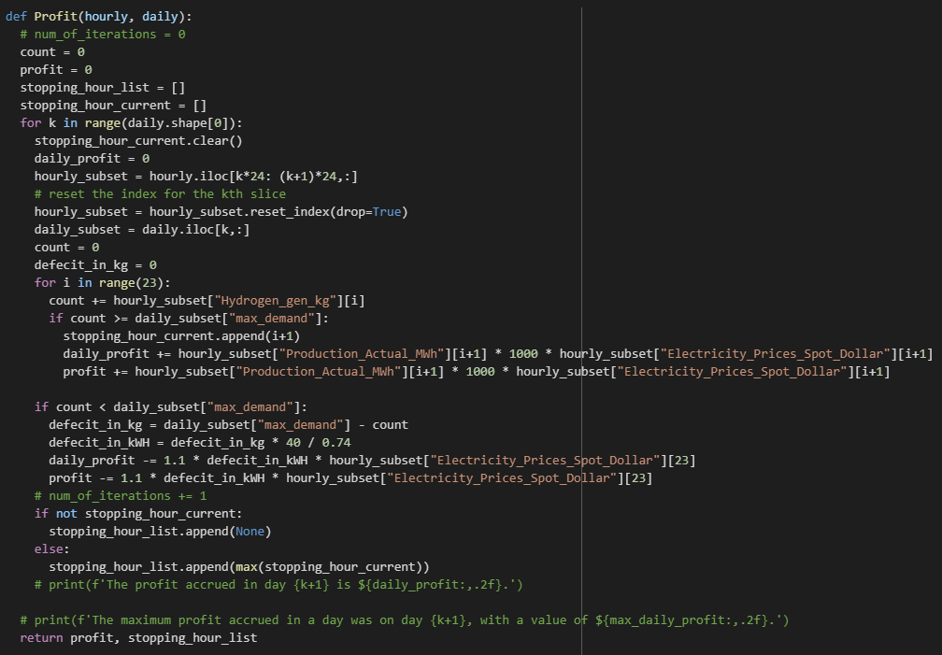
Strategy 2: More Accurate Model
The profit obtained by running the strategy through the whole training data was $144,818,275,000.04.
Although this is less than the profit obtained through strategy 1, this was to be expected as we have a much more accurate model now.

Slide 19
Step 5: Strategy 3 (Machine Learning Model)

Slide 20
Strategy 3: Machine Learning Model
Unfortunately, due to time restraints, we could not complete strategy 3. However, it will still be outlined within this presentation.
Similarly to Strategy 2, we look on an hourly basis and fulfill all the demand of hydrogen per day. In this model however, we do not fill all the hydrogen and then sell, but rather choose particular hours of the day to sell and produce hydrogen.
These hours would be determined with machine learning techniques, e.g. generate a series of numerical suggestions for when to buy/sell electricity and then using a voting classifier model to choose the best allocation for each day.
We would look at the forecasted energy produced for a particular hour as well as the forecasted price of selling. If we saw a hour in which we produce a lot of energy, but with a low selling price, we would store it as hydrogen to help meet demand. Otherwise, if there was a lot of energy produced with a high selling price, we would sell.
This would work similarly if we produced low amounts of energy.
Clearly this strategy would produce more profit than strategy 2 and is a more sophisticated model that utilises the full potential of the information given within the data.
We know that strategy 2 will give a higher profit than $145bn but less than $180bn

Slide 21
Step 6: Prepping the test data

Slide 22
Prepping the Test Data
The test data had quite a few inconsistencies and problems:
There were no missing values in the data
A whole week of the daily data had zero as the values so we replaced this with the average of the rest of the data
There were negative values within the hourly table, which we replaced with zero as the values were very close to zero
The dates in the daily table changed between American formatting and British formatting so we standardised it with British formatting.
We also added a few columns into our dataframe so strategy 2 would work:
We added a hydrogen generated per hour column to the hourly data
We added a maximum demand between the forecasted and actual demand to the daily data

Slide 23
Step 7: Result and Summary

Slide 24
Result and Summary
The profit obtained from strategy 2 on the test data was $18,916,885,222.74 and is our final submission answer.
The accompanying spreadsheet has the data from the electrolyser.
As discussed earlier, Strategy 3 would result in more profit eventually, however there are a few more improvements we could consider.

Slide 25
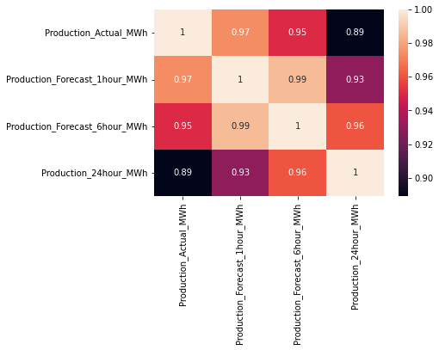
Result and Summary
We could consider the correlation between forecast and actual values of production and demand. Once we have a correlation, we could predict demand and refine our model based off these observations.
Additionally, we could consider the question of how wind speed fluctuates over time. If wind speed fluctuates drastically over a small time frame (e.g. during a storm) then we may need to be wary of the forecast electricity production values in Strategy 3.
We could also consider what forecast value of production is the most accurate and implement and refine Strategy 3.

