Slide 1
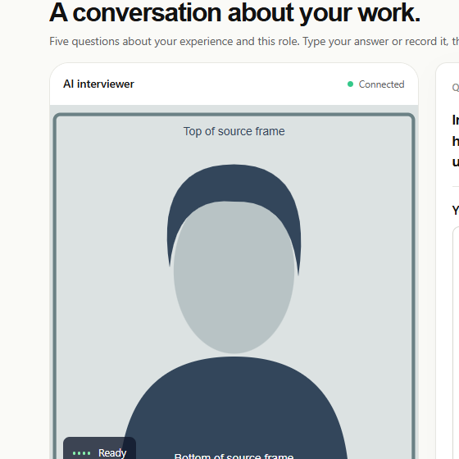
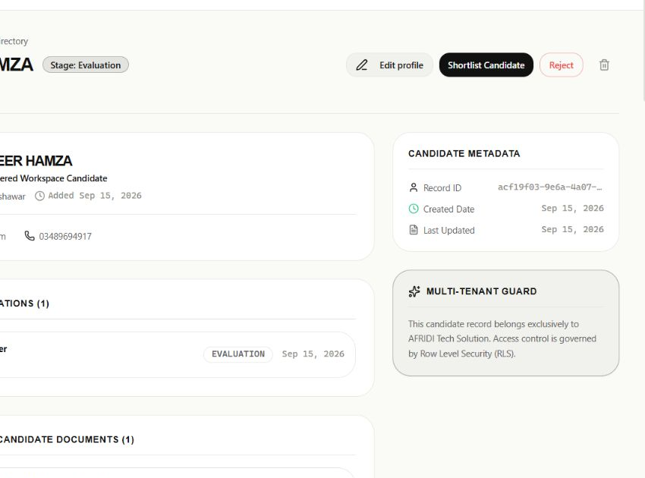
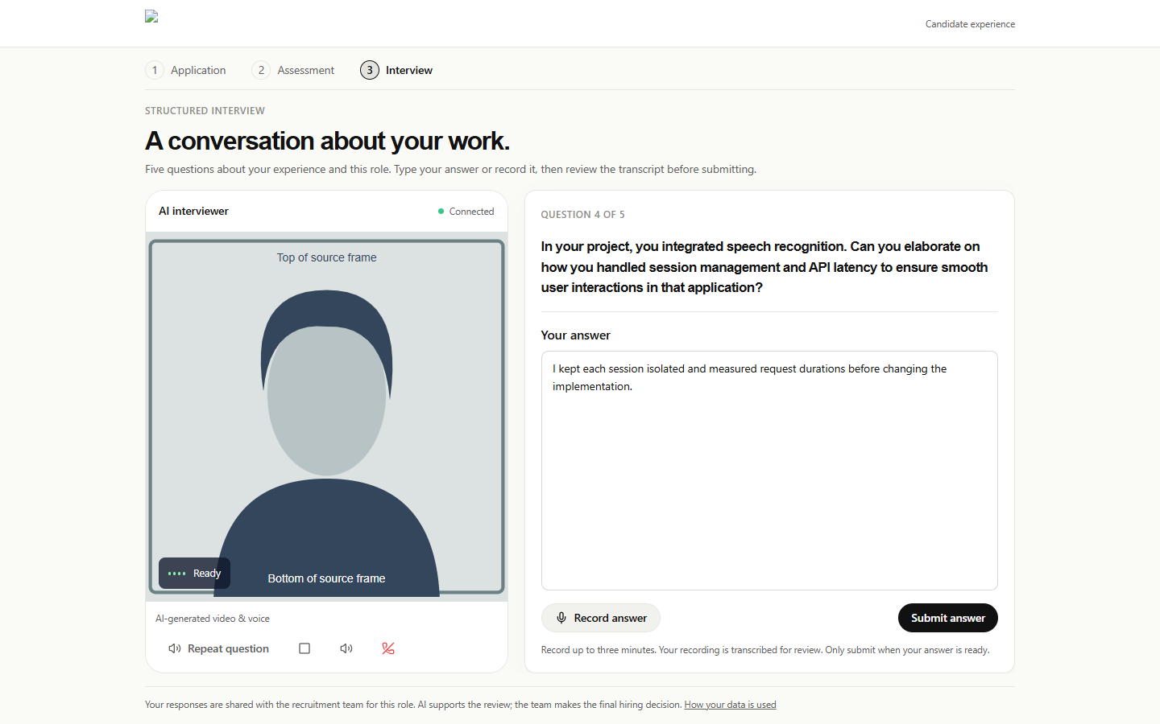
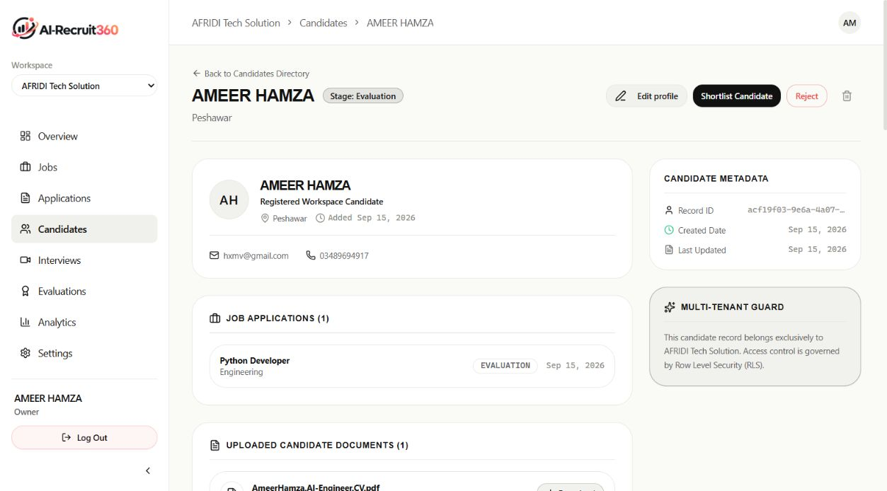


ai_recruit360 .
AI-assisted resume screening, anti-cheat skills assessment, and multimodal conversational avatar interviews.
BSc Final Year Project (Session 2022-2026)
DEPARTMENT OF SOFTWARE ENGINEERING
Mirpur University of Science and Technology (MUST), Mirpur-10250
🎓 Students
👤 Supervisor
Ameer Hamza
FA22-BSE-030
Babar Hussain
FA22-BSE-044
Ali Naqi
FA22-BSE-050
Engr. Syeda Iqra Gillani
Lecturer, Dept of Software Engineering
📖 1. INTRODUCTION
🎯 2. OBJECTIVES
Corporate talent acquisition faces a severe hiring bottleneck: recruiters receive 500+ applicants per requisition and spend under 7 seconds per CV. Legacy keyword-based Applicant Tracking Systems (ATS) reject top-tier engineers due to keyword mismatches while rewarding superficial keyword stuffing.
ai_recruit360 is an enterprise-grade autonomous recruitment platform that evaluates candidates across a server-authoritative three-stage pipeline (Resume Screening, Skills Assessment, and Multimodal Interview) to deliver verifiable, bias-free candidate rankings with 90.2% cost reduction.
• Develop in-memory stream parser for PDF/DOCX resumes (380ms).
• Enforce strict Pydantic JSON schemas to eliminate AI hallucination.
• Implement server-authoritative anti-cheat testing with database locks.
• Stream real-time WebRTC conversational avatar with sub-1.5s turnaround.
• Formulate multi-dimensional 30/30/40 composite candidate scorecard.
• Eliminate demographic bias through blind resume redaction.
• Slash corporate recruitment operational costs by 90.2%.
⚙️ 3. METHODOLOGY
📊 4. KEY RESULTS
📥
1. Resume Stream Ingestion
PDF/DOCX parsed in-memory (380ms) without disk writes
👥
90.2%
Cost Reduction
$146.31/mo for 500 applicants vs $1,500/mo legacy ATS
⚡
1.41s
Conversational Latency
Deepgram STT (240ms) + LLM (400ms) + TTS (390ms)
↓
2. Deterministic AI Screening (30%)
Strict Pydantic JSON schema guarantees zero hallucination
🧠
↓
3. Anti-Cheat Skills Assessment (30%)
Server expires_at locks & DOM telemetry tracking
🛡️
100%
Test Pass Rate
32 automated unit, integration & RLS penetration tests
🔒
Zero
Cheating & Leakage
Tamper-proof server locks & PostgreSQL Row-Level Security
🛡️
↓
4. Multimodal AI Interview (40%)
Simli WebRTC avatar + Deepgram STT (240ms) + ElevenLabs
🗣️
↓
5. Composite Scoring & Triage
0.30·Screen + 0.30·Assess + 0.40·Interview ranking
📊
⭐ 5. SYSTEM FEATURES
📄
Deterministic Resume Extraction
In-memory byte parsing for PDF/DOCX with Pydantic JSON schemas.
💻 6. APPLICATION INTERFACE
🛡️
Server-Authoritative Anti-Cheat
PostgreSQL database expires_at locks defeat client clock tampering.
CANDIDATE LIVE AVATAR INTERVIEW ROOM (WebRTC)
🗣️
Simli WebRTC Conversational Avatar
Real-time photorealistic visual interviewer with sub-second lip sync.
🎙️
Deepgram Nova-2 Streaming STT
Bidirectional WebSocket audio streaming yields 240ms speech transcription.
🧠
Adaptive Follow-Up Probing
Fast-inference LLM dynamically generates contextual follow-up probes.
Photorealistic talking avatar with dynamic audio visualizer and real-time closed captions. Candidate simply speaks into their microphone.
📊
360° Candidate Evaluation Dossier
Verbatim audio interview transcripts, skill breakdown, and recruiter override.
RECRUITER 360° EVALUATION DOSSIER & AUDIT
🔒
Multi-Tenant Row-Level Security
PostgreSQL kernel-level RLS policies isolate organization records.
📄 8. REFERENCES
1. IEEE Standard 1016-2009: Standard for Information Technology - Systems Design - Software Design Descriptions.
2. Deepgram & ElevenLabs (2024): Low-Latency Streaming Speech Recognition and Neural Voice Synthesis.
3. Simli AI (2024): Real-Time WebRTC Neural Visual Avatar Rendering and Lip-Synchronization Protocols.
4. PostgreSQL Global Development Group (2024): PostgreSQL Row-Level Security & Multi-Tenant Kernel Isolation.
Multi-stage score breakdown, verified skill matches, anti-cheat event telemetry, and full audio interview transcript with recruiter override controls.
💡 7. CONCLUSION
🌍 SUSTAINABLE DEVELOPMENT GOALS
ai_recruit360 demonstrates the transformative potential of artificial intelligence in modernizing talent acquisition. By integrating deterministic schema-constrained resume parsing, server-authoritative anti-cheat testing, and real-time multimodal avatar interviews, the platform delivers an objective, data-driven, and candidate-centric recruitment workflow.
The system successfully achieves a 90.2% cost reduction while safeguarding candidate dignity and algorithmic transparency through human-in-the-loop recruiter governance.
8 DECENT WORK &
ECONOMIC GROWTH
Promoting fair, bias-free, accessible recruitment, eliminating demographic discrimination, and accelerating equitable employment opportunities.
9 INDUSTRY, INNOVATION
& INFRASTRUCTURE
Building modern, resilient AI cloud infrastructure utilizing real-time WebRTC, neural streaming speech, and server-authoritative computing.
Mirpur University of Science and Technology (MUST), Mirpur-10250
DEPARTMENT OF SOFTWARE ENGINEERING
Faculty of Engineering & Technology | Session 2022-2026
SCAN FOR LIVE DEMO
https://ai-recruit360.vercel.app
INNOVATING TALENT ACQUISITION THROUGH OBJECTIVE AI EVALUATION

