Slide 1
DISTRIBUTED COMPUTING / JAVA SOCKET PROGRAMMING
FRAME
BY FRAME
A
STORY
IN LIGHT
THE
QUIET
SCENE
AFTER
THE
CREDITS
A Letterboxd-inspired film diary
Architecture study · Distributed paradigms · Working browser app
Srinidh 23MCCE04 Distributed Computing

Slide 2
FRAME BY FRAME / MINI PROJECT
Why build a film diary?
The experience
The engineering
The project goal
Films are more than a watchlist: people keep ratings, diary dates, reviews, and recommendations.
A social product coordinates accounts, shared film records, user events, and follower activity.
Build a smaller, testable version using Java TCP sockets and explain its scaling trade-offs.
Not a clone of Letterboxd internals. A prototype that borrows the product idea, implements an inspectable distributed design, and marks unknowns honestly.
02

Slide 3
FRAME BY FRAME / MINI PROJECT
A focused slice of a much larger product
01 Browse & search
02 Log a watch
03 Keep a diary
Seeded film catalog and genre filters.
Date, 1–5 rating, optional review.
Personal history and summary statistics.
04 Find people
05 Follow activity
06 Authenticate
Public diary lookup by username.
Follow/unfollow and view an activity feed.
Register, login, server-issued token, logout.
Browser UI → Java gateway → TCP socket services | No external API or poster assets
03

Slide 4
FRAME BY FRAME / MINI PROJECT
System architecture: one request, multiple hops
APP SERVER 1
BROWSER
WEB
GATEWAY
LOAD BALANCER
DATABASE
SERVER
APP SERVER 2
HTTP is only the local browser adapter (browsers cannot open raw TCP sockets). Between Java tiers: TCP + newline-delimited JSON.
DB server owns primary writes, replica reads, in-memory sessions, and delayed mirror worker.
04

Slide 5
FRAME BY FRAME / MINI PROJECT
Socket programming: the wire contract
1 Build JSON
2 Send a line
3 Read a response
Example: {"type":"LOG_FILM", "filmId": 2, ...}
One object per request.
Java Socket + PrintWriter sends UTF-8 JSON followed by a newline.
Server routes the request and replies with one JSON line: OK or ERROR.
LOGIN returns an opaque token. Diary, feed, follow, and log requests carry that token; the data tier checks it against the claimed username.
Protocol code: protocol/Message.java · RequestRouter.java · ConnectionHandler.java
05

Slide 6
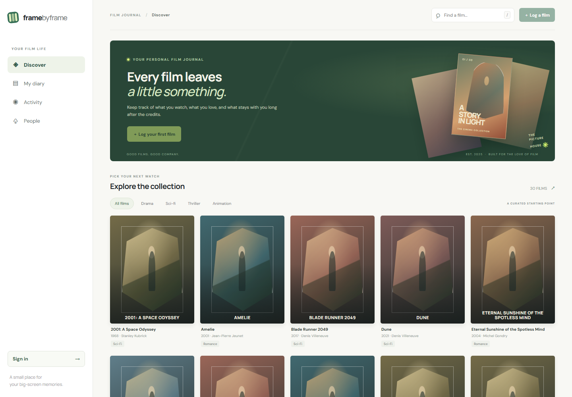
FRAME BY FRAME / MINI PROJECT
The interface: a real browser front end
Discover
Search, genre filters, film cards.
Diary
Ratings, dates, reviews, stats.
People
Follow and public diary lookup.
06

Slide 7
FRAME BY FRAME / MINI PROJECT
Distributed paradigms visible in the prototype
Horizontal scale-out
Primary / replica
RPC over sockets
Two interchangeable app-server instances share the same database service.
Writes go to primary; reads use replica. Delayed copying makes stale reads visible.
A DB method call crosses a network boundary and can time out or fail.
Important distinction: these are prototype decisions. Public Letterboxd sources do not confirm the company's exact deployment or algorithms.
07

Slide 8
FRAME BY FRAME / MINI PROJECT
Algorithms and the trade-offs they expose
Round robin
Atomic counter mod backend count
Simple and even; no health checks
Async replication
DelayQueue + worker
Fast write response; stale replica reads
Feed fan-out
Push entry to follower feeds
Fast feed reads; costly popular accounts
No consensus, health-aware failover, sharding, or exactly-once delivery is implemented.
08

Slide 9
FRAME BY FRAME / MINI PROJECT
Functional verification
✓
Build
Compile all Java sources with included Gson + SQLite JDBC.
✓
Account
Register, login, duplicate rejection, and logout.
✓
Diary
Log film → wait replica lag → reload personal diary.
✓
Social
Use two accounts → follow → inspect feed → unfollow.
✓
Failure
Stop a service → confirm UI shows a useful error.
Run with start_demo.bat; observe all five service terminals and the browser UI.
09

Slide 10
FRAME BY FRAME / MINI PROJECT
Limitations are part of the design
Availability
Consistency
Round robin can route to a dead backend. No health checks, retries, or failover.
Replica lag can hide a new entry for a short time. The queue is not durable.
Security
Data recovery
Local demo only: no TLS, token expiry, rate limits, or production-grade password hashing.
Two SQLite files on one machine are not independent failure domains; no backup workflow.
A useful next iteration: health probes + timeouts + idempotency + lag metrics + failure tests.
10

Slide 11
FRAME BY FRAME / MINI PROJECT
Possible next development steps
Backend health checks
Stop routing new connections to an unavailable application server.
Bounded timeouts
Return predictable errors when a downstream socket is slow or unreachable.
Durable replication
Persist queued updates so a database-process restart does not discard them.
Automated tests
Cover authentication, socket errors, replica lag, and follow/feed behaviour.
11

Slide 12
FRAME BY FRAME / MINI PROJECT
References and project scope
OFFICIAL PRODUCT REFERENCES
TECHNICAL REFERENCE
Letterboxd — letterboxd.com
Letterboxd About — letterboxd.com/about/
Letterboxd API information — letterboxd.com/api-beta/
Letterboxd Help — letterboxd.com/help/
TMDB developer docs — developer.themoviedb.org/docs
(API reference only; not evidence of Letterboxd's stack.)
The public product references do not provide a detailed deployment diagram. The architecture presented here describes this project's implementation.
12

