Slide 1
IBM University Engagement Project Submission
“Exploring the Power of Agentic AI with IBM Granite and IBM Bob”

Slide 2

Project Title –
FinLit AI — Institutional Digital Financial Literacy & Fraud Defense Agent
Domain of Project –
FinTech / Cyber Fraud Mitigation / Banking & Personal Finance
Student Name | Recent Passport Photo | Email ID | Mobile number [WhatsApp]
AMEER SUHAIL K T |  | ameersuhail81570@gmail.com | 7994329457

Slide 3
Problem Statement –AI Agent for Digital Financial Literacy
The Challenge
Digital financial literacy and fraud defense are critical for modern banking users. Many individuals struggle with identifying online scams, understanding interest rates, budgeting, and managing personal finances. Information about UPI safety, safe borrowing, and fraud prevention is often scattered across technical documents and unreliable sources.
The Objective
Build an AI-powered Digital Financial Literacy Agent that provides personalized financial guidance and fraud defense.
• Personalized Budget Plans — 50/30/20 allocations and emergency reserves
• Regulatory RAG Retrieval — Verified RBI, NPCI, and cybercrime.gov.in guidance
• Scam Detection — Analyze suspicious messages and links with risk scores
• Fraud Escalation — Immediate reporting guidance through 1930
• Multi-Agent System — KnowledgeRetrieval, ScamGuard, BudgetPlanner, VernacularResponse
• Visualization Dashboard — Budget charts, threat indicators, and agent states

Slide 4
Proposed Solution – AI-Powered FinLit Agent
FinLit AI is a multi-agent Financial Literacy and Fraud Defense Agent built using IBM Bob, IBM watsonx.ai, and IBM Granite models.
A Retrieval-Augmented Generation (RAG) pipeline retrieves relevant information from trusted sources such as RBI guidelines, NPCI circulars, and cybercrime portals.
Four Specialized Agents
• KnowledgeRetrieval Agent — Retrieves and summarizes banking and UPI safety guidance
• ScamGuard Agent — Analyzes suspicious messages and links to generate threat ratings
• BudgetPlanner Agent — Calculates 50/30/20 budgets, emergency funds, and loan EMIs
• VernacularResponse Agent — Converts complex financial information into simple guidance
A Flask-based dashboard visualizes advice, cyber risks, financial allocations, and agent telemetry.

Slide 5
Technology Used
IBM Bob Platform — Development, scaffolding, debugging, and workflow orchestration
IBM Granite Model — ibm/granite-3-8b-instruct for natural language understanding, financial reasoning, threat analysis, and summarization
IBM Cloud — Reliable, secure, and scalable infrastructure
RAG — Retrieves relevant regulatory information before generating context-grounded responses
IBM watsonx.ai — Model inference, deployment, configuration, and AI governance
TF-IDF Retrieval — Financial knowledge retrieval from curated regulatory sources

Slide 6
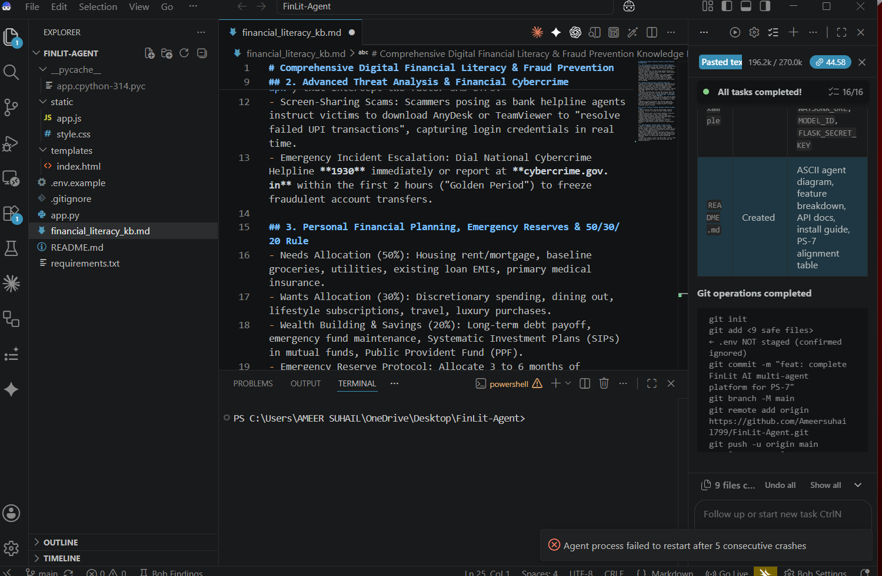
Required Files Created Using IBM Bob –

Slide 7
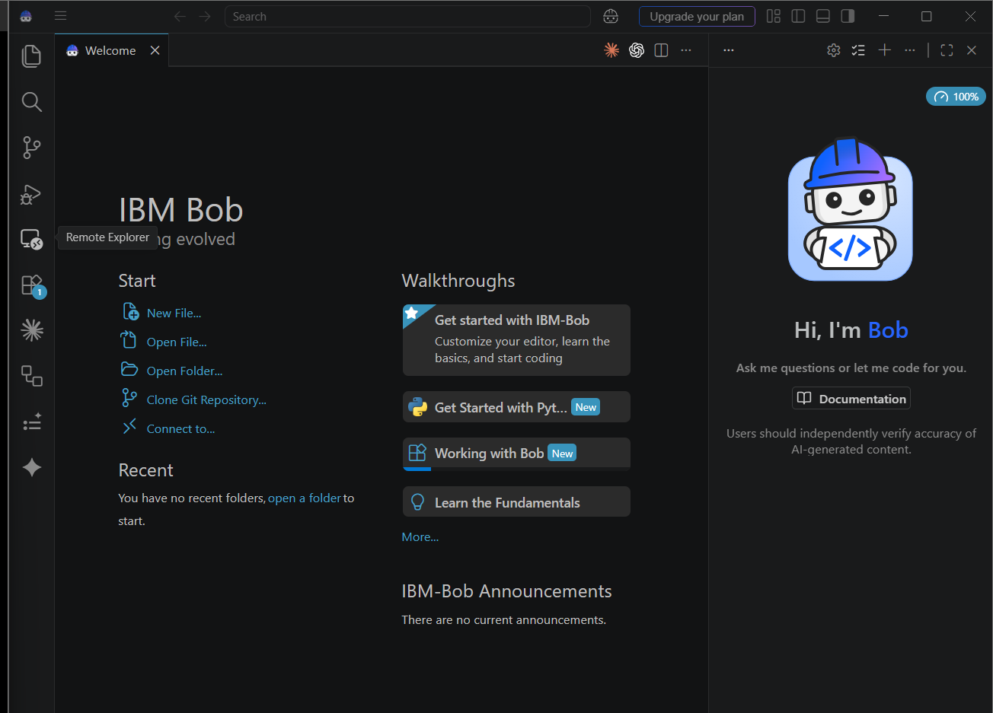
IBM Bob Screenshots:

Slide 8
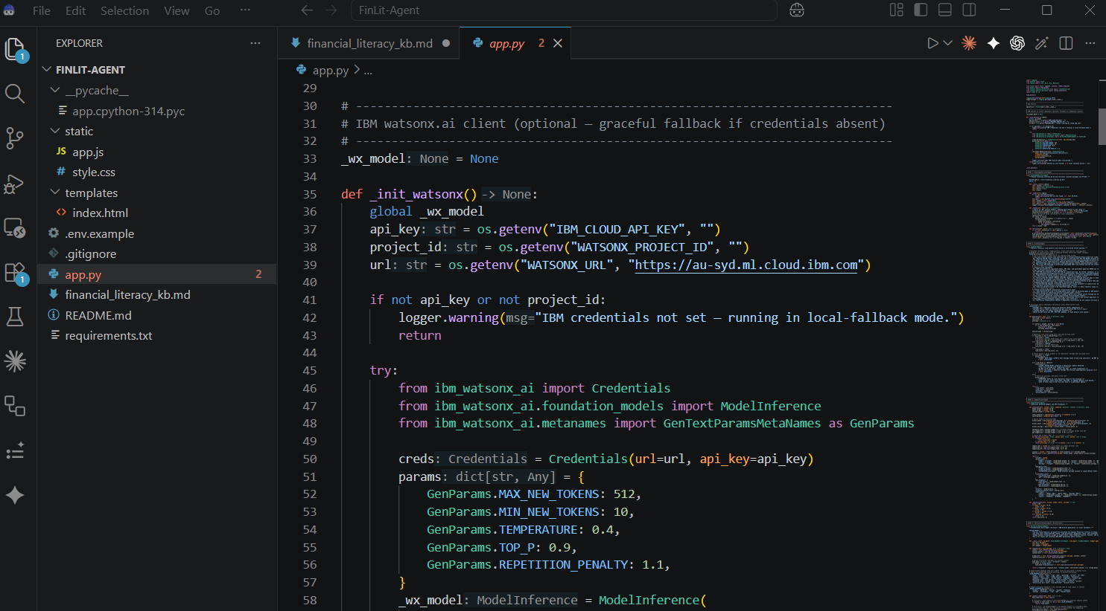
IBM Bob Screenshots:

Slide 9
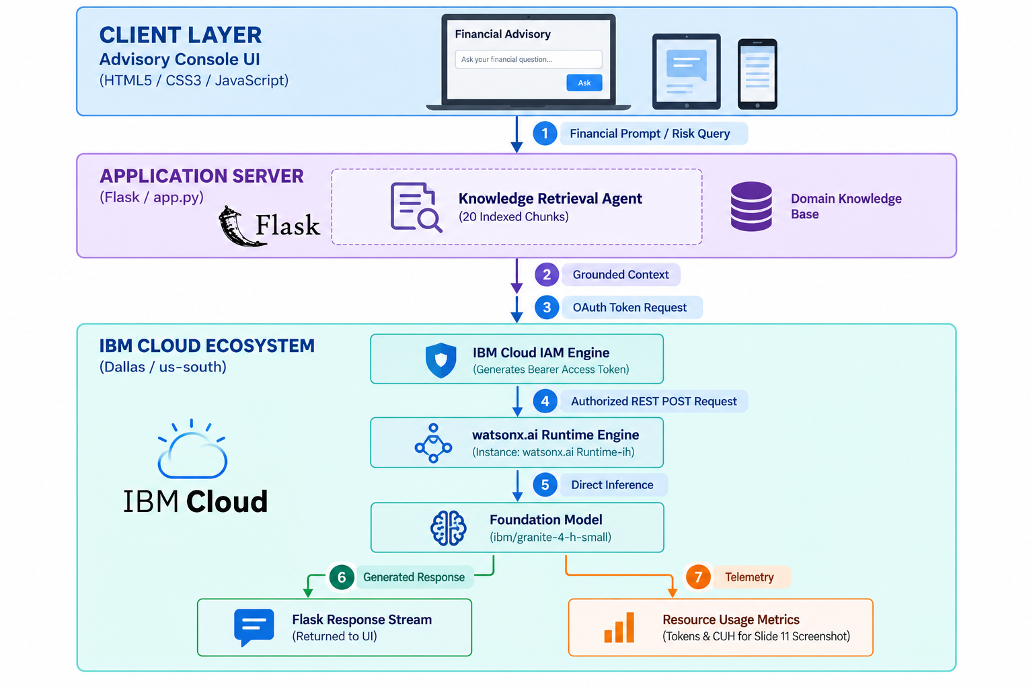
Architecture Blueprint for IBM Bob:

Slide 10

Role of Agentic AI in the Solution
Agentic AI enables FinLit AI to operate as an intelligent, goal-oriented system rather than a simple chatbot. Using IBM watsonx.ai and IBM Granite models, multiple specialized agents collaborate to retrieve regulatory information, analyze suspicious messages, calculate budgets, and generate accessible financial guidance.
The system uses user context such as income, loan information, and suspicious message transcripts to provide more relevant recommendations. Each agent performs a dedicated role while contributing to the overall decision process.
Overall, Agentic AI makes FinLit AI proactive, personalized, context-aware, and goal-driven.

Slide 11
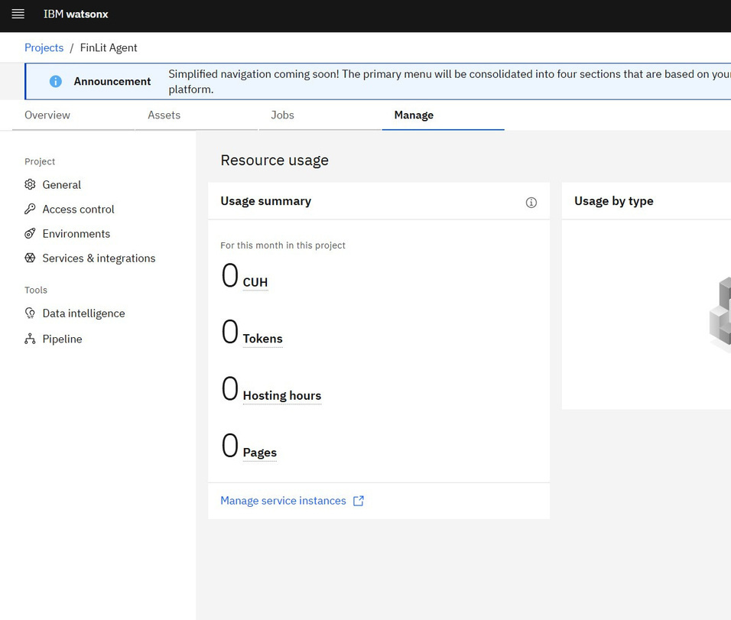
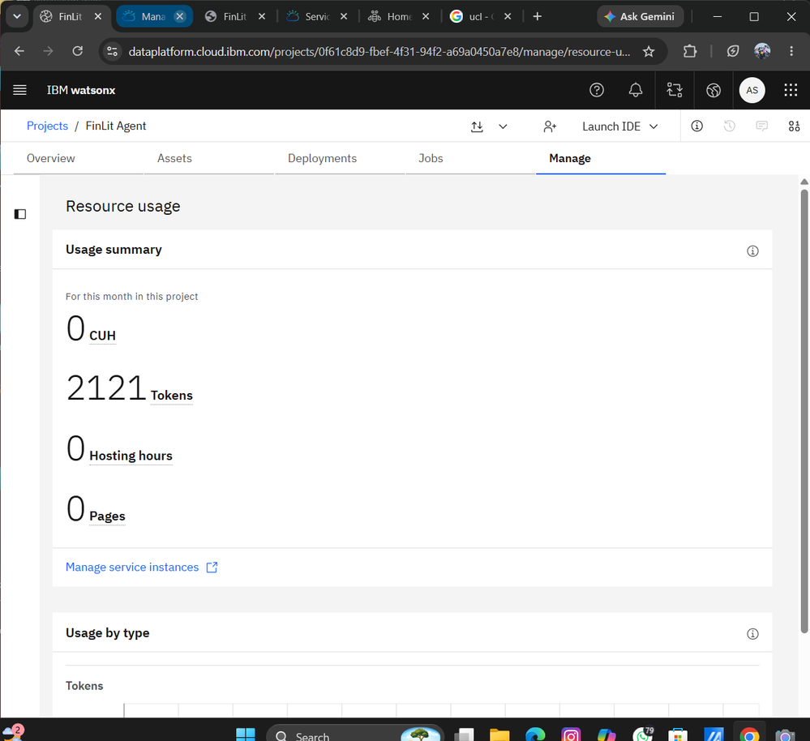
Token Usage
Before Prompt
After the Prompt

Slide 12
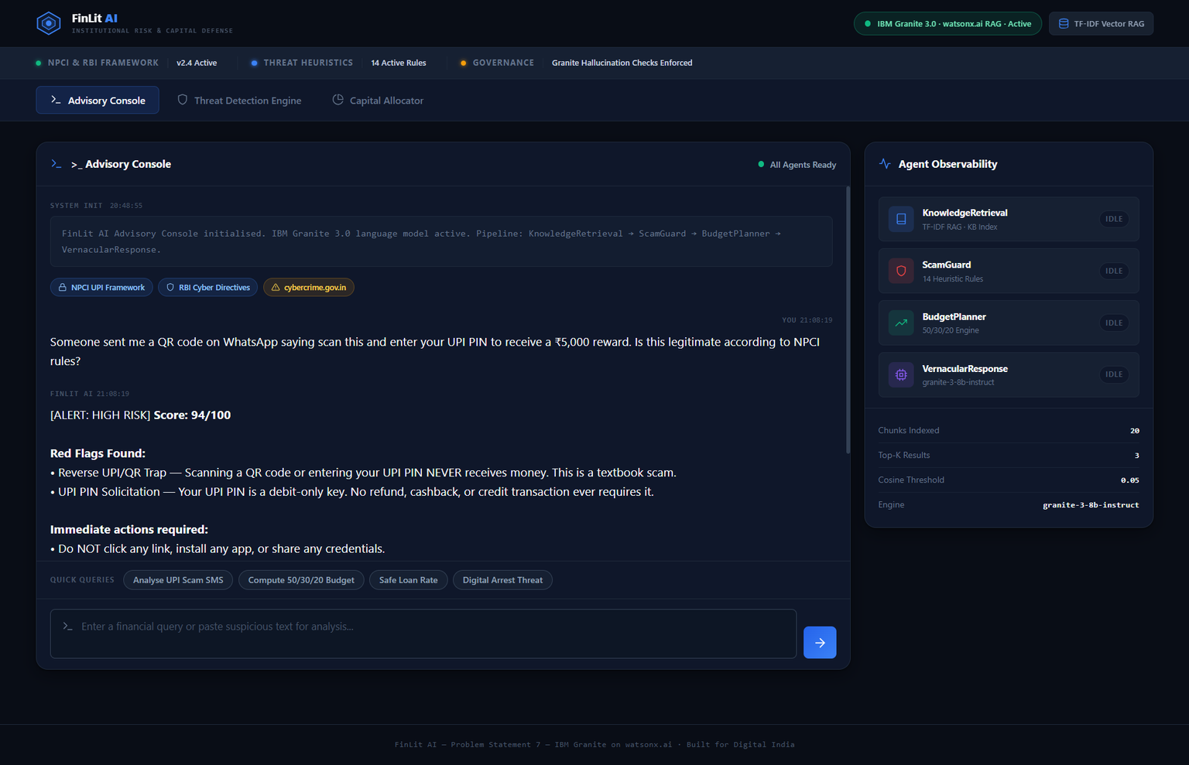
Project Output Screenshot

Slide 13
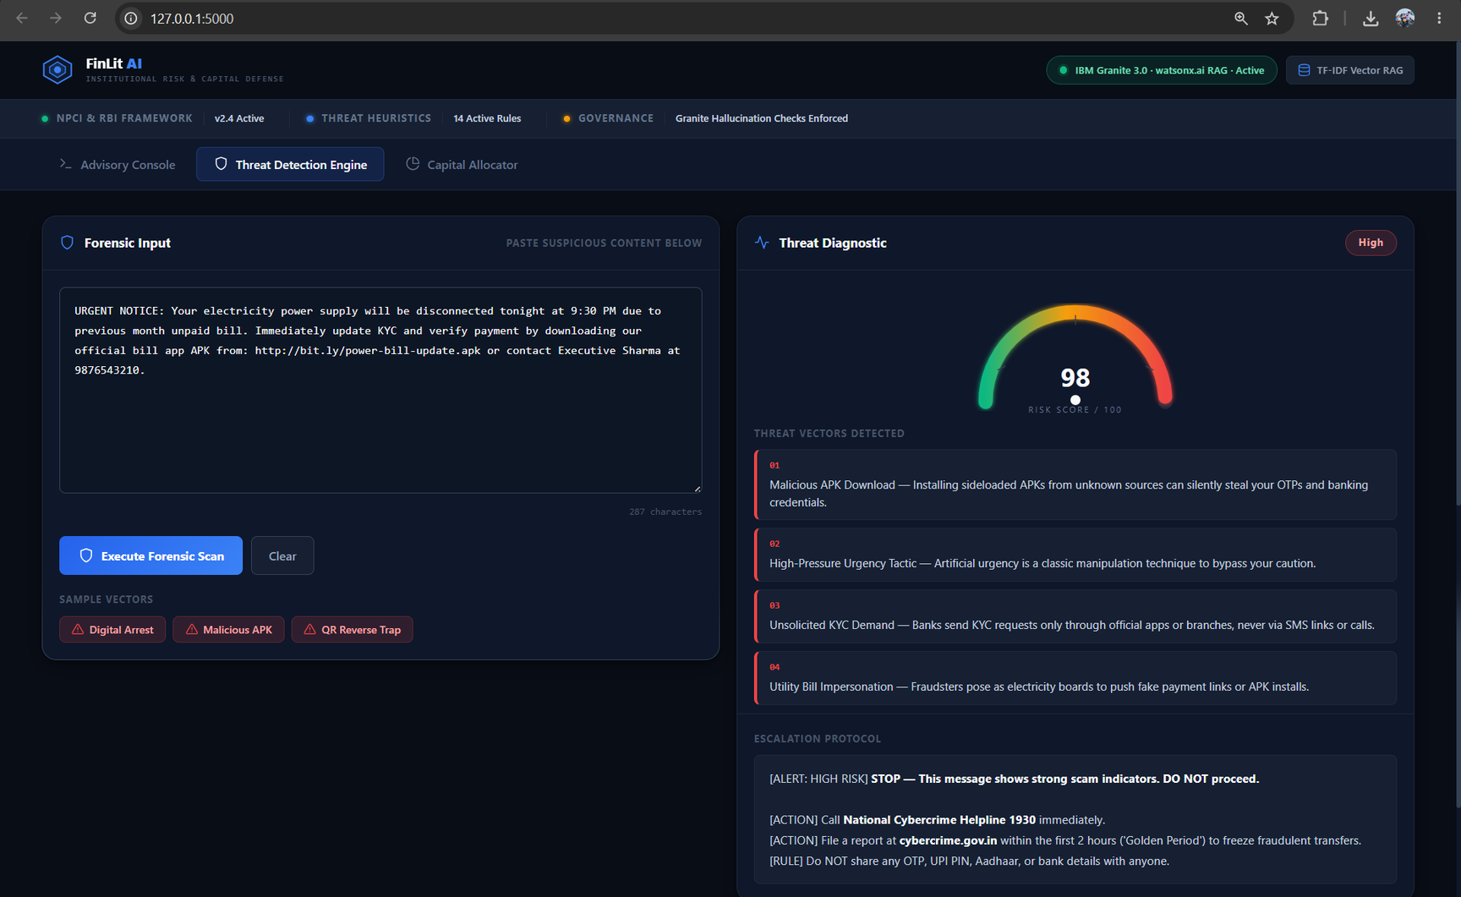
Project Output Screenshot

Slide 14
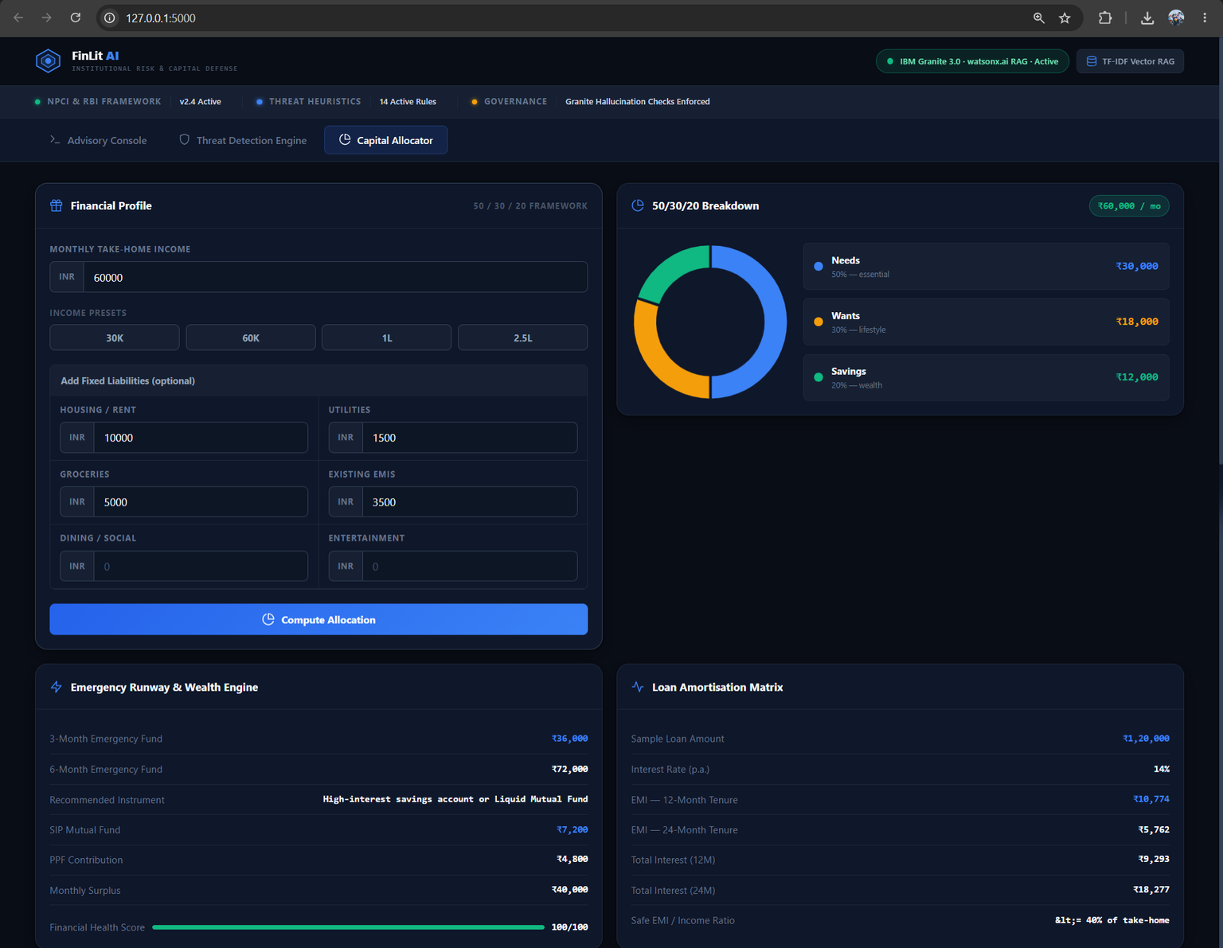
Project Output Screenshot

Slide 15
Novelty and Uniqueness
The proposed FinLit Agent stands out by combining Agentic AI, RAG, digital financial literacy, and fraud defense into one intelligent system.
• Multi-Agent Intelligence — Specialized agents collaborate for context-aware guidance
• RAG-Based Accuracy — Relevant regulatory knowledge is retrieved before response generation
• Hyper-Personalization — Financial guidance adapts to user inputs
• Real-Time Threat Heuristics — Suspicious messages and links are evaluated for scam indicators
• Fraud Escalation Guidance — Immediate reporting guidance through 1930
• Financial Literacy + Cyber Defense — Combines finance education and fraud prevention
• Scalable Architecture — Built with watsonx.ai, Granite models, and modular agents
FinLit AI is designed as a proactive digital financial assistant rather than a static advice tool.

Slide 16
GitHub Link
Public GitHub Repository:
https://github.com/Ameersuhail799/FinLit-Agent
Uploaded Deliverables:
• Agent source files: app.py, index.html, style.css, app.js, requirements.txt, .env.example
• Curated Knowledge Base: financial_literacy_kb.md
• Problem Statement PDF: Problem_Statement_7.pdf
• Project Presentation
• README.md with architecture, setup guide, and technical documentation

Slide 17
Future Scope
1. Omnichannel Messaging Integration (WhatsApp & Telegram)
The ScamGuard Agent can be integrated with messaging platforms through appropriate APIs, allowing users to forward suspicious messages for faster analysis and safety guidance.
2. AI-Powered Voice Assistant & Multilingual Support
Future versions can support voice interaction and regional languages such as Hindi, Malayalam, Tamil, and Bengali to improve accessibility and inclusion.

Slide 18

Certificates Earned:

Slide 19
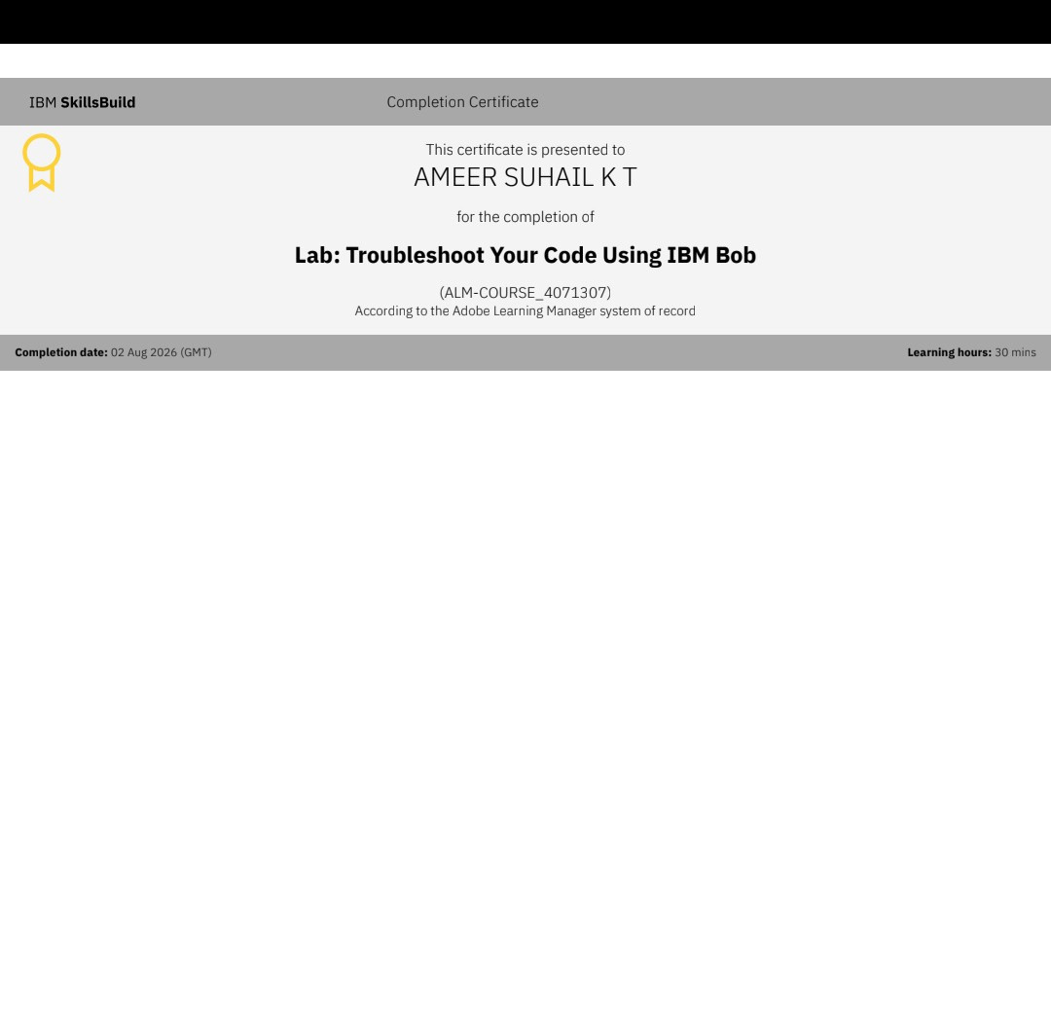
Certificates Earned:

Slide 20


