Slide 1

Dictionaries in Python
By
Ameesha Potnuru
Batch- 434

Slide 2
1. What is Data?
Data means "information" like a name, age, phone number, etc.
2. What are Data Types?
In Python, data types tell us what kind of data we are working with.

Slide 3
Two Main Types:
✅ Primitive Data Types (Single pieces of data)
int → numbers like 5, 10
float → 4.5, 3.14
str → text like "Hello"
bool → True / False
📦 Collection Data Types (Group of data)
list → Ordered items: ["apple", "banana"]
tuple → Fixed group: ("yes", "no")
set → Unique items: {1, 2, 3}
dict → Key-Value pairs: {"name": "ameesha"} ✅ Our main topic!
.

Slide 4
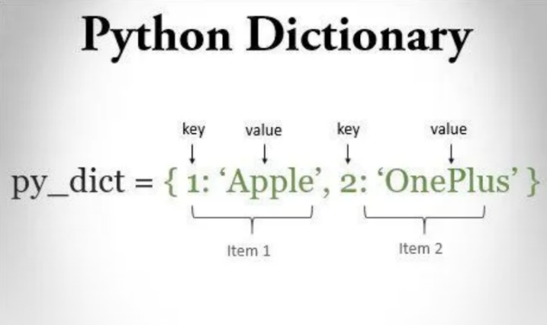
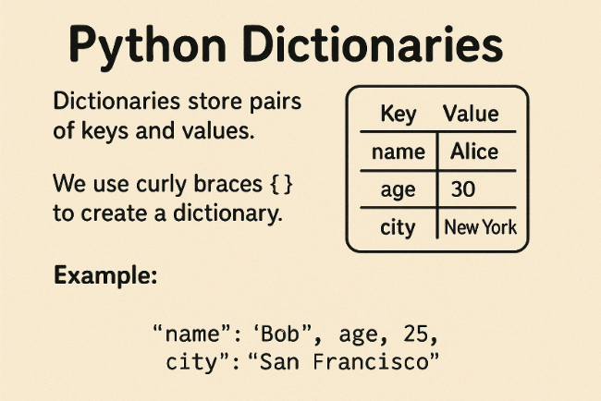
What is a Dictionary in Python?
A Python dictionary is like a real-life notebook or phone contact list, where you save things with a name and some information.

Slide 5
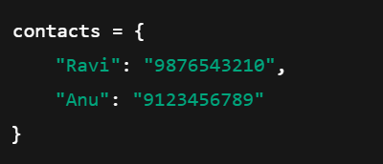
Types of Representations in Dictionary
a = { }
2 . a = dict()
Think of it like this:
You know someone named Ravi, and you saved his phone number.
The name "Ravi" is the key.
The phone number is the value.
So in Python:

Slide 6

Features of Dictionary
Now, if you ask Python:
It gives you Ravi's number: 9876543210
🔁 No duplicate keys allowed.
🧠 Keys must be unique.
📚 Values can be anything – numbers, text, lists, even another dictionary.

Slide 7
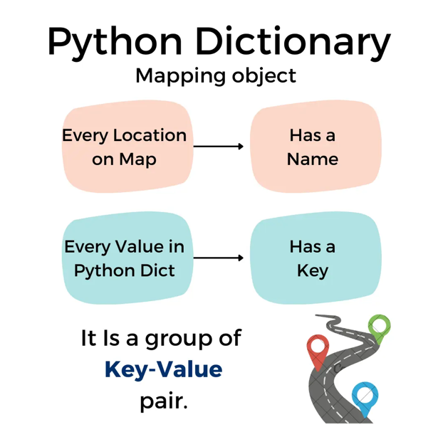

Slide 8
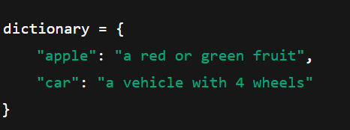


Real-Life Examples
1️ . English Dictionary
You search the word “apple” (key)
You find: "a red or green fruit" (value)
2 . Student Marks Sheet
You can ask: What is Anu's mark?

Slide 9
Why Use Dictionary?
🎯 Fast to find something if you know the key.
🛍️ Keeps data organized.
🧱 Helps build real apps like phone books, student apps, etc.
Very helpful in storing structured data like a mini-database.

Slide 10
Example for Dictionary
person = { "name": "Alice", "age": 25, "city": "New York" } Using .keys() to get all keys
print(person.keys()) # Output: dict_keys(['name', 'age', 'city']) Using .values() to get all values
print(person.values()) # Output: dict_values(['Alice', 25, 'New York']) Using
.items() to get all key-value pairs
print(person.items()) # Output: dict_items([('name', 'Alice'), ('age', 25), ('city', 'New York')]) Using .get() to get the value of a specific key
print(person.get("age")) # Output: 25 Using .pop() to remove a key-value pair and return the value
removed_value = person.pop("city") print(removed_value) # Output: New York print(person) # Output: {'name': 'Alice', 'age': 25}

Slide 11
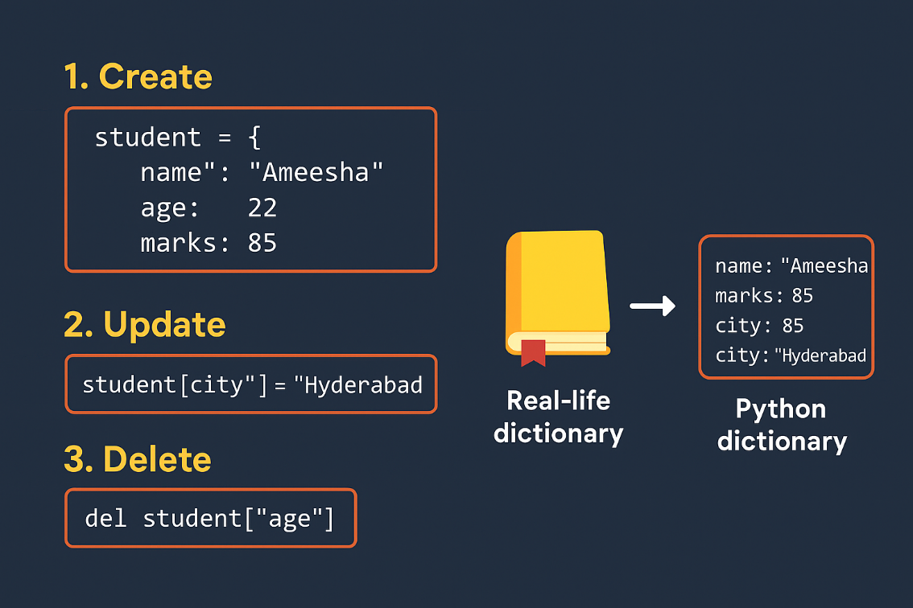
Common Use Cases
Contact apps
Attendance systems
Student report cards

Slide 12
Conclusion :
Just like we use a real dictionary to find the meaning of words, a Python dictionary helps us to find values using names (called keys).
It is one of the most useful tools in Python to store and organize data clearly.
If you remember :
Keys are like names or labels.
Values are the information stored.
Learning dictionaries helps us write better and smarter programs in Python.

Slide 13
THANK YOU

