Slide 1

Team Members : Roshmi Michael
Ameesha Antony Niniya KJ
Amalendhu N Haridas

Slide 2
Challenges of Existing System
Insufficient Infrastructure: Many regions lack proper waste management systems, leading to inefficient collection and recycling, causing pollution and health risks.
Poor Segregation and Low Recycling: Inadequate waste segregation at the source reduces recycling effectiveness, with recyclable materials often ending up in landfills.
Environmental and Health Risks: Improper disposal of hazardous and non-biodegradable waste leads to pollution and poses health risks to humans and ecosystems.

Slide 3
Problem Statement
Inadequate Waste Management Infrastructure: Many regions suffer from insufficient waste management systems, resulting in ineffective waste collection and low recycling rates, which contribute to environmental pollution and public health hazards.
Poor Waste Segregation Practices: The lack of proper segregation of waste at the source significantly diminishes recycling efficiency, causing recyclable materials to be discarded in landfills and exacerbating environmental and health risks.

Slide 4
Solution
Waste Segregation: Use bins for sorting waste (recyclables, organic, hazardous) to ensure proper disposal.
Tracking App: An app tracks the waste type and amount deposited by users, promoting active participation.
Rewards System: Users earn money based on their waste contributions, with earnings deposited into their accounts, incentivizing proper disposal.
Waste Recycle : The deposited waste could be recycled into useful products which could be sold again.

Slide 5
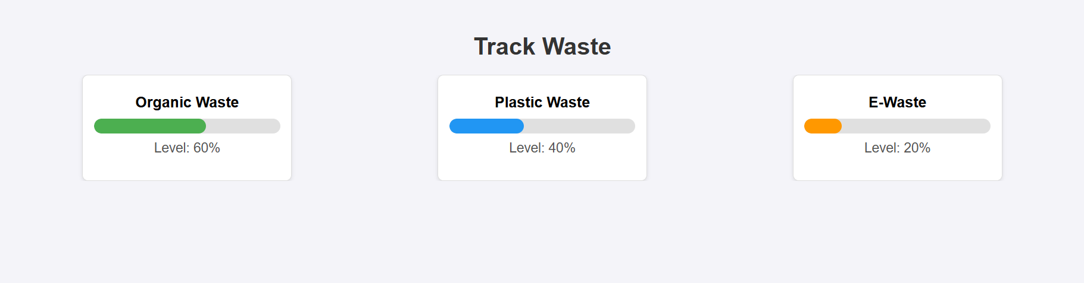
GUI

Slide 6
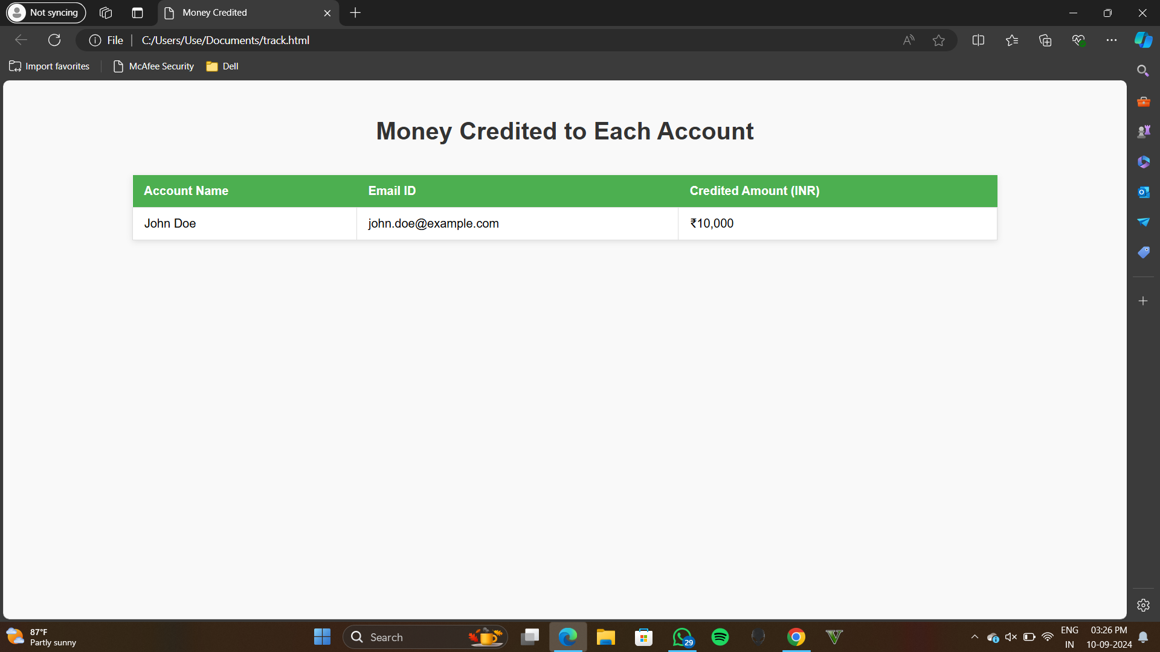
GUI

Slide 7

GUI

Slide 8
Conclusion
Enhanced Waste Management: The system improves waste management by ensuring proper segregation and disposal of different types of waste.
Technology-Driven Solution: Leveraging a tracking app, the system monitors waste contributions, increasing efficiency and user engagement.
Incentivized Participation: By rewarding users for their waste contributions, the system encourages responsible disposal practices, boosting recycling rates and reducing pollution.
Sustainability Promotion: This approach fosters a culture of sustainability, positively impacting communities and the environment.

