Slide 1
NextHikes IT Solutions
Exploratory Data Analysis
Ameesha

Slide 2
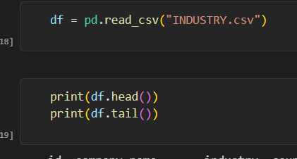
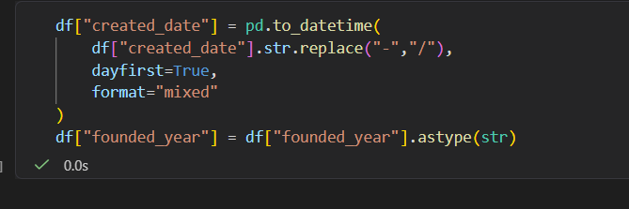
Data Cleaning
Various Libraries were imported, followed by the loading dataset.
First five and last five rows were printed to get an overview of the dataset along with total number of rows and columns.
Changed the data type of “founded_year’ from int to str and of “created_date” from str to datetime.

Slide 3


Data Cleaning
Missing Data
No missing data was found.
Duplicate Data
No Duplicates were found.

Slide 4
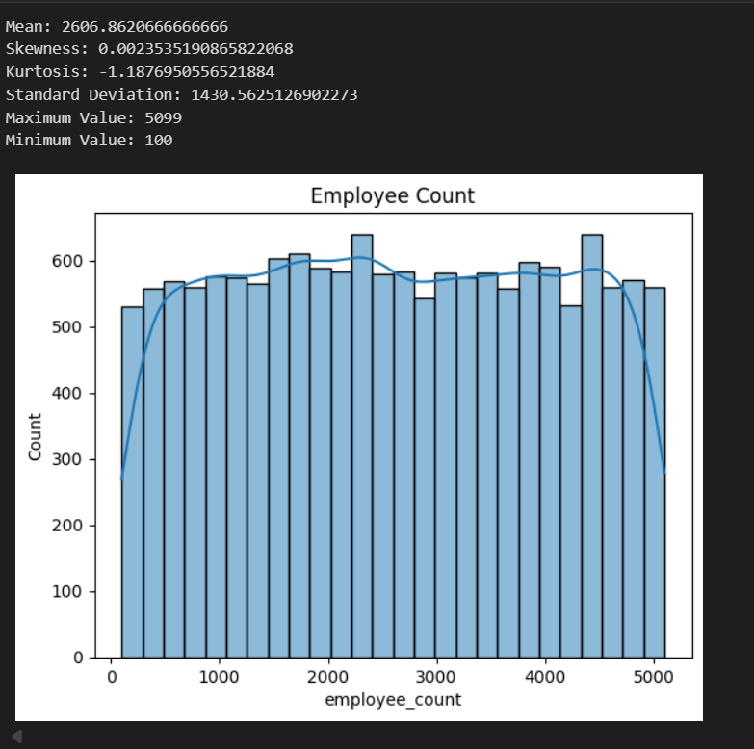
Univariate Analysis
Introduction
Univariate analysis is the simplest form of data analysis — it looks at one variable at a time to understand its characteristics.
Numerical Data
Employee count
- Employee count is evenly distributed among entire range.
- The Kurtosis is -1.18. Negative means it is a platykurtic distribution.
- It has no such outliers.
- the Maximum number of employees is 5099 which indicates that the data could be of small to medium sized companies.

Slide 5

Univariate Analysis
Customer count
The data is spread equally and the maximum number of customers are more than 100000 which shows that the demand is hug for the product.
Market Rating
The companies have an average rating of 2.5 and got very less rating as "5" which indicated the customers are not much satisfied.
- Sufficient room still exists for improvement.
- The companies need to come up woth more new ideas of branding and marketing.

Slide 6
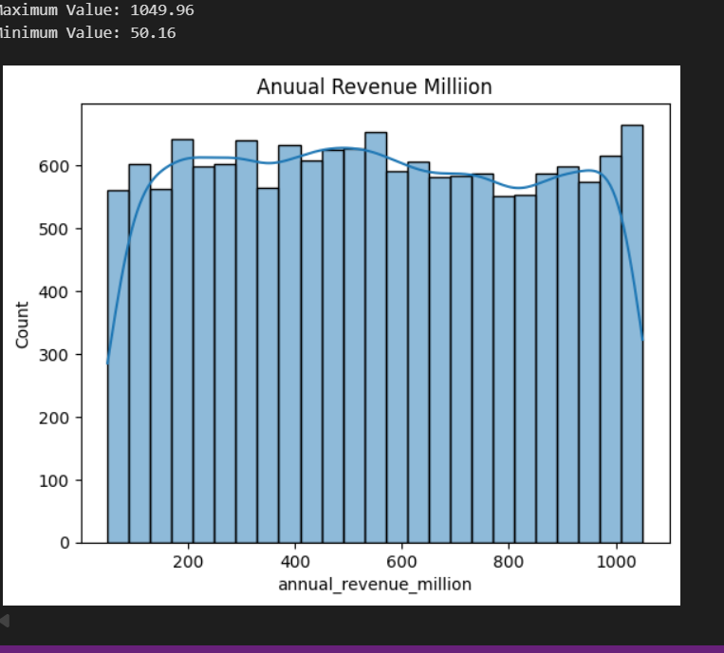
Univariate Analysis
Annual Revenue
- Maximum revenue is 1049 millions.
- Not much variations in the revenue of all the companies.
Profit Margin Percent
- Maximum profit margin percent is 45%.
- Minimum profit margin is 5%.

Slide 7
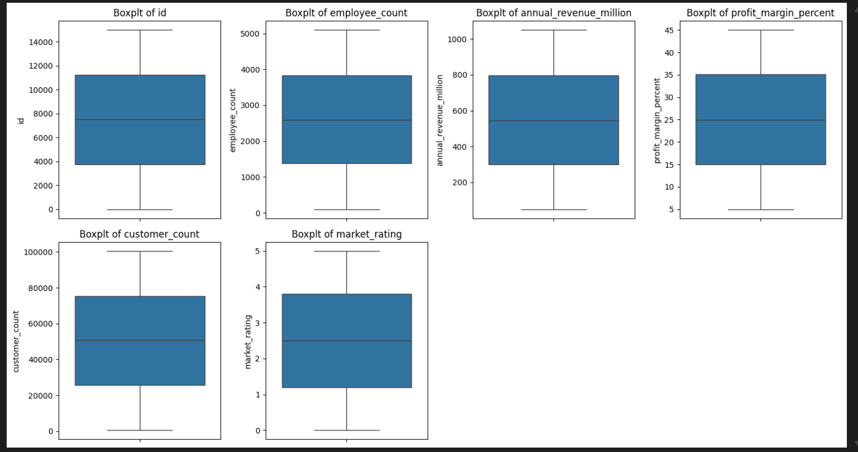
Detecting Outliers
Used Boxplot.
No outliers were detected.

Slide 8
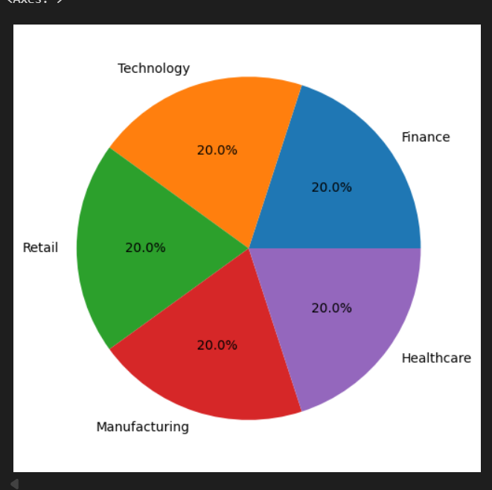
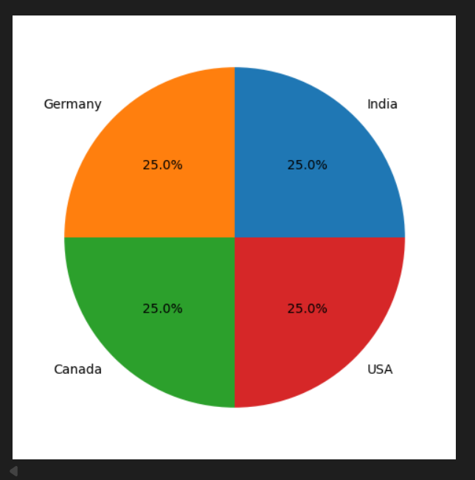
Univariate Analysis
Categorical Data
Profit Margin Percent
All industries are generating equal amount of profit.
Country
There are 4 countries in which the various companies have their product selling and are generating profit equally

Slide 9
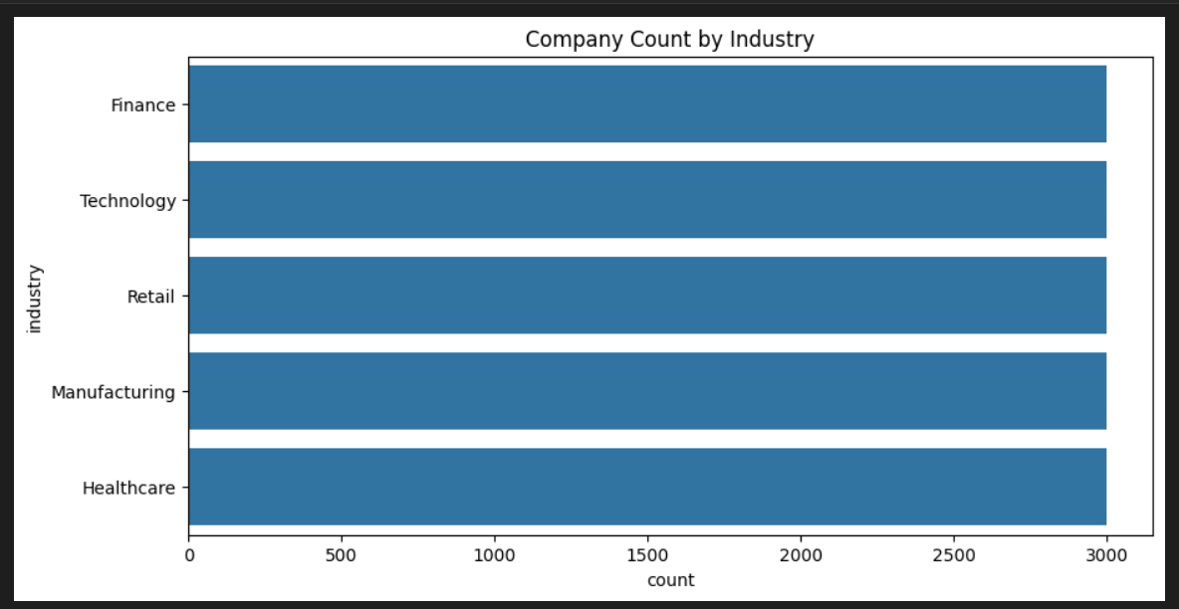
Univariate Analysis
Company Count By Industry
- No Strong Relationship Between Company and Industry.
Older companies do not appear to have a significant advantage in customer acquisition compared to newer companies.
Since all the companies have almost equal amount of customer count, the growth opportunities may be limited.
- No industry dominates the market.

Slide 10
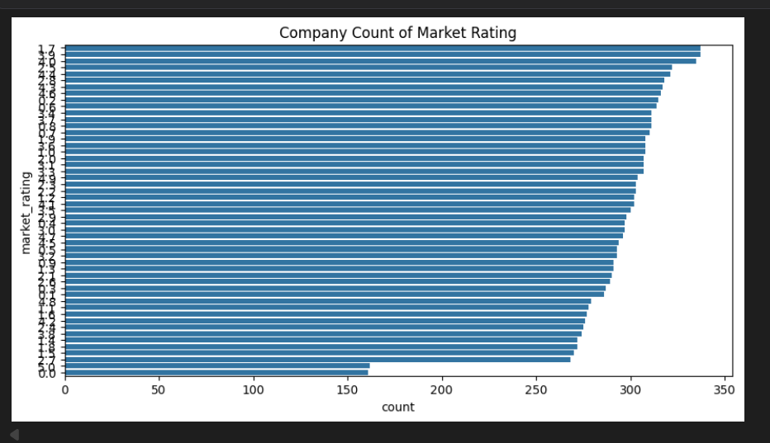
Bivariate Analysis
Company count of market rating
- Most rating categories have company counts between 250 and 350.
- No single rating dominates the market.
- More Companies got higher ratings.
- The graph shows unbiased comparative analysis.

Slide 11
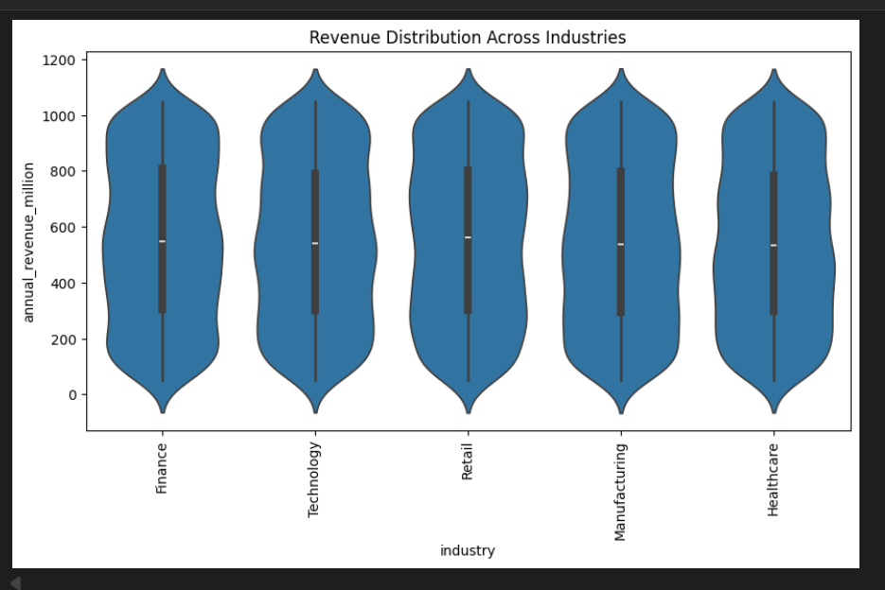
Bivariate Analysis
Revenue vs Profit margin distribution
No strong relationship between profit and revenue.
Revenue Distribution across industries
-The revenue is generated in the same amount across all industries.
- No industry dominates the Annual revenue pf the company.
- All industries are generating the revenue above 1100 millions.
- More scope for growth.

Slide 12
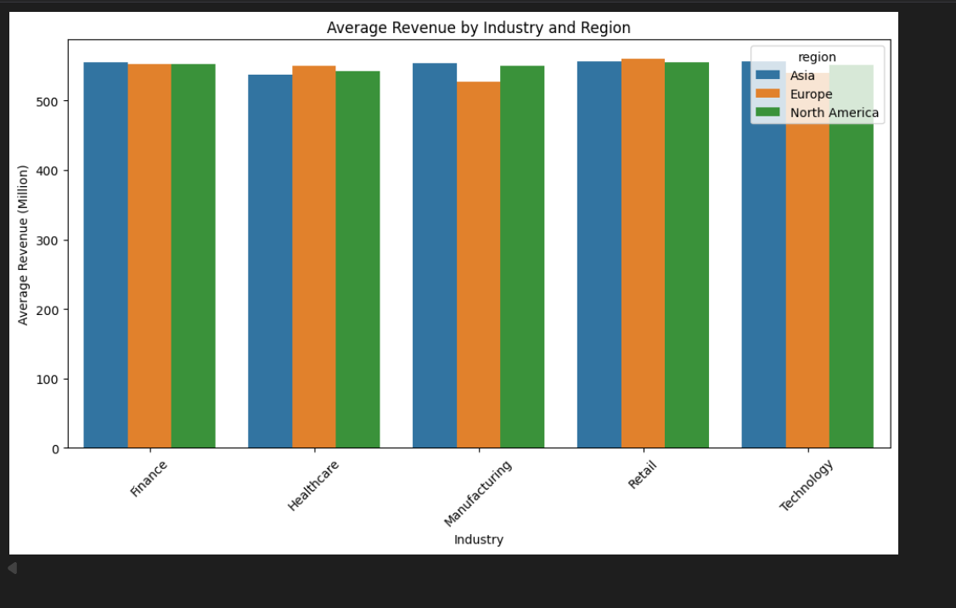
Multivariate Analysis
- Finance Industry and Retail Industry are generating maximum revenue in all the concerned countries.
- Manufacturing Industry is proving least revenue among the concerned countries.
- Overall North America has shown the better results in all the industries.
- More attention need to be paid to Healthcare and Manufacturing industry in Asia and Europe respectively.

Slide 13
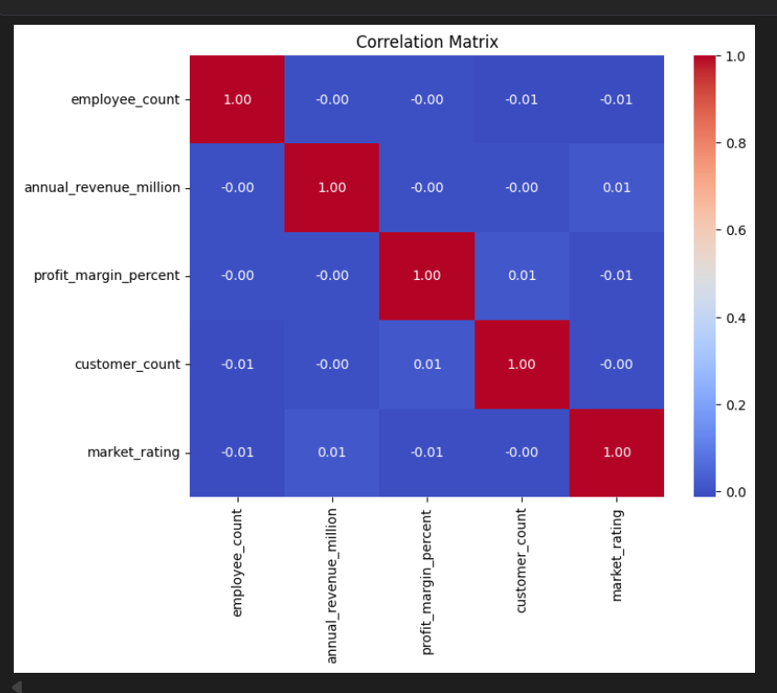
Correlation Analysis
All the variables are independent.
No variable shows any strong relationship.
The data is spread uniformly.
No cluster of data.

Slide 14
Thank you!

