Slide 1
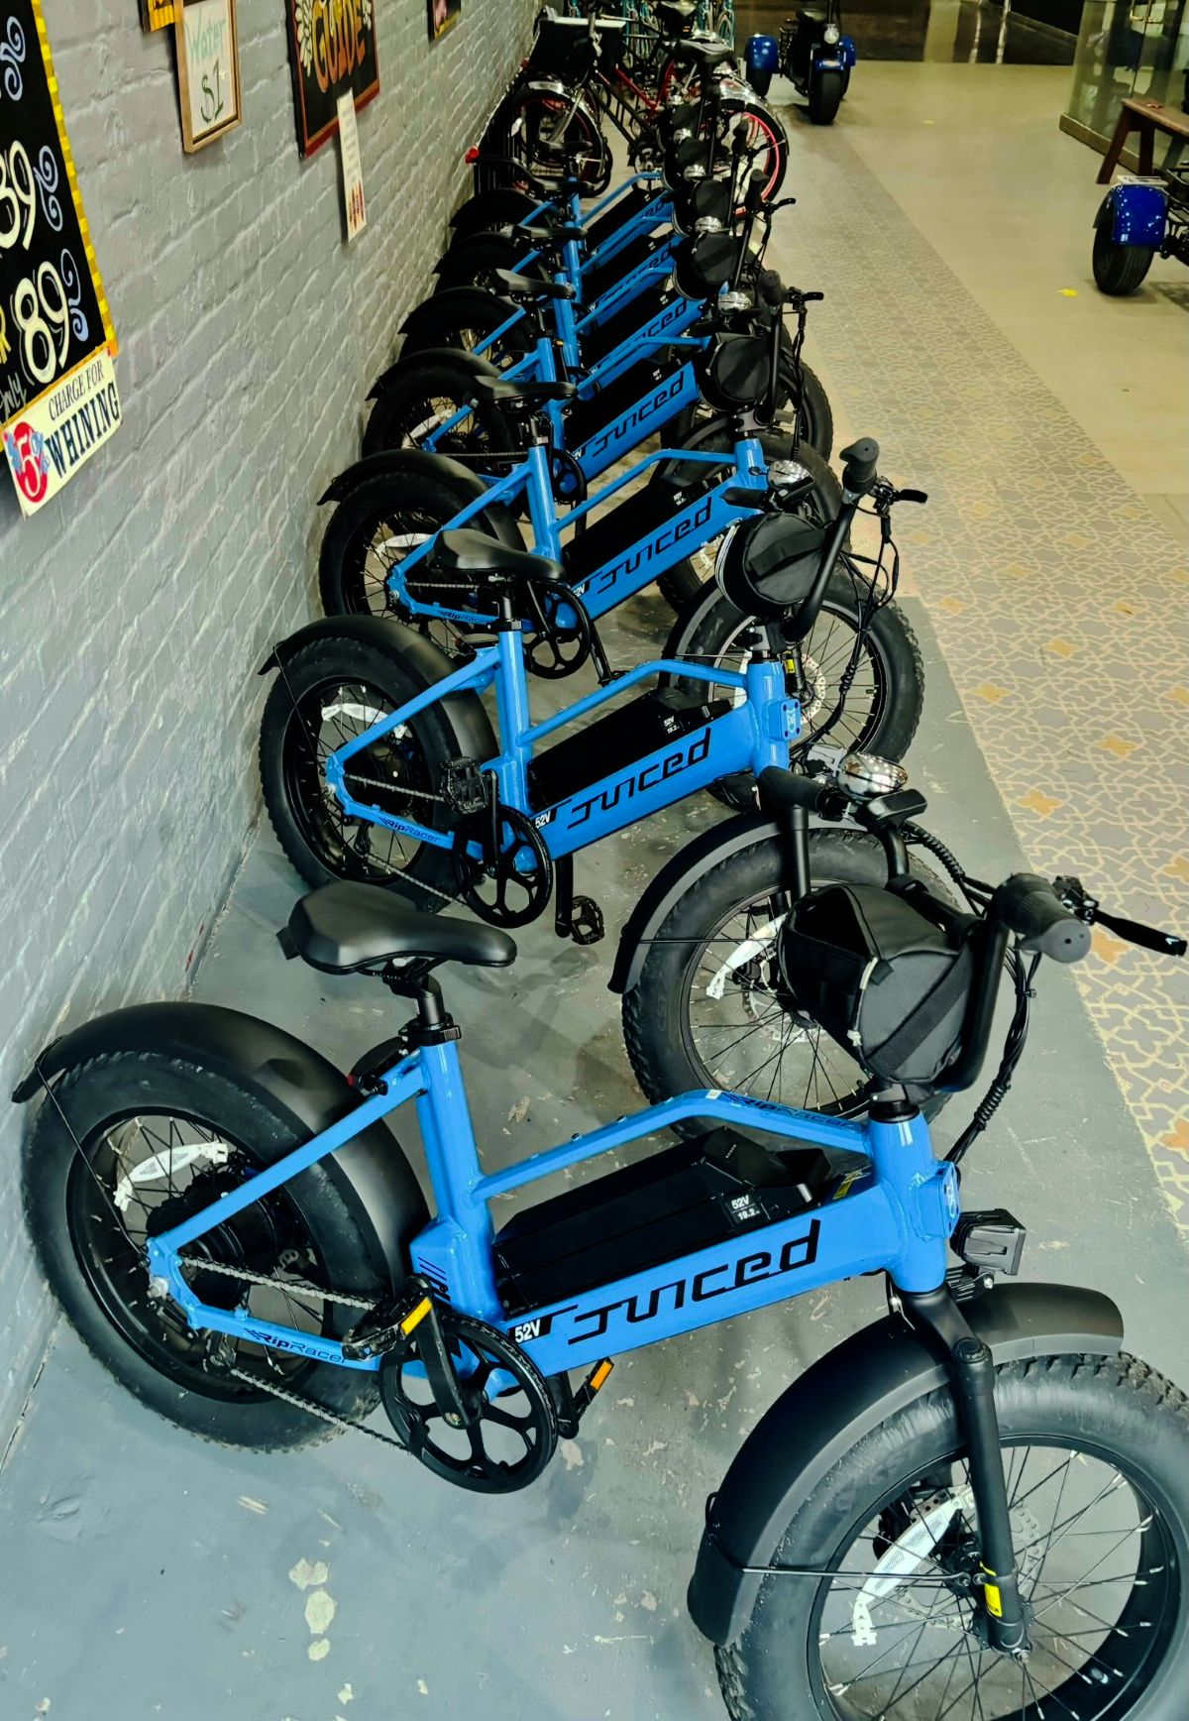
Nexthikes
IT Solutions
Ameesha Bike Rentals Demand Analysis Project

Slide 2
Objective of the project
The objective of the project is to analyze the bike sharing data and understand how factors like weather, time, humidity, weekdays and holiday affect bike rentals.
The goal is to identify trends and patterns in customer behavior and find insights that can help improve bike rental operations.

Slide 3
Methodology
Preprocessing of data
I started the project by preprocessing the data which includes sorting the instant from smallest to largest, making the headers “bold” with first letter capital and then I checked if the dataset had any blanks or not by using the “countblank” function in Excel.
Dataset1: No blanks were discovered which lead to clean pre-processing.
Dataset2 : Some blanks were discovered in the column named “atemp” which was filled by using the syntax “Isblank” and filling it using mean.
Dataset3: No blanks were discoverded.

Slide 4
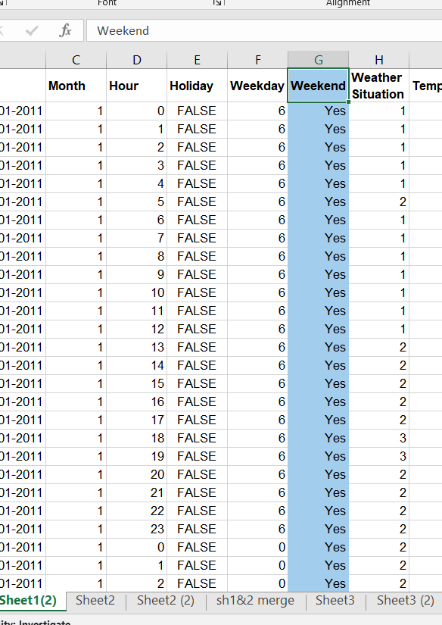
Methodology
Dataset 1
A new column was added to dataset1 named ‘Weekend’ which showed whether that day had weekend or not.
Formula used: IFS(F2=6,"Yes",F2=0,"Yes",F2<=6,"No")
Removed the season column because it has no such use in the analysis, moreover it had the value which made no difference in the evaluation and analysis of data

Slide 5
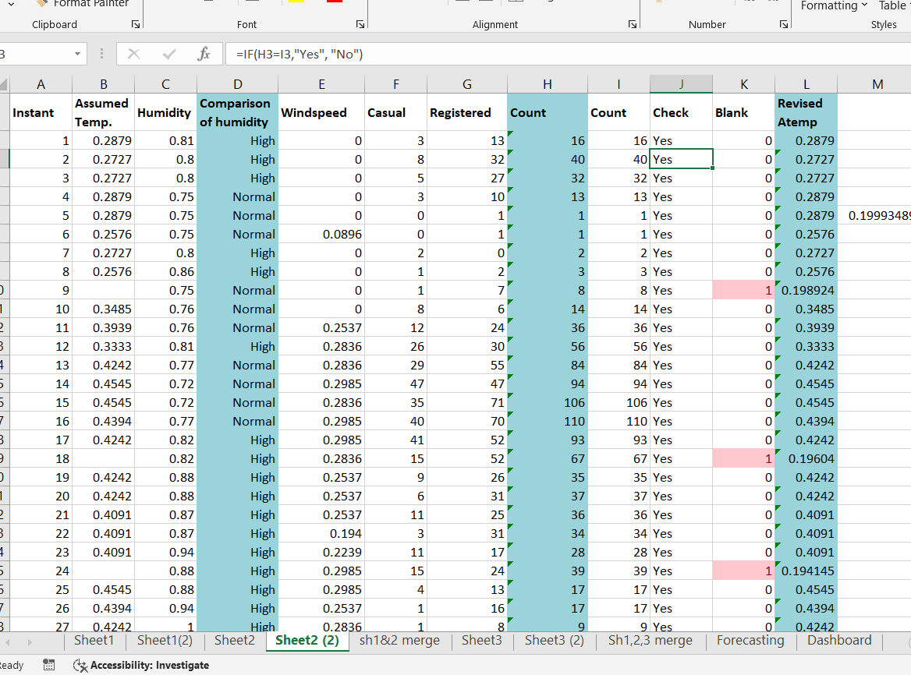
methodology
Dataset 2
A column named ‘Unnamed’ was
The blanks were discovered and filled as mentions in the Slide3.
A new column was given named ‘Count’ which is the sum of casual and registered people who rented bikes which was checked adding a new column and using the Formula: SUM(F2:G2) and one more column was added to check whether the count given is right or not by using
Formula: IF(H2=I2,"Yes", "No")

Slide 6
methodology
Dataset 2
One more new column is added named ‘Comparison of humidity’ in which the humidity is divided into three categories e.i.
Less than 0.5 =Low
Less than 0.8= Normal
Less than 1 = High
More than 1= Very high
Later, dataset1 and Dataset2 are merged together into a new sheet.

Slide 7
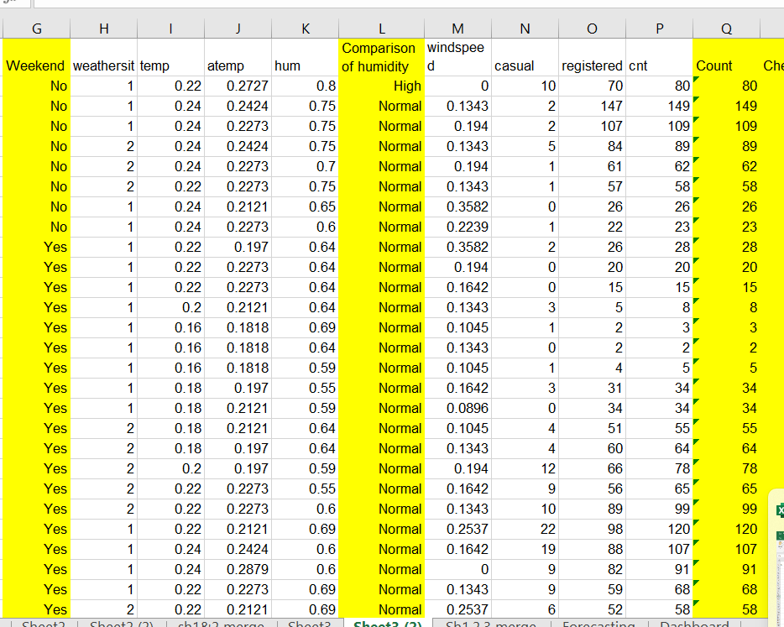
Methodology
Dataset 3
In dataset 3, same functions are performed as dataset1 and dataset2 which includes pre-processing of data, adding new columns like Weekend, Comparison of Humidity, Count and check whether the count given and count calculated are same or not using the same functions.
Later the Dataset3 is merged with the already merged dataset 1 and 2

Slide 8
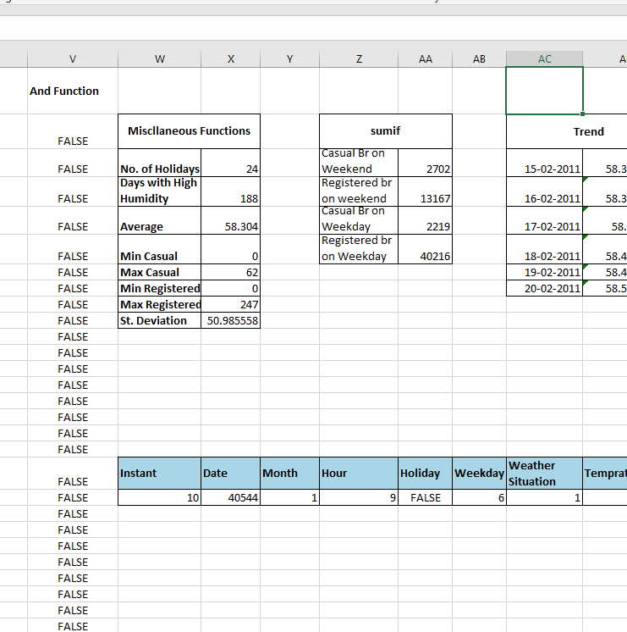
Merged datasets
Various functions are performed in the merged dataset which includes:
Average
Left
Right
Len
If function (formula used : IF(J2>K2,"True","False")
And function (formula used: AND(P2>10,G2="No“)
Sumif function for casual and registered bike rentals on weekday and weekend
Trend function
Xlookuo
Co- relation

Slide 9
Insights and OBSERVAtions
Number of bike rentals are more during the weekday instead of weekends, indicating that most users rent bikes for work or regular travel.
As the windspeed and the demand of bike rentals have the negative co-relation which means as the windspeed increases, the demand for bike rentals decreases.
The degree of temperature has not much influence on the demand of the bike rentals as with the same temperature the demand for bike rental varies.
The number of registered bike rentals is more than the number of casual bike rentals.
There is negative co-relation between the weather situation and demand of bike rentals.
The demand of bike rentals is most when the humidity is low.
According to the trend calculated the average demand per day will be 58 bike rentals.

Slide 10
Challenges
This being the very first project of mine, I had faced a few challenges while doing the project
It was little challenging for me to perform the various functions in the large dataset like this. It was my first time handling a big data.
Another challenging task was VBA Macros, I recorded the macros for the pre-processing of data in dataset1 and when I tried to apply it in the dataset2 , it didn’t work then I again recorded it and then applied it again, the names of the column which dataset1 had changed in dataset2.
I tried third time too but the outcome was not as expected.
I had a little difficulty in the dashboard but I handled it nicely.

Slide 11
Conclusion
The analysis of the bike rental data shows that the demand for bikes is influenced by several environmental and behavioral rentals. Rentals are higher on weekdays compared to weekends. Weather conditions such as windspeed, poor weather and high humidity has less demand for bikes while lower humidity contributes more rides.
Overall, the study predicts an average daily demand is around 58 bike rentals which can help in planning resource allocation and improving service effectively.

Slide 12
Thank you!

