Slide 1
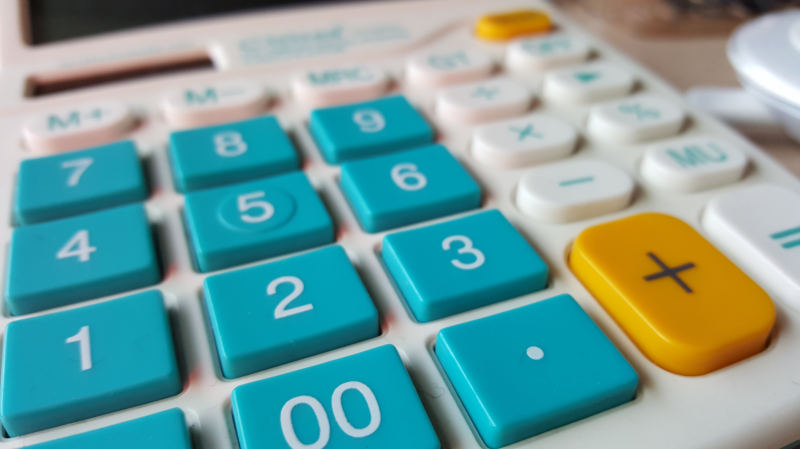
NEXTHIKES IT
SOLUTIONS
AMEESHA
CALCULATOR USING PYTHON

Slide 2
Objective of project
The initial objective of the project was to learn basic python GUI.
Understand layout management.
Perform basic arithmetic operations like addition, subtraction, multiplication and division.
Perform advanced operations like sin, cos, square root etc.
Build a functional GUI application.

Slide 3
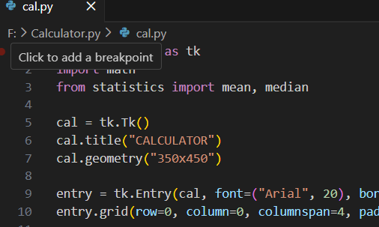
Methodology
The project was started with a little research about the basics of python because of being an absolute beginner to the python.
After exporting the library and math , the interface started which includes the layout of the calculator.

Slide 4
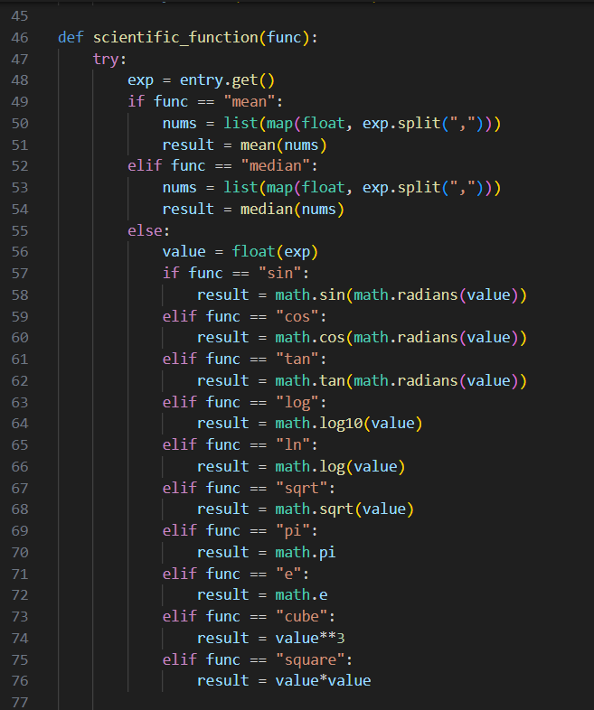
Methodology
Once the interface has been done, operation functions were added including addition, subtraction, multiplication and division..
I tested the part as I built it and in case any error occurred then fixing it at the moment.
More functions like sin, cos, square root, mean, etc has been added

Slide 5
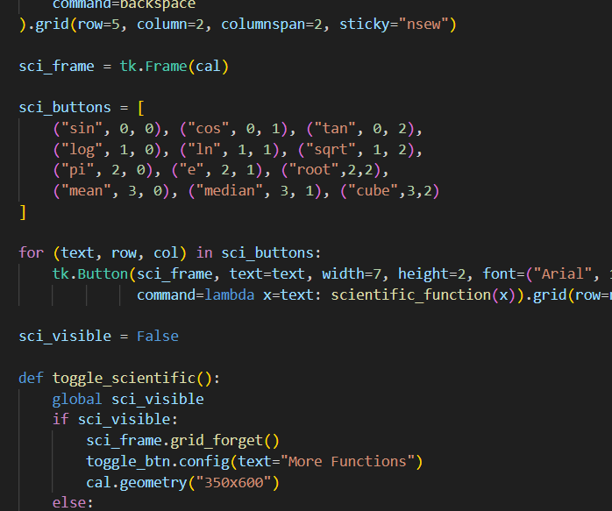
Methodology
Later the buttons were connected with the functions.
A separate button was created to add a different interface which includes the scientific functions.
Finally, the buttons were connected to the functions of another interface.

Slide 6
Challenges
Being new to python, this p0roject pushed me out of my comfort zone in several ways. One of the main difficulties was understanding how the Tkinter’s layout system worked, especially when arranging the buttons in a proper grid to make the interface look clean. I also found it challenging to link each button to the correct function and ensure that the calculator responded smoothly when multiple operations were entered.
Dealing with the errors like incorrect button clicks, spacing issues or the display not updating.
Another challenge was adding features like Clear, All Clear and introducing another interface for the scientific calculations because I had to learn how to reset values without breaking the rest of the code. Even though these steps were tricky at first, they helped me build problem solving skills.

Slide 7
Thank you!

