Slide 1
Assignment-Discussion
Vector-based POS Tagging
Jasani Parth Alpeshbhai , 200050053
Kumari Pragati Gupta , 200050063
Ameeya Ranjan Sethy , 200050006
9 October,2022
Notes:
1

Slide 2
Problem Statement
Given a sequence of words, produce the POS tag sequence
Technique to be used: HMM-Viterbi-vector and Word2Vec vectors – FFNN
5-fold cross validation
Use Universal Tag Set (12 in number)
’.’ ,’ADJ’ ,’ADP’ ,’ADV’ ,’CONJ’ ,’DET’ ,’NOUN’ ,’NUM’ , ’PRON’ , ’PRT’ , ’VERB’ , ’X’

Slide 3
Overall performance – Viterbi symbolic
Precision : 0.940198283308899
Recall : 0.9385240363559173
F-score (3 values)
F1-score : 0.9386931499010809
F0.5-score : 0.9394349573883816
F2-score : 0.938428994887414

Slide 4
Overall performance – Viterbi Word2Vec
Precision : 0.9604942731149146
Recall : 0.960550498867571
F-score (3 values)
F1-score : 0.9604629662664248
F0.5-score : 0.960467122841927
F2-score : 0.9605015364677237

Slide 5
Overall performance – FFNN with BP
Precision : 0.9492435479418486
Recall : 0.9470962732745691
F-score (3 values)
F1-score : 0.9469783997495549
F0.5-score : 0.9479818532819128
F2-score : 09467951214084014

Slide 6
Performance Comparison
 | HMM Viterbi Symbolic | HMM Viterbi Word2Vec | FFNN – BP Using Word2Vec
Precision | 0.940 | 0.960 | 0.949
Recall | 0.938 | 0.960 | 0.947
F0.5 score | 0.939 | 0.960 | 0.947
F1 score | 0.938 | 0.960 | 0.946
F2 score | 0.938 | 0.960 | 0.946

Slide 7
Classification report – Viterbi Symbolic
Tag | Precision | Recall | F1-score
. | 0.98 | 1.00 | 0.99
ADJ | 0.87 | 0.89 | 0.88
ADP | 0.92 | 0.97 | 0.94
ADV | 0.90 | 0.87 | 0.88
CONJ | 0.99 | 0.99 | 0.99
DET | 0.92 | 0.99 | 0.95
NOUN | 0.95 | 0.92 | 0.93
NUM | 0.99 | 0.80 | 0.88
PRON | 0.93 | 0.96 | 0.94
PRT | 0.91 | 0.85 | 0.88
VERB | 0.97 | 0.92 | 0.94
X | 0.17 | 0.35 | 0.23

Slide 8
Classification report – Viterbi Word2Vec
Tag | Precision | Recall | F1-score
. | 1.00 | 1.00 | 1.00
ADJ | 0.92 | 0.92 | 0.92
ADP | 0.95 | 0.97 | 0.96
ADV | 0.91 | 0.89 | 0.90
CONJ | 0.99 | 0.99 | 0.99
DET | 0.97 | 0.99 | 0.98
NOUN | 0.96 | 0.96 | 0.96
NUM | 0.97 | 0.91 | 0.94
PRON | 0.96 | 0.98 | 0.97
PRT | 0.91 | 0.90 | 0.90
VERB | 0.97 | 0.95 | 0.96
X | 0.52 | 0.55 | 0.53

Slide 9
Classification report – Word2Vec with FFNN-BP
tag | Precision | Recall | F1-score
. | 1.00 | 1.00 | 1.00
ADJ | 0.91 | 0.89 | 0.90
ADP | 0.93 | 0.91 | 0.92
ADV | 0.90 | 0.86 | 0.88
CONJ | 0.99 | 1.00 | 0.99
DET | 0.99 | 0.98 | 0.99
NOUN | 0.94 | 0.96 | 0.95
NUM | 0.95 | 0.93 | 0.94
PRON | 1.00 | 0.94 | 0.97
PRT | 0.69 | 0.92 | 0.79
VERB | 0.96 | 0.95 | 0.95
X | 0.76 | 0.39 | 0.52

Slide 10
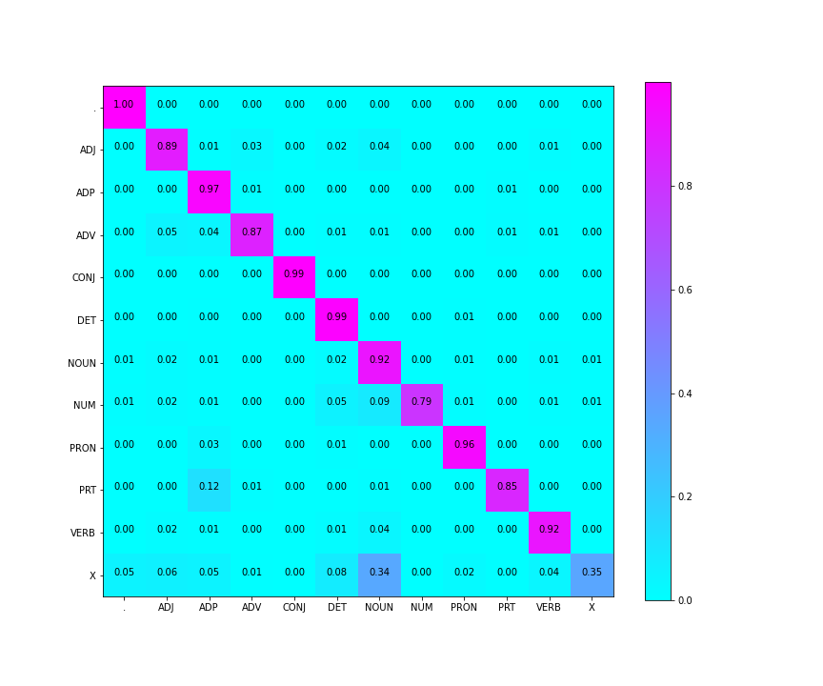
Confusion Matrix – Viterbi symbolic

Slide 11
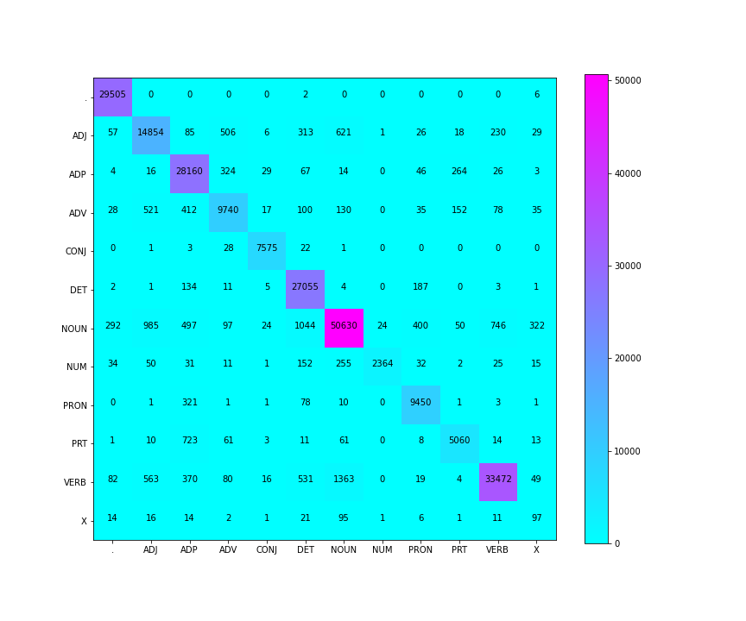
Confusion matrix – Viterbi symbolic (Numbers)

Slide 12

Confusion Matrix – Viterbi Word2Vec

Slide 13
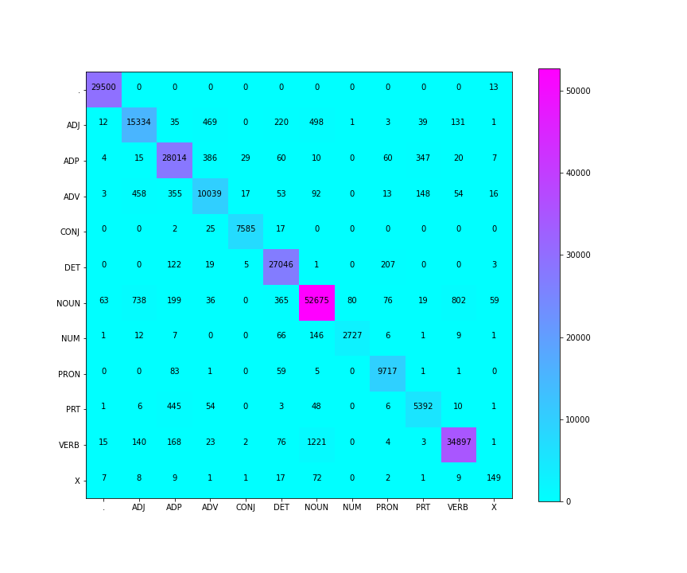
Confusion matrix –Viterbi word2vec (Numbers)

Slide 14
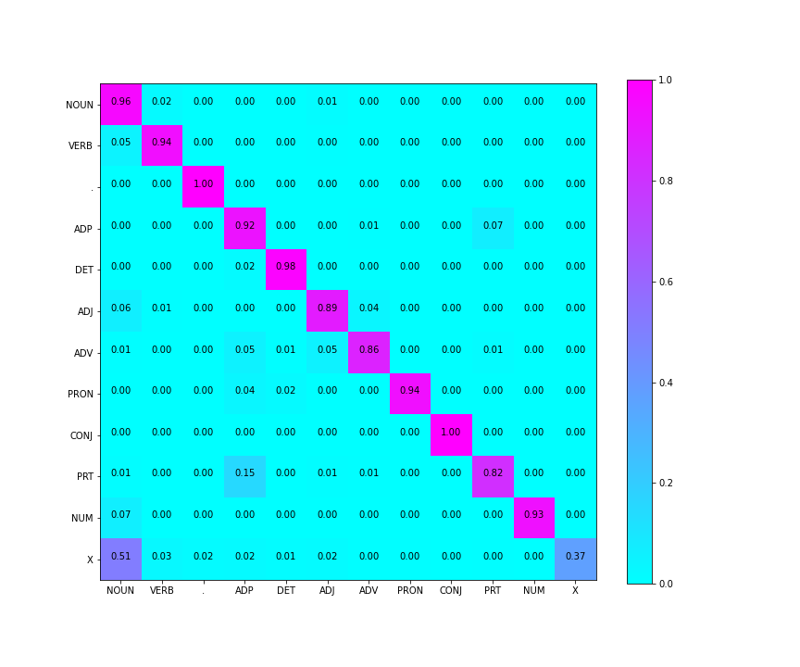
Confusion Matrix – Word2Vec with FFNN-BP

Slide 15
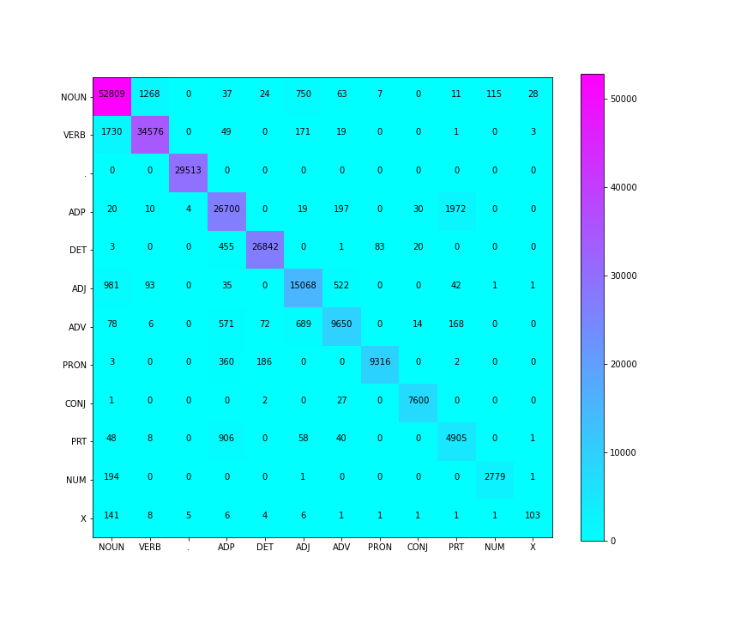
Confusion matrix – word2vec with FFNN-BP (Numbers)

Slide 16
Confusion matrix Analysis
Confusion of tag ‘X’ with ‘NOUN
There is no prior reason for X-NOUN because we predict tag X for extra characters like {ersatz, esprit, dunno, gr8, univeristy, etc} so there might some words like for word vector ignore spell mistakes and return word vector closed to NOUN tagged word.
Confusion of tag ‘PRT’ with ‘ADP’
Keywords for PRT : at, on, out, over per, that, up, with
Keywords for ADP : on, of, at, with, by, into, under
Example
The city expects the higher rooming houses to bring in an additional $40000 a year. (PRT)
I like walking in the park during winters.(ADP)

Slide 17
Confusion matrix analysis
Confusion of tag ‘NUM’ with ‘NOUN’
A cardinal number, five plus one (NUM)
A hit in which the ball crosses the boundary line of the field without a bounce, counting six runs for the batsman
Confusion of tag ‘NUM’ with ‘DET
This is one of the best items of the city.
They had a strong attraction for one another.
Confusion of tag ‘ADV’ with ‘ADJ’
He is travelling underground by subway. (ADV)
This is an underground vegetarian restaurant. (ADJ)
Take the dog outside. (ADV)
There is a news from the outside world. (ADJ)

Slide 18
Confusion matrix analysis
Confusion of tag ADJ and NOUN
Fill in the white space below(ADJ)
He has a speck in the white of his eye.(NOUN)
She is a young woman.(ADJ)
This is a game for young and old.(NOUN)
Confusion of tag ADV and ADP
The school is close by.
He came by the highway.
Confusion of tag VERB and NOUN
He likes to be in an excited state.
He came here to state a problem.
This print is too large for footnotes.
He’d rather print than use longhand.

Slide 19
Confusion matrix analysis
Confusion of tag PRON and ADP
That is her mother.
That these magazines also deluded the krims of the world is unfortunate but inevitable.

Slide 20
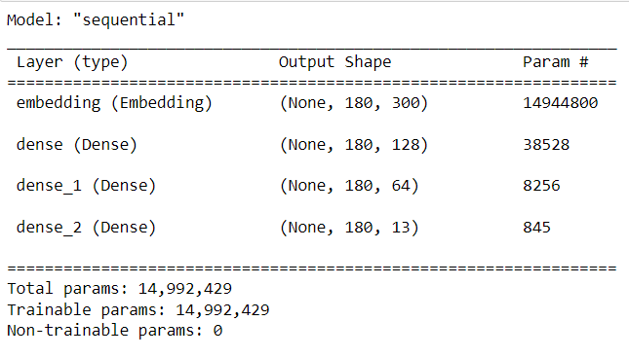
FFNN-BP Model Details

Slide 21
Data Processing and Data Sparsity
Data-Processing
For part-1
Firstly We added start token and end token to each sentences and make each word in lower letter for reducing computation.
We have created 12x300 matrix which stores word vector representing each tag That is useful in calculating cos-similarity while handing unknown word in lexical probability.
For part-2
We have used a Embedding layer in order to pass the embedding matrix which contains the word vectors for all the words in the vocabulary.
Then we have 2 hidden Dense layers with activation function as ‘relu’
Then we have a final output layer with its activation function set as ‘softmax’

Slide 22
Obtaining Word-vectors
We used word2vec model trained on google news dataset and for extracting word vectors from that we used genism module.
Handling Unseen Words
We have calculated 12x300 matrix which stores word vector corresponding to each tag ( this word vector is sum of all word’s vector in train-set which tag as respective tags ).
When algorithm encounter unseen word we calculate cos-similarity between tag vector and word vector and map it to [0,1] by exponential function.

