Slide 1
Assignment-Discussion HMM Implementation
Ameeya Ranjan Sethy , 200050006
Jasani Parth Alpeshbhai , 200050053
Kumari Pragati Gupta , 200050063
4 September,2022
Notes:
<number>

Slide 2
Problem Statement
Given a sequence of words, produce the POS tag sequence
Technique to be used: HMM-Viterbi
Use Universal Tag Set (12 in number)
5-fold cross validation
’.’ ,’ADJ’ ,’ADP’ ,’ADV’ ,’CONJ’ ,’DET’ ,’NOUN’ ,’NUM’ , ’PRON’ , ’PRT’ , ’VERB’ , ’X’

Slide 3
Overall performance
Precision : 0.940198283308899
Recall : 0.9385240363559173
F-score (3 values)
F1-score : 0.9386931499010809
F0.5-score : 0.9394349573883816
F2-score : 0.938428994887414

Slide 4
Per POS performance
Precision Recall F1-Score
Tag-1(‘.’): 0.98, 1.00, 0.99
Tag-2(‘ADJ’): 0.87, 0.89, 0.88
Tag-3(‘ADP’): 0.92, 0.97, 0.94
Tag-4(‘ADV’): 0.90, 0.87, 0.88
Tag-5(‘CONJ’): 0.99, 0.99, 0.99
Tag-6(‘DET’): 0.92, 0.99, 0.95
Tag-7(‘NOUN’): 0.95, 0.92, 0.93
Tag-8(‘NUM’): 0.99, 0.80, 0.88
Tag-9(‘PRON’): 0.93, 0.96, 0.94
Tag-10(‘PRT’): 0.91, 0.85, 0.88
Tag-11(‘VERB’): 0.97, 0.92, 0.94
Tag-12(‘X’): 0.17, 0.35, 0.23

Slide 5
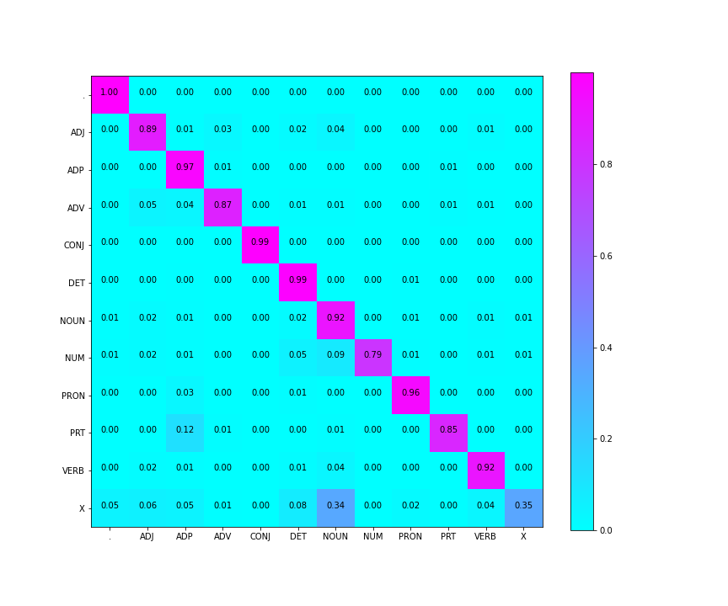
Confusion Matrix (12 X 12)

Slide 6
Interpretation of confusion
(error analysis)
The ‘PRT’ tag is most confused with the ‘ADP’ tag. It is clearly visible from confusion matrix that whenever ‘PRT’ was wrongly predicted, it was predicted as ‘ADP’.
‘PRT’ tag words: on, at, with, that, over
‘ADP’ tag words: on, at, with, by, into, of
So there are many words which can be used as both ‘PRT’ and ‘ADP’ tags
The reason can be the similar nature of adpositions and particles which can be understood from definitions.

Slide 7
Data Processing Info
(Pre-processing)
First we preprocessed the data which included converting the text into lower case and adding ‘^’ as start token and ‘$’ as end token in each sentence.
We created 3 dictionaries:
POS_tag_counts – stores no of times each tag has occured in training set
word_pos_tags – 2D dictionary with 1st key as word w and 2nd key as tag t and stores no of times word w was uses as tag t
Tag_transition_count – 2D dictionary with 1st key as tag1 & 2nd key as tag2 and stores no of times tag2 follows tag1
Let w represent word and t, t1, t2 represent tag, tag1, tag2
P(w | t) = word_pos_tags[w][t] / POS_tag_counts[t]
P(t2 | t1) = Tag_transition_count[t1][t2] / POS_tag_counts[t1]

Slide 8
Inferencing/Decoding Info
Implemented Viterbi As Follows:
i) prev dictionary stores P(word|tag) for last seen word ( i.e previous level )
ii) curr dictionary stores P(word|tag) for curr word and for each iteration update it's value accordingly. After compeletion of one level dat of curr is stored in prev.
iii) parent dictionary helps to backtrack for finding best possible tag for each word in given sentence.
- backtacking formula :
final_tags[i] = parent[i+1][final_tags[i+1]] .
- trying to estimating (i)th level tag due to which (i+1)th level tag has high probabilty.
final_tags is list of tags for given word sequence.

Slide 9
Marking Scheme
1. Demo working- 10/10 (if not, 0)
2. Implemented Viterbi and Clarity on Viterbi- 5/5
3. Transition and Lexical tables clearly described- 5/5
4. Confusion matrix drawn and error analysed- 5/5
5. Overall F-score > 90- 10/10, >80 & <=90- 8/10, else 6/10
6. Unknown word handling- done (5/5; else 0)

Slide 10
Any thoughts on generative vs. discriminative POS tagging
Discriminative POS tagging is Conditional model and therefore it is based on Conditional probability. It needs labelled data, and so it can be used only in supervised learning.
Generative POS tagging is a Joint model and therefore it is based on Joint probability. It can be used in unsupervised learning.

