Slide 1
Fake News Stance Detection
Mid Project discussion
Ameeya Ranjan Sethy, 200050006
Jasani Parth Alpeshbhai, 200050053
Kumari Pragati Gupta, 200050063
27th November, 2022

Slide 2
Problem Statement
Identifying the veracity of a news article is an interesting problem while automating this process can be a challenging task. Detection of a news article as fake is still an open question as it is contingent on many factors which the current state-of-the-art models fail to incorporate. In this paper, we explore a subtask to fake news identification, and that is stance detection. Given a news article, the task is to determine the relevance of the body and its claim.
In short we have to find the kind of relation between the headline and the body of the news article classifying them into agree, disagree, discuss, or unrelated and then highlight the words giving rise to such an output.

Slide 3
Related works
Link of the related research paper we are trying to implement:
https://arxiv.org/pdf/1712.03935.pdf
On the Benefit of Combining Neural, Statistical and
External Features for Fake News Identification
Gaurav Bhatt¹, Aman Sharma¹, Shivam Sharma¹,Ankush Nagpal¹ , Balasubramanian Raman¹, and Ankush Mittal²
¹ Indian Institute of Technology, Roorkee, India
² Graphic Era University, India

Slide 4
Dataset (s)
Original Dataset Link : https://github.com/FakeNewsChallenge/fnc-1
We have used these datasets to convert them into such a dataframe which we can use efficiently. We have converted them into two parts as training set and testing set.
Link of created training dataset : https://drive.google.com/file/d/1Uz3jPHlZl2KpGgIPEZfzJsHFE7-nCcx9/view?usp=share_link
Link of created test dataset : https://drive.google.com/file/d/1KP0SNWwM3lTSfS81XsmhPyZFRikUOnEz/view?usp=share_link
News Articles | Unrelated | Discuss | Agree | Disagree
49972 | 73.13 % | 17.83 % | 7.36 % | 1.68 %

Slide 5
Architecture Plan-1
We present a novel idea that combines the neural, statistical and external features to provide an efficient solution to this problem.
We compute the neural embedding from the deep recurrent model, statistical features from the weighted n-gram bag-of-words model and hand crafted external features with the help of feature engineering heuristics.
Finally, we will use deep neural layer to combine all the features, thereby classifying the headline-body news pair into one of the four categories as agree, disagree, discuss, or unrelated.

Slide 6
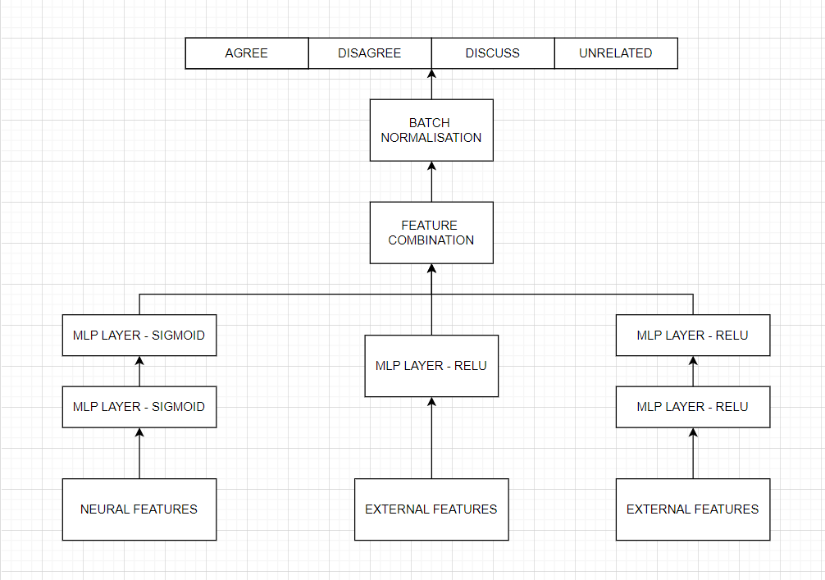
Architecture Plan-2

Slide 7
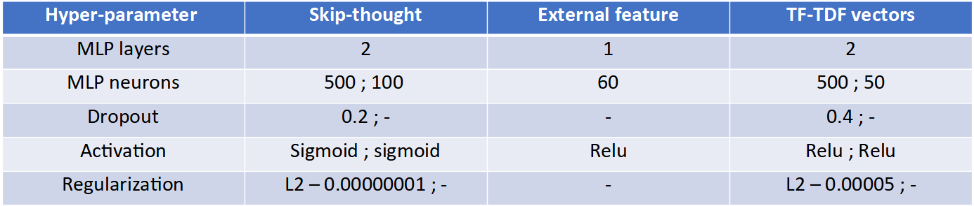
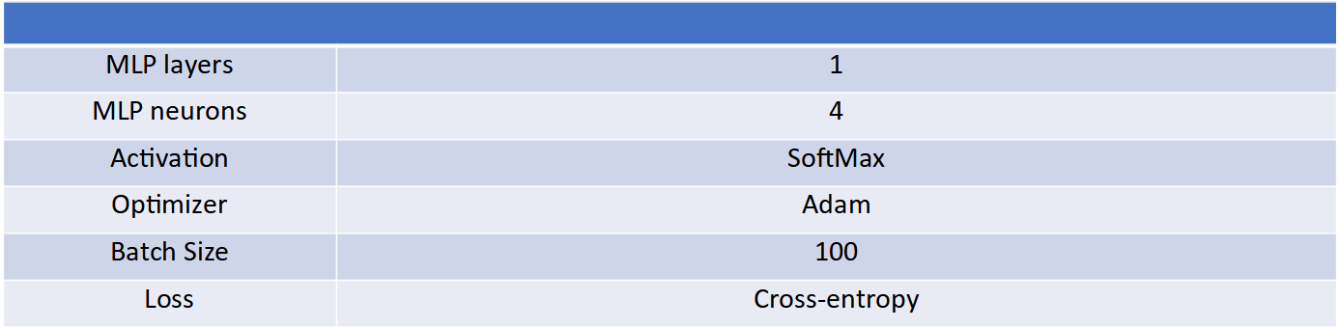
Final Neural Model

Slide 8
Neural Features
In this part of code, we extract the neural feature of each headline and body pair which will help us in stance detection.
We used skip-thought module which encodes sentences to vector embedding of length 2400 each.
The skip-thought is a encoder-decoder based recurrent model that computes the relative occurrence of sentences.
In our case we used pre-trained skip-thought embedding which is already trained on some corpus. We make the use of a pre-trained model since the FNC-1 dataset is relatively smaller than the dataset required to trained this model.

Slide 9
.
We have computed two features which is in effective in evaluating contextual similarity between sentences. The task of stance detection is analogous to the computation of contextual similarity between two sentences – headline and body.
We speculate that the features introduced should be effective for stance detection as well. Given the skip-thought encoding of new and headline as u_news and v_head, we computed two features
Feature1 : u_{news} . v_{head}
Feature2 : | u_{news} – v_{head} |
Both of these features result in 2400 dim vectors each and by concatenating these we get 4800 dim vectors for each headline body pair and feature space as #sample x 4800.

Slide 10
Statistical Feature
Preprocessing of data:
Performed cleaning to get in similar form (lowercase, alpha-num) and removed stopwords
Tokenized words and used Lemmatizer to convert them into their base form
Feature Extraction: (TF-IDF model)
Term Frequency (TF): freq of word in the document
Inverse Document Freq (IDF): weight of rare words across all documents

Slide 11
External Features
We have added majorly 4 external features for training the model which includes :
Character Ngrams
Word Ngrams
Polarity of sentence
Ratio of no of common words between headline-body and total no of words

Slide 12
N-grams
N-grams are continuous sequence of words/tokens in a document. Means they can be defined as the neighboring sequences of items in document.
N-grams model is a type of probabilistic language model for predicting the next item in such a sequence in the form of a (n-1) order Markov model.
N-grams models are simple and scalable – with larger n, a model can store more context with a well-understood space-time tradeoff.
N-gram model will calculate probability based on prev n words.
For this task we have used character and word n-grams from nltk.utils

Slide 13
Polarity of Sentence
For calculating polarity of sentence i.e. [ positive , neutral , negative ] we have used Vader Sentiment module which has method named SentimentIntensityAnalyzer which returns intensity of sentence being positive , negative and neutral.
Why polarity is important feature?
It’s notoriously hard for computer to predict this, in fact it’s even hard for people to predict over text so polarity helps to solve this.
Let’s take an example of word good, we thinks that it must be positive but “good” is used even when we aren’t trying to express a judgement on something. “This is a good time to break for lunch” has neutral sense of word “good”.
The headline-body pairs should have a similar sentiment score if they are related and different if they are unrelated.

Slide 14
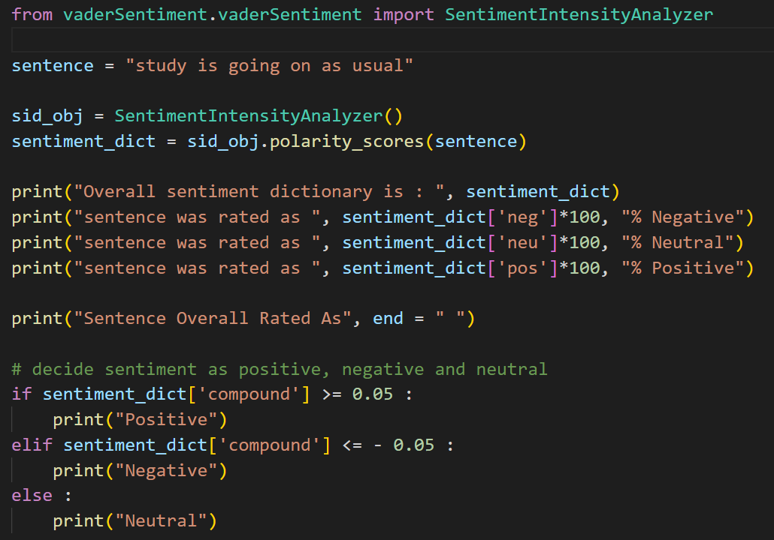
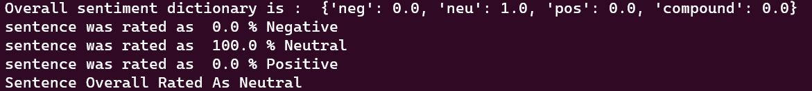
Vader Sentiment Usage

Slide 15
Details of LIME
Models such as linear regression or decision trees are easily interpretable to humans. However, models such as NN and LSTMs have thousands of weights and many layers making it difficult for humans to interpret them.
How does LIME work for text data?
Given a sentence, we first construct bag of words representation for the sentence.
Now the library randomly choose words from the original sentence and manipulates the sentence to generate 5000 sentence with new word combinations.
These samples are weighted by how similar they are to the original sentence using the cosine distance.
From these vectorised sentences and we know their proximity, LIME follows the same process as mentioned in the above section.

Slide 16
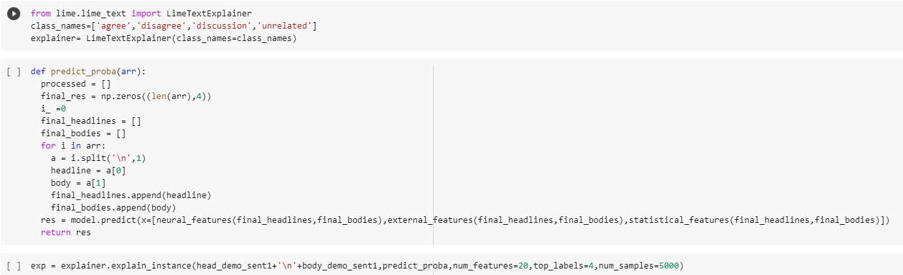
Usage of LIME in Our Model

Slide 17
Metrics to be used
FNC-1 dataset that we have used shows a heavy bias towards unrelated headline-body pairs. Recognizing this data bias and the simpler nature of the related/unrelated classification problems, the research paper has introduced the following weighted accuracy score as their final evaluation metric.
Score₁ = Accuracy_{related, unrelated}
Score₂ = Accuracy_{agree, disagree, discuss}
Score_{FNC} = 0.25 * Score₁ + 0.75 * Score₂
We will use the Score_{FNC} as the main evaluation criteria while comparing the proposed model with other simple neural based techniques such as CNN, biLSTM and many other.

Slide 18
Results
Comparison of FNC scores
Method | Score_{FNC} | Agree | Disagree | Discuss | Unrelated | Overall
FNC-1 Baseline | 75.20 | 9.09 | 1.00 | 79.65 | 97.97 | 85.44
Word2vec + External features | 75.78 | 50.70 | 9.61 | 53.38 | 96.05 | 82.79
Skip - Thought | 76.18 | 31.8 | 0.00 | 81.20 | 91.18 | 82.48
CNN | 60.91 | 35.89 | 2.10 | 46.77 | 88.47 | 74.84
biLSTM | 63.11 | 38.04 | 4.59 | 58.13 | 78.27 | 69.88
biLSTM + Attention | 63.17 | 58.74 | 0.03 | 63.48 | 77.49 | 73.27
CNN + biLSTM | 64.95 | 74.09 | 2.46 | 57.85 | 74.87 | 72.89
Proposed Model | 83.08 | 36.00 | 0.29 | 83.94 | 98.88 | 88.85

Slide 19
Analysis
The proposed model achieves highest score and highest class-wise accuracy on discuss stance whereas achieving high accuracy on other stances that is comparable to FNC-1 baseline score. The only class which gives lowes lower accuracy on all the possible models is the disagree class due to shortage of training samples. Otherwise our proposed model could be easily compare with the FNC-1 baseline score which is shown in the 1st row of the table.

Slide 20
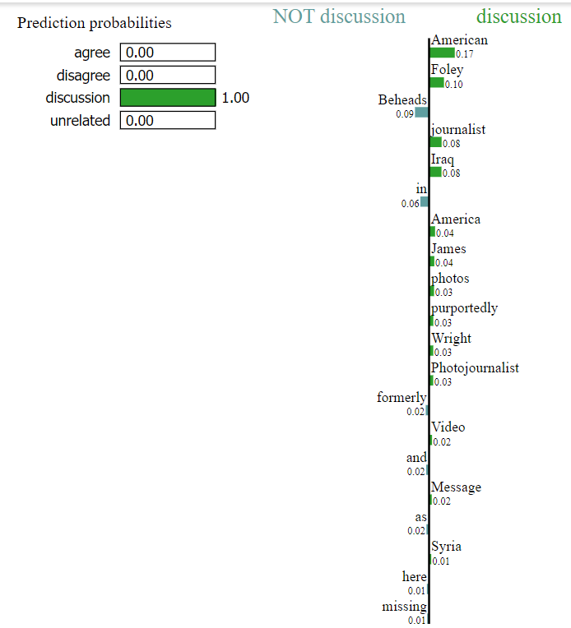
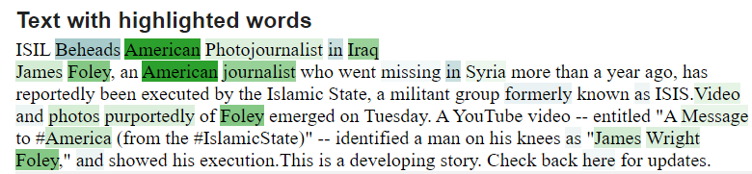
Demo Output of a headline-body pair

Slide 21
Thank You

