Slide 1

Credit Card Fraud Detection Using Machine Learning
Final Project Presentation
Predictive Analytics
Fraud Detection Study by Fatma Mahfoud
Notes:
Hello, my name is Fatma MAhfoud. In this presentation I will discuss my project on credit card fraud detection using machine learning.
The goal of this project is to analyze transaction data and build models that can help identify fraudulent transactions.
Credit card fraud is a major issue in financial systems, and machine learning provides powerful tools to detect suspicious behavior in large datasets.

Slide 2
Business Problem
Credit card fraud causes major financial losses
Millions of transactions occur every day
Manual monitoring is impossible
Machine learning can help detect fraud
Notes:
Credit card fraud is a growing problem for financial institutions and customers.
Every day millions of transactions are processed, which makes it impossible to manually inspect every transaction.
Because of this, banks and payment systems rely on automated fraud detection systems.
Machine learning models can analyze patterns in transaction data and help identify suspicious activities.

Slide 3
Dataset
Credit Card Fraud Detection dataset from Kaggle
284,807 transactions
492 fraudulent transactions
Features include Time, Amount, and PCA variables
Notes:
For this project I used the credit card fraud detection dataset available on Kaggle.
The dataset contains over two hundred eighty thousand transactions.
Out of these transactions, only four hundred ninety two are labeled as fraudulent.
This means the dataset is highly imbalanced, which makes fraud detection more challenging.

Slide 4
Exploratory Data Analysis
Fraud vs legitimate transaction distribution
Transaction amount distribution
Time-based transaction patterns
Correlation heatmap
Notes:
During exploratory data analysis I created several visualizations to better understand the dataset.
The first visualization shows the distribution of fraudulent versus legitimate transactions.
Other plots show transaction amounts and time-based patterns.
I also created a correlation heatmap to explore relationships between variables.

Slide 5
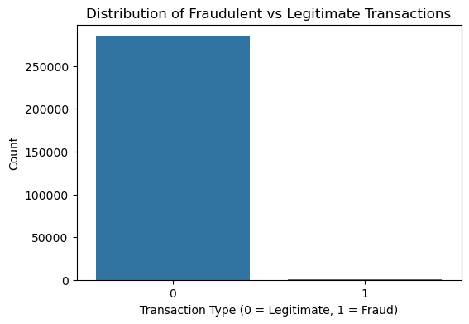
Notes:
This plot shows the number of legitimate and fraudulent transactions in the dataset. Most transactions are legitimate, while only a small number are fraud. This shows that the dataset is highly imbalanced. Because of this imbalance, special techniques may be needed when building the fraud detection model.

Slide 6
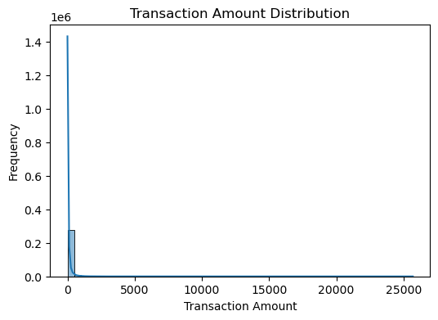
Notes:
This plot shows how transaction amounts are distributed. Most transactions involve small amounts, while large transactions are rare. The distribution is highly skewed to the right. This means that the majority of purchases are low-value transactions.

Slide 7
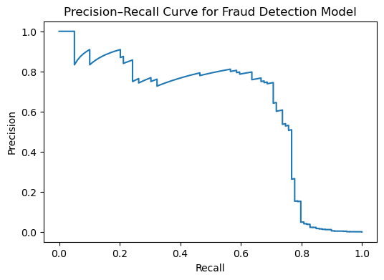
Notes:
This curve evaluates the performance of the fraud detection model. The model starts with high precision when recall is low. As recall increases, precision decreases. This shows the trade-off between detecting more fraud cases and increasing false positives.

Slide 8
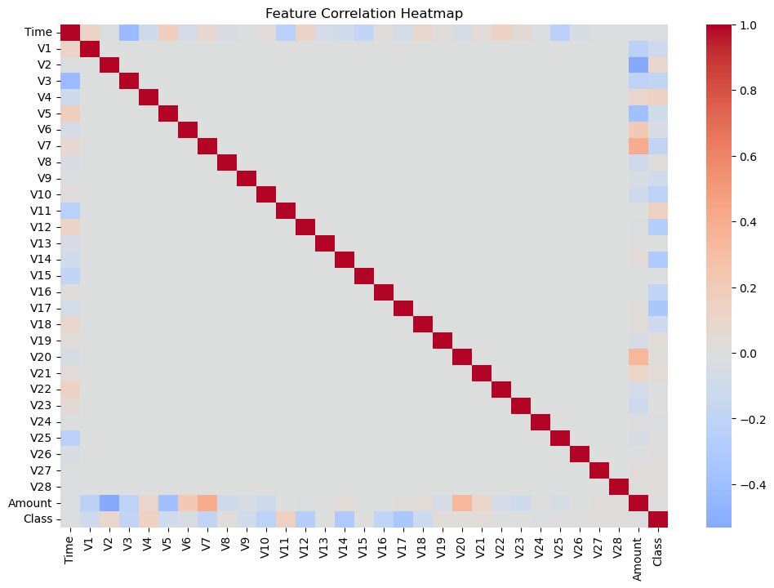
Notes:
This heatmap shows the correlation between the features in the dataset. Most variables have very weak correlations with each other. This is expected because the variables were created using PCA. The fraud class also has low correlation with individual features, which means fraud detection requires analyzing multiple variables together.

Slide 9
Methods
Exploratory data analysis
Handling class imbalance with SMOTE
Machine learning models
Logistic Regression, Random Forest, XGBoost
Notes:
To build the fraud detection model I first performed exploratory data analysis.
Because the dataset is highly imbalanced, I applied SMOTE to help balance the training data.
Then I tested several machine learning models including logistic regression, random forest, and XGBoost.

Slide 10
Model Evaluation
Precision
Recall
F1-score
Precision-Recall curve
Notes:
To evaluate the models I used metrics that work well with imbalanced datasets.
These include precision, recall, and the F1-score.
I also used a precision recall curve to evaluate how well the model identifies fraudulent transactions.

Slide 11
Ethical Considerations
Customer data privacy
Responsible use of financial data
Avoid unnecessary transaction blocking
Notes:
Fraud detection systems must consider ethical issues.
Financial data is sensitive and must be handled carefully.
Another concern is false positives, where legitimate transactions are incorrectly flagged as fraud.

Slide 12
Challenges
Highly imbalanced dataset
Fraud transactions are rare
PCA features difficult to interpret
Notes:
One of the biggest challenges in this project was the extreme imbalance between legitimate and fraudulent transactions.
Fraud cases represent less than one percent of the data.
Additionally, the PCA transformed variables make interpretation more difficult.

Slide 13
Conclusion
Machine learning helps detect fraud
Handling imbalance improves results
Future work: deeper models and more data
Notes:
In conclusion, machine learning models can be very useful in detecting fraudulent transactions.
Handling class imbalance is important for building effective models.
Future improvements could include using deep learning methods or larger datasets to improve detection accuracy.

